Slide 1
Is it worth taking the trouble to study resilience?
Dr. Gill Windle
Senior Research Fellow
Dementia Services Development Centre
Bangor University

Slide 2
Is it worth taking the trouble to study resilience?
What is resilience?
Do we need to measure it?
How can we measure resilience?
Can creative activities support resilience, and if so, how do they do this?

Slide 3
Background
PhD 2003-2006 ‘Variations in well-being: the role of psychological resilience in older age’ (ESRC Studentship)
Longitudinal study (n=3500) – My work is looking at resilience from age 65+ in relation to illness, disability and cognitive impairment, using quantitative and qualitative methods (ESRC £3.3m; 2010-2016)
Challenges and Healthy Ageing: The Role of Resilience Across the Life-course’ (Medical Research Council, 2010)
‘Lifestyle Matters for Health and Well-Being’. RCT of a health promotion intervention (n=400 ). Promoting resilience age 65+ (MRC LLHW £1.3m 2012-2015).

Slide 4
Historical Context
The study of resilience is not new
Early studies focussed on the origins of mental illness in children – looked at the wide variability in outcomes
‘Psychosocial resilience and protective mechanisms’ (Rutter, 1987)
Protective factors and processes
BUT.. a lot of the theoretical development to date has been undertaken from observations with children

Slide 5
“It is a vague concept and difficult to define”
Consensus from research regarding difficulties in developing a single definition of resilience
Prevalence of resilience – between 25% to 84% (Vanderbilt-Adriance & Shaw, 2008)
Strength – disciplinary diversity in the study – it can be explored in different populations, contexts and scientific disciplines

Slide 6
Method
Research from the challenges and healthy ageing team
Stakeholders and academics in discussion
Literature Review using systematic principles – searched academic journals, policy documents, internet.
Applied concept analysis to clarify the definition of resilience Windle, G., & The Resilience Network. (2011). What is resilience? A review and concept analysis. Reviews in Clinical Gerontology, 21 (2), 151-16.
A quantitative methodological review of resilience measurement scales Windle, G., Bennett, K. and Noyes, J. (2011). A methodological review of resilience measurement scales. BMC Health and Quality of Life Outcomes. 9 (8), d oi:10.1186/1477-7525-9-8

Slide 7
Definition
Resilience is the process of negotiating, managing and adapting to significant sources of stress or trauma. Assets and resources within the individual, their life and environment facilitate this capacity for adaptation and ‘bouncing back’ in the face of adversity. Across the life course, the experience of resilience will vary.’
Doing okay or even quite well despite illness and disability

Slide 8
Concept clarification Windle, G. (2011). What is resilience? A review and concept analysis Reviews in Clinical Gerontology, 21 (2), 151-169. http://journals.cambridge.org/repo_A81iOgzq
Essential requirements for resilience
There must be a major risk or adversity that carries a significant threat for the development of a poor outcome
Poor outcomes as a result of the adversity are not experienced; the maintenance of normal development or functioning, such as physical or mental health, or better than expected development or functioning, in the face of adversity. This is often referred to as positive adaptation.
3. There are supportive aspects within the individual’s life and environment that facilitate the capacity for adaptation to adversity (or constitute a risk) – what is present in someone’s life that supports a good outcome?

Slide 9
Example of a resilience framework

Slide 10
Measuring Resilience
Assessments of resilience need to consider:
a) the risk or adversity
b) assets/resources that might offset the effect of the risk
c) the outcome
Quantitative direct measurement – using a resilience measurement scale as an outcome measure
Quantitative indirect measurement – modelling a range of data with multivariate statistics
Qualitative – understanding individual experiences

Slide 11
Promoting resilience through creative activities
Who are the focus of your activities?
What is their adversity?
Why do you think creative activities might build resilience? (your ‘theory’)
How might they benefit from a resilience promoting activity?
How will you know they have benefited?

Slide 12
Why do you think creative activities might build resilience? Cognitive Reserve Hypothesis
Creative Activities
New skills/learning
Social connections/networks
Efficacy
Cognitive Health

Slide 13
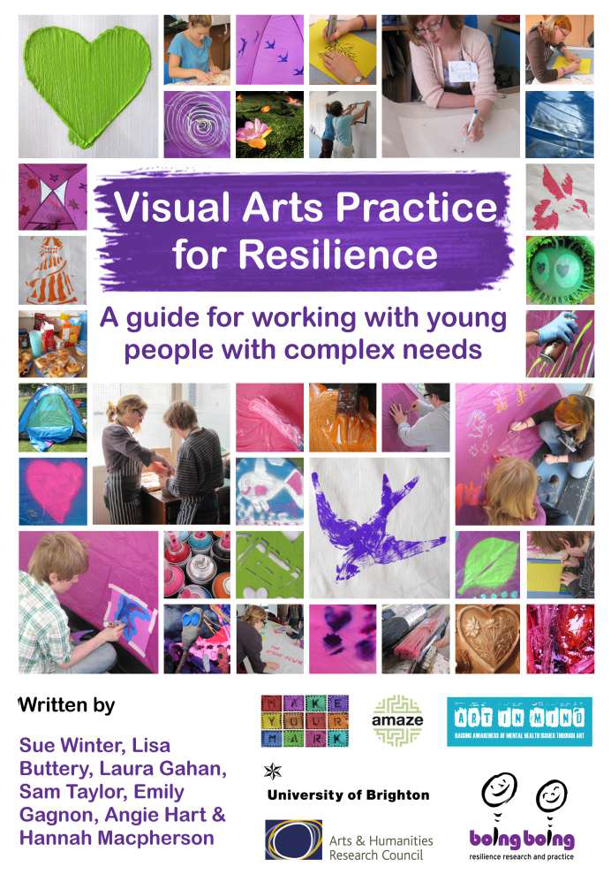

Slide 14
Conclusion
Is it worth taking the trouble to study resilience? YES!
“Nonetheless, it remains the case that progress on delineating resilience processes with the precision that Rutter and other pioneers hoped for will require close attention to conceptual and measurement issues” (Masten, in press).

Slide 15
Dr. Gill Windle, Senior Research Fellow Dementia Services Development Centre Bangor University g.windle@bangor.ac.uk
Diolch yn fawr/Thank you

