Slide 1
It’s good to talk!
Presented by Rose Gilroy
School of Architecture, Planning and Landscape
Newcastle University
For the research team: RG; Barbara Douglas; Moyra Riseborough.
Presentation to the Seminar on “The role of creative interventions in fostering connectivity and resilience in older people”
April 1st 2014

Slide 2
Nothing about us without us
Older people are a valued resource
Older people are acknowledged as equals
Work is undertaken in collaboration between older people & agencies
The process produces practical ideas which make a difference

Slide 3
An ecological framework of resilience (2014) Kate Bennett and Laura Soulsby
Social policies
Social support services
Neighbourhood
Economy
Health and Social Services
Psychological resources
Biological resources
Gender age
Health behaviour
Individual
Society
Community
Social support
Social cohesion
Social participation
Housing

Slide 4
Issues of physical architecture
Double hung corridors, lack of light.
Well furnished lounges that stand empty

Slide 5
Issues of social architecture
“Space, light, accessibility and a shared sense of purpose- the idea of being part of a community, and of ordinary people taking control of housing processes – have been a recurring theme”
HCA (2009) Housing Our Ageing Population: Panel for Innovation, page 57

Slide 6
The project: Is there potential for co-housing in Newcastle
Four action research workshops
One with older people and carers
One with Chinese Elders
One with planners, architects, developers and housing providers
One with social care, health, housing decision makers and local politicians

Slide 7
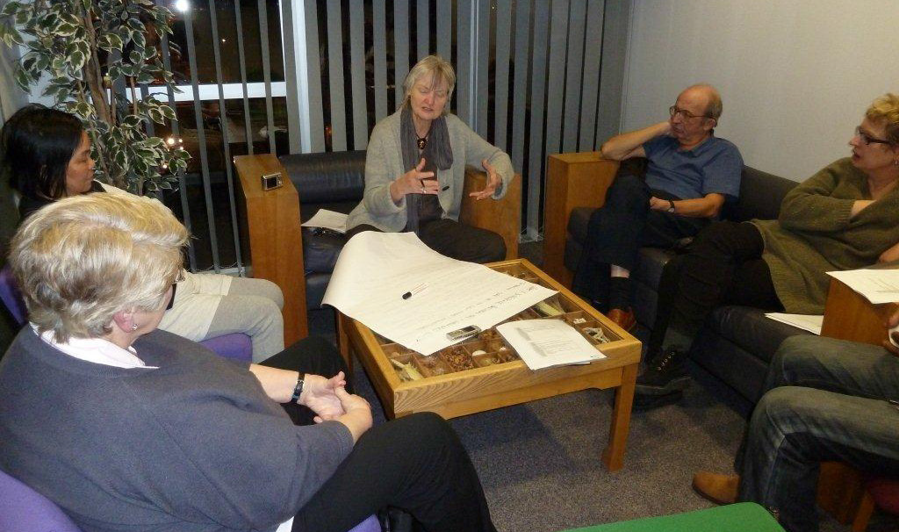
Workshop programme
Short presentation on co housing with a film clip
Quick question and answer session and a comfort break
Discussion groups go through a list of questions and people come up with some views, comments and ideas
We come back together and share what we think
End with what is coming next

Slide 9
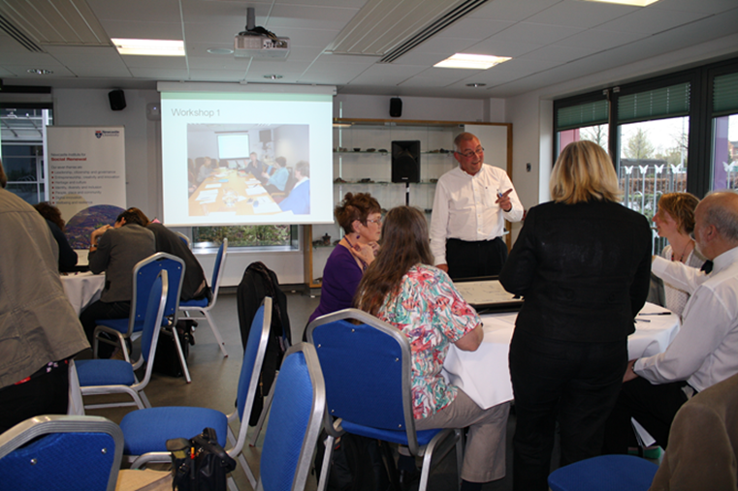
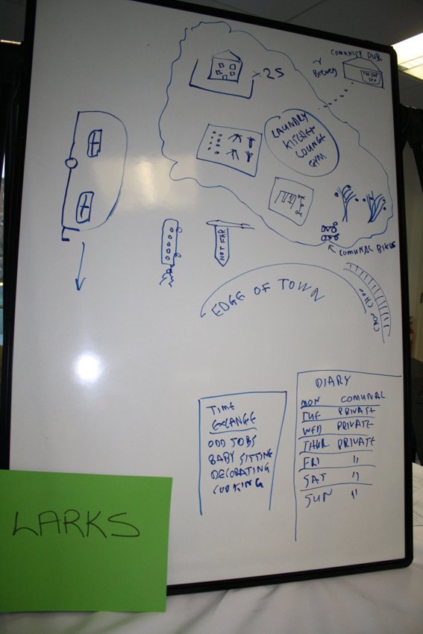
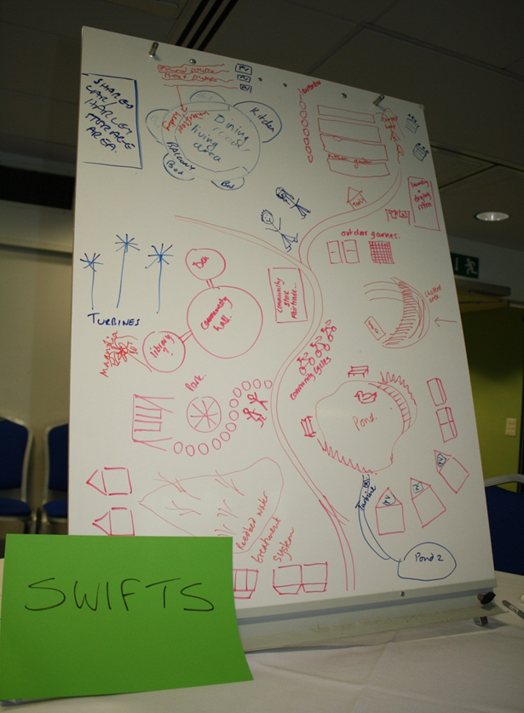
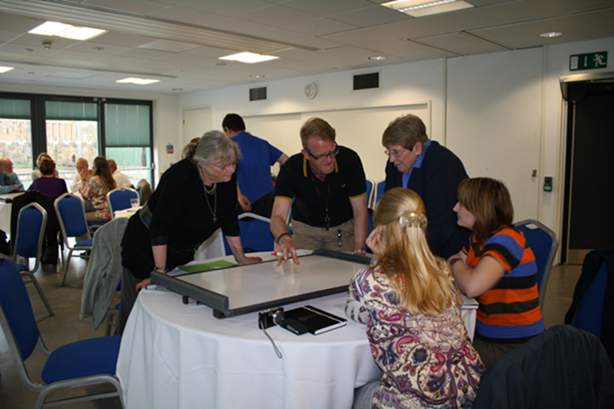

Slide 10
An ecological framework of resilience (2014) Kate Bennett and Laura Soulsby
Social policies
Social support services
Neighbourhood
Economy
Health and Social Services
Psychological resources
Biological resources
Gender age
Health behaviour
Individual
Society
Community
Social support
Social cohesion
Social participation
Housing
Notes:
Our consideration of resilience is anchored in the concept of the tripartite ecological framework through which we can understand the importance of a range of components: societal, community and individual that may promote resiience. These components are not hierarchical but it might be that a variety of factors at more than one level may be necessary though not all have to be present.
Deep dissatisfaction with the current services and targeted housing offer to older people against a background of distressing reports about neglect of older people in hospital wards and at home for those receiving home care prompted older people in Newcastle to want to explore a different sort of housing.

Slide 11
Co-housing as an investment in our future selves
“I am clear about the design and layout I want. It has to be easy to look after, attractive and practical with room for the adaptations and equipment I might need as time goes on”
“I like the idea of cohousing because I can think maybe for the first time about how I would like to live and where”.

Slide 12
An ecological framework of resilience (2014) Kate Bennett and Laura Soulsby
Social policies
Social support services
Neighbourhood
Economy
Health and Social Services
Psychological resources
Biological resources
Gender age
Health behaviour
Individual
Society
Community
Social support
Social cohesion
Social participation
Housing
Notes:
Our consideration of resilience is anchored in the concept of the tripartite ecological framework through which we can understand the importance of a range of components: societal, community and individual that may promote resiience. These components are not hierarchical but it might be that a variety of factors at more than one level may be necessary though not all have to be present.
Deep dissatisfaction with the current services and targeted housing offer to older people against a background of distressing reports about neglect of older people in hospital wards and at home for those receiving home care prompted older people in Newcastle to want to explore a different sort of housing.

Slide 14
How do I avoid empty days?
How can I manage transitions?
How can I `safeguard my convoy of supportive people`?
How do I find recognition when I no longer have formal status through waged work?
How do I celebrate my achievements?

Slide 15
The response
“ We need the space to explore our own feelings on how to live, not just how others organise it ”

Slide 16
An ecological framework of resilience (2014) Kate Bennett and Laura Soulsby
Social policies
Social support services
Neighbourhood
Economy
Health and Social Services
Psychological resources
Biological resources
Gender & Age
Health behaviour
Individual
Society
Community
Social support
Social cohesion
Social participation
Housing
Notes:
Our consideration of resilience is anchored in the concept of the tripartite ecological framework through which we can understand the importance of a range of components: societal, community and individual that may promote resiience. These components are not hierarchical but it might be that a variety of factors at more than one level may be necessary though not all have to be present.
Deep dissatisfaction with the current services and targeted housing offer to older people against a background of distressing reports about neglect of older people in hospital wards and at home for those receiving home care prompted older people in Newcastle to want to explore a different sort of housing.

Slide 17
Thank you for your attention

