Slide 1
Ageing, Participation (and the City-Village)
Andrew Miles
University of Manchester

Slide 2
Plan
Stratification and participation
The meanings and placing of participation
Participation, identity and resilience

Slide 3
Theory
Disengagement
Crisis
Activity
Continuity

Slide 4
Stratification and Participation

Slide 5
Participation in the Arts by Age (Source: Taking Part Survey, 2009-10)

Slide 6
Importance of age effects in structuring taste and participation
Second only to class (Bennett at al, Cultural, Class Distinction, 2009)
Younger preference for contemporary and commercial forms (cinema, night clubs, rock music, modern art, sci fi, TV comedy), older for established practices (orchestral music, stately homes, romantic fiction, TV news and documentaries).
Need to unpack age, cohort (generation) and life course dimensions (Scherger, 2009)
Life course (and gender) effects on active participation, importance of labour market engagement and family formation; decline in highbrow cultural participation is a cohort effect, reflecting value changes through cohort replacement.

Slide 7
Participation versus Non-Participation (an MCA of free-time activities for the Taking Part Survey, 2008-09)

Slide 8
Participation and Well-being (an MCA of free-time activities for the Taking Part Survey, 2008-09)

Slide 9
What does it mean to participate?
Qualitative studies focusing on life histories and participation narratives
Manchester’s cultural institutions project. 100 in-depth interviews with the ‘users’ and ‘non-users’ of formal cultural venues from different part of the city
National Child Development Study. In-depth interviews with 220 panel members at age 50.
Relationship to formal cultural participation defined by detachment, disidentification and circumstance

Slide 10
Everyday participation & ordinary culture
Non-users of cultural institutions often involved in vibrant informal cultural networks defined by ostensibly mundane pursuits and social relationships. Formal culture is irrelevant. Part of an alien way of life
Right. Monday…go for a mooch into [town]… a bit of browsing, think of what I’m going to buy on Thursday...Do window shopping first, and then pick my daughter up from nursery, go to the local park, bring her back and watch the telly, … And Thursdays, when I get my money [laughs]… I normally go in to every single clothes shop, and then start out at the end and work my way up and then go back to the end again and think I’ll have that one…Saturdays, it depends on what my daughter wants to do, park or swimming or whatever…Sundays… maybe go up and see my mum and dad....
I love going food shopping. I love it. I’d love to go into Tescos and think right I haven’t got a budget, boom, boom, boom, boom, boom...I love going round and thinking, you know--,…‘cause I watch Gordon Ramsey, I think ooh what can--, what can I make tonight, you know. I think ooh, ooh I’ll have that, I’ll have that and I love doing all weird concoctions. Female, 20s.

Slide 11
Ghostly participation
Participation narratives also reveal ‘real’ cultural participants but under the survey radar because they don’t self-identify as such - personal, privatised engagement and meaning-making, divorced from mainstream institutional contexts
I just like started painting… [Q. Why did you choose watercolour?] …Because it’s cheaper than oils. Also, it was on telly once, I was watching…We’ve got Sky now…[Q. You said you’ve been to the Lowry, what did you see at the Lowry?] There was some artist on, we didn’t go specially for that--, Catherine, my daughter, was there doing a thing for school and… there was an exhibition on for some artists so I went around and took a look at them. Couldn’t tell you who it was…Male, 50s

Slide 12
Narratives of trauma, disjuncture, (dis-)orientation
More prevalent with age (because more time for more things to go wrong?)
But crisis is endemic and therefore mundane
Family and relationships stories to the fore
Reiteration of the informal, quotidien sphere, and of the social in cultural participation
Importance of civic as social participation (for middle-class women)
Men tend to plough single furrows, women are often multiply engaged

Slide 13
I’ve never thought about joining anything particularly…because I don’t need to, because I have got all these social network things, or people I could call on if I need to something or want to go somewhere and that sort of thing. I mean, you know, the girls that I referred to that I worked with, I mean we can go to the theatre together if we want to…we’re like a second family to each other, all of us…We’ve all been through all sorts of experiences…
I really like computer games and things like that, we do have a Wii and a couple of computery things. And I--, I love doing crosswords and the sudoku’s and things like that…And that sort of thing, but yeah we like music as well and films. [Husband’s name] reads a lot, I'm not such avid reader, I'd rather watch a film. Female. 50.

Slide 14
Yeah, I’ve--, I mean it’s--, I don’t have a social life other than a--, if you like, a committee type of social life or a club type of social life. I found it very hard when I first came as a young single woman, particularly I think in a farming sort of area, you were looked at with a little bit of suspicion because, you know, in case you were on the catch for people’s husbands type attitude. So I did keep myself very much to myself at the beginning and I suppose I’m a little bit old fashioned because I’m not the sort of person--, as a single person would have gone out on my own, wouldn’t have gone clubbing or anything like that. So joining the different clubs and societies was a way of having a social life but without being that social, if that’s not a contradiction in terms. Female, 50.

Slide 15
How should we think about participation?
Much cultural sector based thinking on ‘barriers on participation’ focuses on individual level, psychological factors (e.g. Keaney 2008)
Lacking developed understanding of the structural, spatial, biographical and relational socio-cultural contexts shaping behaviours (Miles 2013)
Crucial to broaden our conception of the ‘cultural’ and the ‘creative’ and to recognise the social work - through group formation, identification and boundary marking - that participation does

Slide 16
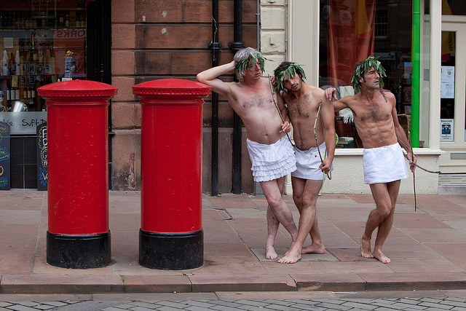
Understanding everyday participation articulating cultural values
5-year interdisciplinary research project funded by the AHRC within its communities and creative economy programme
Focus on meanings, ‘stakes’ and consequences of everyday participation
Participation as ‘situated’ through a place-based studies of 6 contrasting ‘cultural eco-systems’
Based on a range of primarily qualitative methods
Informed re-use of existing quantitative data, new histories of participation and policy and local mapping work
Experimental application projects
Study of the relations of different practice communities to inform future research and policy development
Four universities and 17 sector partners
(www.everydayparticipation.org)

Slide 17
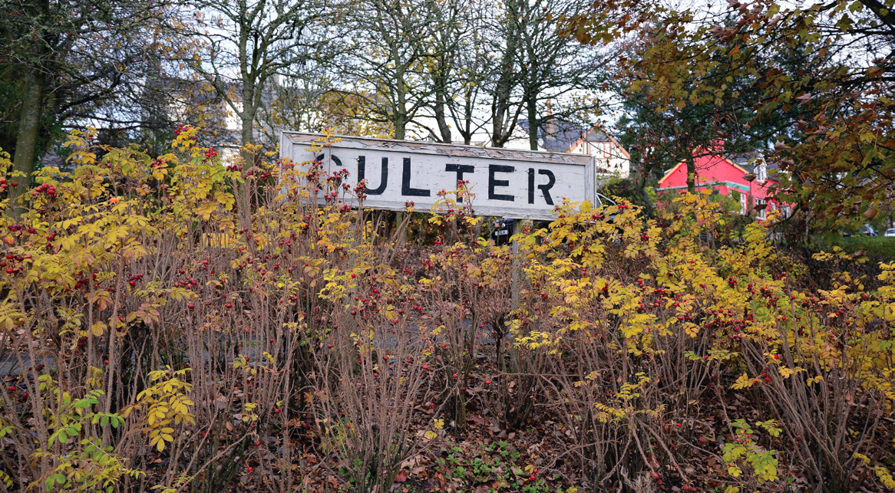
Former industrial village on the boundary of Aberdeen
Communities on ‘the edge’ of Scotland
City-Shire
Site of transformation – economic, physical, social - into dormitory town for the oil wealthy

Slide 18
Core methods
Mapping (demographic and assets)
In-depth interviews (2 waves)
Ethnography
Village Hall
Social Club
Leisure and Health Club
Social Network Analysis

Slide 19
Some key themes
Older groups and key actors among them at the core of a very rich associational culture
Overlapping of social, cultural and civic
Centrality of class and age dynamics
Indigenous/incomer relations
Core rhetoric of ‘the village’
The role of the past in present forms of identification – resistance to change and ‘elective belonging’ (Savage et al, 2005)
Williams (1973), The Country and the City

Slide 20
Resilience

Slide 21
Resilience as a social category
A pre-existing state
Embedded in everyday social and cultural participation
Rooted in a time when ‘work got under the skin of life (Joyce, 1980)
Senior citizens central
Public face operationalised by ‘the usual suspects’ – a core, though differentiated, largely middle-class, network
Ambivalent relationship to the state
The passing of a generational moment?
‘Community-minded people’.
‘Older people are more prone to preparing for emergencies because of the way they’ve grown up’

