Slide 1
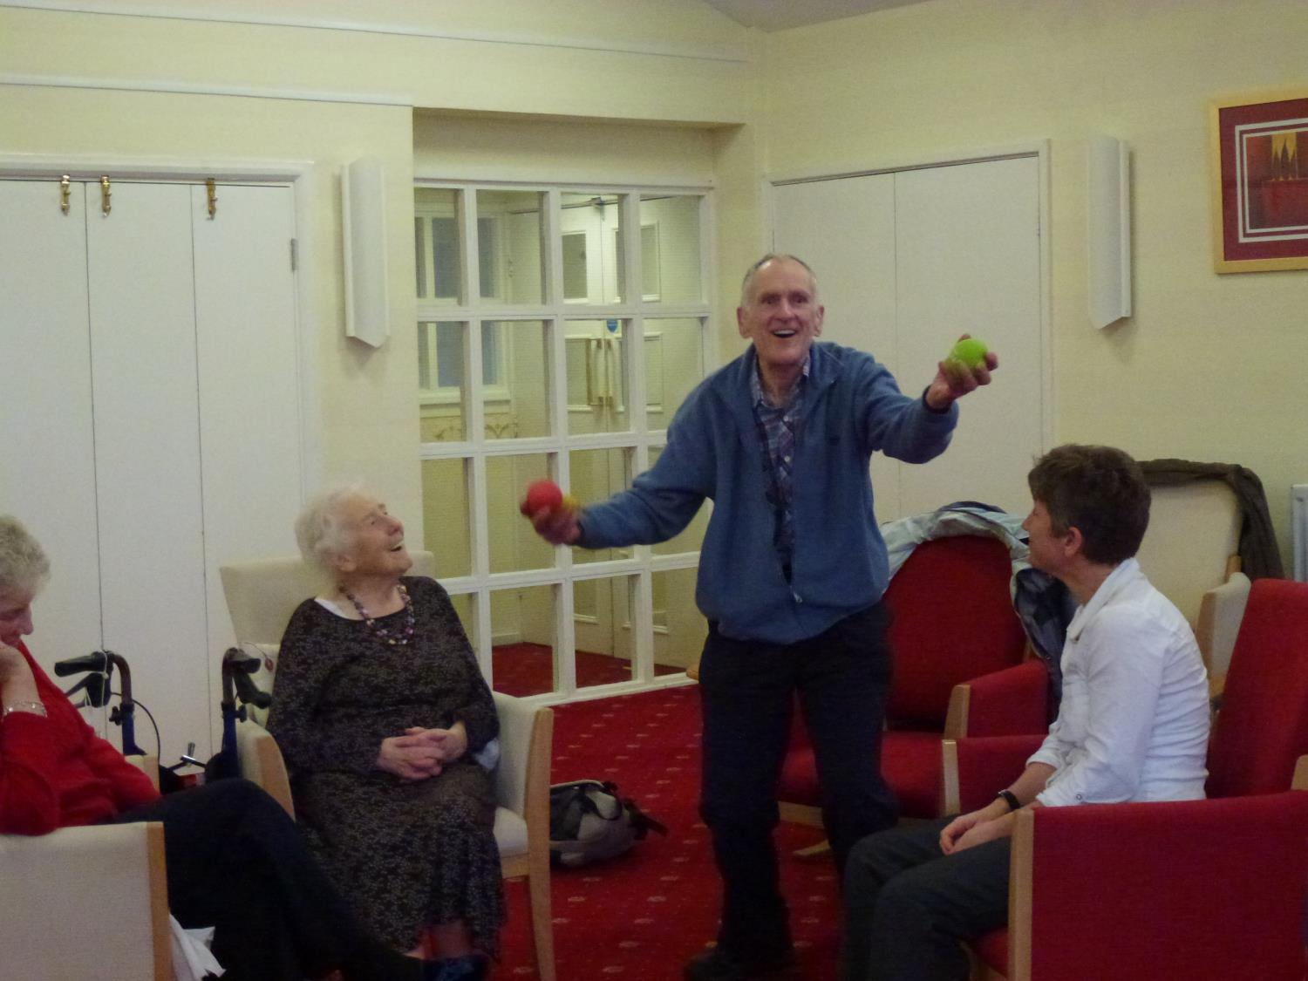
Problems with the concept of Resilience

Slide 2
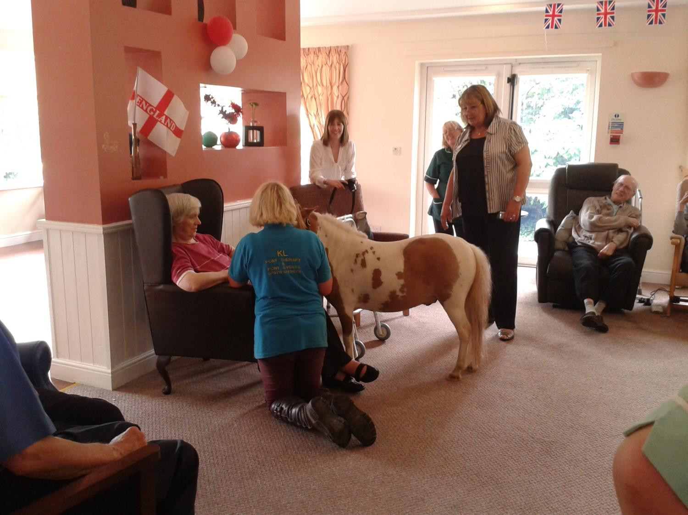

Slide 3
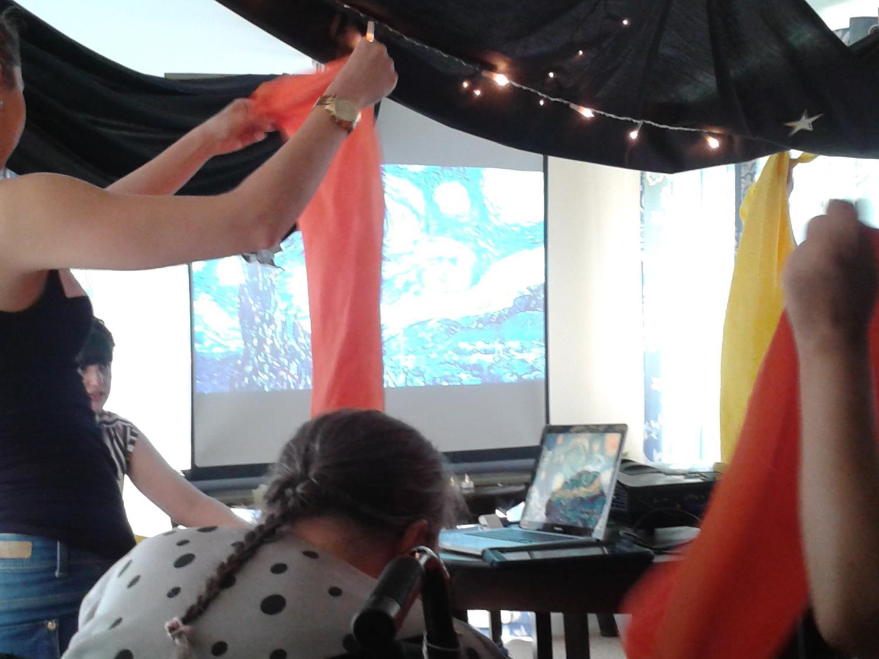

Slide 4
Cautious in offering positive ideals or emancipatory change
Negotiate ordinary upheavals (Bauman, Adams, Waldo 2001).
Explore processes
Individual and community

Slide 5
Public services, housing, income support, employment law influence level of risk (Seccombe 2002).
Individualism
Impact of individual on community
Privileges adaptation that results in people fitting into pre-existing structures

Slide 6
Risks
Socio-economic disadvantage
Elder abuse
Bereavement
Decline in health – dementia, depression, physical frailty
Changing social roles – retirement
Notes:
Baltes and Baltes – the usefulness of subjective criteria is undermined by the plasticity of the human self to adapt subjective assessments to objectively diverse conditions.

Slide 7
What makes us resilient?
Strong internal locus of control
Making downward comparisons
Practical skills
Supportive social networks – social trust, reciprocity, participation in civic life
Built environment
Access to culturally relevant services
Low levels of socio-economic stratification

Slide 8
How did they overcome challenges?
Community – post-war rationing has made generation more resilient (period effect)
Community - Living at sheltered accommodation unit
Community - Charitable work
Social support coupled with determined personality trait - Friends invited me on holiday after two years of being widowed: “I came home and thought ‘I’ve got to get on with it’.”
Philosophical adaptation - “As you age, you don’t worry about things as much.”
Cognitive Strategies/personal rituals - Keep relatives alive by talking to them

Slide 9
Bereavement and Widowhood (Bennett 2010)
Is it useful to quantify the length of time grieving takes?
Achieved gradually or following turning point
Turning points – joining a club not prosaic
Does a self-report questionnaire pick up depression?
If you remarry are you resilient?

Slide 10
Conclusions
Conceptualise relationship between individual and community resilience
Remove risks

