Slide 1
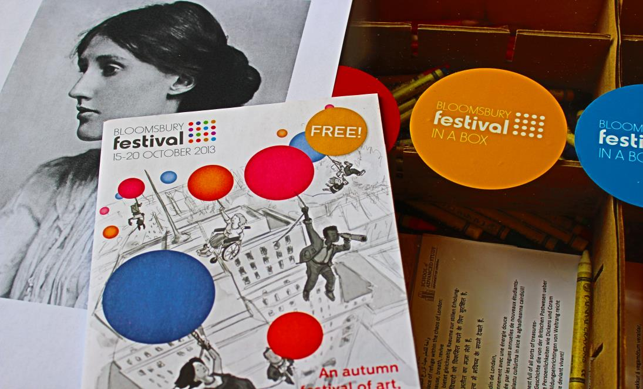
Bloomsbury Festival in a Box: Engaging Socially Isolated People with Dementia
Dr. Michael Eades, Cultural Contexts Research Fellow, School of Advanced Study, University of London

Slide 2
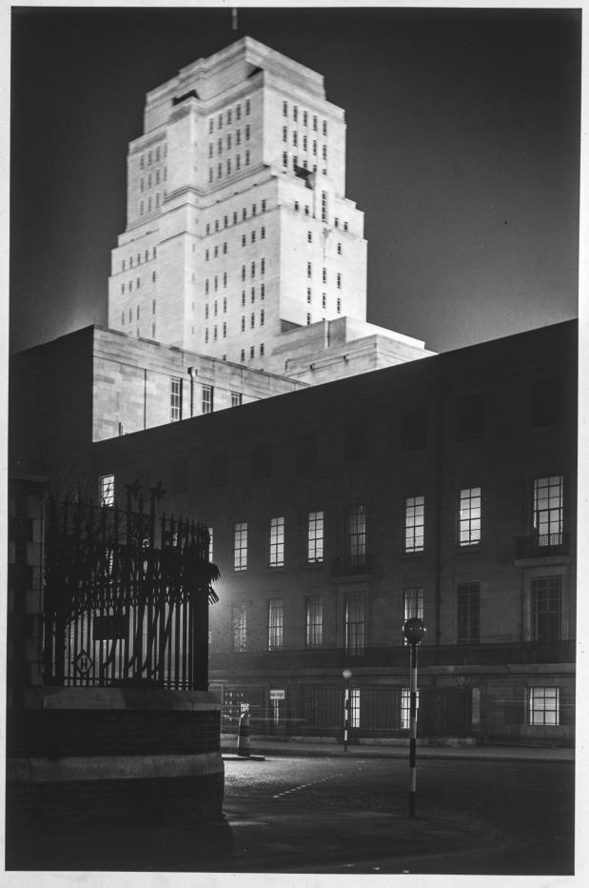
What is a Cultural Contexts Research Fellow?
Researching cultural contexts for and facilitating public engagement with humanities research within and around the School of Advanced Study, University of London.
Projects to date (2013-2014):
Bloomsbury Festival cultural engagement project (AHRC Cultural Engagement piliot) (2013)
PI Bloomsbury Festival in a Box: engaging socially isolated people with dementia (AHRC Cultural Value project) (2013-2014)
Being Human: a festival of the humanities (Nov 2014), the UK’s first national festival dedicated to public understanding of the humanities. @BeingHumanfest

Slide 3
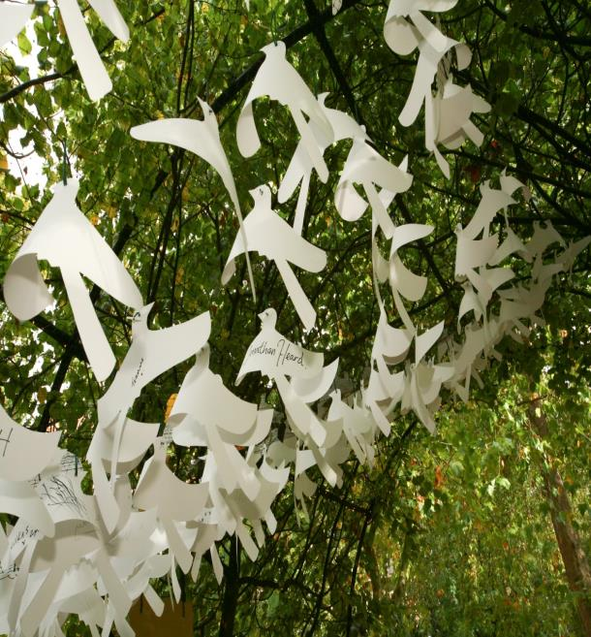
Bloomsbury Festival in a box
Aug 2013 - April 2014: researched, developed, implemented and analysed a pilot scheme for engaging people with dementia in the arts.
A peripatetic, ‘boxed’ version of the Bloomsbury Festival has visited the homes of six ‘socially isolated’ people with dementia in Camden. Conducted follow on interviews and analysis.
A collaboration between the School of Advanced Study (SAS), the Bloomsbury Festival, Age UK Camden, and University College London. Funded by the Arts and Humanities Research Council (AHRC).

Slide 4
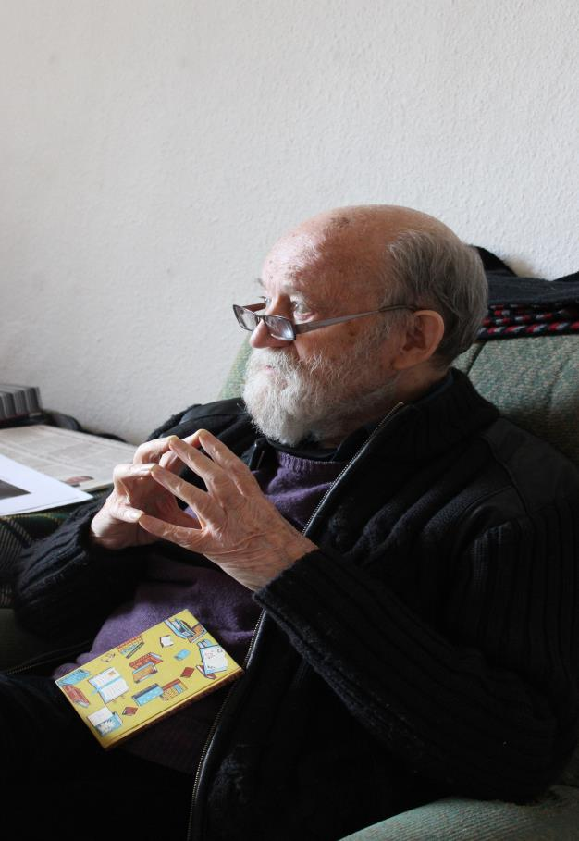
Research Questions
What is the core value of cultural engagement among people with dementia and living in isolation?
Can participation in cultural activity lead to increased social inclusion, cognitive performance, and social wellbeing among this population, using the cultural and intellectual resources of Bloomsbury?
What is the value of engaging people with dementia in the planning and provision of culture; how might we better recognise this group of people as a valuable cultural resource?

Slide 5
Everyday Creativity & Resilience
festivals and the everyday
creativity and the everyday
dementia and the everyday
Connections and tensions between the ‘everyday’ and ‘exceptional’/’ordinary’ and ‘extraordinary’. Can we reconcile?
‘The festival rediscovered and magnified by overcoming the conflict between everyday life and festivity and enabling those to harmonise in and through urban society, such is the final clause of the revolutionary plan’
Henri Lefebvre, 1971, Everyday Life in the Modern World

Slide 6
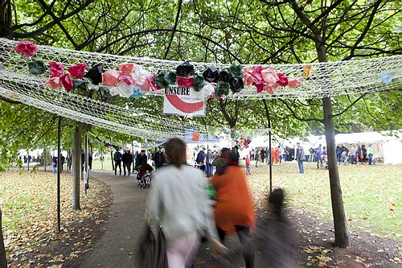
The Festival in a Box Concept
Emerged from research into the ‘Cultural Contexts’ of the Bloomsbury Festival:
What (and who) is missing from the cultural narrative of Bloomsbury, and of this event?
How can we take the festival to them?
Camden Dementia Befriending Service: ‘These are often the individuals in our community who can become isolated and forgotten’

Slide 7
From ‘cultural meals on wheels’ to Archives of Engagement
In the heart of an area famous for libraries and archives, might these Festival in a Box outreach devices be reconceptualised as archives of engagement?
Containers for cultural material/engagement; but also gathering stories from those living with dementia in the area.
An opportunity to participate in re-articulating the cultural narrative of Bloomsbury itself.

Slide 8
A Narrative Approach: ‘Storying’ Dementia:
Restoring personhood
Ryan and Martin (2013): ‘The construction, telling or writing, and sharing of stories serve to promote connections between the person living with dementia and others, thereby fostering personhood’ (193)
Challenging cultural narratives
Kenyon and Randal (2009): ‘a number of gerontology scholars are working to re-story our understanding of dementia, and viewing dementing individuals as, in their own way, still “biographically active”’ (255).
What is a story?
Hyden and Antelius (2011): ‘Doing research with persons with communicative disabilities quiet often tends to upset the often implicit and taken-for-granted narrative norms of the researcher’ (6)

Slide 9
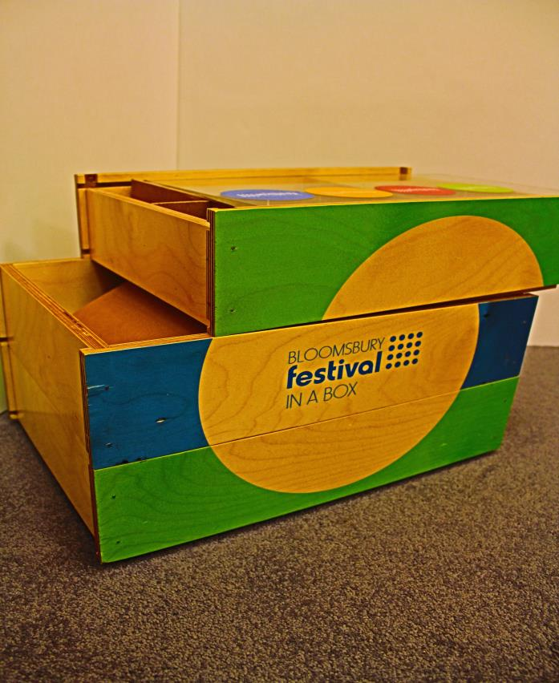
The Box as Narrative Archive
An opportunity to work along the tension between a number of ‘big’ and ‘small’ Bamberg (2004)
The ‘“big stories” of biographical identity’ [and] […] the “small stories” of everyday life’ Angela Woods(2001) .
The box becomes an archive of stories big and small, of identity, but also of cultural narratives of place, culture, and community

Slide 10
Project Timeline:
Phase One –(August-September 2013) Development/Recruitment:
ethics, research, recruitment, training. Box Design.
Phase Two – (October) Launch/Outreach Festival Exhibition & Outreach
Bloomsbury Festival workshop and launch of our blog
Phase Three - Weekly Visits (November 2013-Jan 2014)
6 participants receive 3-4 weekly visits with artists from the Bloomsbury Festival.
Phase Four – Analysis (Feb-March 2014)
Follow-on interviews (artists and befrienders). Transcription of visits. Individual and collective group readings.
Phase Five –Write Up & Dissemination (April/May 2014)

Slide 11
Weekly Visits: Structure & Method
Visits included both a quantitative and qualitative element:
Start of Session:
‘Single Question Happiness Measure:
Art Session
Art workshop (poetry, ceramics, storytelling, music)/session (audio recorded).
Materials added to box at end of session.
Narrative interview
How long have you lived in this area?
What did you do today?
How did it make you feel?
Have you done anything like this before?
Did it bring back any memories?
End of Session:
Happiness measure repeated
Notes:
Claudia: some context on the happiness measure and research methodologies for dementia

Slide 12
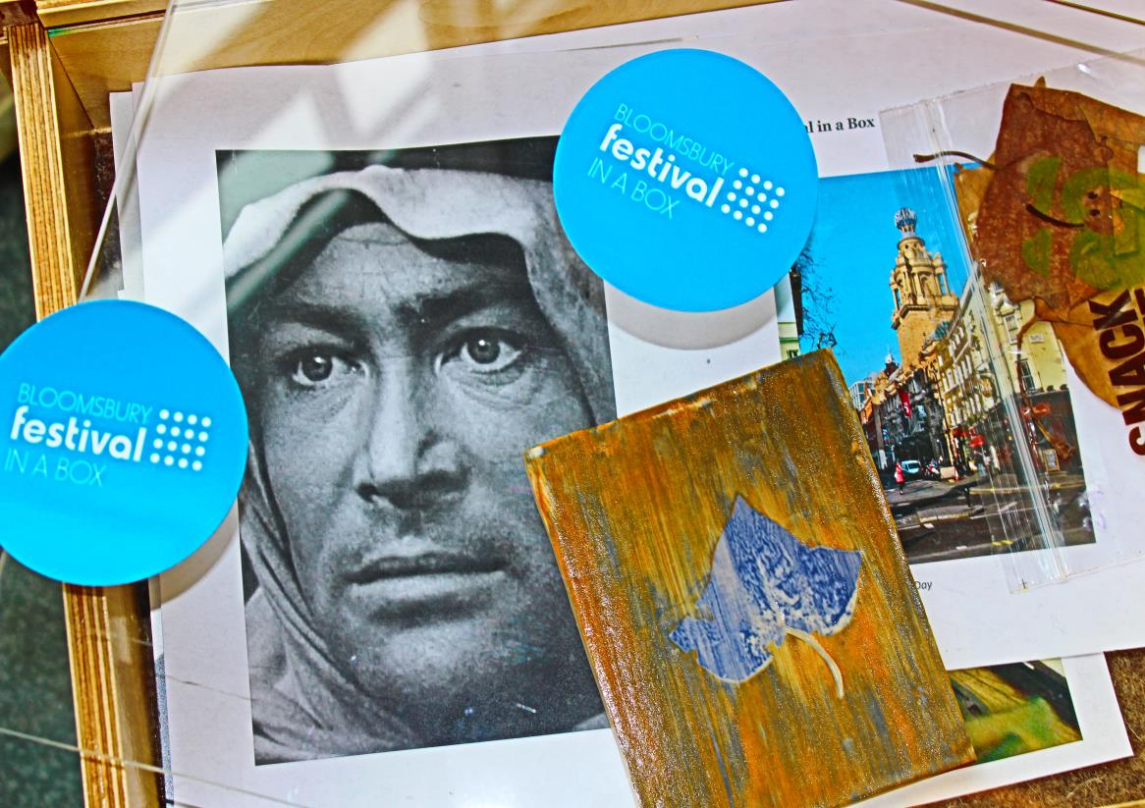
Creativity and Resilience: snapshots from the archive
Notes:
The FIAb archives contain a wealth of resources, what follows is a necessarily brief series of snapshots of the contents.

Slide 13
Creativity:
Gosh I’m an artist […] I didn’t realise I could do anything like that (P1)
‘it’s been a long time since I did anything like that […] But I used to love it’ (P2)
I was [shy] at first but from being in a drama group you get to open out. That’s a good thing. If you know a good drama group, you join’ (P2).
I always think of people as theatrical productions (P4)
I think I've always scribbled one way or the other (P5)
‘Well I haven't thought about writing for a long time’ (P5) I think this is the only time I haven't, now. (P5)
Notes:
Claudia to read

Slide 14
Resilience
Well, I’m a person that I… don’t like misery, and my friends and people who are, you know, introduced to me they’re surprised […]“You’re never moaning!” I say, “Why? Do you want me to moan?” (P2)
Nearly eighty, you know… I’m in good condition but you know there are times that I feel that I’m in prison for a crime that I haven’t committed. I still feel that. (P4)
You see I’m not like most of your patients who are incapable; I’m capable of doing absolutely everything [laughter]. (P6)
I want to write my poem now. My poem. (P3)
Notes:
Claudia to read

Slide 15
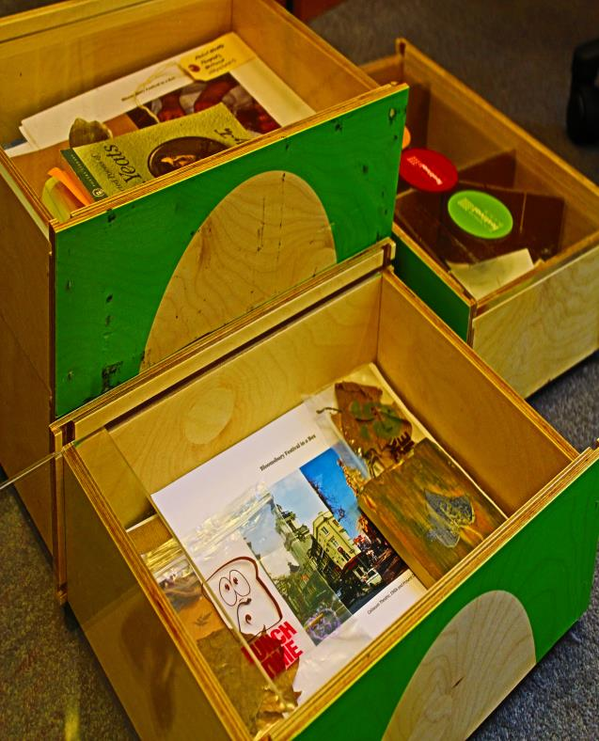
Reconceptualising Resilience
A box of critical texts:
Resilience of self/ personality
Resilience in place & community
Resilience in connection and companionship, shared experiences of creativity.

Slide 16
Artist and Befriender Perspectives
Archive of connection:
That’s one of the things I get from the Bloomsbury thing. Like when you think about these artists, you know, you, me, [participant’s name], really unlikely people to come together and share something amazing. So, yeah, that gives me a lot of hope and, yeah, I think I would take that away from it. (B2)
Archive of inspiration:
it’s kind of looking at what you do from a completely different perspective I suppose […] a lot of the work I do is all about story telling – and it made me get right down to the nitty gritty and break it down to what is this actually about […] it seems like all the best work that I do is about story telling and it made me ask myself questions about what my story was that I wouldn’t have done necessarily otherwise (A2).
Notes:
Michael to read

Slide 17
Artist & Befriender Perspectives
I’ve lived in Camden my whole life, so meeting people that have lived in Camden for 30 years, 40 years and hearing their experience of it. Especially with [P2], she’d lived there for a long time and she told a lot of her story about what it was like growing up there and that was nice to hear. And I think that such a built up…in the centre and the city…that community aspect you don’t get very strongly, so you don’t hear the stories of people that have lived there for 40 years. (A3)
Shifting conceptions of creativity, everyday conceptions of place and community.
Notes:
Claudia/michael to read

Slide 18
Familiarising Dementia
Recent shifts in perspective: framing dementia within the ‘everyday’:
Pam Schweitzer (2011): a ‘growing emphasis on the concept of dementia as a disability which, like other disabilities, society can work with and come to terms with. People with a disability increasingly expect society to listen to them, to plan for, and with, them and to adapt to their needs’
John Killick (2013): ‘dementia as a disability, with all that implies of coming to terms and social attitudes, rather than considering it solely as a medical condition, with the emphasis on treatment’

Slide 19
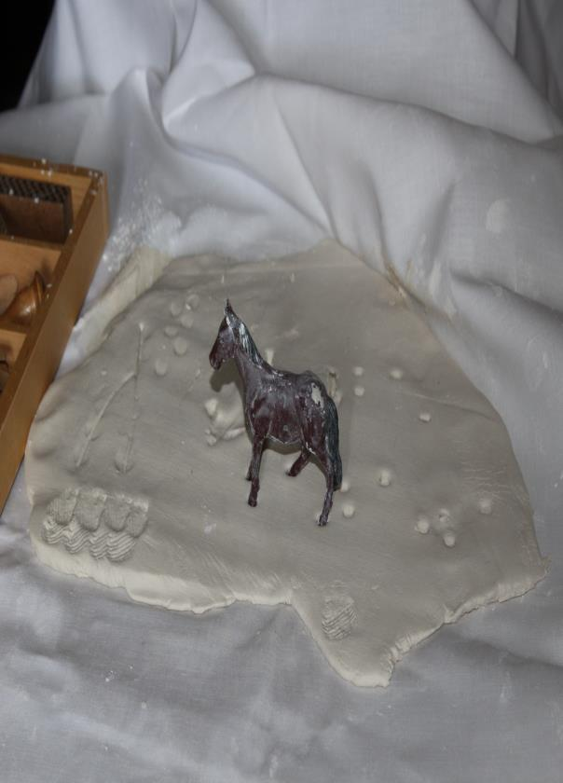
Another reframing: the extraordinary everyday
‘Once we have re-framed our view of dementia and shifted our focus from disability to possibility, it is easier to see the intersection of creativity with dementia. In fact, [Dewitt] Jones’s definition of creativity seems to embrace the very core experience of the person living with dementia: looking at the ordinary, but seeing the extraordinary’
Lee and Adams (2011)

Slide 20
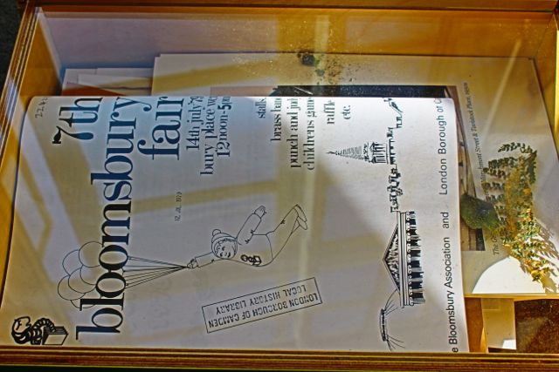
The Ordinary Extraordinary
This returns us to our intersecting ‘ordinary exceptions’:
festivals and the everyday
creativity and the everyday
dementia and the everyday
‘The transformation of everyday life can only be accomplished when the festival is no longer a “few dazzling moments” but has penetrated everyday life and transformed it’ (Ben Highmore, 2002: 124).

Slide 21
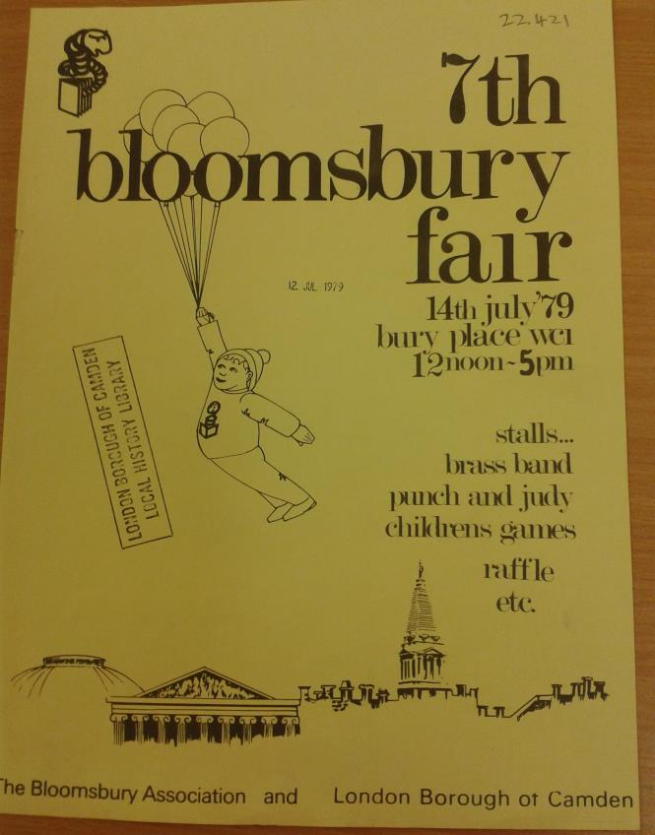
Resilience: confronting a Defamiliarised Cultural Reality
To live with dementia is to experience involuntary immersion in a defamiliarised world. We might have to (with resilience on our own part) defamiliarise our own world in order to find creative social and political approaches to the condition.
FIAB archive allows access to a de- familiarised Bloomsbury (and Bloomsbury Festival) through the perspective afforded by some of its best established, but most vulnerable residents.
The Bloomsbury Festival, and Bloomsbury itself, as ‘a defamiliarised cultural reality’ (Clifford, 1986)

Slide 22
Unlocking the Archive: a critical lens
Andre Breton (1929): ‘the future resolution of […] two states, dream and reality, which are seemingly so contradictory, into a kind of absolute reality, a sur-reality, if one may so speak’ (First Manifesto of Surrealism).
‘As a surrealist, he believes in the carnivalisation of everyday life’ (Patrick Keiller, Robinson in Space)

Slide 23
Ethnographic Surrealism
A socially applied, ethical surrealism?
James Clifford (1986) ‘The ethnographic label suggests a characteristic attitude of participant observation among the artefacts of a defamilliarised cultural reality […] a disruptive and creative play of human categories and differences, an activity that does not simply display and comprehend the diversity of cultural orders but openly expects, allows, indeed desires its own disorientation’ (140).
Ben Highmore (2009): ‘[b]y employing Surrealism for an ethnographic project, the “will to order” of anthropology is seriously undermined, while at the same time Surrealism’s tendency to revel in mythic individualism is effectively countered’ (Highmore, 2009: 82).
Susan M. Shultz (2009) that:
To say that dementia is a surreal condition is probably not to say anything anyone doubts who has confronted a relative or friend with Alzheimer's disease. More interesting, on a literary level, is the way in which writing about dementia creates a hybrid form, documentary surrealism. If documentary poetry combines the strengths of historical writing, journalism, collage, and the lyric, then documentary surrealism opens up the field to the ways in which the imagination is actualized by mental illness or other extreme states (online)

Slide 24
Thank you!
Michael.eades@sas.ac.uk
@michaeleades2

