Slide 1
Community Mapping and Creative Interventions
Phil Jones @philjonesgeog
8 July 2014

Slide 2
Sparkbrook ward
32,415 population
31% less than 15 years old (23% Birmingham)
22% households no one speaks English as primary language (7.5% Birmingham)
51% economically active (64% Birmingham)
23% households overcrowded (12% Birmingham)
61% Asian origins (27% Birmingham)

Slide 3
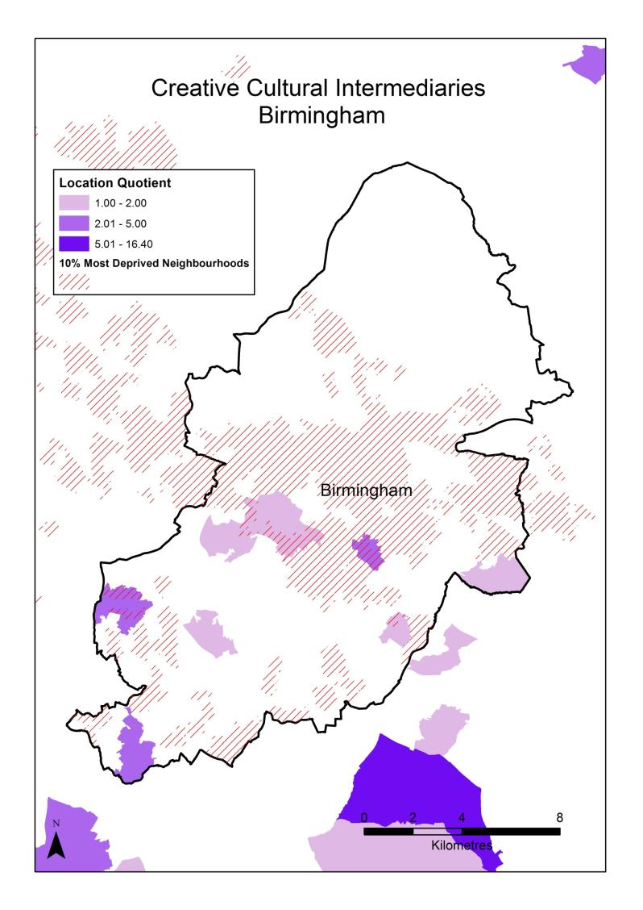
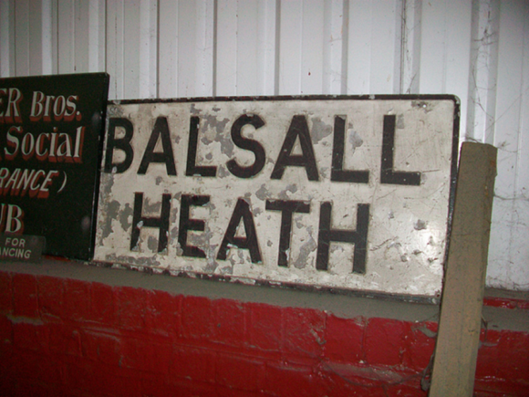

Slide 4
City Centre
Digbeth
Printworks
Edgbaston
University
Mac Arts
Moseley

Slide 5
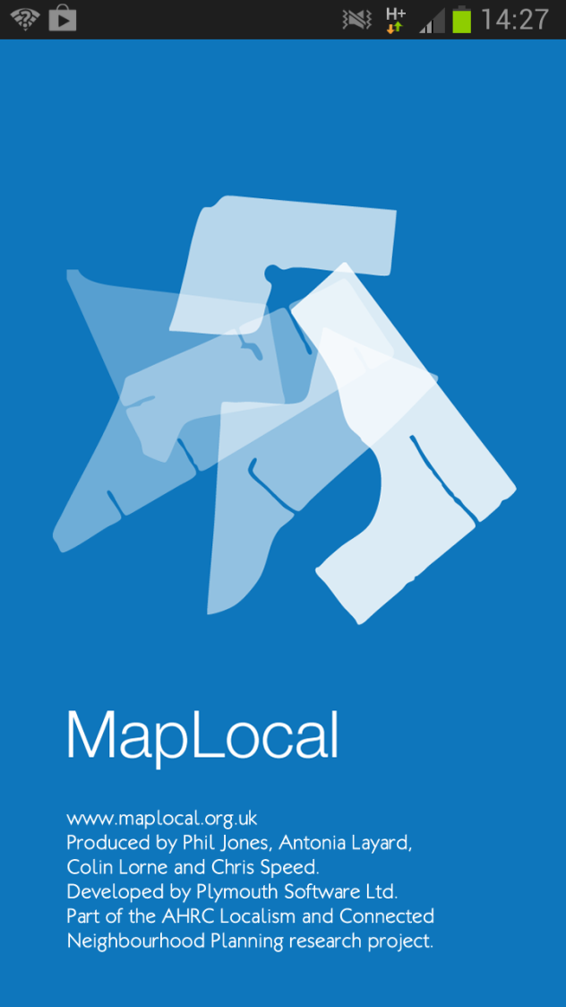

Slide 6
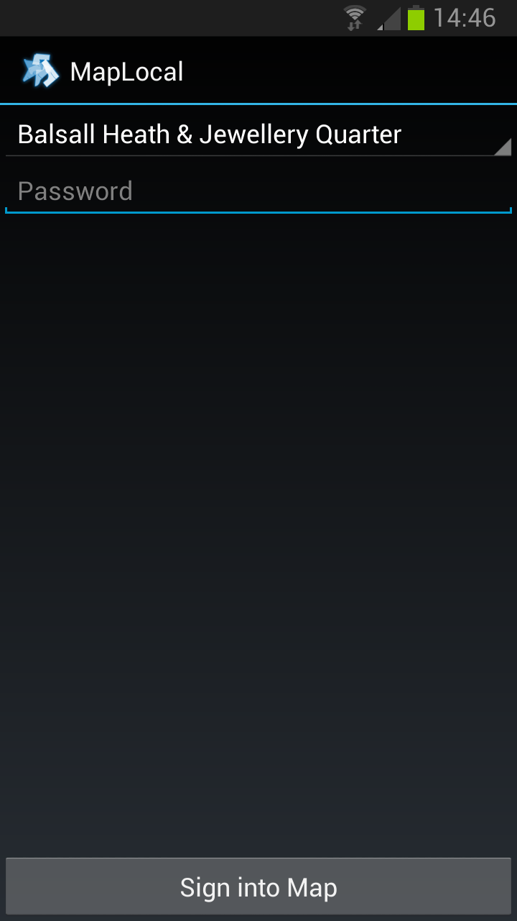

Slide 7
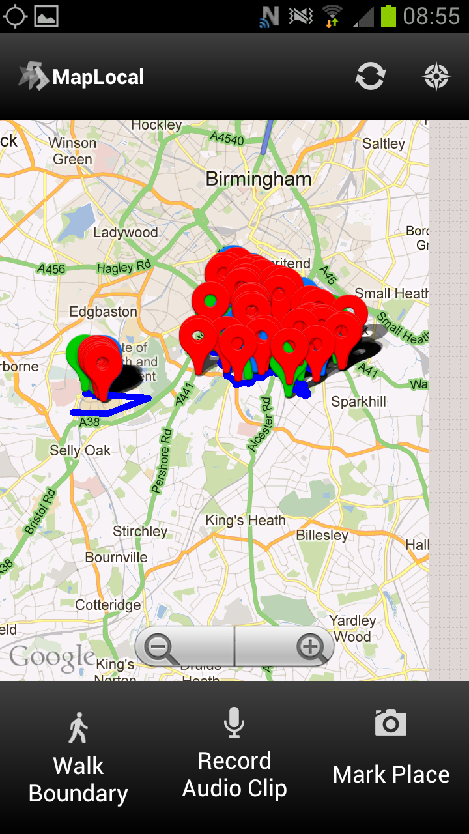

Slide 8
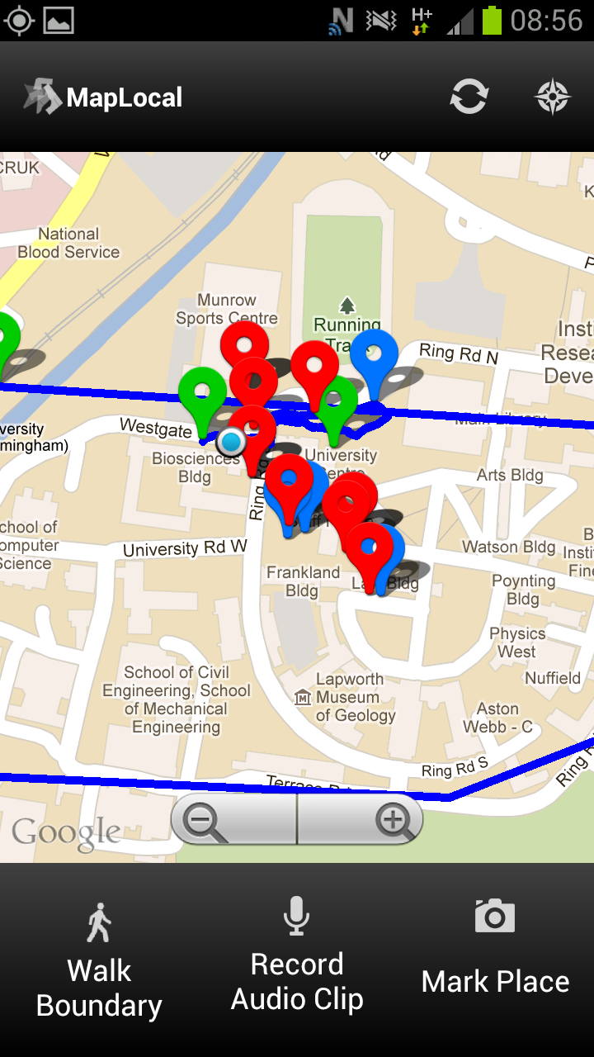

Slide 9
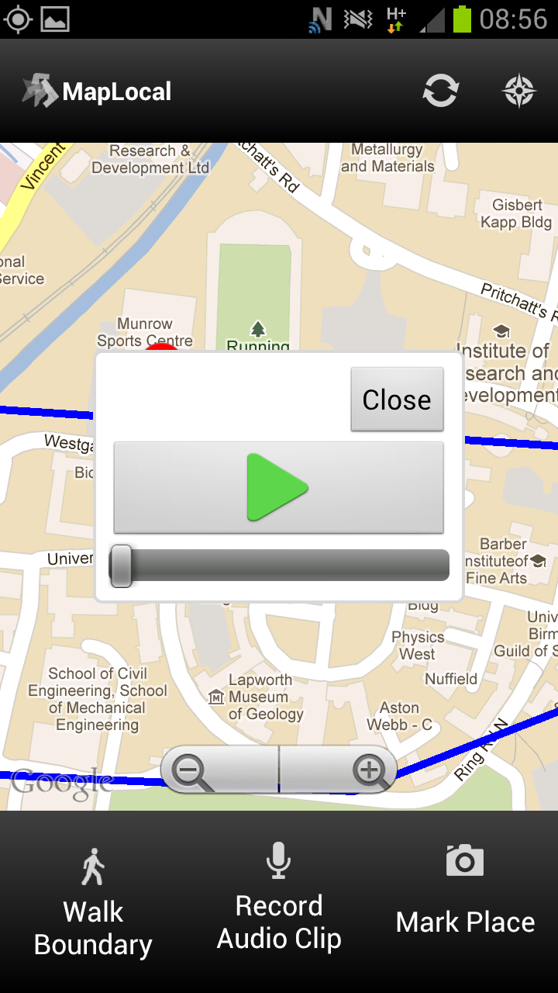

Slide 10
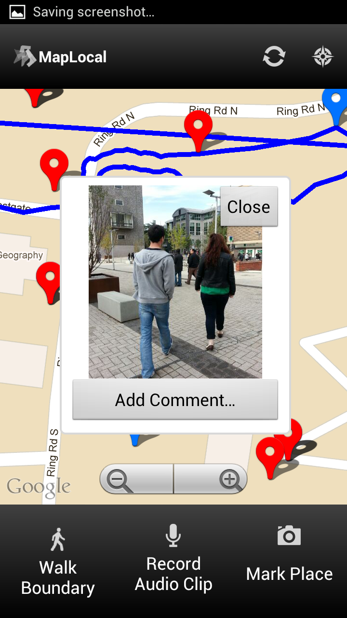

Slide 11
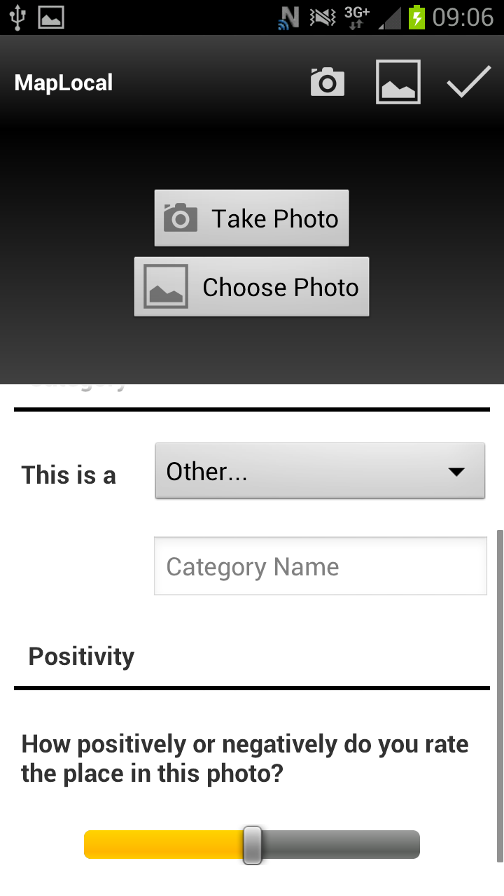

Slide 12
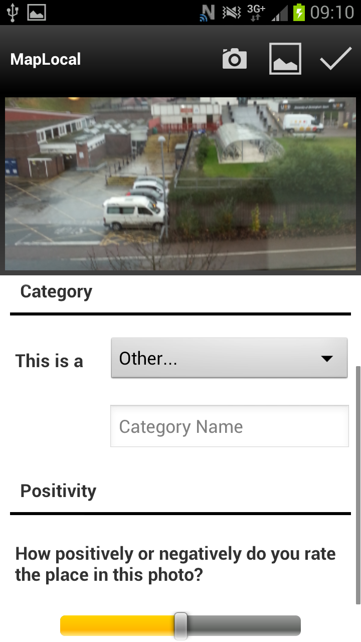

Slide 13
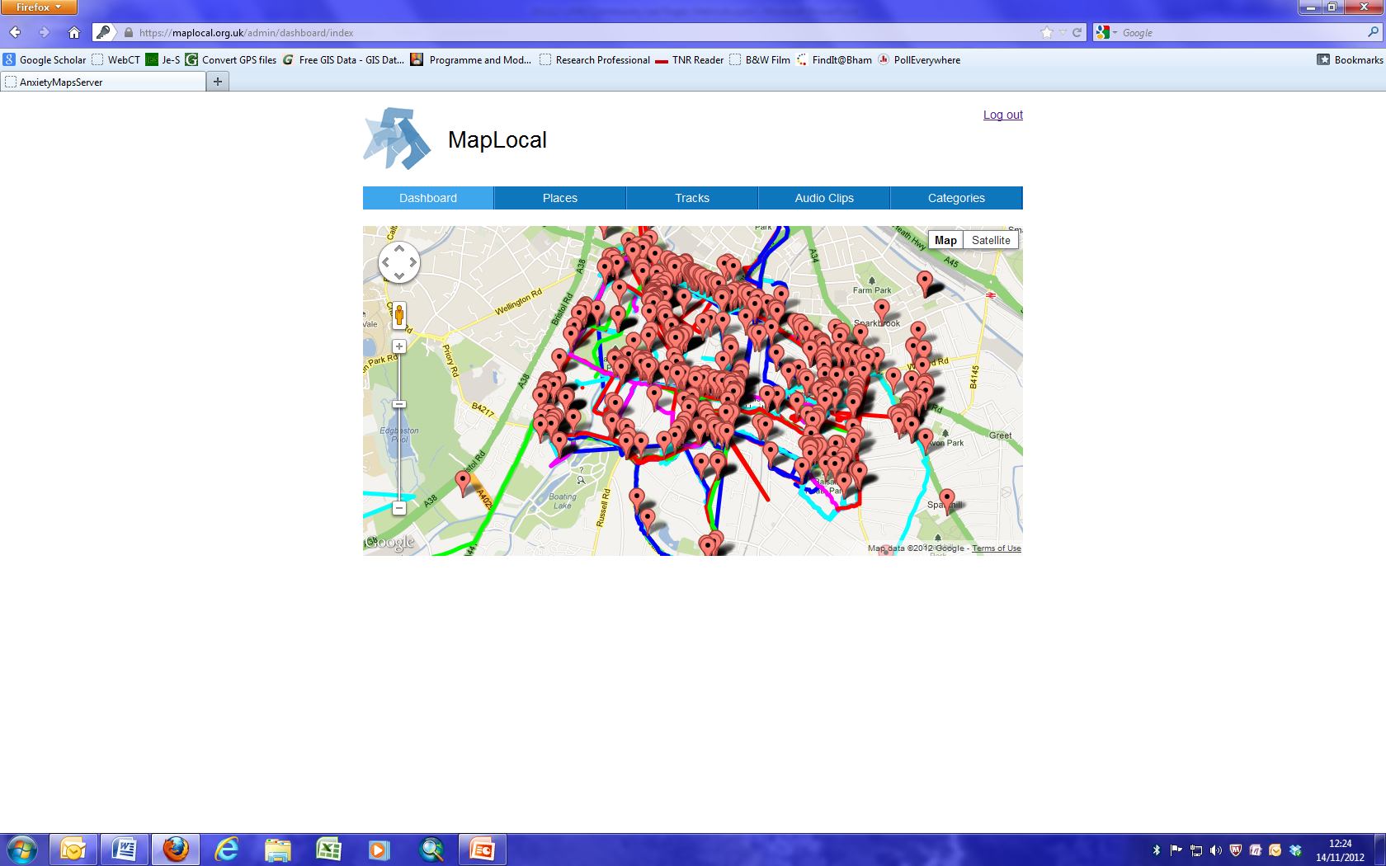
Balsall Heath

Slide 14
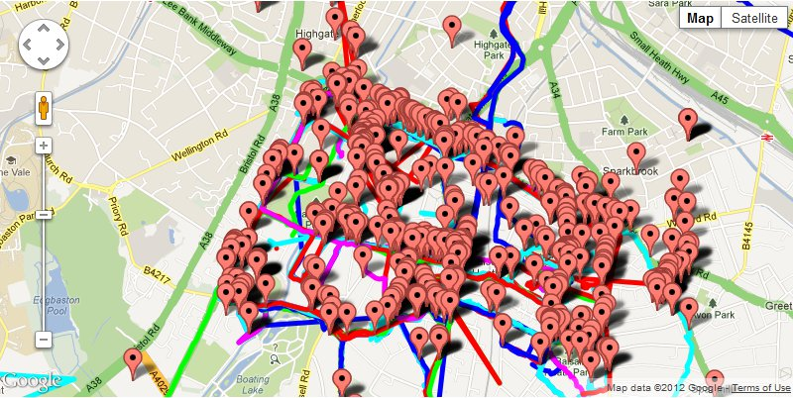
This is the planned site for the travellers to come and park here and we have managed to the community living around here. I think the planners need to hurry up and do something because this is affecting the residents of Highgate and of Balsall Heath.

Slide 15
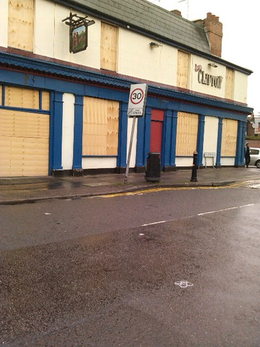
...recently, this pub has been closed down and is up for sale and most likely I think some restaurant will take over, they'll turn it into a restaurant and they'll include this in the Balti Belt.

Slide 16
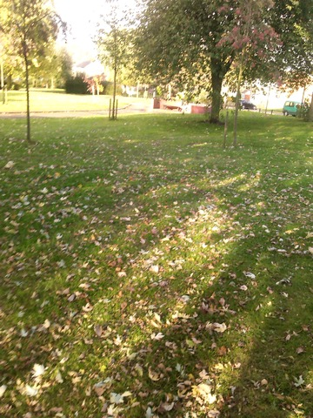
At the moment, I am at George Street Park. Well, it's a very nice, quiet, small park in the winter but in the summer, some very bad things can happen. Like there's beginning to be a lot of drug selling and drug dealing in this park during the summer.

Slide 17
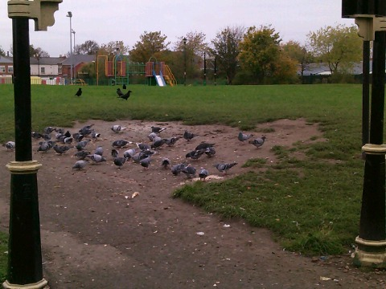
This is Nelson Mandela Park and it's used by the school, Nelson Mandela School as well. It's a nice park, it's got a play area in the middle and a little play area for the kids. One of the problems in this park, people tend to feed the pigeons and it's creating a bit of a rat problem, so it's a bit of a shame but it's a really nice park, overall.

Slide 18
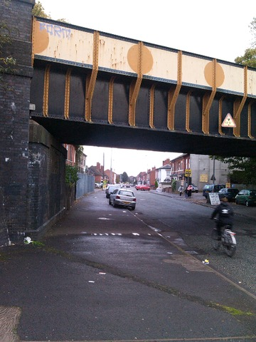
There was a train station here in the past. For some reason it was closed up. Now if it was re-opened again it would be really useful for the community and the people living round here.

Slide 19
Perceptions of culture, desire for change
Walking interviews and focus groups since January 2014
How is culture perceived in Balsall Heath?
What ‘official’ things are engaged with?
What matters to individuals (“This is my cultural chip shop!”)
How are mobility and participation constrained?

Slide 20
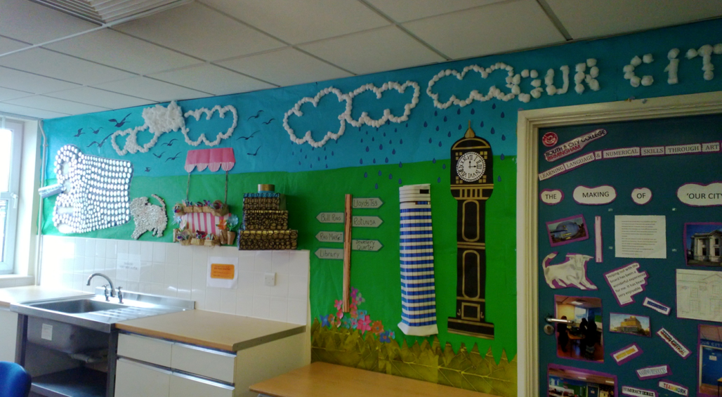
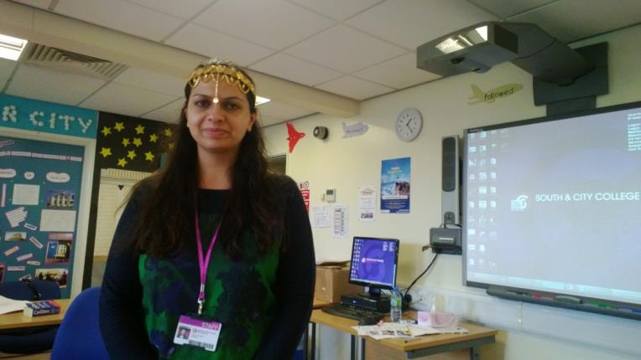
English Language Class

Slide 21
Birmingham Cultural [budgeting] Pilots
Running 2013-14
Built on experience from DCLG’s Neighbourhood Community Budget Pilot Oct 2011-Apr 2013
£95k ACE/BCC/DCLG
Three case study neighbourhoods mapping onto Community budget pilot areas
Balsall Heath
Castle Vale
Shard End
£40k extension from DCLG/ACE agreed March 2014

Slide 22
Cultural Intermediation Interventions
Setting up a panel July/August 2014
How would you like to see your neighbourhood differently?
What things of (cultural) value in Balsall Heath would you like to see more of?
Can an arts/cultural organisation help realise that vision for change?
Bidding for resource from a funder (us!)

Slide 23
For example?
We haven’t got the money to reopen a rail line
Could an artist come in and do a project about how it might transform the community
Lobbying BCC / Centro

Slide 24
We’ll let you know in 12 months
@cultintermed
culturalintermediation.org.uk
Phil Jones
p.i.jones@bham.ac.uk

