Slide 1
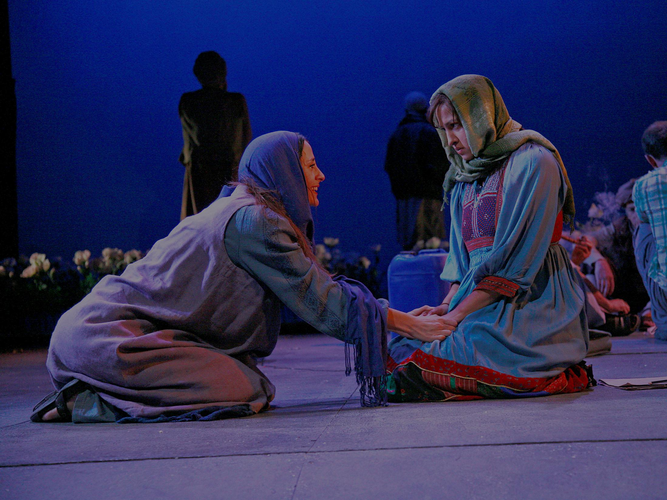

Arts Council England: our role, mission and strategy
Phil Cave
Director, Engagement and Audiences
Arts Council England
October 2014
The Great Game: Afghanistan at the Tricycle Theatre, 2010

Slide 2
I will talk about…
What we do and how we do it
Goal 2 ‘…for everyone’
Context
Examples of what we are doing
Arts, culture and older people: what's happening now and emerging thinking on future focus
Time for questions
Notes:
Here’s what we’re going to cover today.

Slide 3
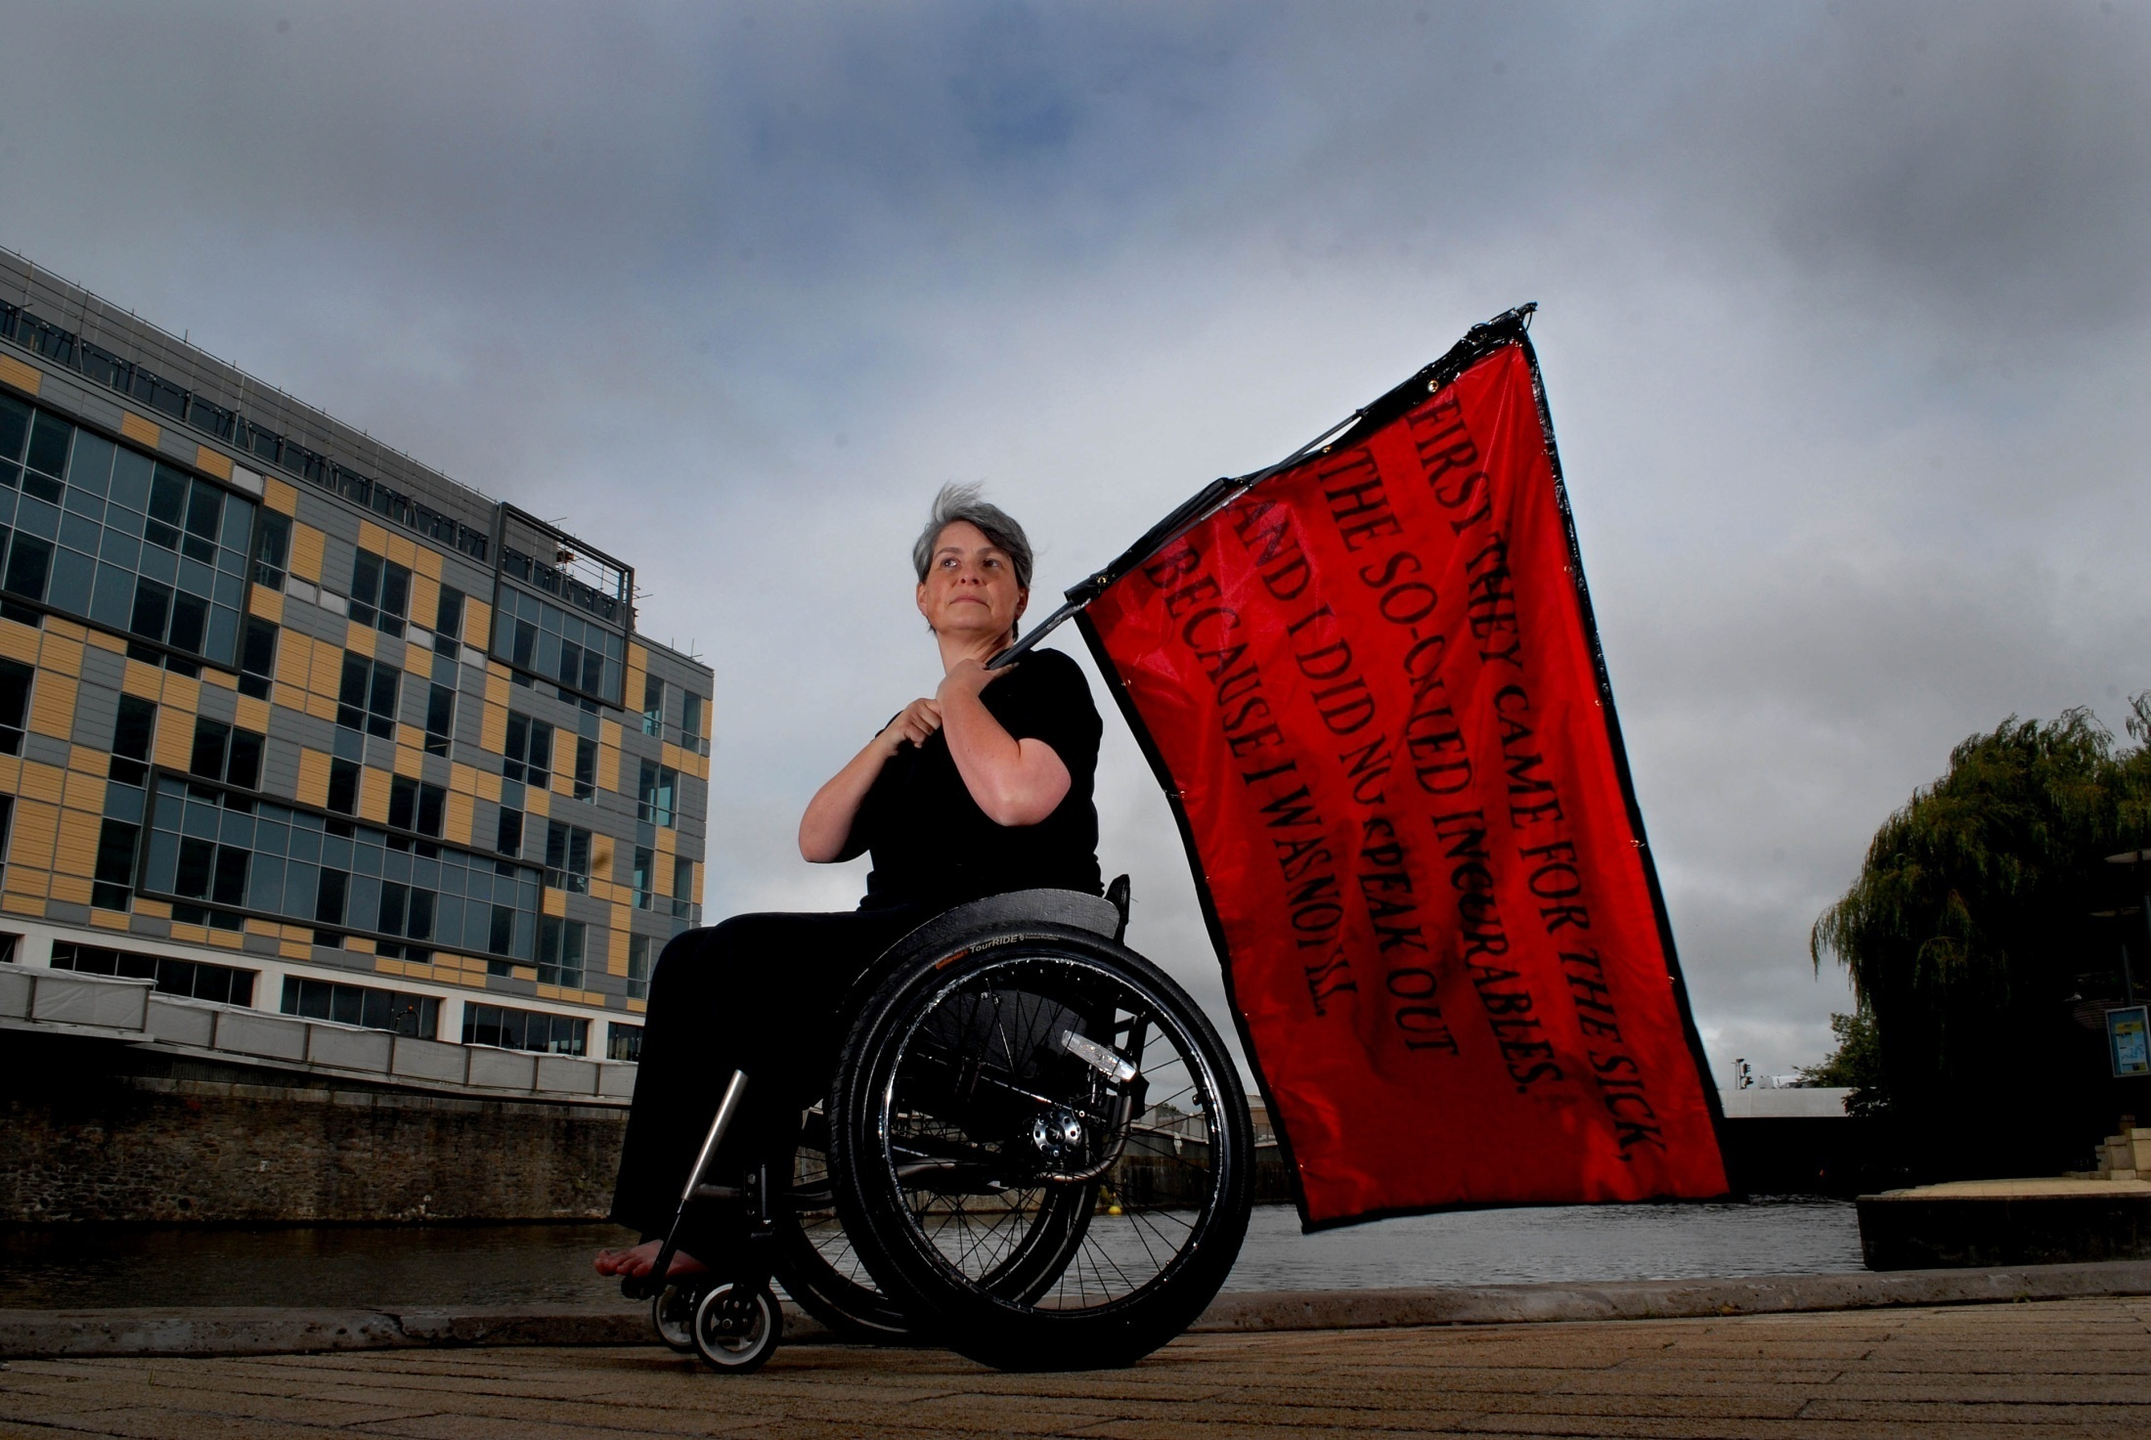
What do we do?
Fourth Plinth. Artist and activist Liz Crow sat on the plinth on her wheelchair and wearing full Nazi regalia to draw attention to a hidden history and the message it holds.

Slide 4

What do we do
Great art and culture for everyone
the arts… (theatre, dance, music, literature, crafts, digital, circus, festivals, visual arts)
…museums and libraries
Notes:
Our mission is 'great art for everyone' and we work to achieve this by championing, developing and investing in arts and cultural experiences that enrich people's lives.
We support a range of activities across the arts - from theatre to digital art, reading to dance, music to literature, and crafts to collections.
As of 2011, we also have responsibility for museums and libraries, which previously sat with another government department. Our relationship with these sectors is slightly different, as we do not fund them in the same way. More on this later.

Slide 5
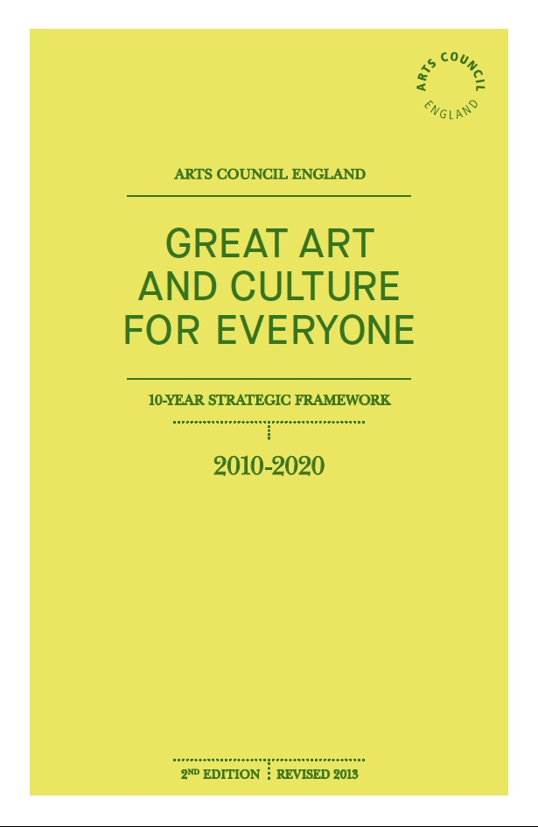

Slide 6
Our 5 goals are:
Goal 1: Excellence is thriving and celebrated in the arts,
museums and libraries
Goal 2: Everyone has the opportunity to experience and
to be inspired by the arts, museums and libraries
Goal 3: The arts, museums and libraries are resilient
and environmentally sustainable
Goal 4: The leadership and workforce in the arts, museums and libraries are diverse and appropriately skilled
Goal 5: Every child and young person has the opportunity to experience the richness of the arts, museums and libraries
Notes:
The 5 goals are:
Our goals are:
Excellence is thriving and celebrated in the arts,
museums and libraries
Everyone has the opportunity to experience and
to be inspired by the arts, museums and libraries
The arts, museums and libraries are resilient
and environmentally sustainable
The leadership and workforce in the arts, museums
and libraries are diverse and appropriately skilled
Every child and young person has the opportunity
to experience the richness of the arts, museums
and libraries

Slide 7
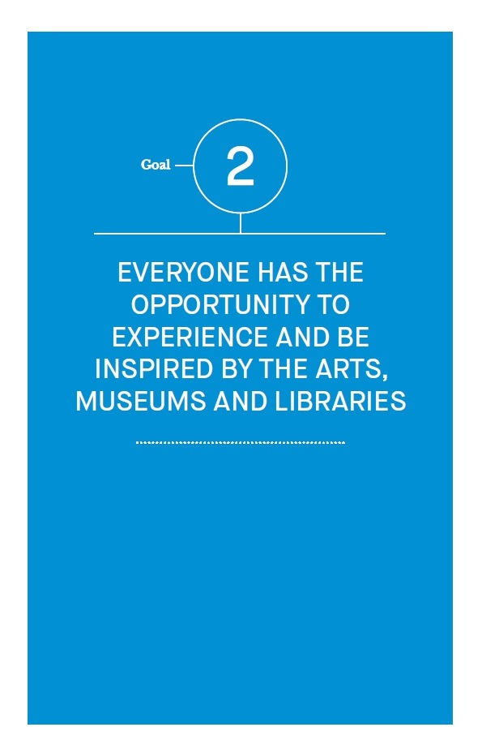

Slide 8
Goal 2: What will success look like?
more people have the opportunity to experience and participate in great art, museums and libraries
the number and range of people experiencing great art, museums and libraries has increased
engagement levels have increased among those currently least engaged in arts and culture
there is a demonstrable increase in the depth and quality of people’s cultural experience

Slide 9
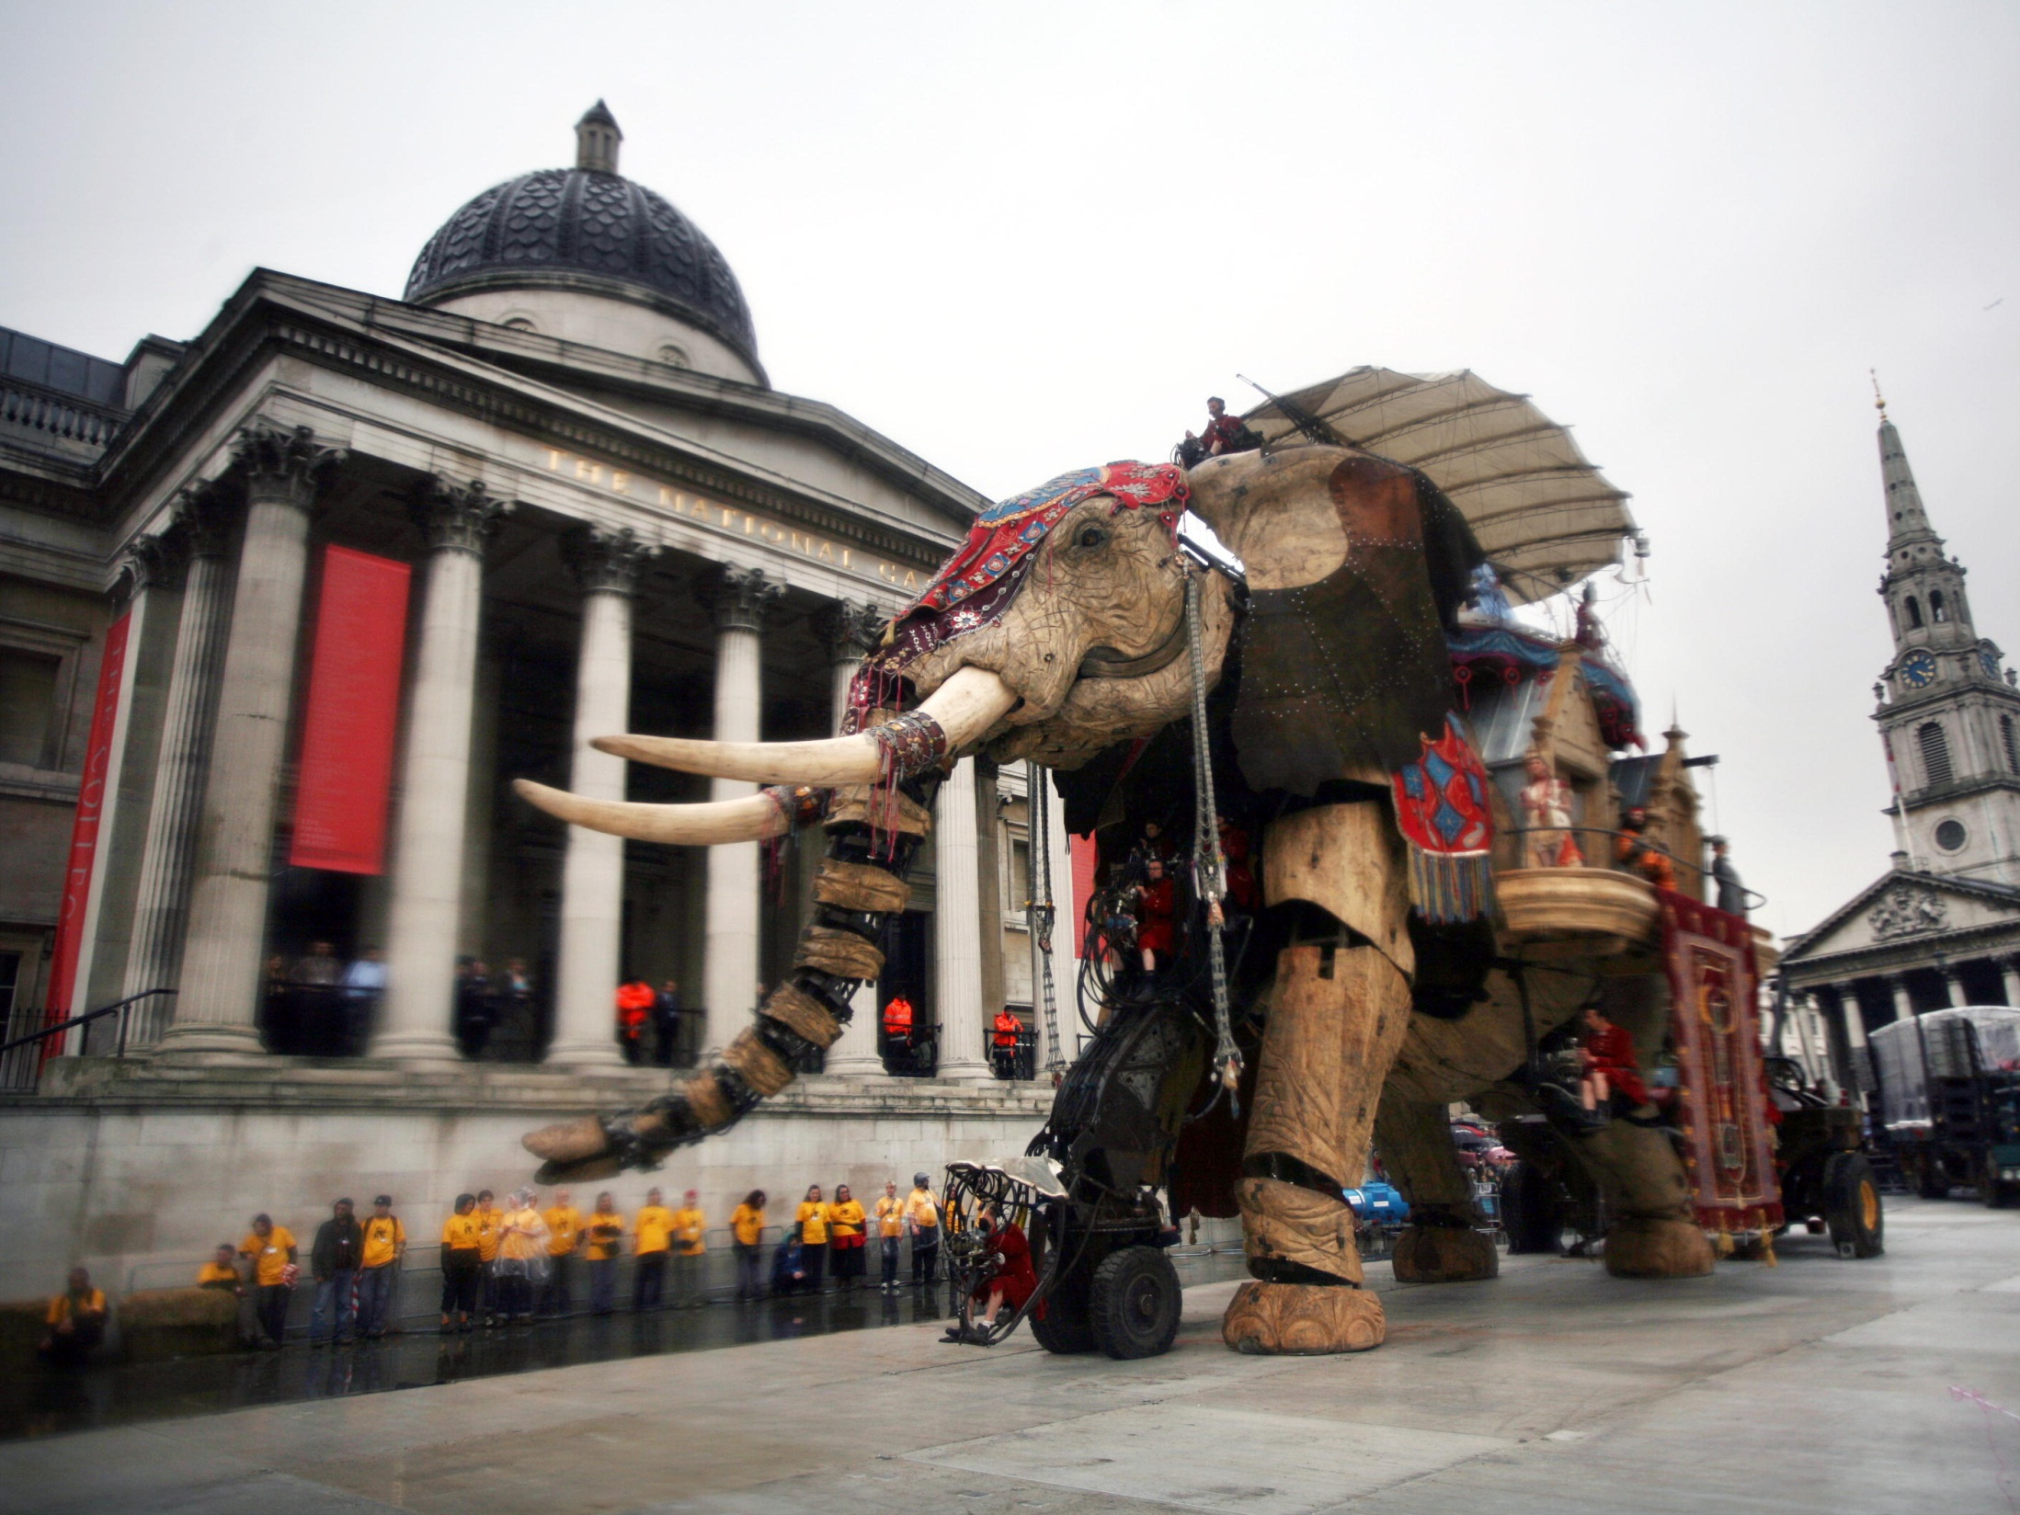
How?
Trafalgar Square, London 2006
Photo: Sophie Laslett

Slide 10
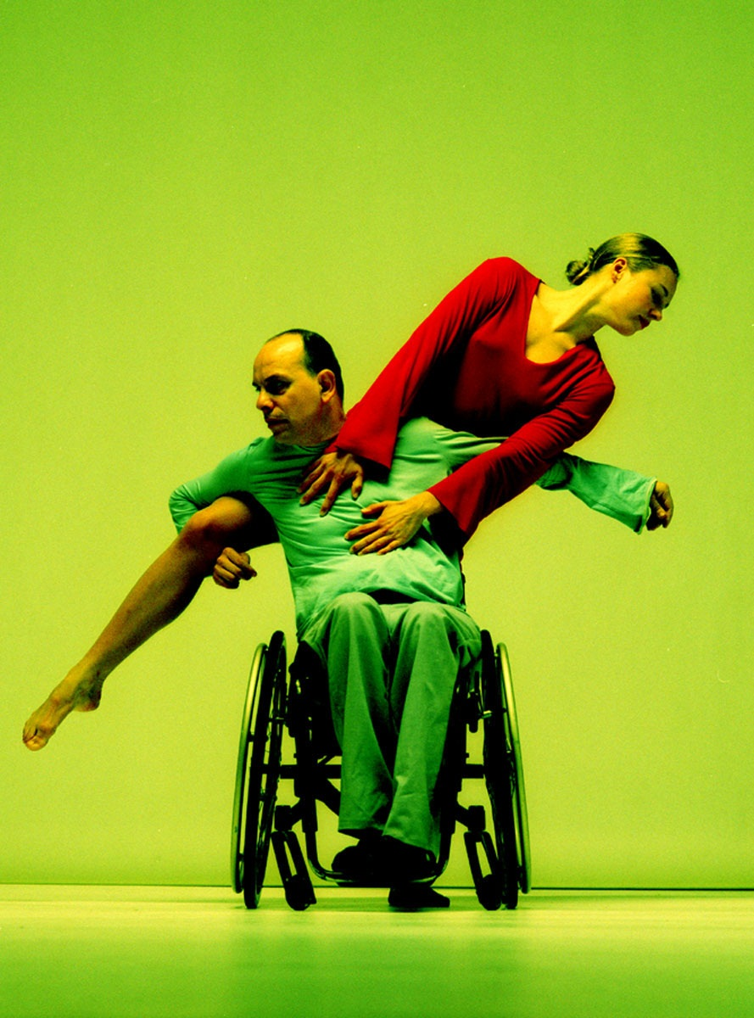
Our roles
funding
development
advocacy
David Lock and Stine Nilsen from Candoco Dance Company performing Shadow by Finn Walker
Notes:
We have three main roles:
We are responsible for distributing money to artists and arts organisations
We are responsible for the development of the sector and responding to key strategic gaps and market failures: including developing partnerships, promoting audience development and encouraging the creative economy
Finally, we advocate for the importance of the arts to government and other bodies

Slide 11
Funding
Two funding sources:
Grant-in-aid
Lottery
Three funding streams:
national portfolio of organisations
open access grants for project funding
funding to support specific strategic initiatives
Notes:
We receive our funding from two sources:
Grant in aid from the UK government.
Money from the national lottery, part of which is allocated to ‘good causes’. (will this need more explanation?)
We have three main funding streams
- National portfolio of organisations: regular funding to around 690 arts organisations, plus new cultural portfolio funding museums through a major grants scheme
Open access grants: distribution of Lottery funds. We currently deliver this through a programme called Grants for the Arts.
Strategic funding initiatives: these are such as touring, museums development fund (strengthen the museums’ infrastructure) and catalysts arts (philanthropic giving; building endowments and fundraising capacity)

Slide 12
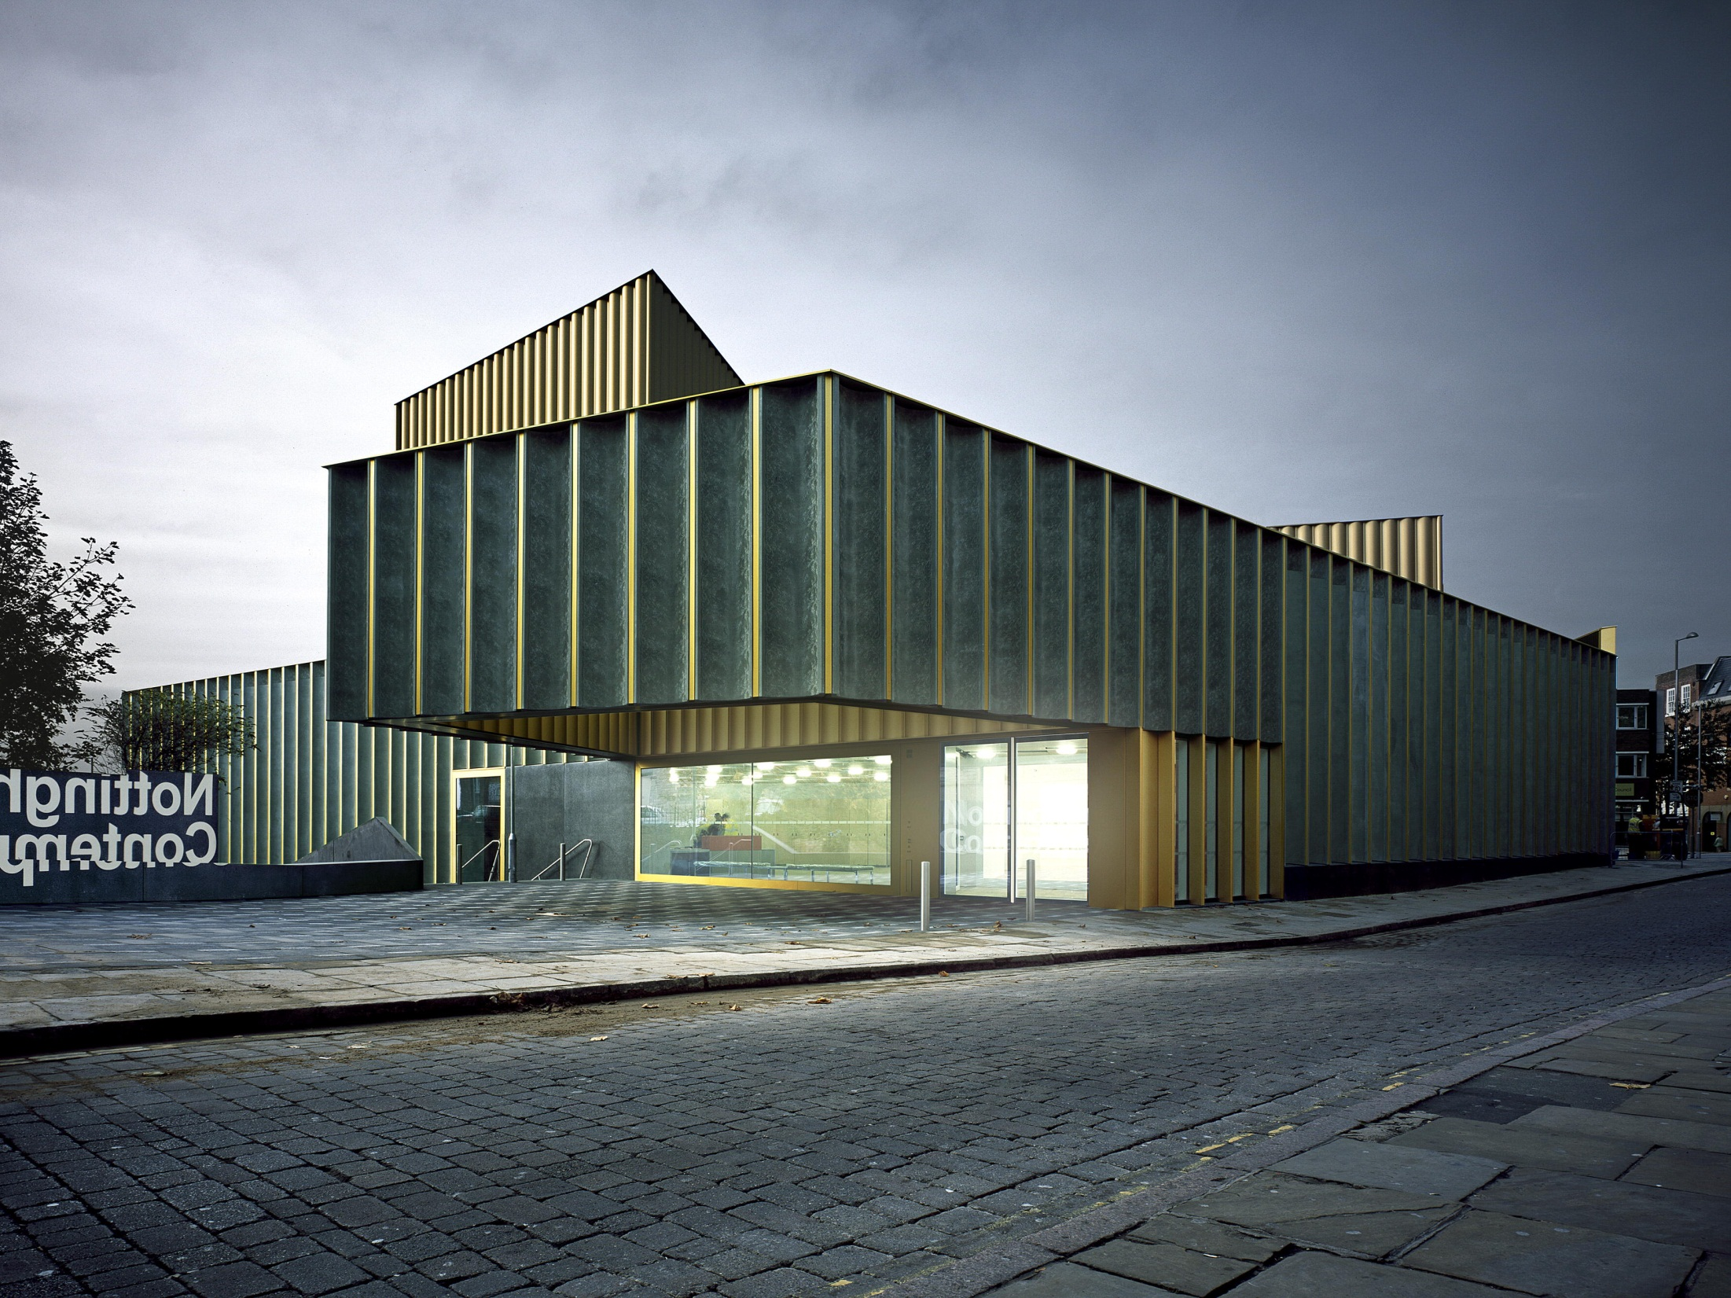
Context
Nottingham Contemporary Launch, East Midlands
Photo: Andy Taylor Smith
Notes:
What's on my minds as we think about priorities for goal 2

Slide 13
Influences of arts engagement – key drivers of arts attendance and participation
Independent of other factors, the following have a moderate to large impact on engagement with the arts at a national-level:
Media consumption – those consuming the arts via the media and digital channels are more likely to engage with the arts
Childhood experience – people encouraged to engage in the arts as a child are significantly more likely to engage with the arts as an adult
Socio-economic factors – being educated to degree-level is a positive driver of engagement with the arts
Age – as people get older, they are less likely to engage with the arts
Ethnicity – People from a White background are more likely to engage with the arts than people from a BME background
Notes:
Back in 2010, the Arts Council worked with the Department of Culture, Media and Sport, Sport England and English Heritage worked on some advanced statistical analysis of the drivers of engagement in culture and sport. Key factors shaping arts were tested using regression modelling.

Slide 14
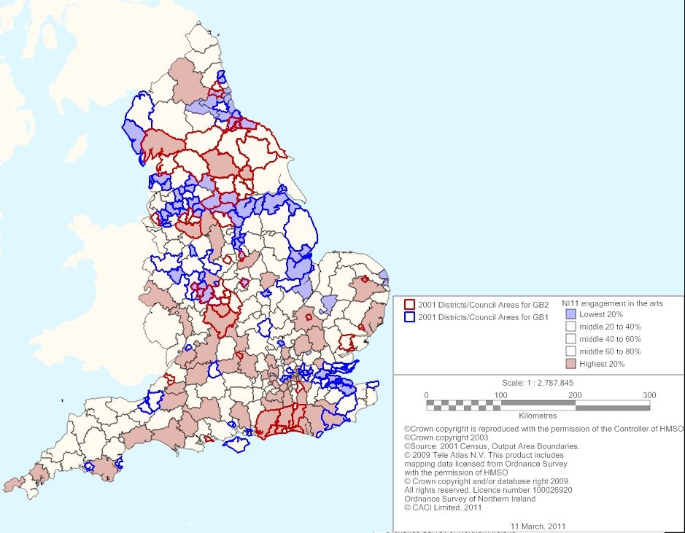
Areas with the highest arts attendance and participation
Areas with the lowest arts attendance and participation

Slide 15
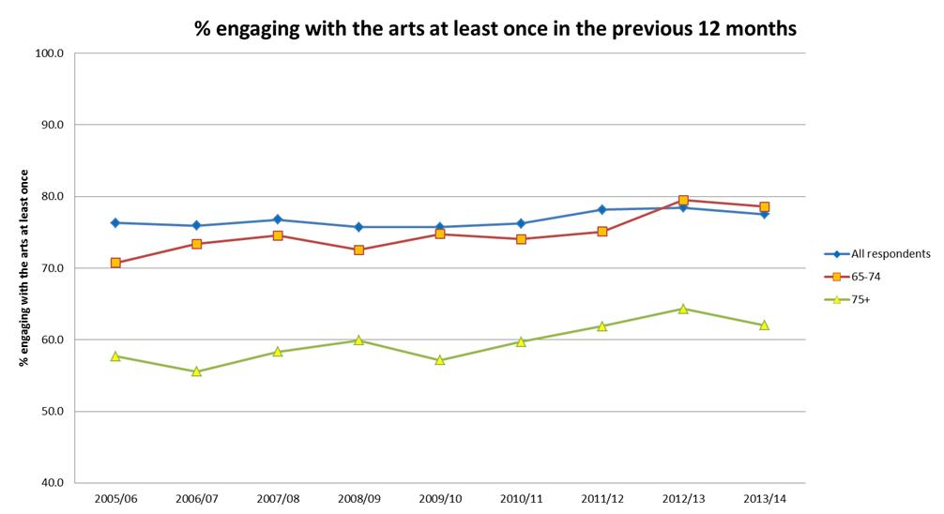

Slide 16
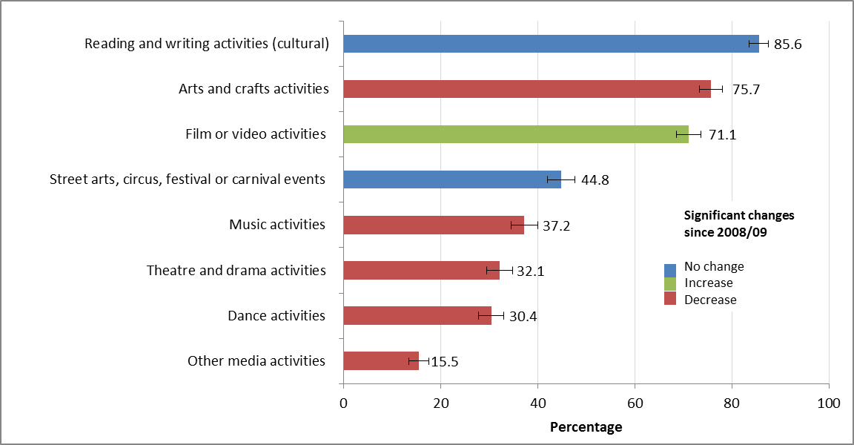
Longer-term changes to cultural tastes and preferences evident in children and young people’s arts and cultural behaviour?
Arts activities engaged in by 5-10 year olds in the last year outside of school, 2013/14, showing significant changes since 2008/09

Slide 17
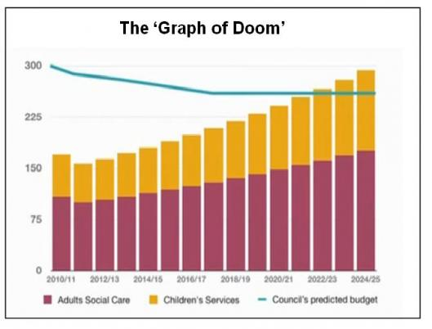
Pressures on local government

Slide 18
Context summary
Attendance/participation levels generally high – but established challenges remain
Changes in the way people are engaging with arts and culture
National government cuts
Local government cuts
Changing demographics (older population and changes in ethnic profiles looking forwards)
Fair distribution of funds/area of benefit- particularly as balance of GIA and Lottery funds likely to shift
Notes:
Notes
Within Goal 2 we have made a commitment to prioritise people and places with the least engagement. I know that many of you have also made commitments to reach out to communities (both people and places) that traditionally may be less likely to engage in the arts and culture and your contribution to this priority is vital.
Strategic funds such as touring and digital will play their part too and you will be aware that earlier in the year we also launched a strategic fund that is designed to address this priority head on called Creative people and places. This is the vision for Creative people and places which hopefully should be familiar to you.

Slide 19
Programmes: Creative people and places
In 2012 we launched a £37m strategic fund called Creative people and places with the vision:
more people experiencing and inspired by the arts
excellence – both artistic and in engaging communities
10 year vision (3 years funding)
communities help to shape local arts provision
experimenting with new and innovative ways to deliver excellent arts experiences
including long-term collaborations between local communities and arts organisations, museums, libraries and local authorities and private sector
Notes:
Notes
Within Goal 2 we have made a commitment to prioritise people and places with the least engagement. I know that many of you have also made commitments to reach out to communities (both people and places) that traditionally may be less likely to engage in the arts and culture and your contribution to this priority is vital.
Strategic funds such as touring and digital will play their part too and you will be aware that earlier in the year we also launched a strategic fund that is designed to address this priority head on called Creative people and places. This is the vision for Creative people and places which hopefully should be familiar to you.

Slide 20
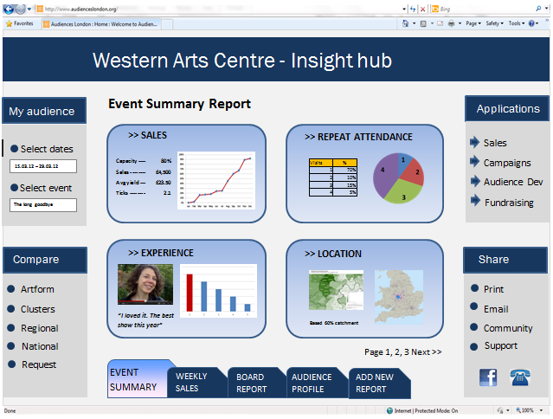

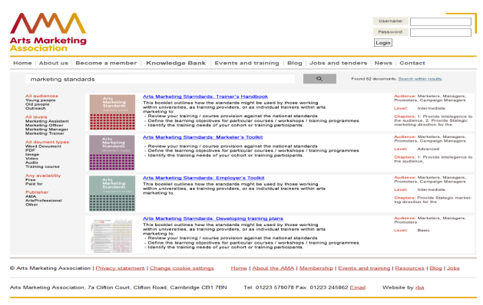
Audience focus strategic fund
create the first ever national live & digital
audience data collection and benchmark
service. Help to understand….
what it means for you
6 industry bodies leading a national
campaign to reach more families
training and support to adopt
best practice www.culturehive.co.uk

Slide 21
Arts and older people: what's happening now ?
Arts and health funding and activity through our on-going grant programmes
Feeding into national initiatives eg Prime Ministers Champion Group – Dementia Friendly communities
Dedicated strategic fund in partnership with the Baring Foundation

Slide 22
Arts and older people in care strategic fund: aims
£1m fund, supported by the Arts Council and the Baring Foundation
Funded 4 exemplar projects with the aims of:
Convincing care providers to develop on-going arts activity
Develop tools/insight for more residential providers to do the same
Showcase artistic excellence
To support care staff and artists to do this
A voice for older people in their communities
Notes:
The key aims of the programme are to:
encourage residential care providers in partnership with arts organisations to commit to and invest in on-going programmes that give residents access to high quality arts experiences
establish a series of sustainable, exemplar, programmes of arts and engagement activity giving older people in residential care access to a wide range of quality arts experiences as audiences and participants
showcase artistic excellence in residential care settings and stretch aspiration for the range of arts that residents can access
develop tools and resources for more residential care providers to adopt on-going programmes of arts engagement activity and to provide practical support for them to identify appropriate artists and local arts opportunities
support the professional development of residential care staff to increase their confidence to deliver arts engagement programmes in their care settings
support the professional development of artists to create collaborative arts projects with older people, their carers and the wider community
through documentation, evaluation and dissemination stimulate debate and share learning about approaches to engaging older people in care in the arts and inspire others to develop best practice
demonstrating the role of the arts in providing a voice for older people and bring local communities and people in care homes closer together

Slide 23
Arts and older people in care strategic fund
The successful applicants are:
Arts for Health Cornwall & Scilly Isles (AFHC)
The Courtyard which will work with older people in the County of Herefordshire
We do. which will benefit older people in West Yorkshire
Abbeyfield in Nottingham
Notes:
The key aims of the programme are to:
encourage residential care providers in partnership with arts organisations to commit to and invest in on-going programmes that give residents access to high quality arts experiences
establish a series of sustainable, exemplar, programmes of arts and engagement activity giving older people in residential care access to a wide range of quality arts experiences as audiences and participants
showcase artistic excellence in residential care settings and stretch aspiration for the range of arts that residents can access
develop tools and resources for more residential care providers to adopt on-going programmes of arts engagement activity and to provide practical support for them to identify appropriate artists and local arts opportunities
support the professional development of residential care staff to increase their confidence to deliver arts engagement programmes in their care settings
support the professional development of artists to create collaborative arts projects with older people, their carers and the wider community
through documentation, evaluation and dissemination stimulate debate and share learning about approaches to engaging older people in care in the arts and inspire others to develop best practice
demonstrating the role of the arts in providing a voice for older people and bring local communities and people in care homes closer together

Slide 24
Arts and older people: Emerging thinking on next steps
The proposed activities fit broadly under the following two aims:
Supporting the cultural sector to become more age and dementia aware and proactive in welcoming older people and their carers and families
Reaching home bound isolated older people through arts and culture
Notes:
The proposed activities fit broadly under the following two aims:
Supporting the cultural sector to become more age and dementia aware and proactive in welcoming older people and their carers and families
Examples of activity
All public facing Arts Council funded cultural organisations participate in a programme of age and dementia awareness. This would draw on off the shelf training programmes around dementia and would also be a natural development from the current industry led drive to become more family friendly. Cultural organisations would be invited to achieve recognised standards of best practice eg National Dementia Declaration
A cross section of funded organisation develop or adopt innovative proactive approaches to become exemplars on how to reach out to include older people and their families and carers – for instance The Albany and Theatre by the Lake
Intergenerational arts projects to raise awareness of dementia and develop the confidence and skills of young people to engage with older people
Reaching home bound isolated older people through arts and culture
Examples of activity:
Mentoring volunteers to provide arts and cultural activities. To tackle the problem of loneliness among older people, Age UK has developed befriending services. The service works by assigning each older person a befriender, who provides friendly conversation and companionship on a regular basis over a long period of time. All befrienders are volunteers, who freely give up their time to help lonely older people. Artists would mentor interested volunteers in how to provide a range of creative activities that could be offered to homebound people and to enhance the time they spend together. This builds on an approach currently supported in the West Midlands as part of the Baring Foundation/Arts Council arts and older people commissioned grant programme
Cultural community connectors. Where there isn’t an established system of volunteering to reach the most isolated older people, we will support the expansion of an approach being uses in several Creative people and Places. The Community connectors model operates through a mix of volunteers and paid part time coordinators. Modest local commissioning budgets allow the connectors to develop bespoke programmes of activity that represent the place and the community.
Key partners
Age UK, Age Concern
Commercial and charitable care providers
Core cities, ADUK and relevant local authorities
Baring Foundation
Arts and museums sector bodies eg TMA, MA, ABO

Slide 25
You may also be interest in
Arts Council/NCVO commissioning – research and support
Arts Council R& D Fund to be launched

Slide 26
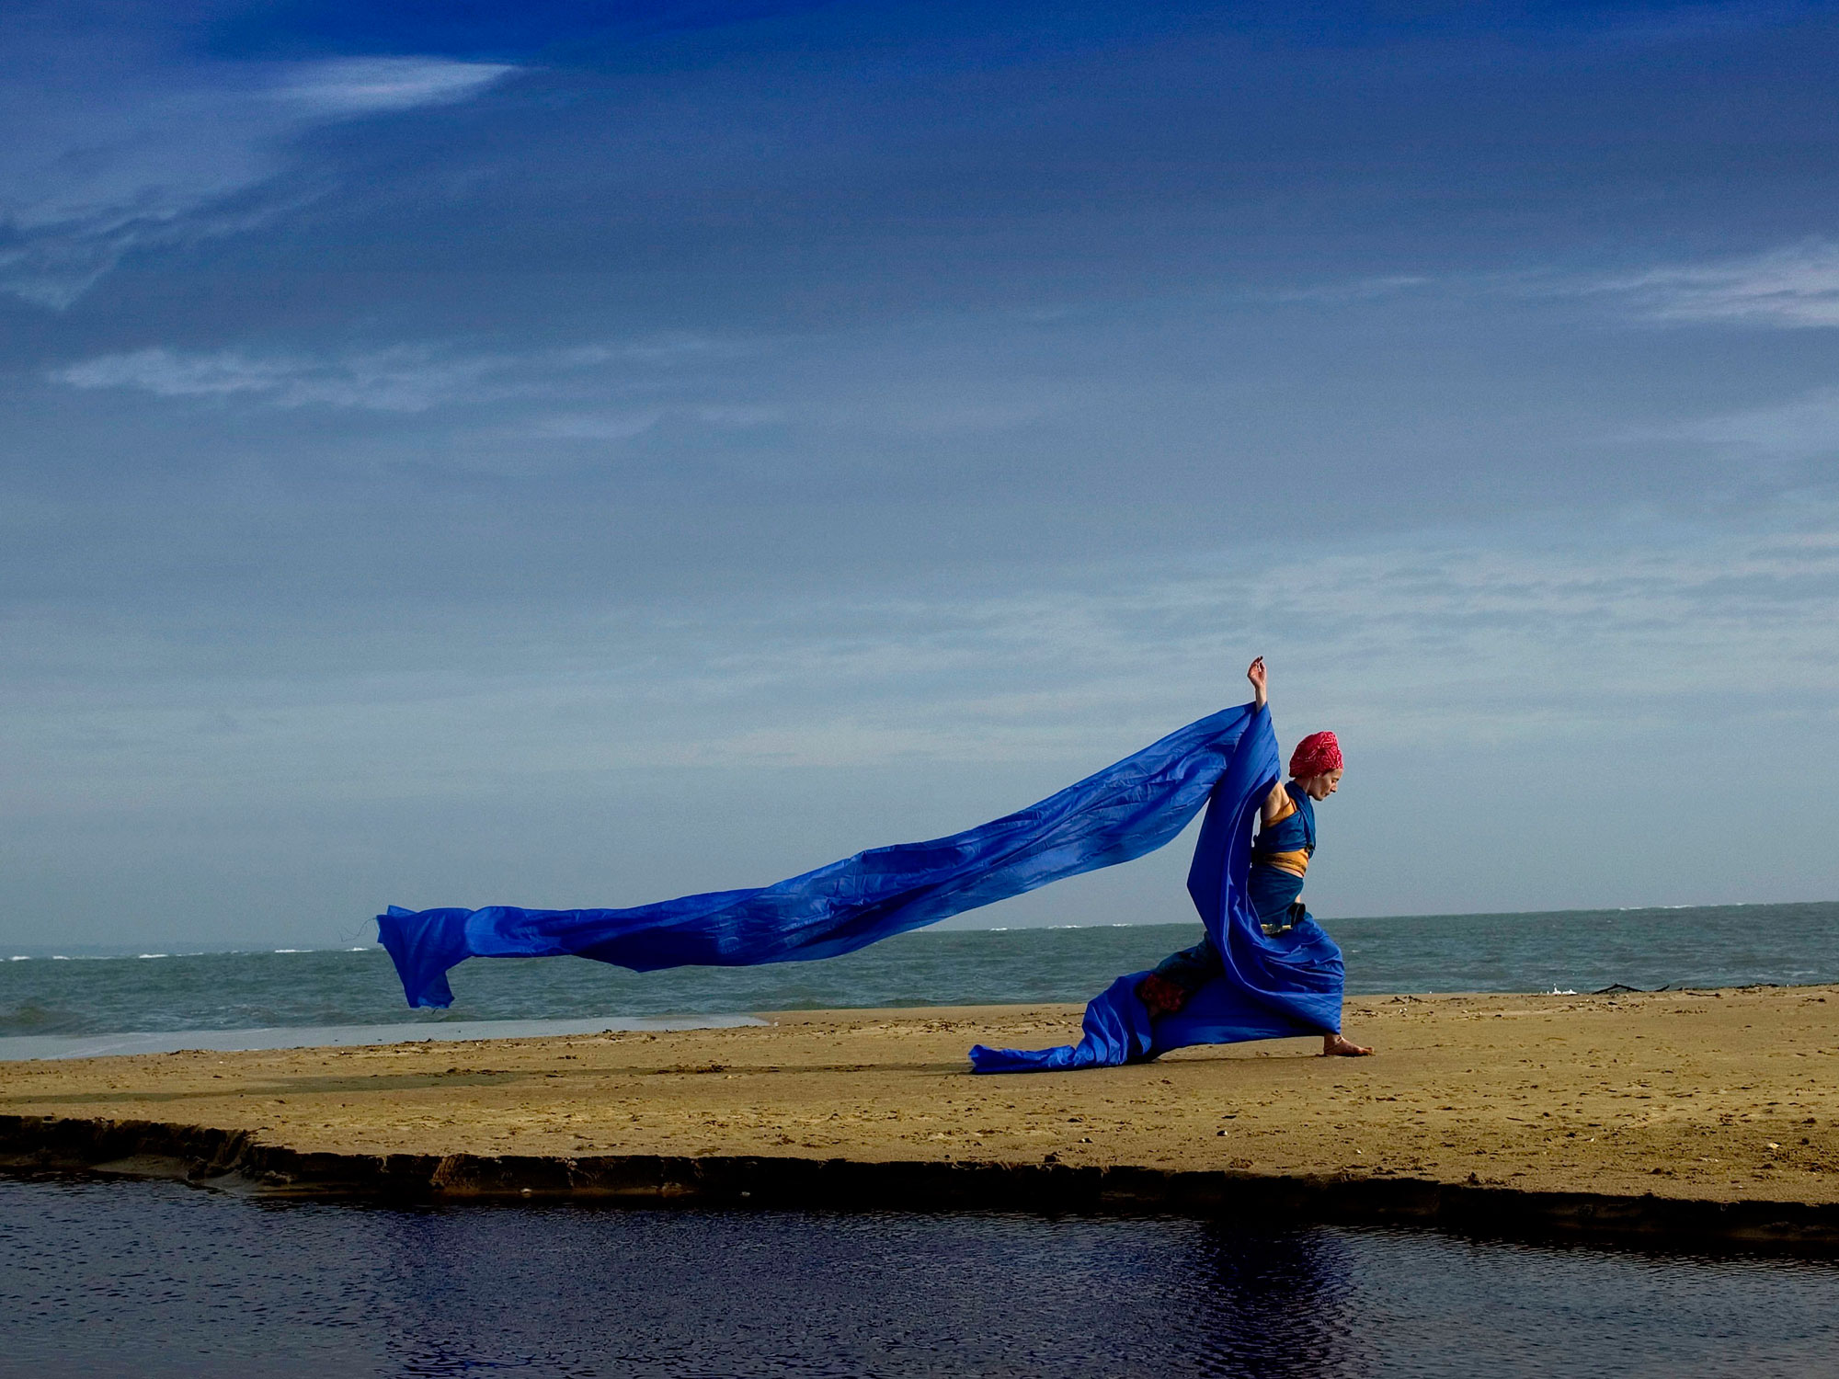
Any questions?
Debbie Fionn Barr taking part in Dance SCAPES project, Dorset
Photo: Kevin Clifford

Slide 27
Thank you
Email:
Philip.cave@artscouncil.org.uk

Slide 28
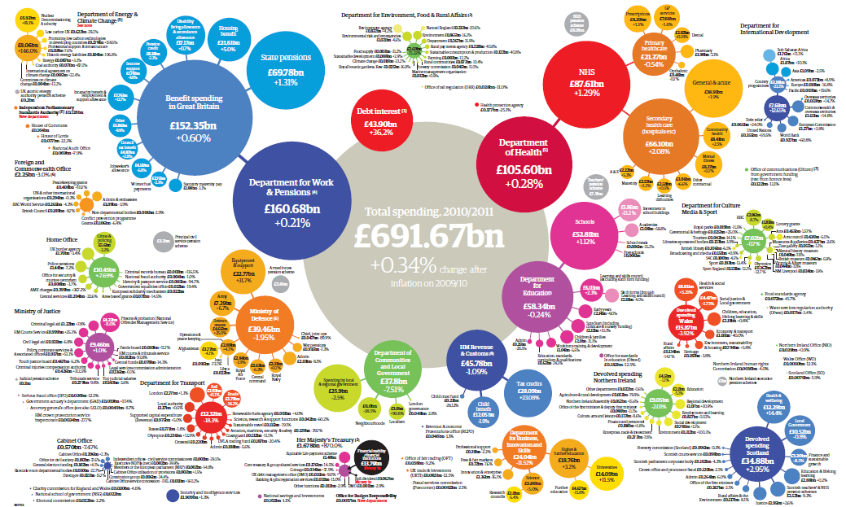
Our settlement from government
Notes:
This diagram represents the entirety of government spend in the UK. The size of the circle is the size of spend.
The green dot on the left represents funding to DCMS (see over).
Our goals are:
Excellence is thriving and celebrated in the arts,
museums and libraries
Everyone has the opportunity to experience and
to be inspired by the arts, museums and libraries
The arts, museums and libraries are resilient
and environmentally sustainable
The leadership and workforce in the arts, museums
and libraries are diverse and appropriately skilled
Every child and young person has the opportunity
to experience the richness of the arts, museums
and libraries

