Slide 1
Creation of large flat floor learning space Workshop 1. Bev Robinson ESS Pam Woolner ECLS Ulrike Thomas ECLS Georgina Robson ESS 13th January 2014

Slide 2
Large flat floor learning space
2 workshops
13th January 2015
To consider what we would like and how we could use such a space.
3rd February 2015
Feedback on designs developed following ideas generated in the January workshop
Student consultation
A workshop open to all students to input into the design ideas generated from today’s workshop
A workshop with architectural students to explore the ideas and designs from todays workshop.

Slide 3
Large flat floor learning space
13th January 2015 Workshop Participants
Over 120 people invited to attend today or provide email input -
36 responses – 9 academics & 13 professional support staff attending today
Academics who have been involved in/shown an interest in exploring different ways of delivering learning and teaching
Equate project
Learning and Teaching Conference Keynote session
Director of Excellence in Learning and Teaching
ESS design refurbishment working groups
Word of mouth
Libraries
Conferencing
Exams
Research institutes
Professional Services
Estates Planning and Improvements
NUIT Audio visual services, computer cluster support team
Estate faculty co-ordinators
Learning Teaching and Development Services
Time tabling team

Slide 4
Large flat floor learning space
Large room for learning that provides some flexibility for working with large groups of people. i.e. not a fixed rake lecture theatre
Capacity 150 people plus?
What could you/would you use this type of space for?
What do you need in this space to support it?

Slide 5
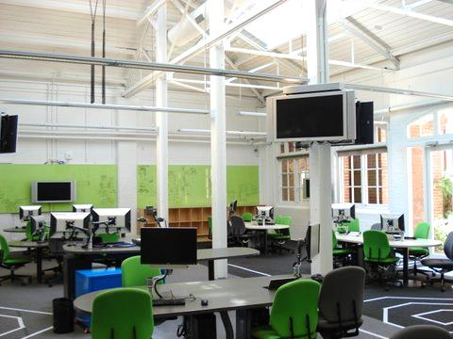
Large flat floor learning space
What/who is it for?
Engineering Lab Melbourne University

Slide 6
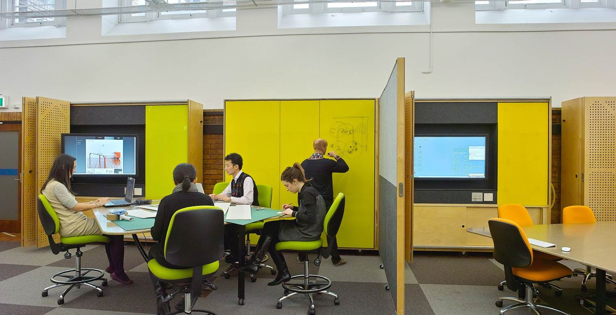
Large flat floor learning space
Multi use? How adaptable does the space need to be? What else is required to support this?
Melbourne University

Slide 7
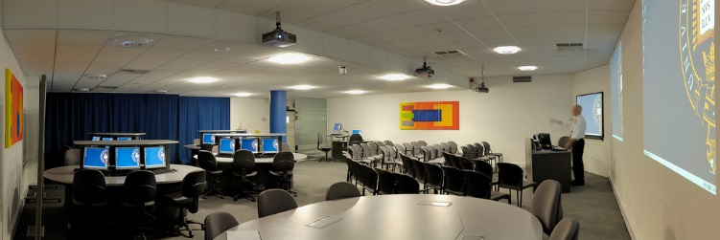
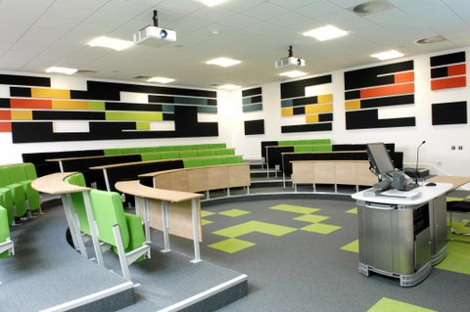
Large flat floor learning space
Daylight or no daylight
Warm or cool
Bright or calming

Slide 8
How could a big flat floor HE space be used for effective learning and teaching?
In groups and using the materials provided generate two or three room layouts to demonstrate how a large flat floor teaching room could be used by yourselves, your school, your faculty, the University.
What do we want to do in there?
Who is for? Primary users.
What would we need?
What furniture?
What technology?
What environment – daylight, ventilation, heating, acoustics
What support spaces might we need? –storage?
What resource/support would the space need?
Have you seen any spaces anywhere that provide and example of what would be good?

Slide 9
Large flat floor learning space
What Next:
We’ll take away the proposals and analyse the key uses and requirements
Sketch up some options based on the above
Share these with all who have registered and interest
2nd Workshop on Tuesday 3rd November 2pm -3.30pm gain feedback on the proposals
Meet with students and discuss the proposals with them

