Slide 1


Dr Shaheda Ahmed
Scientific Manager

Slide 2



Introduction to Alcyomics
Alcyomics Ltd provide solutions for pre-clinical drug safety and efficacy testing as well as chemical and cosmetic safety assessments.
Our aim is to work with our clients to get the best possible solution to their safety and efficacy problems
Pharma
Chemical
Cosmetic

Slide 3
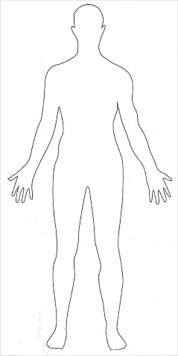
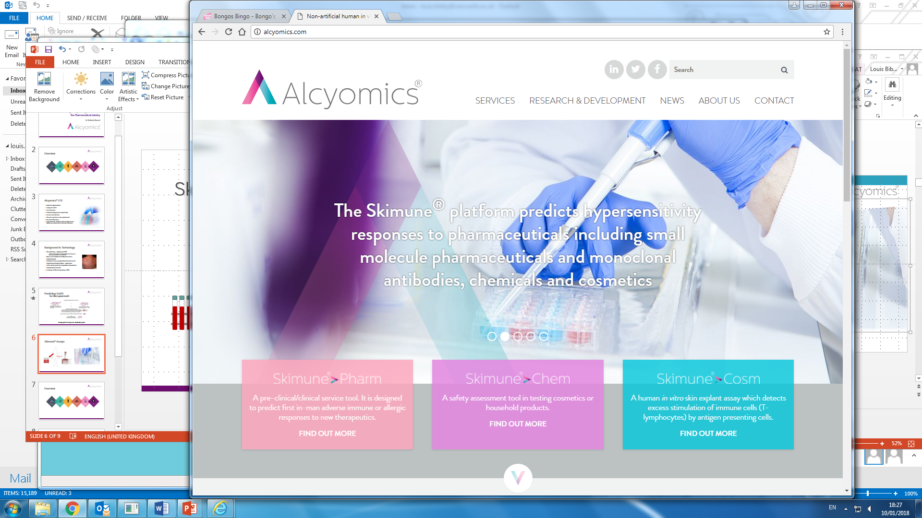
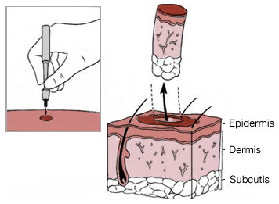
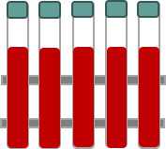
Skimune® Assays
Our tests use blood & skin biopsies
from healthy volunteer donors
Human in vitro test

Slide 4
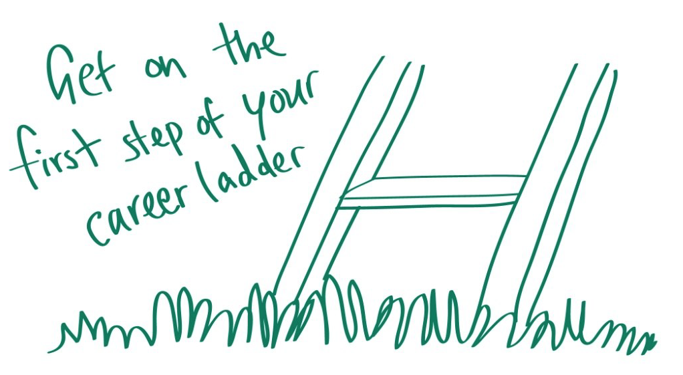
Internship opportunities

Slide 5

What can Alcyomics offer?
Hands on research experience and training
Exposure to a exciting and challenging scientific work environment
Set of skills, technical, communication, time management and leadership
Test personal attributes, abilities, and interests in relation to your career choice and job demands
Integrate and complement academic studies with the on-the-job professional level experience
Experience the different divisions of a business e.g. R&D, marketing, sales, business development, scientific writing
Contribute to projects, client studies, research analysis and innovative ideas
Participate in meetings and conferences and network with a variety of industry and academic professionals

Slide 6

Self management
Communication
Teamwork
Problem solving
Creativity & innovation
Taking responsibility
Commercial/business awareness
Time management
Decision making/initiative
Interpersonal skills
Motivation/drive
Flexibility/adaptability
Organisation/planning
Project management

Slide 7

Where are our previous interns now?
Intern 1- Scientific event management
Intern 2- Intellectual Property
Intern 3- Scientific sales
Intern 4- PhD
Intern 5-
Define direction for post-graduate studies, explore strengths, strong direction to career options

Slide 8
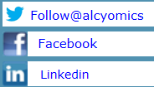
For more information email:
shaheda.ahmed@alcyomics.com
or visit our website:
www.alcyomics.com

