Slide 1
Understanding, finding and demonstrating additionality for REF2021
Sumi David, University of Exeter
Bella Reichard, Newcastle University
Juergen Wastl, Digital Science

Slide 2
Understanding “Additionality”
Sumi David, University of Exeter

Slide 3
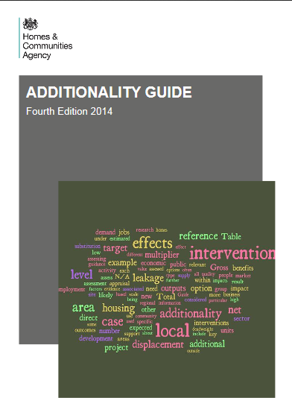
The UK Government (Economist’s) view of “Additionality”
Additionality is the extent to which something happens as a result of an intervention that would not have occurred in the absence of the intervention.
Additionality Guide, 3rd edition

Slide 4
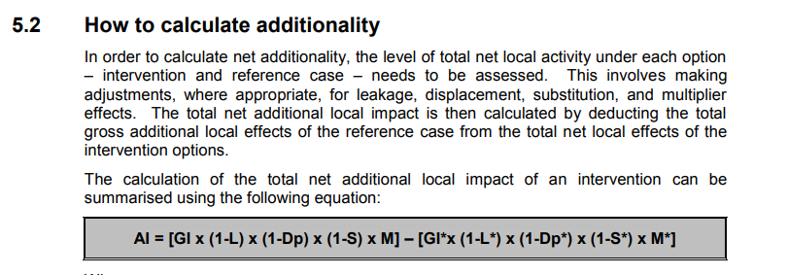
The UK Government (Economist’s) view of “Additionality” in a local economic growth context….
Deadweight: An assessment of which outputs and outcomes would happen even if you did nothing.
Leakage: The proportion of outputs that benefit those outside of the intervention’s target area or group.
Displacement effects and Substitution effects

Slide 5

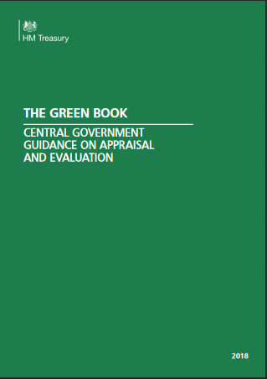
Treasury evaluation guides
Impact assessment (heavily simplified):
an overview of costs and benefits
Types of impact expected at the outset?
What was the baseline?
What were the outcomes?
Are there significant unintended effects?
Could it have happened anyway?
The counterfactual: can we describe what would have happened without it?

Slide 6
Planning and monitoring added-value
Logic models and similar
Theories of change?
Can there always be a baseline? Is there a useful proxy?
Is there always a counterfactual?
Planning for the serendipitous??

Slide 7
Whose “added value”?
The researcher?
The contributor/collaborator/co-creator?
The participant?
The intended beneficiary?

Slide 8
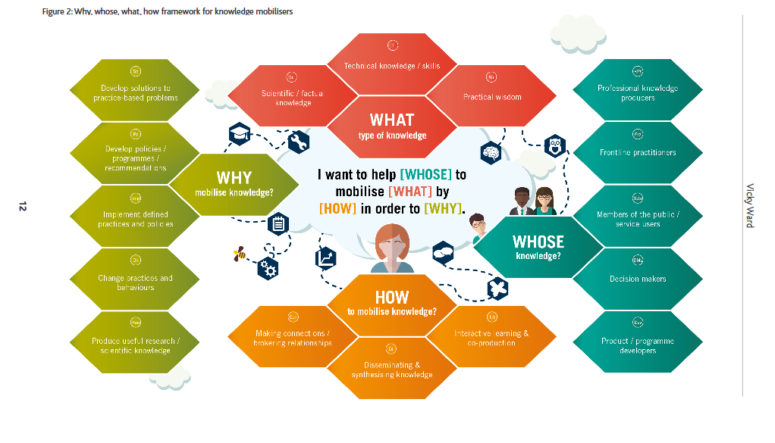
Vicky Ward, “Why, whose, what how framework for knowledge mobilisers” https://core.ac.uk/download/pdf/42625436.pdf

Slide 9
Articulating added-value
Evidence
Context
Creativity in expressing the intangible
The vignette – the single story to exemplify the many

Slide 10
Language in REF2014 Impact Case Studies - What additional knowledge can we use for 2021?
Bella Reichard, Newcastle University
With thanks to Mark Reed, Newcastle University
b.reichard2@ncl.ac.uk; Twitter: @bellareichard

Slide 11
Linguistic analysis
124 “high-scoring” (4*) case studies
93 “low-scoring” (1* or 2*) case studies
includes only the “text” sections 1, 2, 4 – excludes sections 3, 5 (references)
Which 2,3 and 4-word combinations appear more frequently in high- or low-scoring case studies?
Readability analysis (Coh-Metrix)
…plus findings from thematic analysis

Slide 12
1. Highlighting Significance
High
Low
Official endorsement for significance: Government, parliament, official bodies e.g. WHO
Describing or contextualizing scale: millions of, long term, more than
Hardly any phrases about significance that appear more often in “low”
Vague, buzzwords: policy and practice; a range of, a number of

Slide 13
2. Highlighting Reach
High – specific,
high-magnitude
Low – vague,
low-magnitude
Many phrases involving “UK” or “US”
-> Sub-national impact can still have wide “reach” – but this needs to be contextualized (e.g. poetry festival attracted “double the number” that is usual in the area)
Phrases involving “national” or “international” (indicating generalisations – “high” more likely to list specific countries)
Phrases involving “local”

Slide 14
3. Establishing links between research and impact
High
Low
resulting in
led to the
cited in
used the
was used
-> mostly used in Section 4 “Details of the impact”
-> clear causal links
has informed (Sections 1 and 4)
of the research (Sections 2 and 4)
-> more vague, potentially causal links
Link research to impact, rather than to other research or to pathway

Slide 15
3. Establishing links between research and impact
Deep cohesion (Coh-Metrix)
Causal connectives (“because”, “so”) – significantly more often in High in Main Panel C and D
High: above average of general English texts
Low: below average
Disciplinary difference – Main Panel A seems to make more causal links explicit than Main Panel D

Slide 16
4. Style – Logical connections
Connectivity (Coh-Metrix)
Logical relationships (“and”, “but”, “or” etc.): very low compared to general texts, but even lower in low-scoring case studies (Main Panel A/C)
-> making these explicit leaves less for the reader to infer

Slide 17
4. Style - Easy to read?
Flesch Reading Ease
Common measure
based on word- and sentence-length
the higher the score, the easier to read
Main Panel A: harder to read than Main Panel C/D
Main Panel C/D: "low" significantly harder to read than “high”

Slide 18
4. Style – use of adjectives
Good example
Inappropriate use
Some High used few/no adjectives -> factual impression
Adjectives used in testimonials -> 3rd-party endorsement for the quality of the claim
Issues in 38% Low (vs 20% High), e.g. overclaiming or vague use
e.g. "substantial" on its own gives impression that precise figures are either not available (why?) or not high enough to be reported

Slide 19
Summary – Impact Case Studies should…
Be specific: What has changed? Who benefits?
Include explicit links between the research and the impact, with evidence but not too much detail to distract from the impact
Focus on the reach and significance of the impact; where “reach” is not geographically impressive in the context of the Unit of Assessment, it should be explained in what ways it is impressive
Be easy to read, with causal and logical relationships made visible

Slide 20
Where to get more details?
Post on Fast Track Impact blog:
https://www.fasttrackimpact.com/single-post/2017/12/19/What-makes-a-4-research-impact-case-study-for-REF2021
Look out for our paper:
Reichard B, Reed MS, Chubb J, Hall G, Jowett L, Peart A (in preparation) Pathways to a top-scoring impact case study. Submitting to Palgrave Communications

Slide 21

Additionality… or: The case of Continued Case studies?
?
Juergen Wastl, Digital Science
Director Academic Relations and Consultancy
j.wastl@digital-science.com
Twitter: @juergen_wastl

Slide 22
Additionality… or: The case of Continued Case studies
A premier and a nuisance:
Definition & Refinement… and first time use in REF2021
Analysis of REF2014 Impact
How to find continued impact?
How will it be used in REF2021?

Slide 23
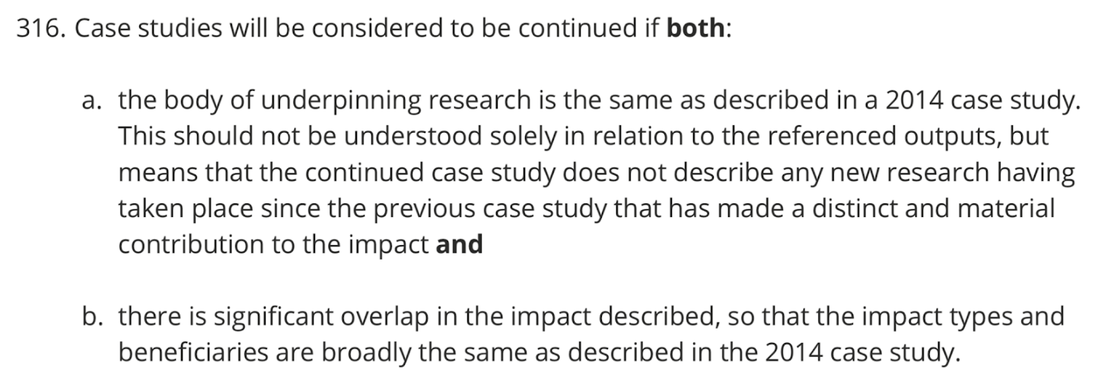
Definition of continued case studies/impact
A Premier:
Continued case studies:
Guidance (paragraphs 314 to 317)
Panel criteria (paragraphs 292 to 295)
Inform your decision making by answering the question: what happened to previous underpinning research from 1st August 2013?
NB: Body of 22k doi REF 2014 underpinning research
(Digital Science curated and mapped these for HEFCE/Research England and the impact DB) https://impact.ref.ac.uk/casestudies/

Slide 24
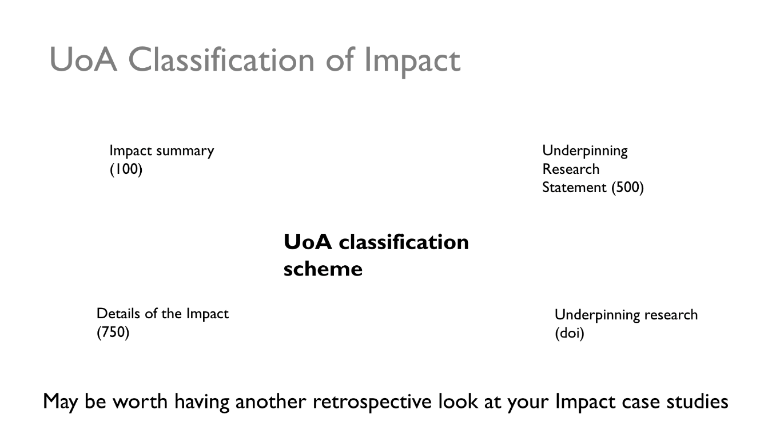
Analysis of REF2014 Impact
Another way looking at it…
Analysis of the Impact Narrative and underpinning statement

Slide 25
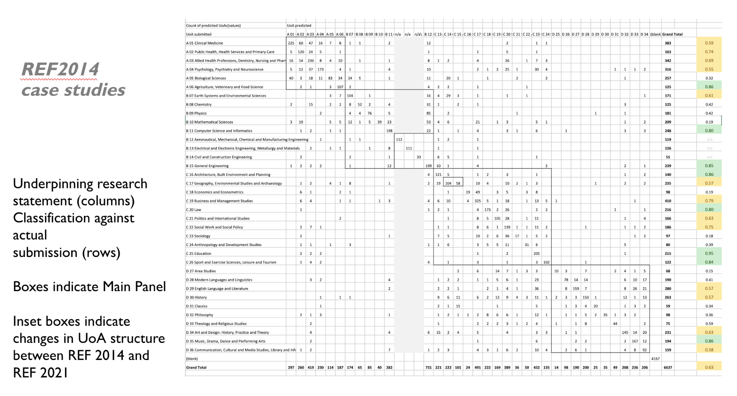

Slide 26
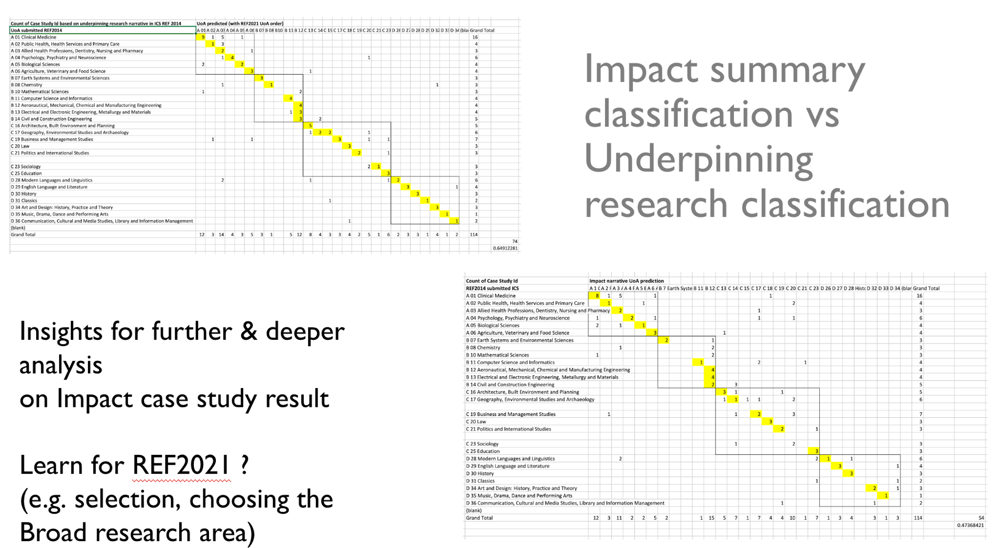

Slide 27
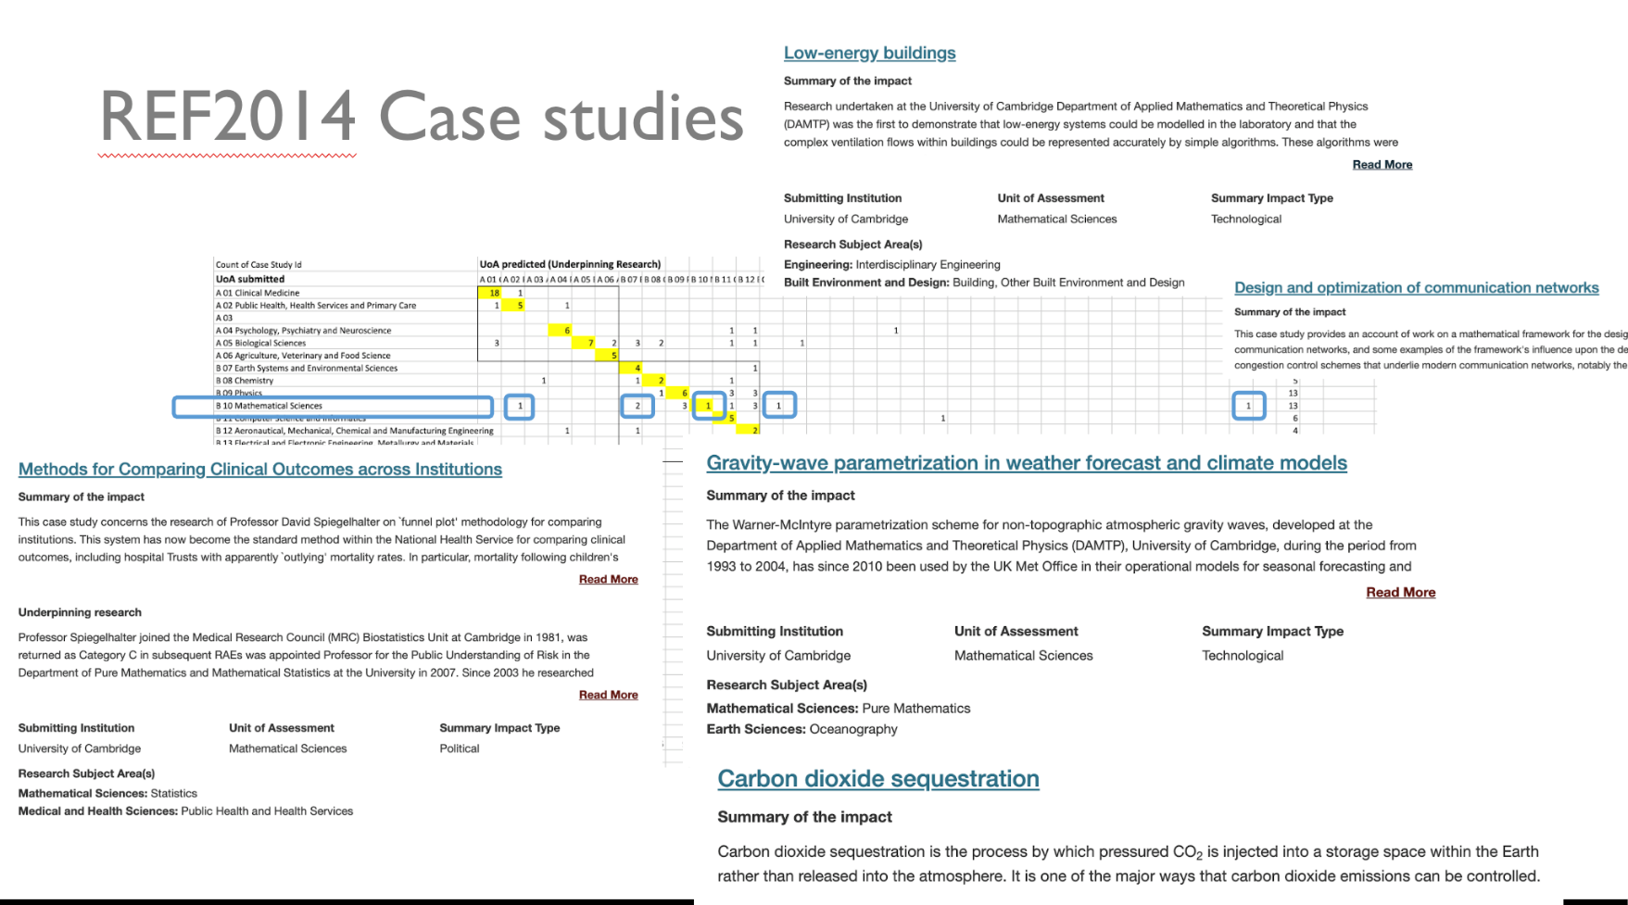

Slide 28
How to deal with continued case studies
Submit: yes or now?
Submit: different UoA?

Slide 29
How to make an informed decision
A Nuisance: Finding evidence
Patent citations, policy mentions, News and blogs and more
using Altmetric Explorer to find links corroborating evidence of impact.
For underpinning research for envisaged case studies:
What happened throughout the eligible time frame (all outputs) ?
What happened to your RAE2008 & REF2014 (and MOCK REF 2021) outputs?

Slide 30
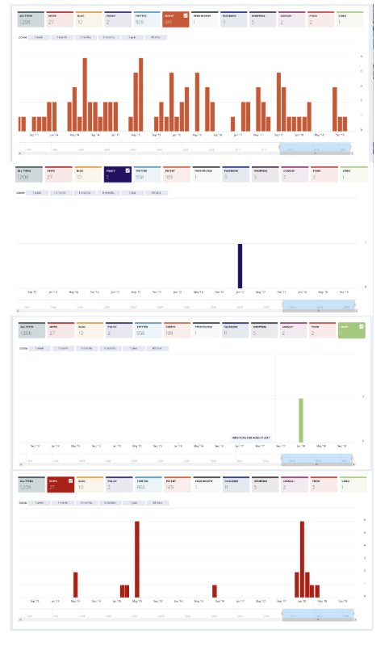
Altmetric Timeline of mentions
Create reports from saved searches for:
Departments
Researchers
UoA
For underpinning research:
past
current
forgotten

Slide 31
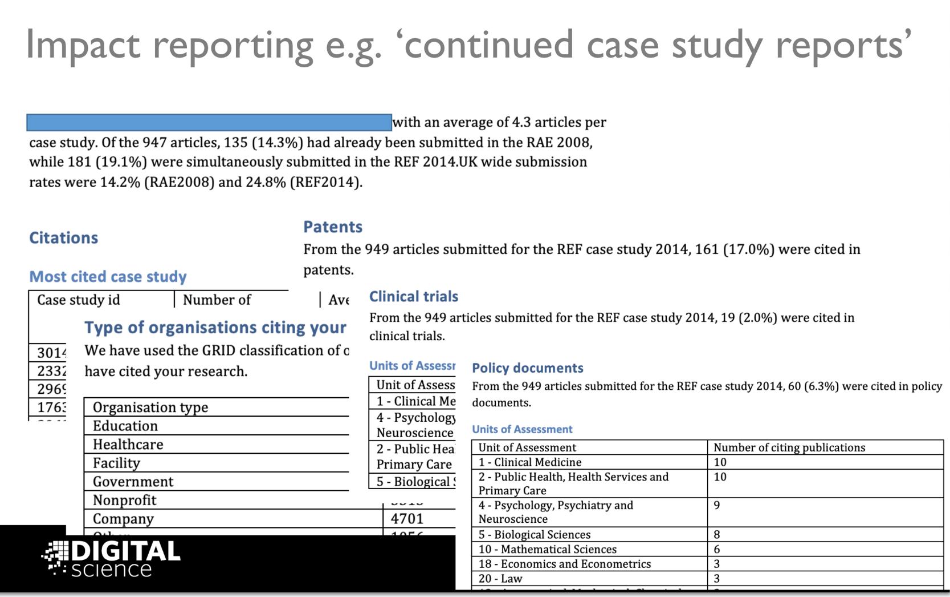

Slide 32
Will continued case studies be used in REF2021?

