Slide 1
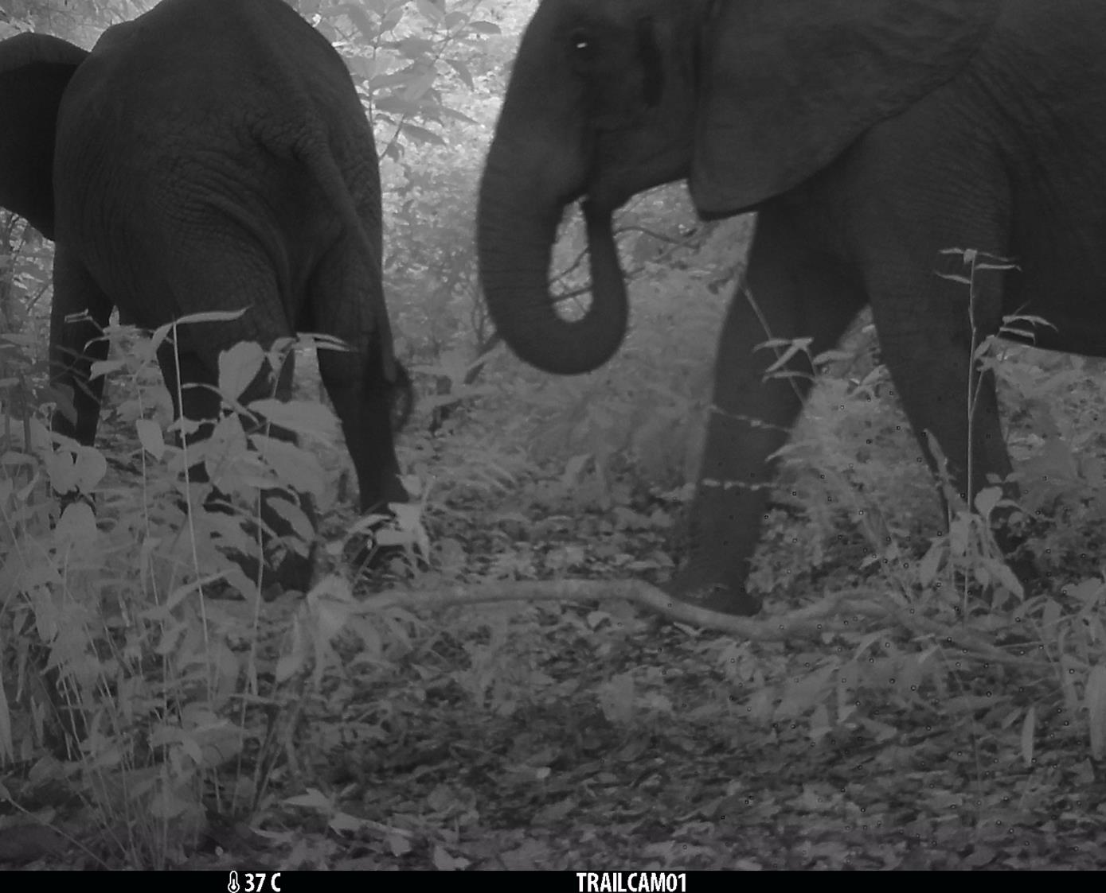
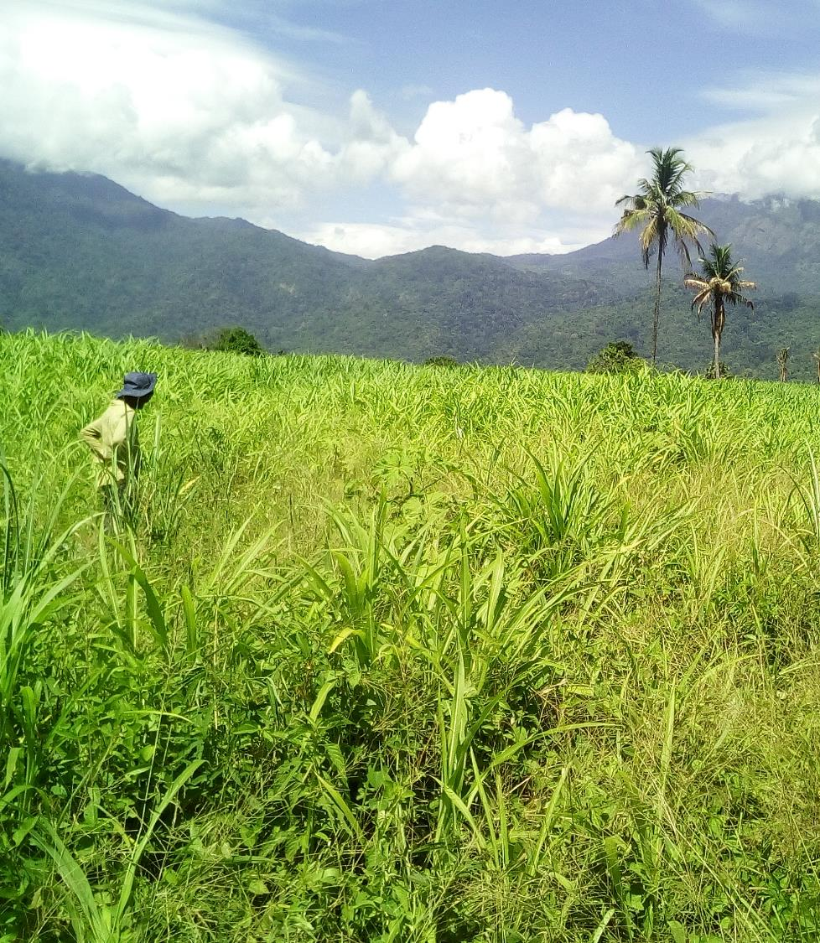
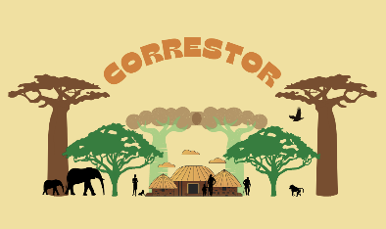
Restoration for biodiversity, wellbeing and climate change mitigation in tropical forest-agricultural landscapes
Marion Pfeifer, Susannah Sallu, Eleanor Moore, Deo Shirima, Lauren Barnes, Andrew Marshall, Margherita Lala

Slide 2
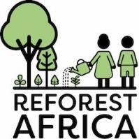
Key funding by
Core team members
Add on funding by
Partners
Natural England

Slide 3
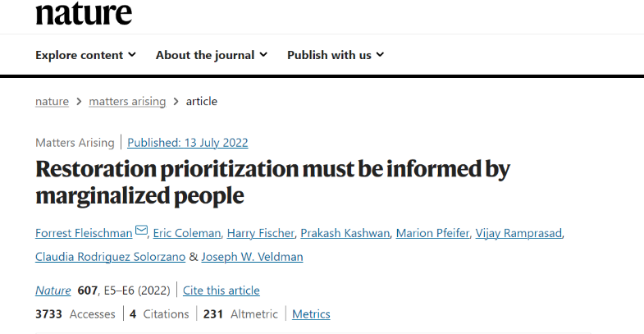
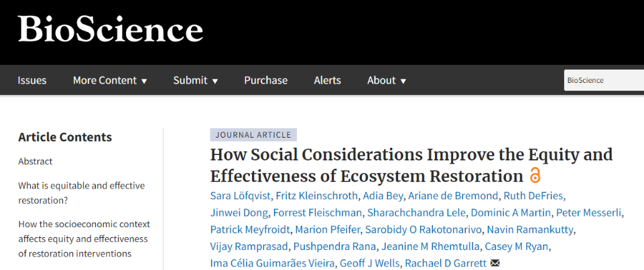
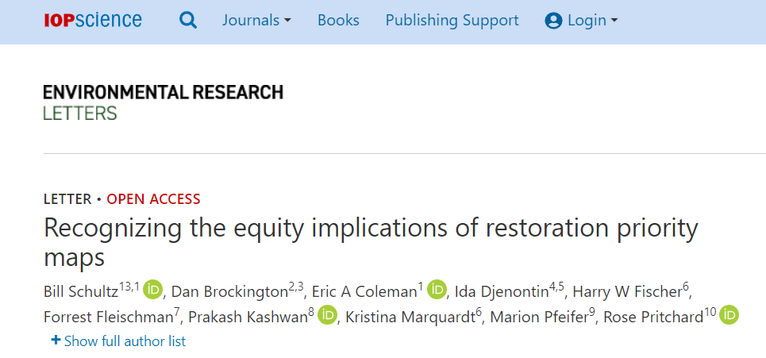
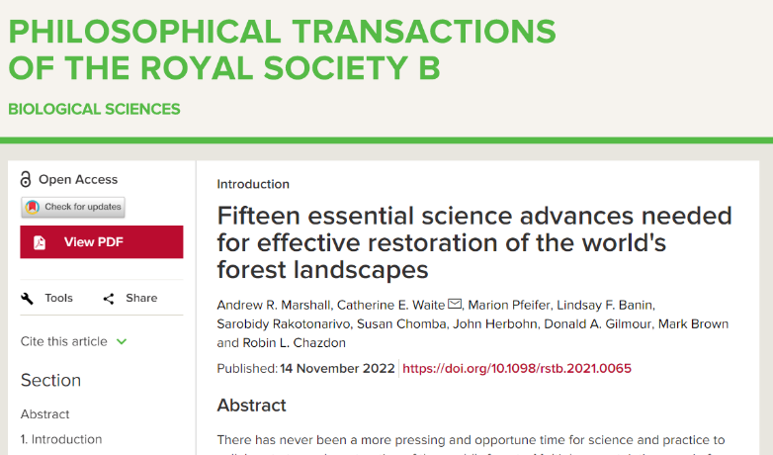
Restoration for biodiversity AND people

Slide 4
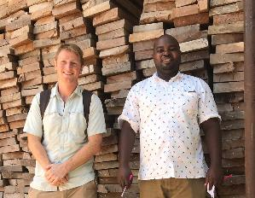
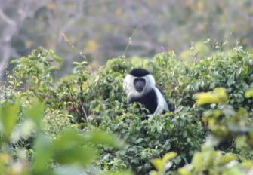
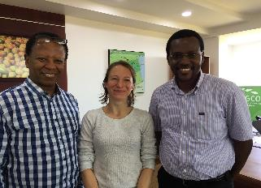
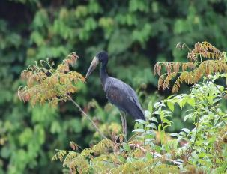
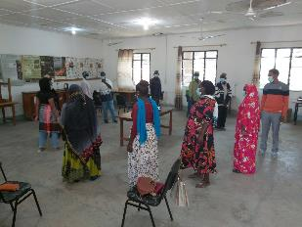
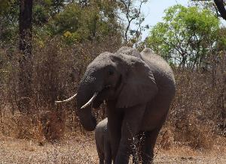
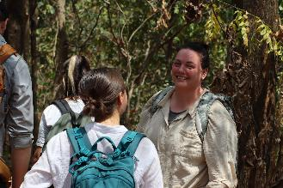
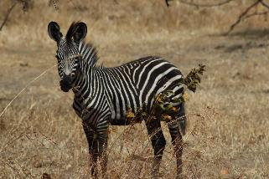
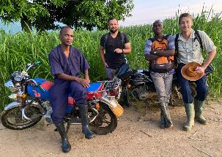
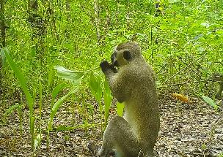
How to do bottom-up restoration?
“A just and effective approach to restoration begins by working with the people who live on and make a living from the land to identify their priorities for restoration.”
But what does it mean and how do we make this work for people AND biodiversity?

Slide 5
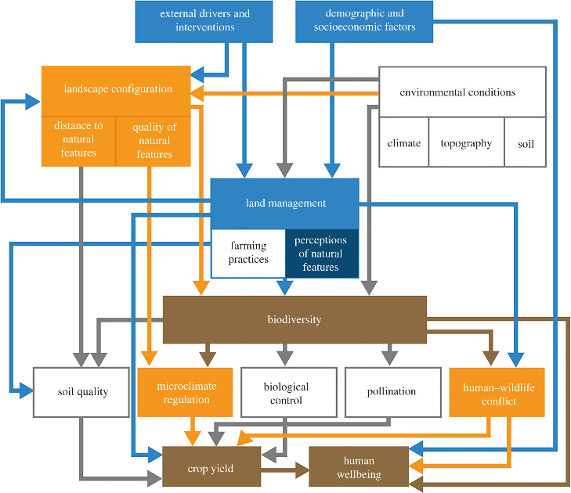
Using a systems approach framework as a tool
We developed it for rural farmed landscapes as a guide for planning, monitoring & adapting restoration projects. It provides clear indicators and integrates biophysical with social pathways in ways that can be measured & modelled
Governance and adaptive management are included as external drivers and interventions
Changes in landscape configuration, environment and land management predict outcomes for biodiversity and people
Understanding of pathways and mapped predictions allow engagement with partners in the landscape for decision-making, planning, evaluation
Guerreiro – Milheiras et al. 2022 Front Forests Global Ch, Pfeifer et al. 2022 Phil Trans Roy Soc B

Slide 6
Using a systems approach as a tool
Changes in landscape configuration, environment and land management predict outcomes for biodiversity
Schneider-Maunory et al. 2017 Biol Conserv, Pfeifer et al. 2017 Creation of forest edges has a global impact on forest vertebrates. Nature; Wearns et al. 2019 J Animal Ecol; Betts et al 2019 Science; Watling et al. 2020 Ecol Lett
And for microclimate
Hardwick et al. 2015 Forest Agric Meteor; Pfeifer et al. 2019 PeerJ
And for human – crop - wildlife interactions
Lauren Barnes (Elephants, MBiol), Becca Sargent (Lions, PhD)

Slide 7
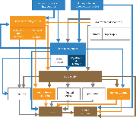
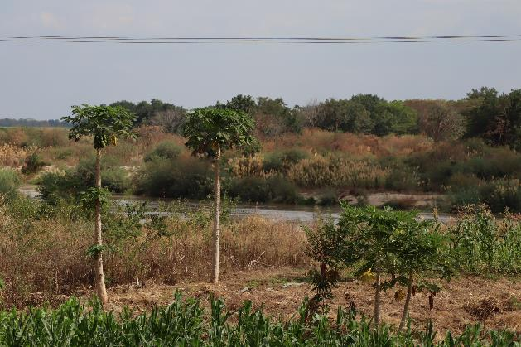
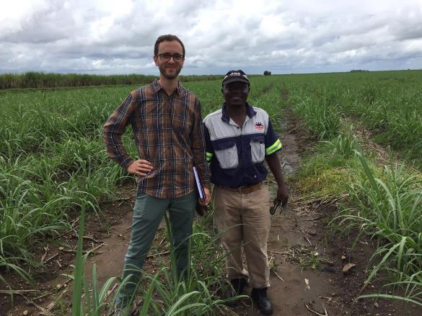
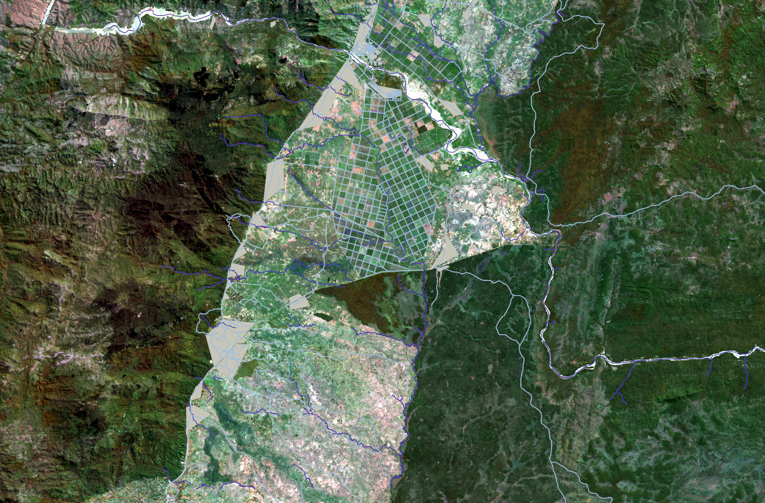
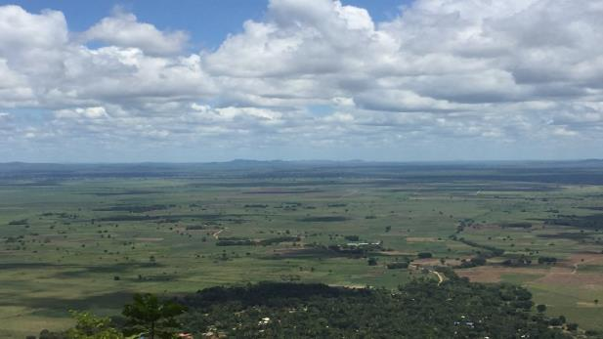
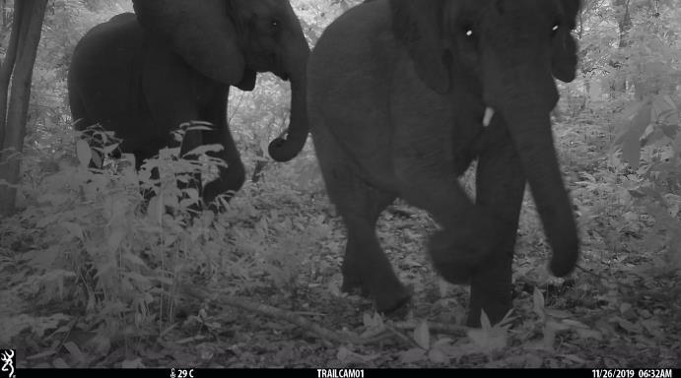
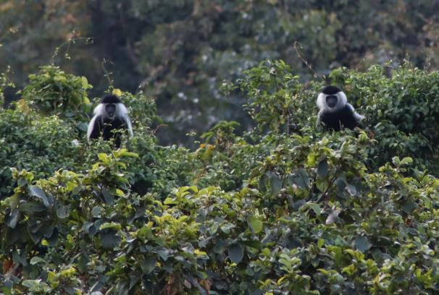
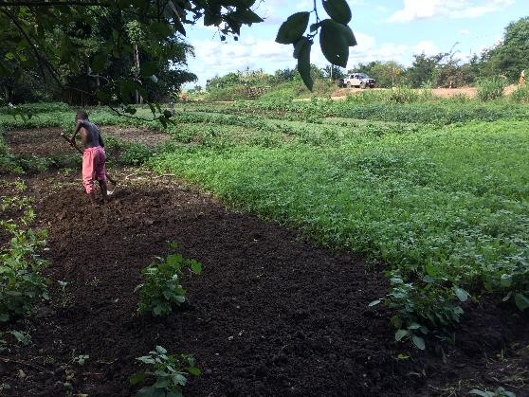
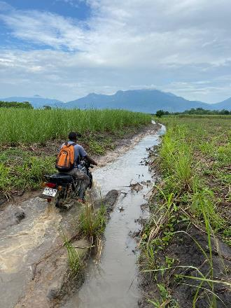
Applying the tool: case study in Tanzania

Slide 8
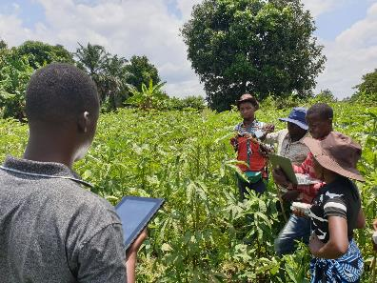
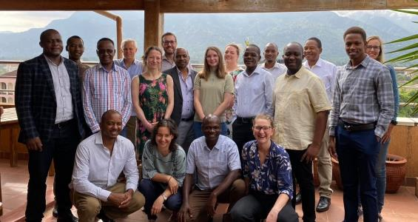
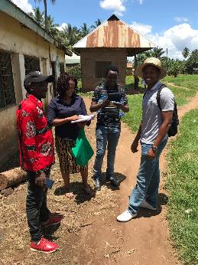
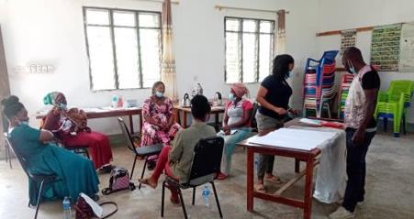
Data collection teams sent out 2019 – 2021
Ecological data collection:
Microclimate sensor stations
Camera traps
Bird surveys
Vegetation, soil & insect plots
Crop damage (elephants)
Social data collection:
Inception meetings
Household surveys
Interviews
Farmer focus groups
Government focus groups
Knowledge exchange events

Slide 9
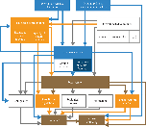
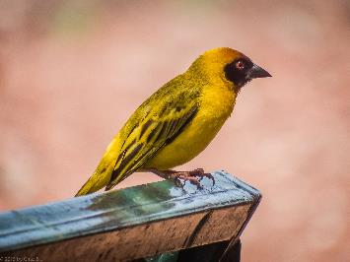
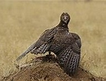
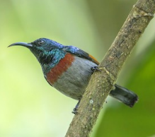
Plenty of biodiversity insights: lda models
Kilmbero Weaver
Key message 1: birds like the complex small-holder farmed parts of the landscape.
The intensification of sugarcane production and extension towards small holder farmed land will have detrimental effects on the number of bird species unless it is carefully managed for.
Management needs to focus on retaining access to trees and other natural / seminatural habitat features. These currently are primarily found along water ways (rivers, creeks, channels).
Martial eagle
Rufous-winged sunbird
Key message 2: the intensification of sugarcane production and extension towards small holder farmed land may likely have detrimental effects on birds that could control insect pests on crops

Slide 10
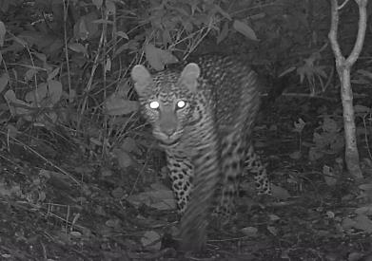
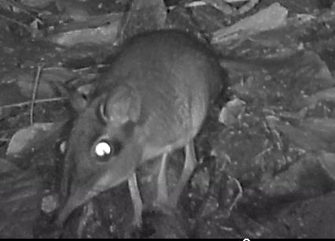
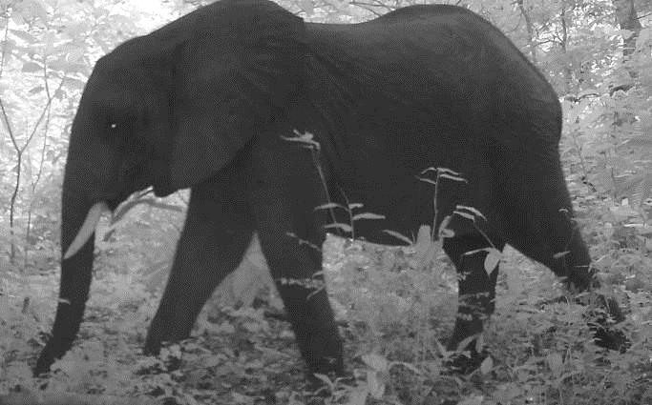
Plenty of biodiversity insights: lda models
Key message 3: Mammals require natural habitats and are primarily found in forests
Kilmbero Weaver
Martial eagle
Rufous-winged sunbird
Crop
Forest
2
8
10
8
10
Restoring tree cover habitats along rivers or along farm boundaries will benefit overall mammal diversity in the landscape
Grassland
Crop - elephant conflicts are spatially variable & more likely near forests

Slide 11
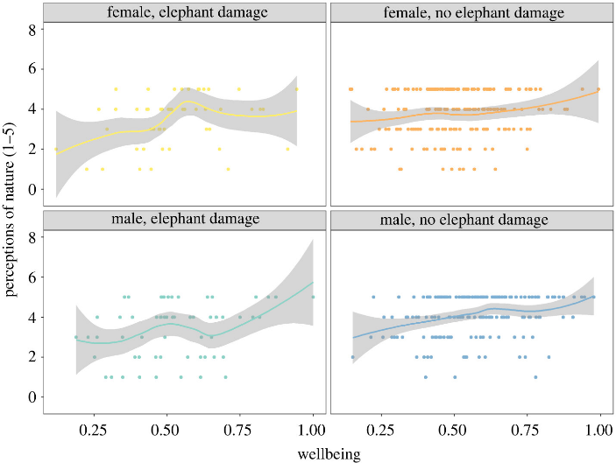
Plenty of social insights:
Perceptions of natural capital and human wellbeing
Trees feature in visions that small-holder farmers have for their farms
Ideal farm: fruit trees, firewood or for timber/construction purposes, multipurpose trees, beekeeping as income-generating activity.​
People's perceptions of nature as being of ‘high value’ increased with household wellbeing
Challenges​: High costs​. Fires because of sugarcane​, Environments for wild animals/ pests. ​Security issues:​ theft​, Reduce visibility of wild animals and farmers to other farmers​. Negative for crops

Slide 12
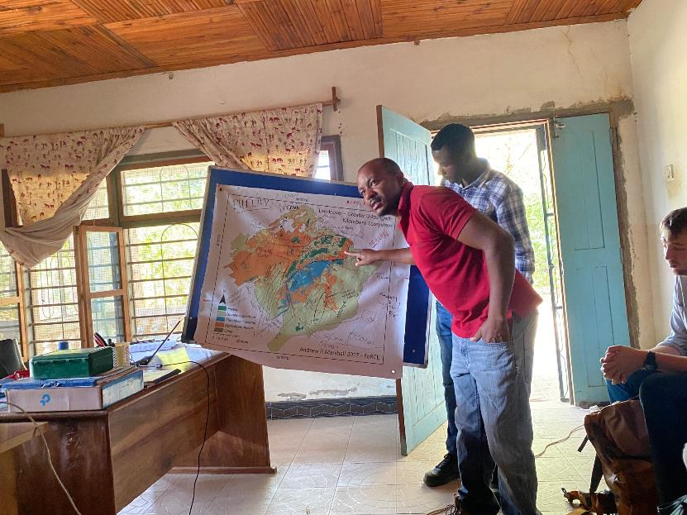
Too much too soon –who is in the driving seat?
The government’s visions views on land allocation to trees and related challenges
The NGOs interested in tree planting have funding to realise their visions already
encourage farmers ‘to adopt agroforestry and change their mindset’

Slide 13
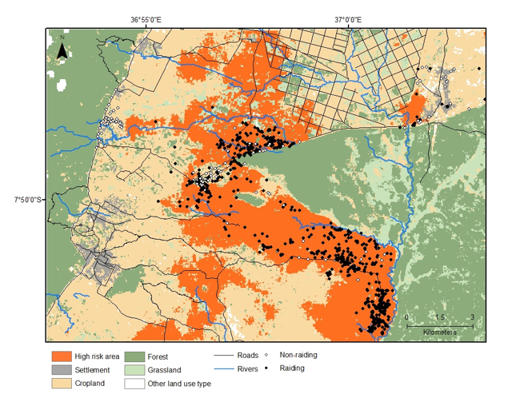
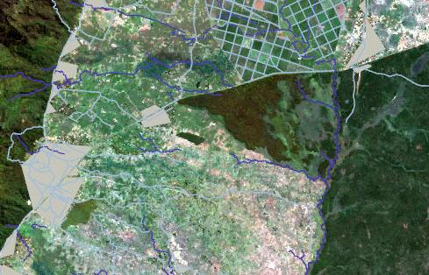
Thinking about costs to people – it matters!
The baseline risk for elephant crop raiding is spatially highly variable in the landscape but can exceed 70% for several smallholder farms.
Changing landscape configuration will alter elephant movements
Lda models predict changes in spatial locations of conflict events
Lauren Barnes, submitted to J Appl Ecol

Slide 14
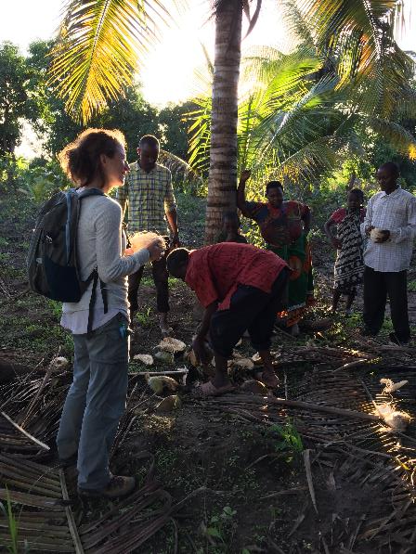
What does this mean for restoration in the landscape
How perceptions of nature's value and wellbeing will respond to changed risks (in space) will require monitoring
Tree planting outcomes for biodiversity and people depends on ‘where these trees are planted’ and ‘in what configuration’. They need to be able to reflect on the evidence and make informed decisions.
Both social and ecological data suggest that tree restoration may be perceived as beneficial – but this requires support in terms of farming advice (pest control,disease ID, tree : crop selection, tree growing)

Slide 15
What does this mean for restoration as a sector

Slide 16
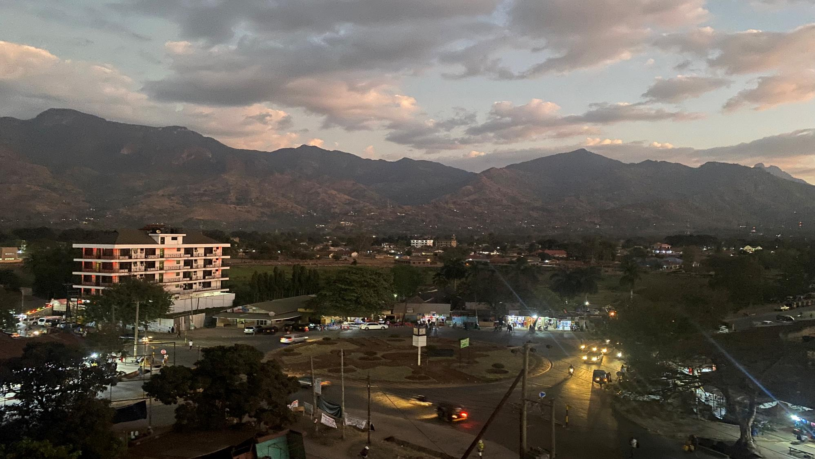
Thank you & take home messages
(1) Doing the restoration process right takes time. It requires compromise and flexibility. It requires to get the data: social and ecological.
(2) Free, informed, prior consent: dialogue with communities from planning stage onwards will be needed.
(3) If you want more trees, you need to give farmers advice/demonstration farms : how to get more yield, how to manage pests, how to plant and grow trees
(4) The restoration sector needs an independent audit system, with evaluation for (i) biodiversity and people outcomes, (ii) the process used. They should be asked to register their interests and funding, their targets and data collection (geotagged).

Slide 18
“[The word] ‘priority’ has its own urgency,” Fagan told Mongabay. “If we define areas as high priority for restoration, there’s such a mania right now to plant trees in the world that people are going to do it.”
In their rebuttal to Fleischman and Pfeifer’s critique, the Strassburg-led team wrote, “When properly planned and implemented, restoration can strengthen community bonds, create jobs, generate income and increase the provision of nature’s contributions to people.”
But to Fleischman, that aspiration can have little basis in on-the-ground reality.
“Those might be the people who have the most to gain from restoration,” he said, “but they might also be the people who have the most to lose.”

Slide 19
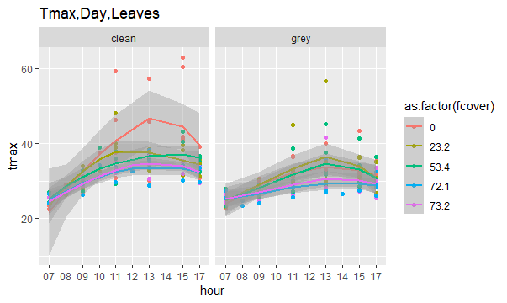

Slide 20
Title:
Restoration for biodiversity, wellbeing and climate change mitigation in tropical forest-agricultural landscapes
Abstract:
The science guiding design and evaluation of restoration interventions in tropical landscapes is dominated by ecological processes and outcomes and lacks indicators and methods that integrate human wellbeing into the restoration process. We apply a new systems approach framework for tree restoration in forest-agricultural landscapes to show how this shortcoming can be addressed. Demonstrating ‘proof of concept’, implemented as part of Agrisys Tanzania and Correstor projects, we test statistical models underlying the framework pathways with data collected from a case study in Tanzania. We predictively map how changes in landscape configuration under scenarios of restoration ((e.g. tree restoration along rivers) will alter outcomes for biodiversity, elephant:crop damage, microclimate and wellbeing. We highlight how maps with insights from system pathways and focus group discussions can be used to explore - with stakeholders - restoration opportunities and constraints at local (farm) and landscape scales that consider local knowledge and value systems and multiple outcomes.

Slide 21
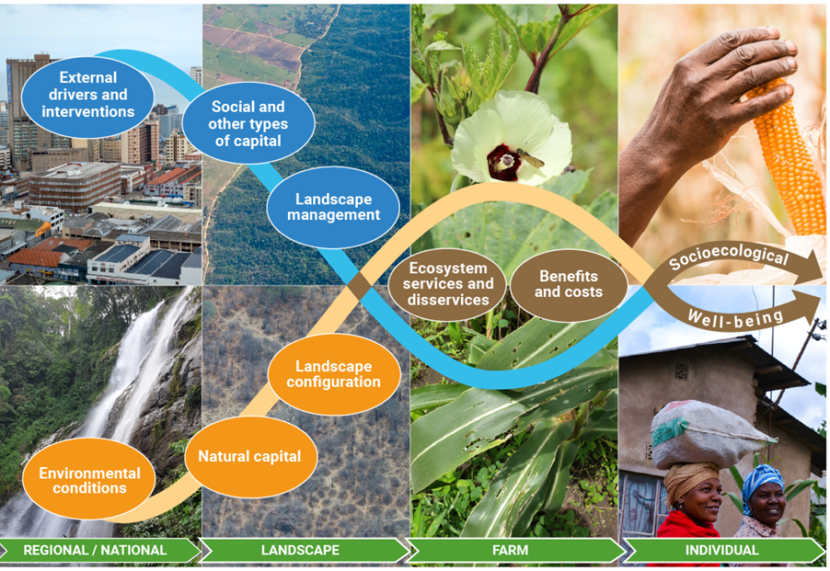
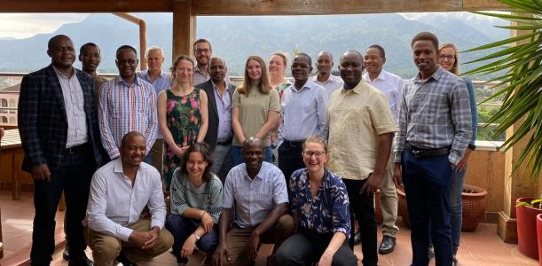
How to do bottom-up restoration?
“A just and effective approach to restoration begins by working with the people who live on and make a living from the land to identify their priorities for restoration.”
Guerreiro – Milheiras et al. 2022 Front Forests Global Ch, Pfeifer et al. 2022 Phil Trans Roy Soc B
Notes:
This is how John Cannon wrote up our thoughts in an accessible way on Mongabay on 02/11/2022.
A systems approach allows us to link elements within and across the human and natural components and to capture the complexity of interactions between them and the system drivers across scales of space, ecology and organization [19]. Applied to FLR, a systems approach could prove essential to predict synergies and trade-offs in outcomes at the food security–biodiversity–climate change nexus [20], resulting from competing demands on land and resources [21]. FLR can enhance ecosystem services and reverse biodiversity loss, but can also have negative consequences for either, if both are treated in isolation [22]. It can bring benefits to people but also real or perceived costs to their wellbeing, through effects on food security [23,24]. Costs can manifest as disservices such as crop damage from wildlife and through reduced access to land [25]. Disservices may, in turn, affect communities' perceptions on the value of trees or other natural features and thus shape decision-making on land management, thereby reshaping biodiversity and food security outcomes.

Slide 22
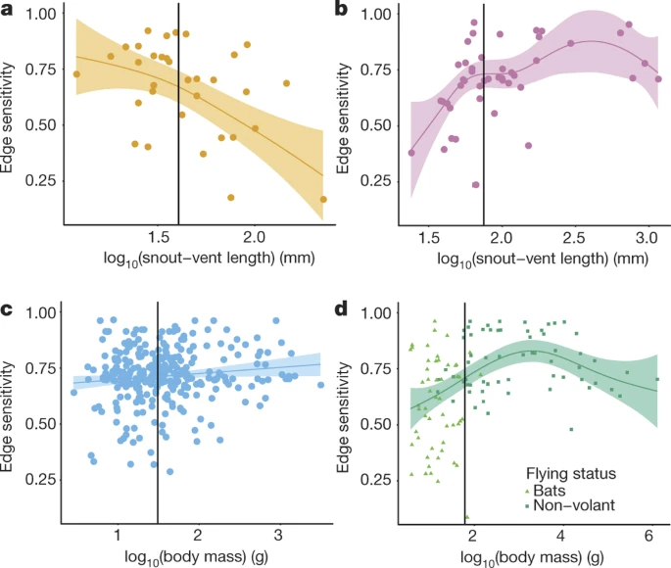
To emphasize: species have complex resource needs
Forest core dependent species only
Landscape configuration affects the abundance distribution of species. And by extension services and disservices regulated by biodiversity.
Species vary in their responses (some are generalists, some need large core areas of their preferred habitats, some are edge specialists), at least partly regulated by their traits.
Indirect and direct potential drivers: microclimate, resource availability, protection from predators, hunting pressure
Pfeifer et al. 2017 Creation of forest edges has a global impact on forest vertebrates. Nature 551
Notes:
Landscape composition: IPBES definition The distribution, size and abundances of patch types represented within a landscape. Configuration is spatially explicit because it refers not only to the variety and abundance of patch types, but also to their placement or location (dispersion) in the landscape.

