Slide 1
Anti-racism forum
7 December 2022

Slide 2
Today’s session
We will:
Learn about artists and artistic practices that deal with issues and topics raised in anti-racism work.
Listen to two interviews from the Audio Arts archive.
Discuss in pairs our responses to the interviews.
Propose actions we can take to contribute to change in the sector.

Slide 3
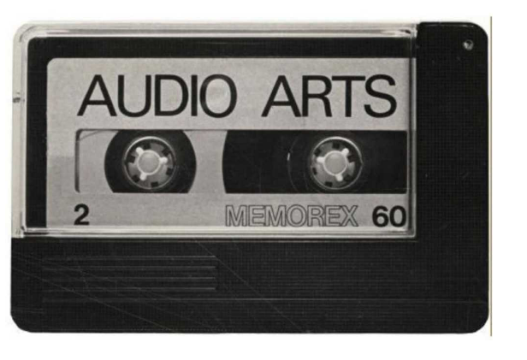
Introduction
Audio Arts archive is an audio cassette magazine initiated by artists William Furlong and Bill Barker in 1973. The magazine ran until 2006 and captured recordings of conversations with contemporary artists about their practices and exhibitions. The archive is a great source to hear about artistic practice and from artists that you might not of heard talk about their work before. The archive is digitized and can be found online via Tate website.
https://www.tate.org.uk/art/archive/tga-200414/material-relating-to-william-furlongs-audio-arts-magazine
An Audio Arts cassette - TGA 200414, Tate Archives

Slide 4
ACTIVE Listening
Close your eyes
Tune in to the sound being played.
Try to focus beyond what is being heard to what is being said.

Slide 5
Rasheed araeen
‘From Two Worlds’, Whitechapel Gallery, 1986

Slide 6
From Two worlds
Artists included: Rasheed Araeen, Saleem Arif, Franklyn Beckford, Zadok Ben-David, Zarina Bhimji, The Black Audio Film Collective, Sonia Boyce, Sokari Douglas Camp, Denzil Forrester, Lubaina Himid, Gavin Jantjes, Tam Joseph, Houria Niati, Keith Piper, Veronica Ryan, and Shafique Uddin
Curated by: Nicholas Serota and Gavin Jantjes
Date: 1986
Location: Whitechapel, London and Fruitmarket Gallery, Edinburgh UK
Significance: “From Two Worlds was a major undertaking and was at the time the most substantial exhibition of Black artists’ work at a major London gallery to have taken place. Predictably perhaps, it featured the work of a number of relatively prominent Black artists. However, it also featured the work of a number of other artists, whose inclusion was perhaps less predictable, thereby representing an intriguing mix of practitioners. The exhibition also generated a significant amount of press coverage.” (source: diaspora-artists.net)

Slide 7
https://www.fruitmarket.co.uk/archive/from-two-worlds/

Slide 8
https://www.tate.org.uk/art/archive/items/tga-200414-7-3-1-27/audio-arts-volume-8-nos-2-3 running time: 09.52

Slide 9
What are the points covered by Rasheed and Bill?
Do you agree with what they are talking about?
Tell your partner why you do or don't agree.
Tell your partner about something that stood out to you during their conversation?
In your experience, what has changed since 1986 in the context of what Rasheed and Bill were discussing?
In your view, what hasn't changed since 1986 in the context of what Rasheed and Bill were discussing?
What might you be able to do, to help change this?

Slide 10
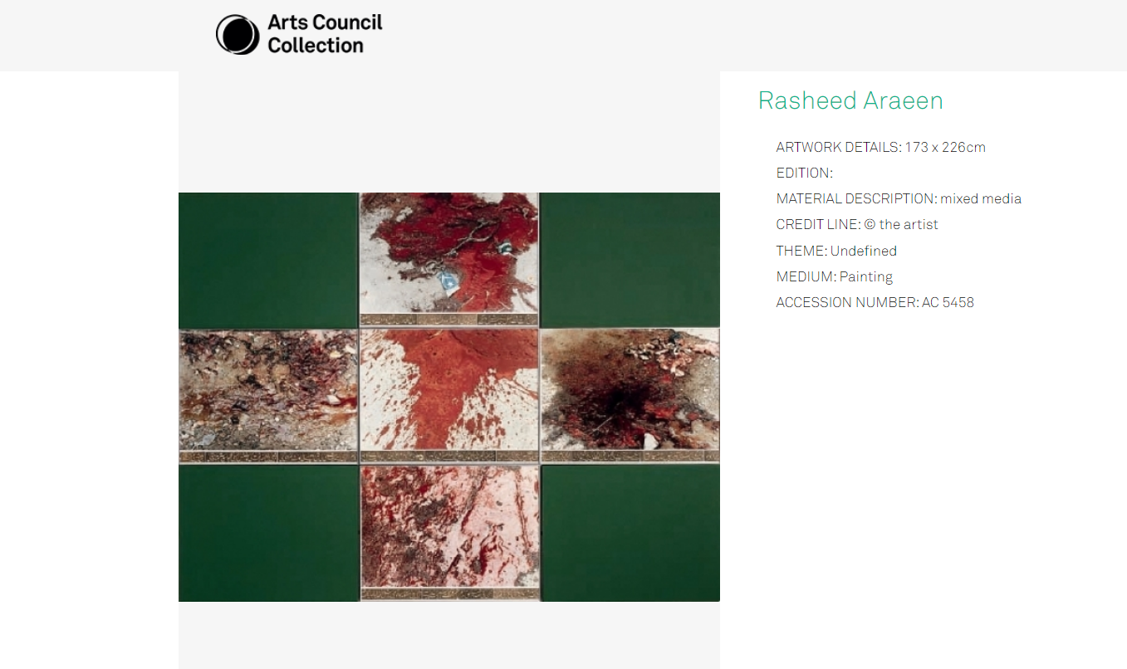
Green painting, 1985

Slide 11
Feedback to the Room
We welcome any comments or conclusions that you discussed in your pairs to be shared with the room.

Slide 12
Chantal akerman
Exhibition: documenta11, Kassel, 2002

Slide 13
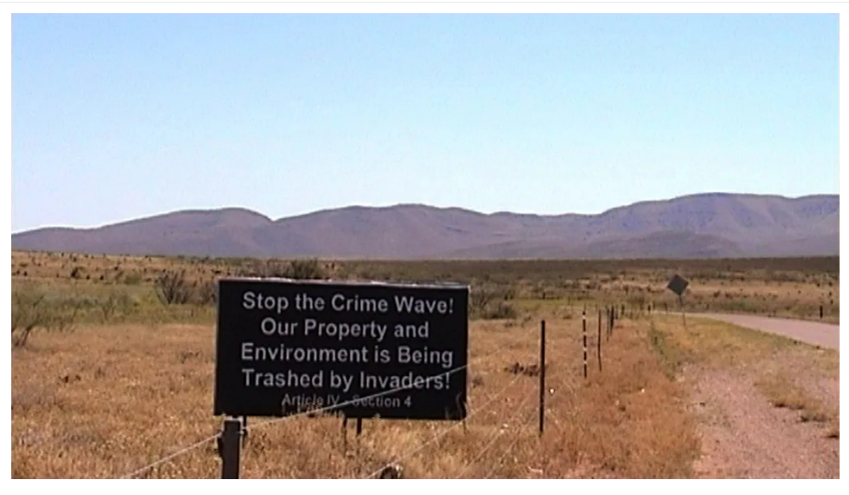
From the otherside
Artist: Chantal Akerman
Date: 2002
Location: documenta11, Kassel, Germany
Film Still, From the Otherside (2002),Chantal Akerman, Marian Goodman Gallery

Slide 14
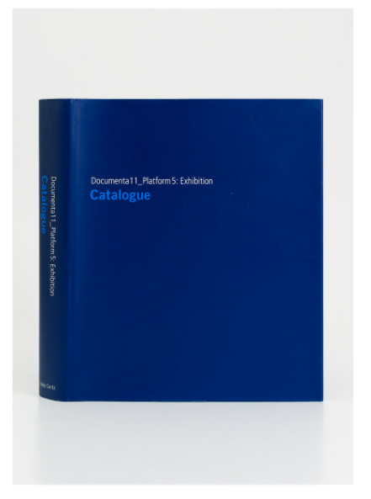
documenta11
Artistic Director Okwui Enwezor, with co-curators Carlos Basualdo, Ute Meta Bauer, Susanne Ghez, Sarat Maharaj, Mark Nash and Octavio Zaya
Significance: The most noteworthy achievements of documenta 11, as Wolfgang Lenk wrote in his essay, consisted in its questioning of the “unspoken hierarchies of attention in the Western exhibition scene,” its denial of the legitimacy of the “West’s exoticizing view of ‘the foreign,’ and the confrontation of that perception with those artistic activities that conflict with our projection...” (source: documenta.de)
Exhibition catalogue in the library.

Slide 15
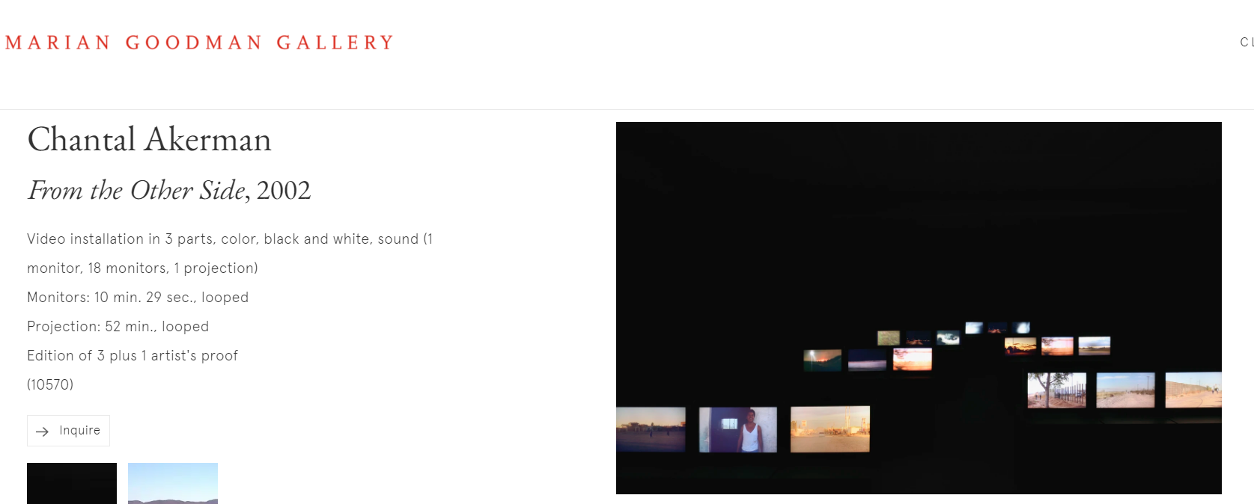
From the other side, 2002
https://www.youtube.com/watch?v=EOyv_s9PeyE

Slide 16
https://www.tate.org.uk/art/archive/items/tga-200414-7-3-1-63/audio-arts-volume-20-no-4-volume-21-no-1
RUNNING TIME: 11.13

Slide 17
What are the points covered by Chantal and Bill?
Tell your partner about something that stood out to you during their conversation?
In your experience, what has changed since 2002 in the context of what Chantal and Bill were discussing?
In your view, what hasn't changed since 2002 in the context of what Chantal and Bill were discussing?
What might you be able to do, to help change this?

Slide 18
Feedback to the Room
We welcome any comments or conclusions that you discussed in your pairs to be shared with the room.

Slide 19
Thank you
Content by Dr Gayle Meikle
December 2022

