Slide 1
A National-Scale Infrastructure Database and Modelling Environment for the UK
Mr David Alderson
Dr Stuart Barr, Mr Craig Robson
Dr Alexander Otto, Prof Jim Hall, Mr Scott Thacker, Dr Raghav Pant
International Symposium for Next Generation Infrastructure
SMART Infrastructure Facility, University of Wollongong
3rd October 2013

Slide 2
Overview
Introduction
National Infrastructure System Model (NISMOD-DB)
Contents
Technology
Visualisation
NISMOD-DB for Networks
Overview
Structure
Visualisation
Future work…
Summary
Contacts and Links

Slide 3
Introduction
Infrastructure planning, investment, delivery, maintenance, upgrading and improving all require DATA!
Supply and demand (NISMOD-LP)
Asset inventory
Performance
Failures and recovery
Connectivity
Integrated data management environment required
Storage, maintenance and updates
Modelling and analysis
Visualisation and dissemination

Slide 4
NISMOD-DB - Contents
Database of spatial and aspatial infrastructure-related data for the UK
Traditional physical infrastructure assets
Hazards
Infrastructure capacity and demand modelling inputs and outputs (NISMOD-LP)
Network modelling and storage
Network-enabled database schema
Physical infrastructure network construction
Prototype visualisation tools
Visualisation of infrastructure networks
Infrastructure data dashboard for demographic and economic projections to 2100

Slide 5
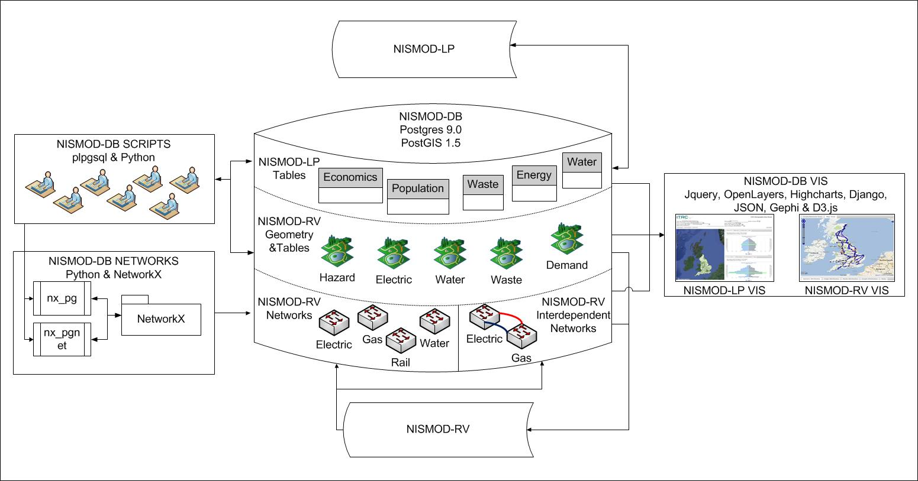
NISMOD-DB - Overview

Slide 6
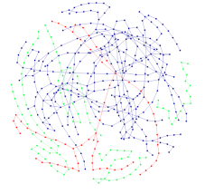
NISMOD – DB – Technology
Prototype web client(s)
D3js.org
Desktop
{“key”: “JSON”}
Middleware / Analysis packages
NetworkX
Network views
(SQL/plpgSQL)
SQL / plpgSQL
Database(s)
Admin
Network Schema

Slide 7
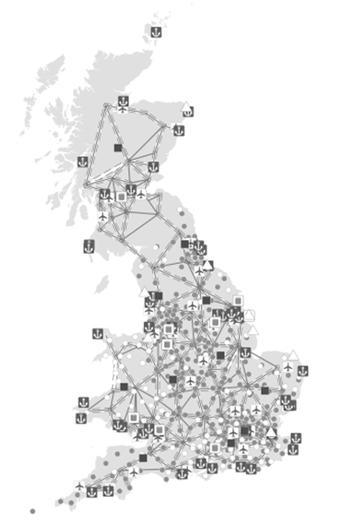
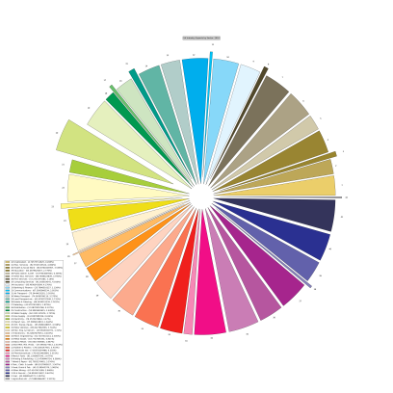
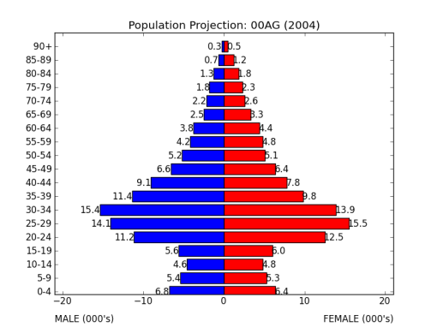
NISMOD-DB - Visualisation
Requirements:
Reporting
Investigation
Interactivity
Standard approaches: maps, plots, charts, graphs, diagrams…

Slide 8
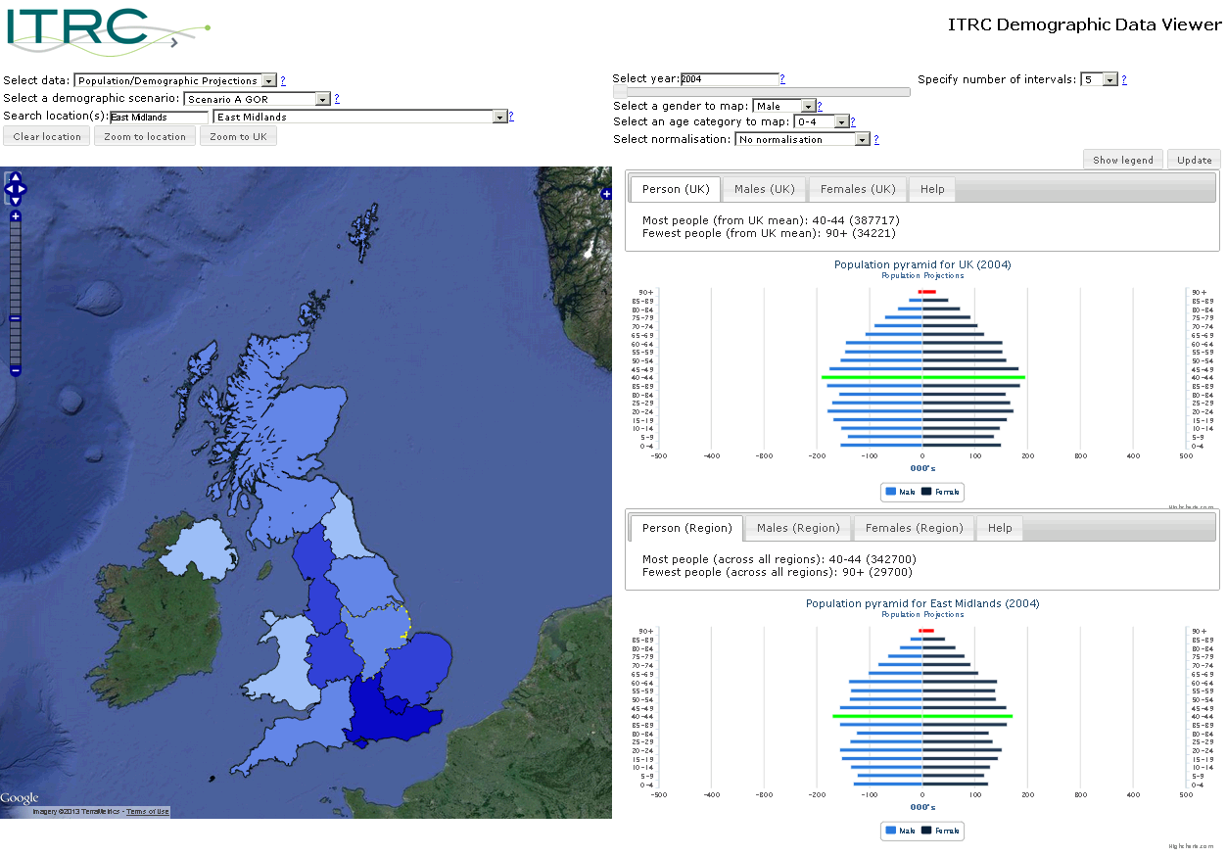
NISMOD-DB – Visualisation…
Control Panel
Map Panel
Chart Panel

Slide 9
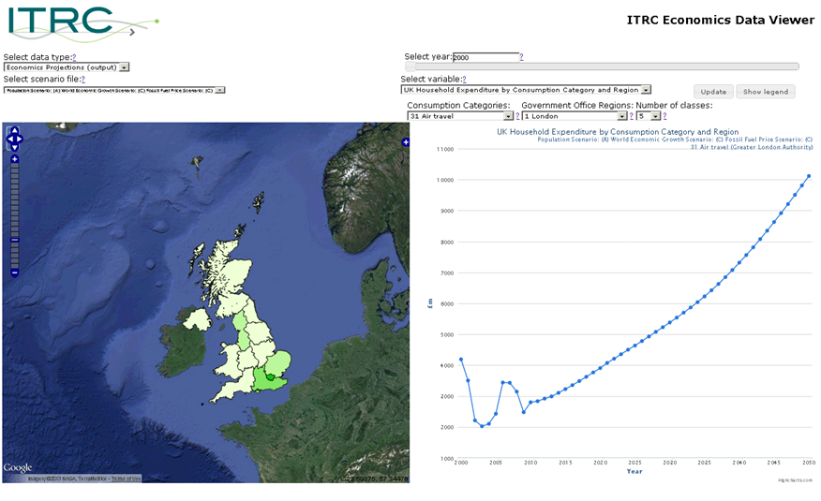
NISMOD-DB – Visualisation…
Control Panel
Chart / Map Panel
Chart Panel

