Slide 1
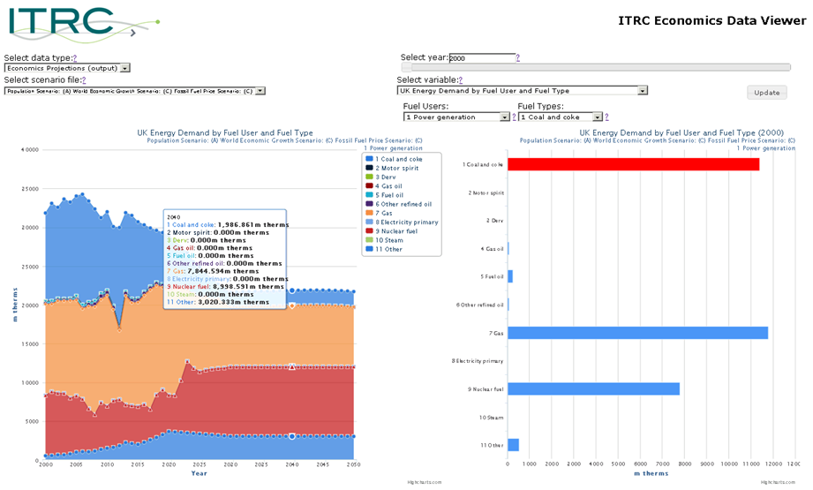
NISMOD-DB – Visualisation…
Control Panel
Chart / Map Panel
Chart Panel

Slide 2
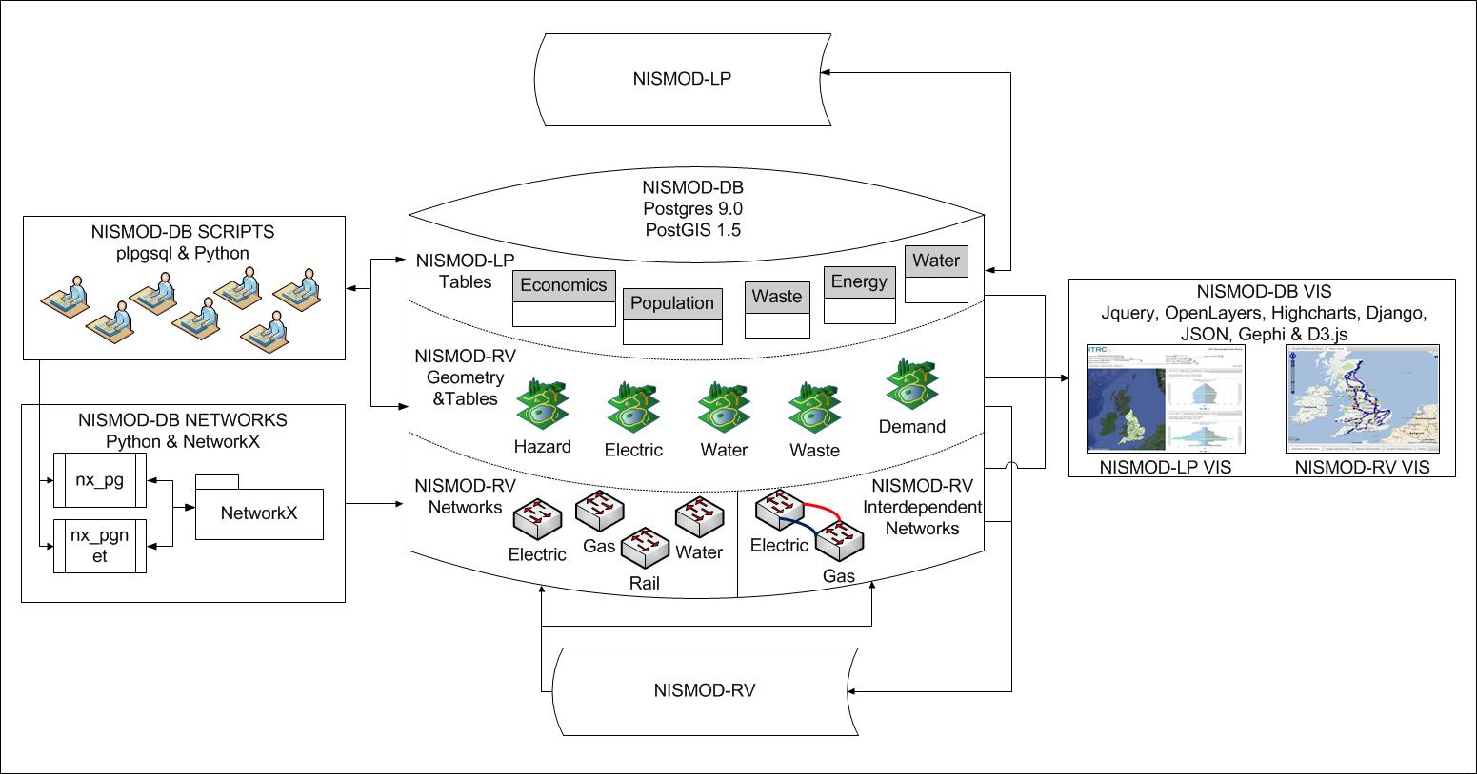
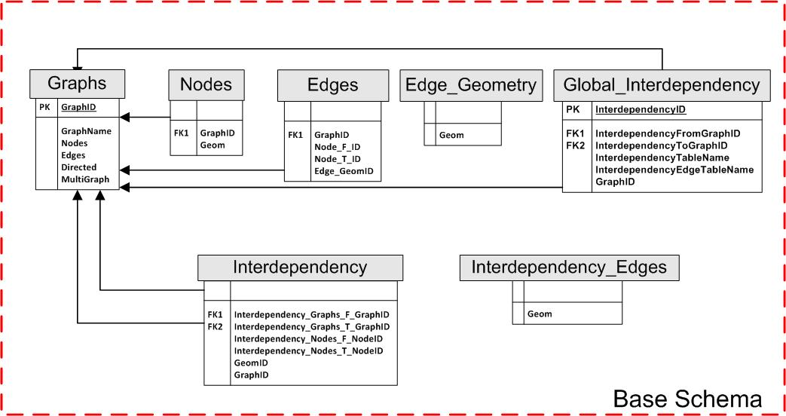
NISMOD-DB for Networks
Architecture to handle various regional and national scale spatial networks
Storage
Analysis
Visualisation

Slide 3
NISMOD-DB for Networks…
Import / export graph: GEXF, PAJEK, YAML, GRAPHML, CSV, JSON
Calculate metrics: wrap NetworkX algorithms, can add custom calculations
Publish networks: Interface with Geoserver WMS via gsconfig (in dev)
Network Database
Schema
nx_pg
nx_pgnet
NetworkX

Slide 4
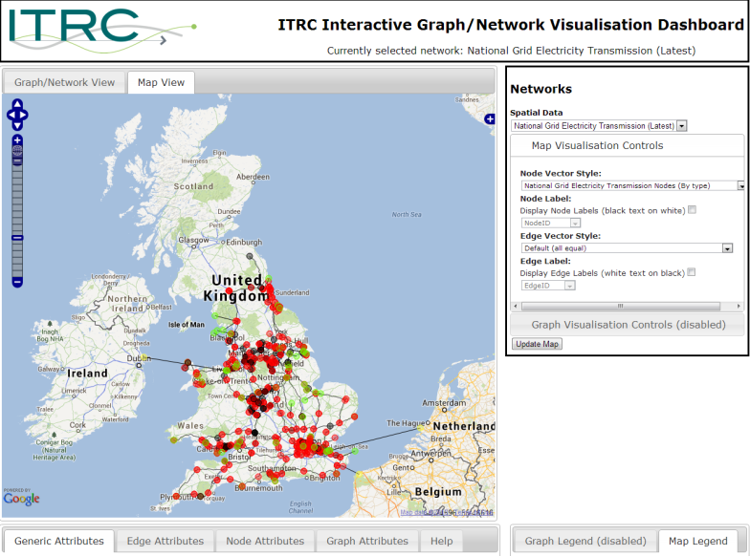
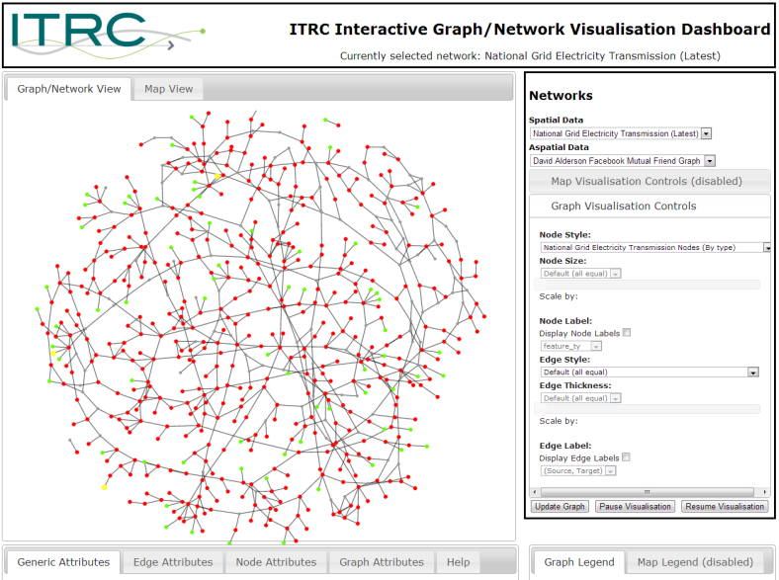
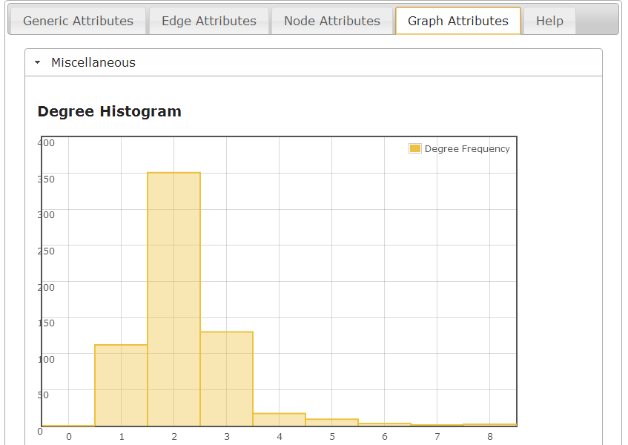


NISMOD-DB – Networks…
NISMOD-DB for Networks…
UK Road
OS Meridian (24071 nodes, 50292 edges)
OS Strategi (18066 nodes, 28089 edges)
UK Rail (2526 stations, 1415 junctions)
UK National Grid-owned Electricity Transmission
Generation Stations, Interconnectors, Substations (643 nodes)
Underground cables, Overhead lines, Interconnectors (759 edges)
UK National Grid-owned Gas Transmission
Offtakes, Block Valves, Compressors, Storage Sites, LNG Sites, Terminals, Pipelines plus more (625 nodes, 679 edges)
Topographical View
Topological View
Metric View

Slide 5
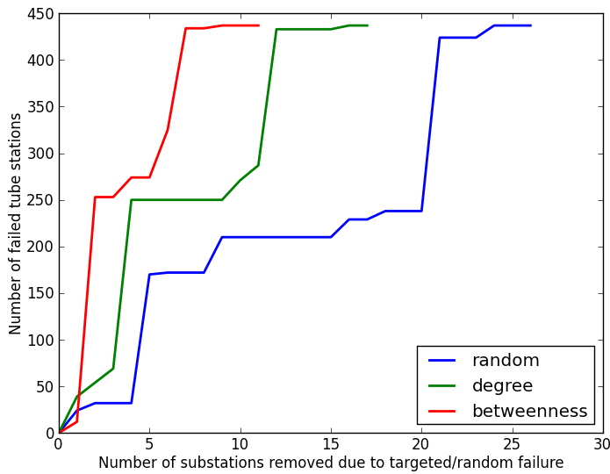
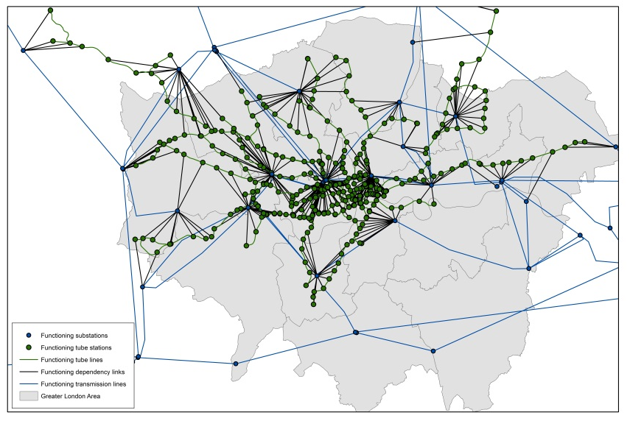
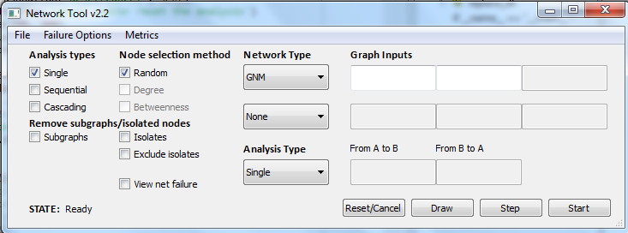


Example: Network analysis, London, UK
Substations
Tube stations
Dependency links
GUI for network analysis

Slide 6
Future Work…
Complex sets of outputs from infrastructure capacity and demand modelling (NISMOD-LP)
Integration of inputs/outputs within NISMOD-DB
Web services for remote execution
Development of infrastructure data dashboards
Extension of current dashboards per sector
Single, integrated interface for all sectors
Development of visualisations for investigating and disseminating infrastructure performance
Development of network visualisation
Use of network visualisation tools for NISMOD-LP
Further development of network visualisation dashboards for failure simulation
Extension of network module for end-to-end network construction, storage, analysis and dissemination

Slide 7
Summary
Data available on many aspects of infrastructure
Management, provenance, analysis and dissemination key to effective research
Relational database, with spatial and network extensions being developed as part of UK ITRC to:
Handle model outputs for future capacity and demand under range of different scenarios
Build, store and manage networks
Disseminate data via prototype visualisation tools

Slide 8
Links
Infrastructure Transitions Research Consortium
www.itrc.org.uk
http://gow.epsrc.ac.uk/NGBOViewGrant.aspx?GrantRef=EP/I01344X/1
School of Civil Engineering and Geosciences, Newcastle University
www.ceg.ncl.ac.uk
Geospatial Engineering Group@ Newcastle
http://www.ncl.ac.uk/ceg/research/geomatics/geospatialengineering/
Geospatial Engineering Group Blog @ Newcastle
http://blogs.ncl.ac.uk/geospatialengineering
Centre for Earth System’s Engineering Research (CESER) @ Newcastle
http://www.ncl.ac.uk/ceser/

Slide 9
Thank you.
David.Alderson@ncl.ac.uk
Stuart.Barr@ncl.ac.uk
C.A.Robson1@ncl.ac.uk
Alexander.Otto@ouce.ox.ac.uk
Jim.Hall@eci.ox.ac.uk
Scott.Thacker@ouce.ox.ac.uk
Raghav.Pant@ouce.ox.ac.uk

