Slide 1

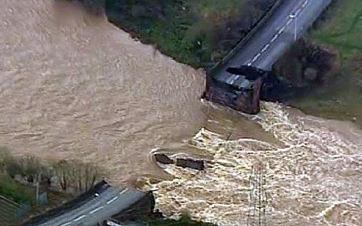
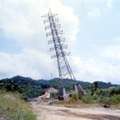

Modelling Infrastructure Systems for Resilience and Sustainability
Sarah Dunn, Sean Wilkinson, Gaihua Fu and Richard Dawson

Slide 2
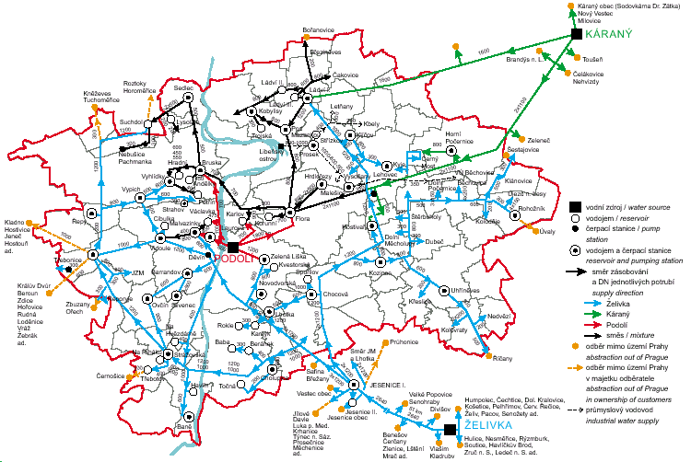
Analysis of Infrastructure Systems
Underlying Network Architecture
Vejvodova (2006)

Slide 3
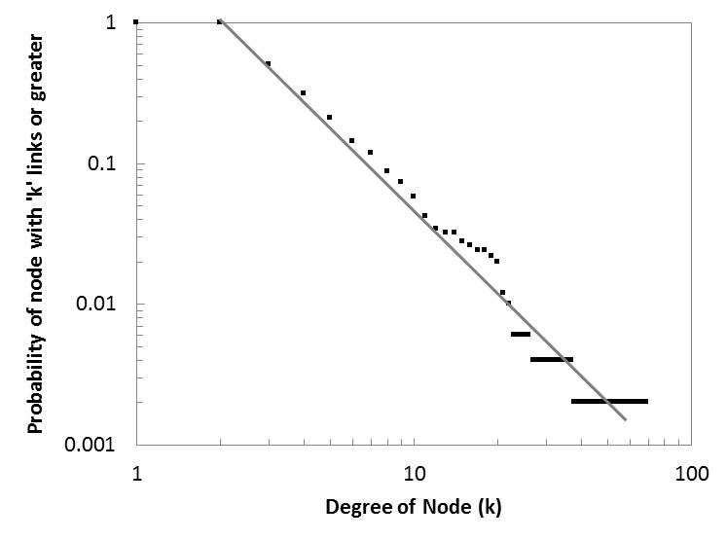
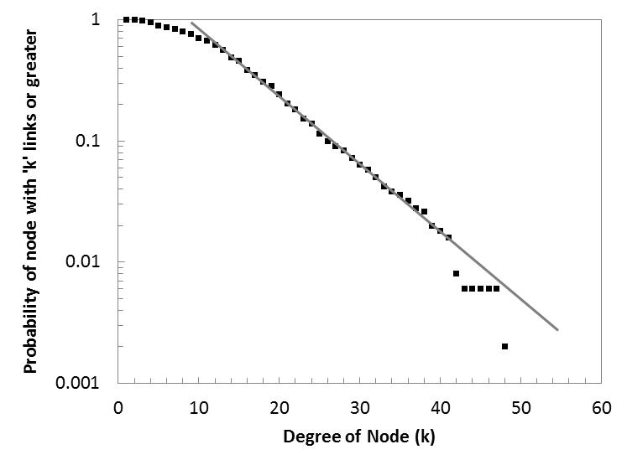
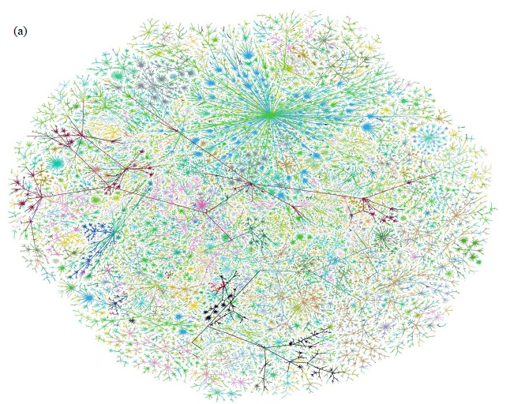
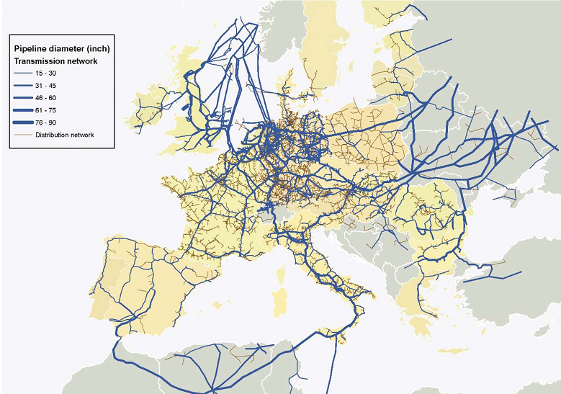
Scale-Free Networks
Exponential Networks
The Internet
(Albert, et al. Nature: 1999)
The World-Wide-Web
(Albert, et al. Nature: 2000)
Electrical Distribution Systems
(Sole, et al. 2008)
Airline Networks
(Wilkinson, et al. 2012)
Newman (2003)
Carvalho, et al. (2009)

Slide 4
Network Generation Algorithms
Scale-free network generation algorithm:
Barabasi, A. L. and Albert, R. (1999). "Emergence of scaling in random networks." Science 286(5439): 509-512.

Slide 5
Network Generation Algorithms
Exponential network generation algorithm:
Wilkinson, S. M., Dunn, S., and Ma, S., (2012) ‘The Vulnerability of the European Air Traffic Network to Spatial Hazards’ Natural Hazards. 60(3): 1027-1036.

Slide 6
Topological Hazard Tolerance
Infrastructure networks have been shown to be:
Resilient to random hazard

Slide 7
Topological Hazard Tolerance
Infrastructure networks have been shown to be:
Vulnerable to targeted attack

Slide 8

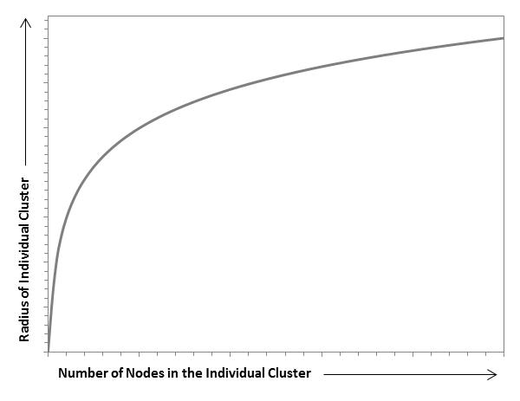

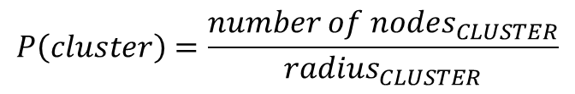
Development of Spatial Network Model
Starts with the input of initial conditions
Seed node locations and their geographic influence
The remaining nodes are then added individually
Each cluster can attract new nodes
New nodes located randomly within cluster
Each cluster expands with added nodes
$$P\left(cluster\right)=\frac{{number of nodes}_{CLUSTER}}{{radius}_{CLUSTER}}$$
$$Radius=C_{D }\left(\ln\left(number of nodes\right)+1\right)$$

