Slide 1

Thank you for coming!
We hope you enjoyed it ☺

Slide 2
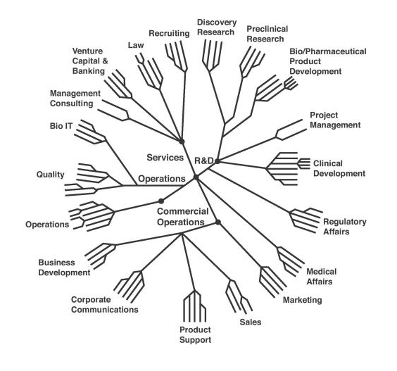
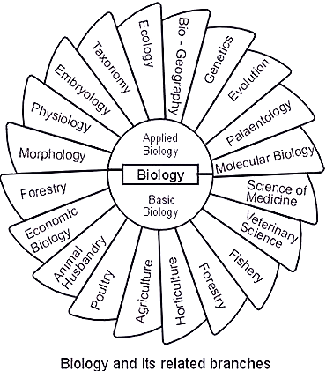
Career in life sciences

Slide 4
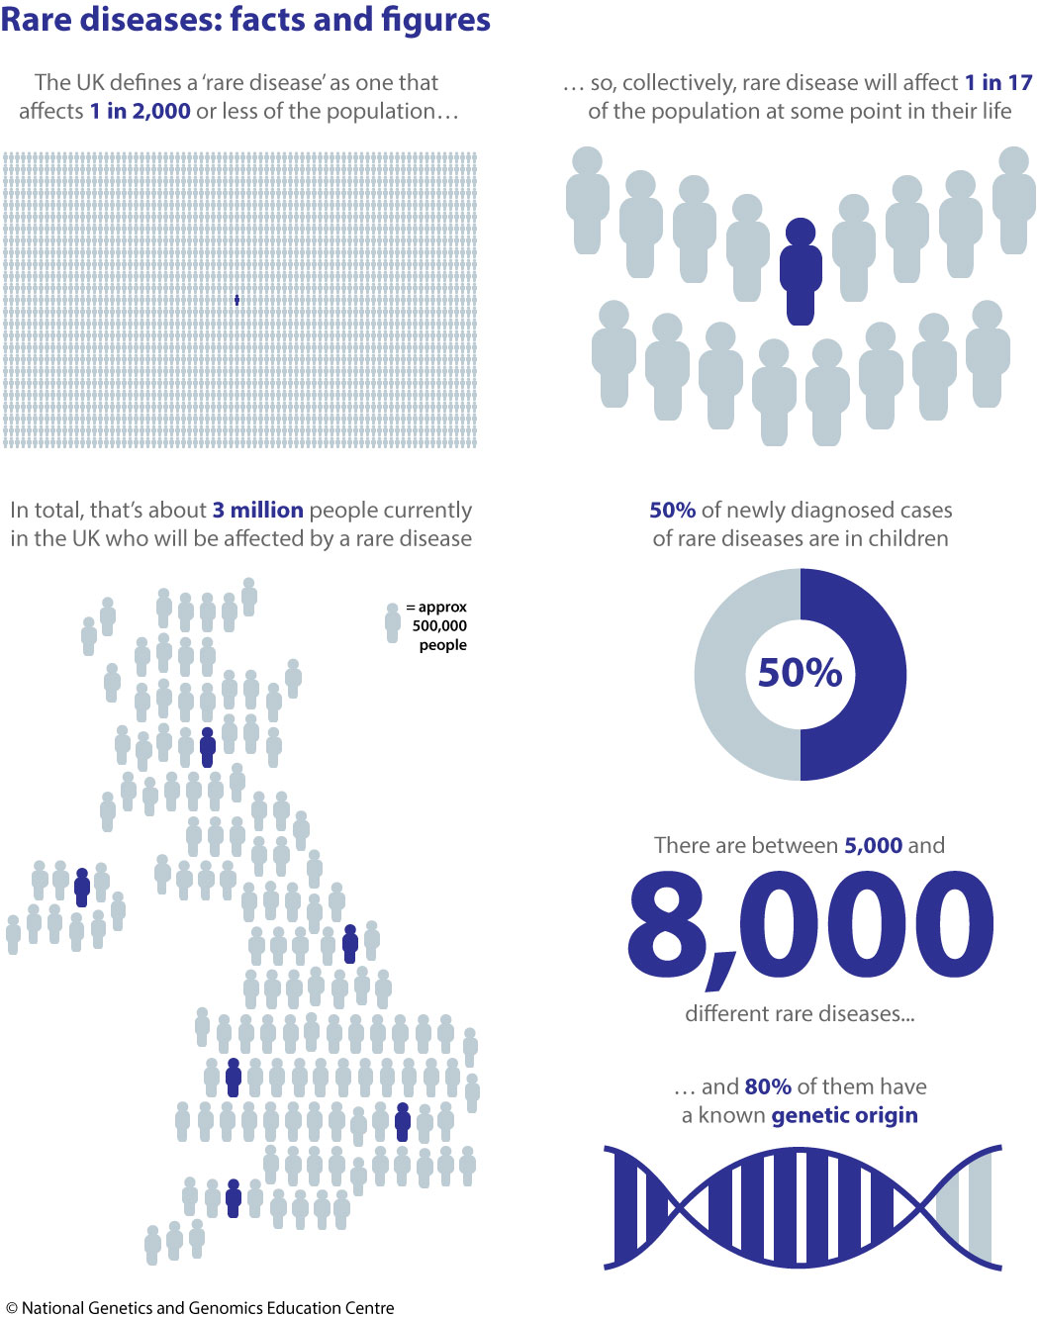

Slide 5

SCIENCE

Slide 6

Future events/work placement etc
https://blogs.ncl.ac.uk/igmengagement/
https://twitter.com/IGMengageNCL

