Slide 1
Open Badges in an Academic Context
Graeme Redshaw-Boxwell, Patrick Rosenkranz, Sriyani Jayaweera, Sara Maioli

Slide 2
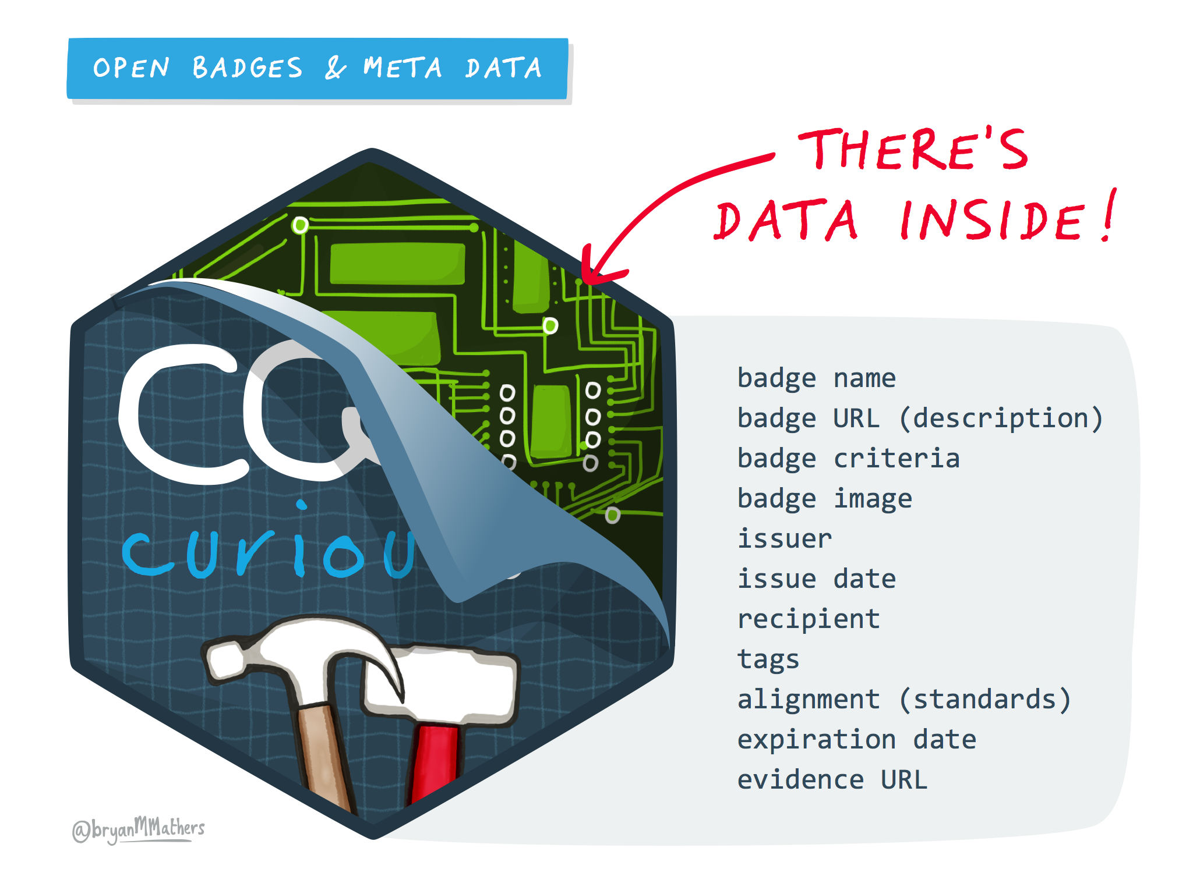
What is an open badge / digital credential?
Notes:
what is a digital credential, history at the Uni

Slide 3
The Project
Notes:
Project - fund, aims, people

Slide 4
Open Badges – why bother?
Degree programmes should asses and give credit for all intended learning outcomes.
Degree transcript should be sufficient give evidence of students’ attainment.

Slide 5
But…
Many programmes develop skills and outcomes that are not directly assessed in academic work.
Some voluntary activities have no formal recognition.
Employers look for graduates that stand out.

Slide 6

Open badges….
offer a way of demonstrating attainment that goes beyond ( and can work alongside) academic achievement.
involve aspects of gamification and professional social media interaction.
can signal specific engagement and skill development to employers, e.g. transferable, graduate skills.

Slide 7

Badge 2A: Psychology Enterprise Challenge 2018 –Youth Focus NE
This badge shows that the bearer has participated in the Psychology Enterprise challenge 2018 in collaboration with Youth Foundations. To meet the challenge, a team has to develop and then pitch an idea for a product, service or initiative to support young people in the North East who are affected by loneliness and social isolation.
The badge demonstrates
1. Ability to work effectively as part of a team
2. Creative application of psychological literacy to address real -world problems.
3. Effective presentation of ideas in the form of a pitch.
To attain the badge a candidate must:
1. Attend the Enterprise challenge.
2. Work as party of team to creatively develop a product or service to support young people affected by loneliness and social isolation;
3. Consider financial, ethical and practical constraints in relation to the idea, and include these in the pitch.
4. Pitch the idea in the format specified to a panel of judges.

Slide 8
Badge 4: CFA Enterprise Challenge 2018
The CFA Institute Research Challenge is a global competition that tests the equity research and valuation skills, and the investment report writing skills of university students.
This annual educational initiative promotes best practices in equity research among the next generation of analysts through hands-on mentoring and intensive training in company analysis skills.
This badge shows that the bearer has participated in the CFA Enterprise challenge 2018 in collaboration with the CFA Institute. To meet the challenge, a team has to submit an equity research report on a publicly traded company assigned by the CFA Institute.
The badge demonstrates
1. Ability to work effectively as part of a team.
2. Intensive training in company research and analysis applying business and finance literacy to a publicly traded company.
3. Ability to abide to the CFA Institute Code of Ethics and Standards of Professional Conduct, which are the ethical benchmark for investment professionals around the globe.
To attain the badge a candidate must:
1. Attend the CFA briefing webinar.
2. Conduct equity research and valuation and write a financial analysis of a publicly traded company.
3. Attend the meetings with the external and internal mentors.
4. Work collaboratively as part of a team, assuming leadership in specific tasks.

Slide 9

Digital badges in Chemistry
Differentiation in mixed ability teaching groups
Recognition of hard work in practical sessions/ Calculations
Confidence building in future studies/career
Competitive exercise

Slide 10




Digital Badges in Chemistry Badges

Slide 11


Digital Badges in Peer Tutoring and Student Voice

Slide 12
Evaluation
Knowing they were being awarded, did you work towards achieving your badge?

Slide 13
Evaluation
Do you think that use of Open Badges as rewards by academic departments would motivate students to put in more work on extracurricular activities such as intra-department competitions?

Slide 14
Evaluation
Do you think the badge you received will be useful when you are seeking a job in the future, with 5 being very valuable and 1 being not very valuable at all?

Slide 15
Questions?

