Slide 1
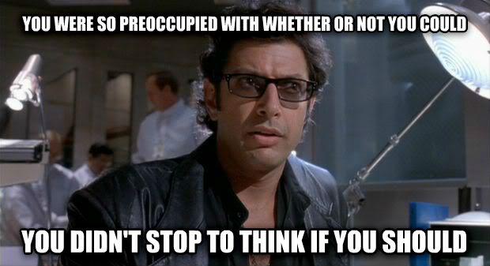
Technology: Could versus Should
Teaching and Learning Conference, 2019
Newcastle University
David Johnson, PhD student

Slide 2
The Same Issues in the Literature
'Will Technology Transform Education or Will the Schools Co-Opt Technology?' (1990)
'"Just Don't Ask Me to Define It": Perceptions of Technology in the National Curriculum' (1993)
'Using Technology in Education: When and Why, Not How.'(1996)
'National Strategies for the Promotion of On-Line Learning in Higher Education. (2001)
'Integrating Technology in Schools, Colleges and Departments of Education: A Primer for Deans.' (2006).
'Creating a Ripple Effect: Incorporating Multimedia-Assisted Project-Based Learning in Teacher Education' (2008)
'Technology in Today's Classroom: Are You a Tech-Savvy Teacher?’ (2011)
'Transformation of Teaching and Learning in Higher Education: Towards Open Learning Arenas: A Question of Quality.' (2016)

Slide 3
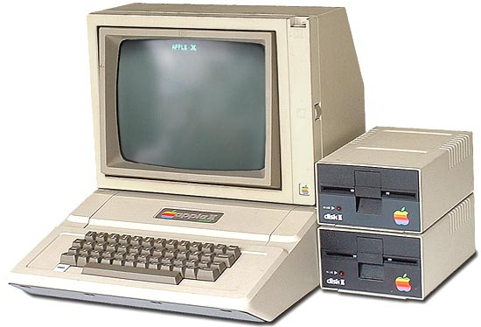
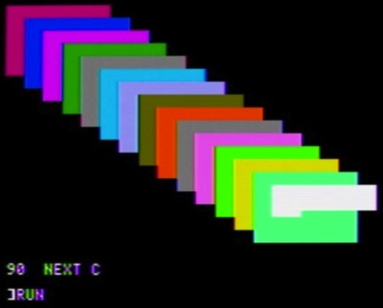
What COULD Technology Do?
A model: Apple computers in
schools in 1982.
Do this task, type these things,
and that's it.
Yes, you may play Pac-Man
afterwards.
Success or failure? What was the
goal?

Slide 4
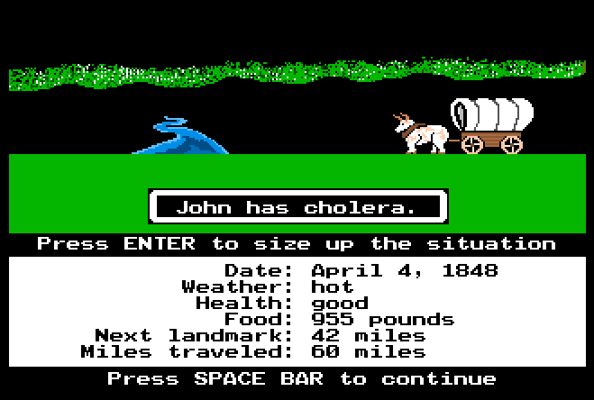
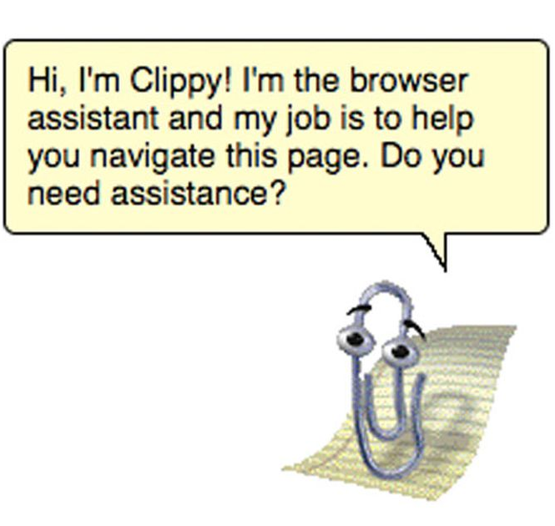
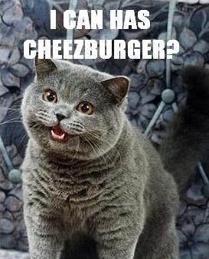
Repeating the Model
Hardware: here is a COMPUTER,
so you can get some work done.
(Or play Oregon Trail.)
Software: here is MICROSOFT OFFICE,
so you can get some work done.
(Or argue with the paperclip helper.)
On-line access: here is the INTERNET,
so you can get some work done.
(Or look at pictures of cats.)

Slide 5
Your Results May Vary
Three recent education technology efforts:
  Wide-spread deployment of iPads in secondary education. Result: from 'meh' to catastrophic failure.
  Wide-spread deployment of 'Smart Boards'. Result: disuse.
  Newcastle University App. Result: wide-spread use.
Why such different results?

Slide 6
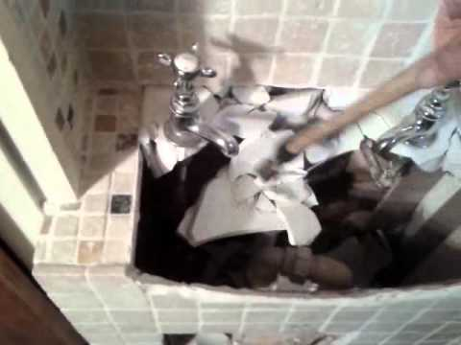

Redefining Technology for Education
Technology is a tool, and nothing
more. It is not a panacea; it is
not inherently a solution; it is
not a superpower.
There are implications for
thinking about technology as a tool.
We need to escape from the 'lightbulb
on a pencil' problem.

Slide 7
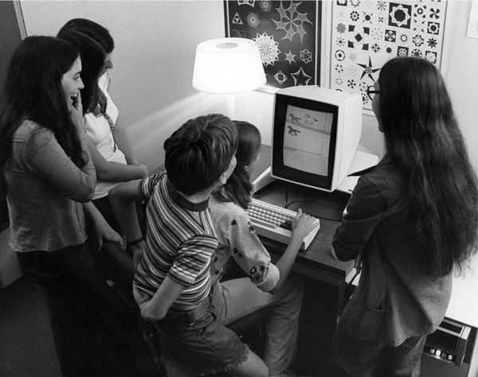
Could Vs. Should: Back to the Start
Xerox PARC: a ridiculous
success almost no one has
heard of (circa 1970s).
They asked a different question:
How can we make a computer
so simple a child could use it?
It's our turn to ask a different question. Not what could technology do for us, but what should the tools be for the best possible education.

