Slide 1
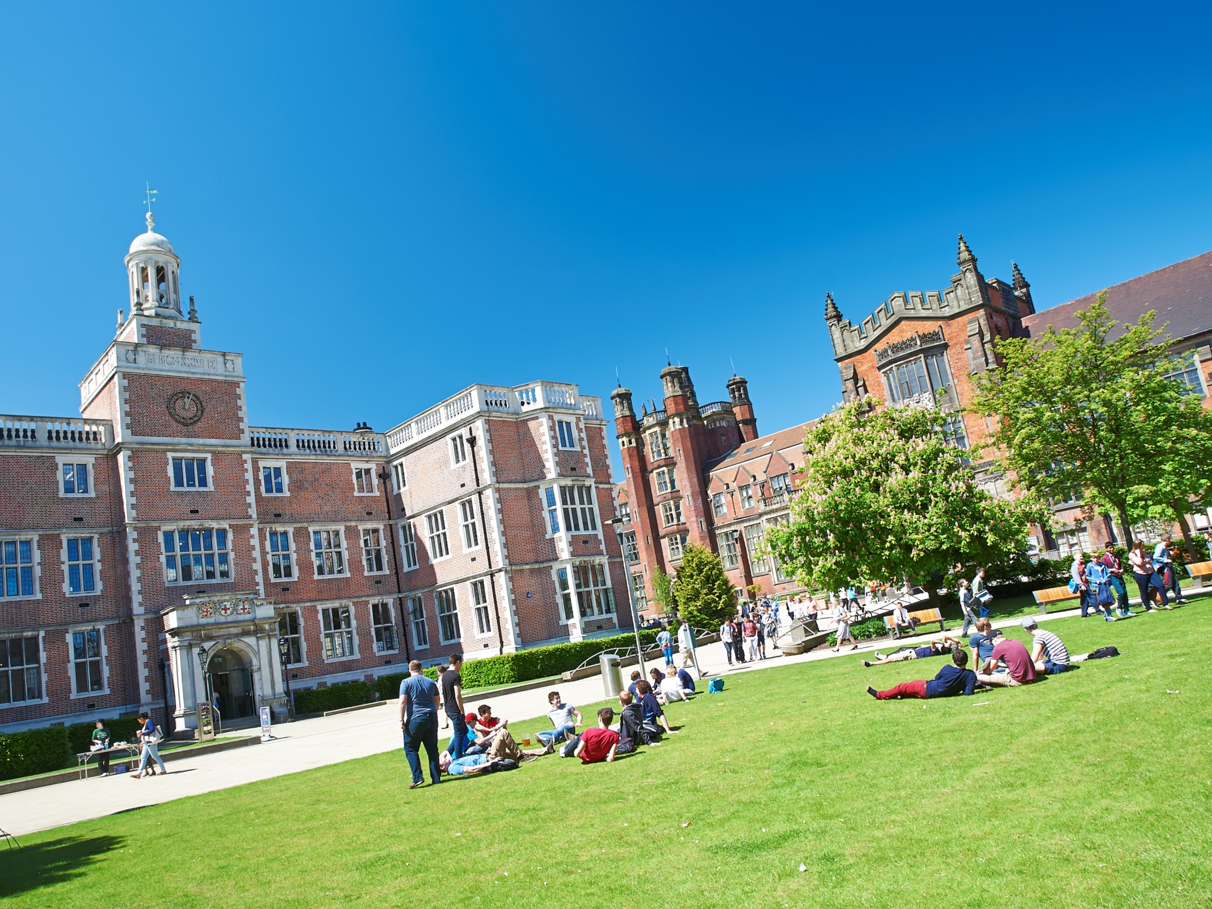


Newcastle Educators
Peer Dialogue Pilot 2019
Vanessa Armstrong
School of Biomedical Sciences

Slide 2


Newcastle Educators:
Sharing Educational Excellence Series 2018-2019
Opportunity to engage and network with others across campus and hear from awardees as to what excellence means
Newcastle Educators blog
Sharing our practice across the institution
https://ncleducators.wordpress.com/
@NewcastleEduca1
E
Educators@Newcastle.ac.uk
Teams Page
https://www.facebook.com/groups/717073635095218/

Slide 3
Peer Dialogue Scheme
Context:
Similar across university/ CASAP
Continuing professional development
Strengthen professional relationships ->trust, respect
Time/opportunity to reflect
‘Borrow’ ideas/methods

Slide 4
Pilot scheme:
How it works:
Sign up; https://forms.ncl.ac.uk/view.php?id=3197197
Randomly generated list on Excel
People A,B,C,D,E……..
A will observe B, B will observe C ….. ->loop
A will contact B (email list circulated by NE).
  Pre meeting
  Session
  Post session catch up
Session types- anything goes!
‘Critical friends’
Form –low key

Slide 5
“Inspiration to develop my teaching methods”
“Observing students and the way they interact with course material”
“This has given me the opportunity to observe sessions that are not traditional ‘teaching’, I found it really useful”
“Even though the field was very different to my own, it was good to experience good teaching practice, just in a different setting”
“It was interesting to see how different/similar cohorts of students are”
“Professional services involvement”
“More of an understanding of how things are done in different parts of the University.”
“Chance to network”
“I am looking forward to seeing what people do around the university”

