Slide 1
The Great Wall of Chinese Student Engagement
Developing a bespoke careers offer
Helen Atkinson

Slide 2
8%
Notes:
Chinese students represent 8% of all students on campus this year and 41% of international student numbers
Nearly 2500 Chinese students across our four campuses this year
Large student cohort- we need to be providing them with the careers support they need
Important for us to prepare our students, key recruitment market for us

Slide 3
Notes:
Students may assume that this is easy/ don’t engage in their career development early
Underestimate time and effort taken to search for opportunities/ and limited understanding of what employers want in terms of skills and experience

Slide 4
Notes:
Additional problems- students miss opportunities in China as far removed from Chinese labour market/ may miss graduate recruitment deadlines in Chin
Vast majority of students return to China but are often unprepared- reverse culture shock

Slide 5
Notes:
6 week programme, semester 1

Slide 6
Notes:
Session examples- also LMI content, and info to help manage student expectations e.g. salary expectations for graduate level roles

Slide 7
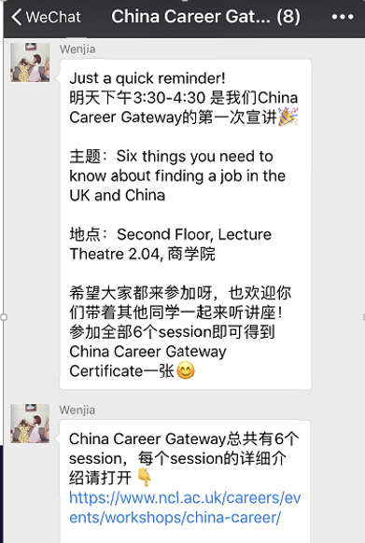
Notes:
WeChat to engage
JobsOC students promoted to students in Chinese which was welcomed

Slide 8
12%
19%
Notes:
218 individual students participated in the programme
12% of all Chinese students on campus attended at least one of the sessions, 19% of all PGTs
Wide range of academic schools
100% of student survey participants would recommend programme to a friend and felt programme enhanced their understanding of the UK and Chinese labour markets

Slide 9
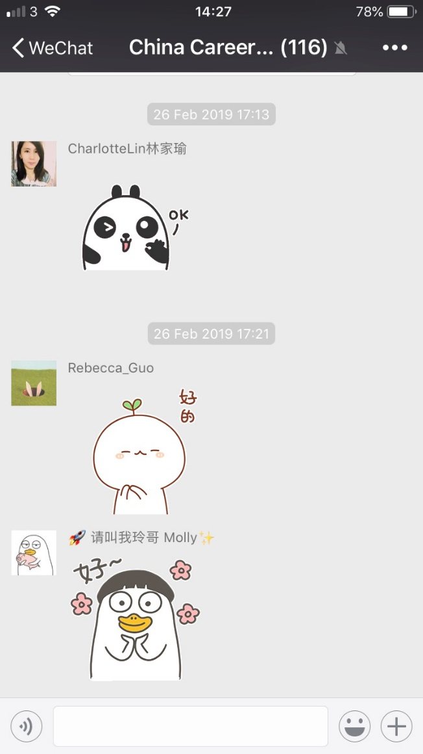
100% of survey participants felt the programme had better prepared them for UK and Chinese job markets
100% would recommend the programme to a friend
“This is my fifth year here…and I feel very privileged the Careers Service thinks about Chinese students and gives us help”

Slide 10
helen.atkinson1@ncl.ac.uk

