Slide 1
Supporting highly desirable engagement and employability for postgraduates in Singapore
Stella Toh
3 April 2019

Slide 2
Agenda
The Singapore Beginnings for the 4th Industry Revolution (IR4.0)
Impact on Higher Education
Schemes and Support System
NewRIIS aligns to IR4.0

Slide 3
Agenda
The Singapore Beginnings for The Singapore Beginnings for the 4th Industry Revolution (IR4.0)
Impact on Higher Education
Schemes and Support System
NewRIIS aligns to IR4.0

Slide 4
The Singapore Beginnings for IR4.0
2010: Economic Strategies Committee recommended developing higher skills in our workforce, growing an innovative economy, and building a distinctive global city.
5 years plan which conceived SkillsFuture and the IAL (Institute of Adult Learning)
2016: Committee on the Future Economy (CFE) developed economic strategies for the next decade. The CFE engaged over 9,000 stakeholders, including Trade Associations and Chambers (TACs), public agencies, unions, companies, executives, workers, academics, educators and students.

Slide 5
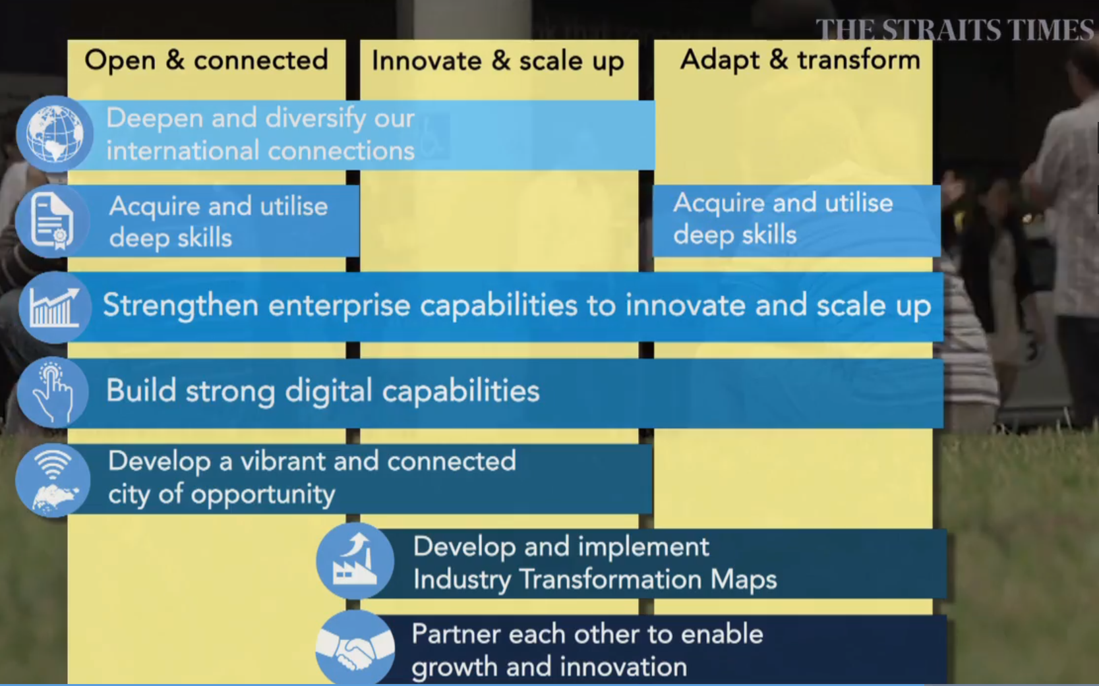
The Singapore Beginnings for IR4.0
Report of The Committee on The Future Economy (2017)

Slide 6
Agenda
The Singapore Beginnings for the 4th Industry Revolution (IR4.0)
Impact on Higher Education
Schemes and Support System
NewRIIS aligns to IR4.0

Slide 7
Impact on Higher Education
Singapore Minister of Education on the importance of higher education reform for Industry 4.0 (March 2017)
Singapore’s approach to higher education reform
(1) Experiential learning
(2) Promote digital literacy
(3) Diversify higher education pathways
(4) Encourage lifelong learning
(5) Broadening the role of universities

Slide 8
Agenda
The Singapore Beginnings for the 4th Industry Revolution (IR4.0)
Impact on Higher Education
Schemes and Support System
NewRIIS aligns to IR4.0

Slide 9
Schemes and Support System
SkillsFuture is a national movement to provide Singaporeans with the opportunities to develop their fullest potential throughout life, regardless of their starting points.
SkillsFuture Credit : to encourage individual ownership of skills development and lifelong learning.
All Singaporeans aged 25 and above received $500 credit from January 2016.

Slide 10
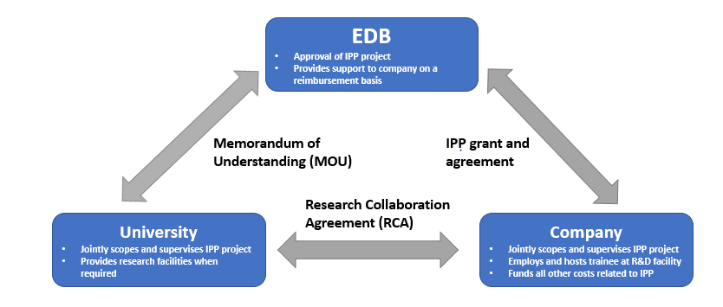
Schemes and Support System
EDB-IPP II: Economic Development Board – Industrial Postgraduate Programme II

Slide 11
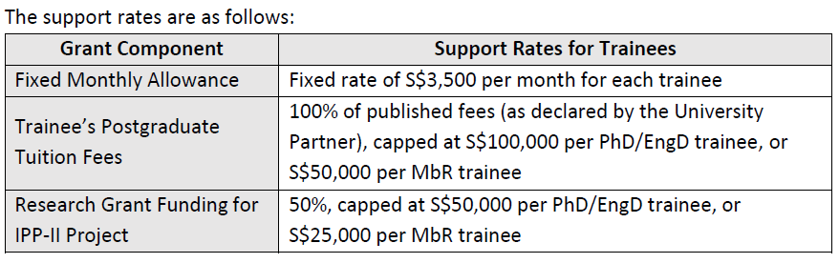
Schemes and Support System
EDB-IPP II
Allows companies to fund trainees pursuing PG studies based on projects jointly scoped out by the company and its chosen university partner.

Slide 12
Schemes and Support System
E2i Training Grant
e2i (Employment and Employability Institute) provides networks for individuals and companies in seeking skills and solutions for growth.
Up to 50% course fees subsidy for Singapore Citizens / Permanent Residents*

Slide 13
Schemes and Support System
Marine Port Authority
Maritime Cluster Fund (MCF)
The Maritime Cluster Fund (MCF) facilitates the growth of Singapore's maritime cluster by supporting the industry's manpower and business development efforts as well as its drive for productivity improvements.

Slide 14
Agenda
The Singapore Beginnings for the 4th Industry Revolution (IR4.0)
Impact on Higher Education
Schemes and Support System
NewRIIS aligns to IR4.0

Slide 15
NewRIIS aligns to IR4.0
Attain EduTrust certification by 2020
Allows International student enrolment: to diversify learning and teaching platform
Potential to deliver NU UG programmes in Singapore: inroads to industry via industry attachment programmes
Actively initiate conversations with government offices on support and grants

Slide 16
NewRIIS aligns to IR4.0
Deliver in bite-size pieces
CPDs to support lifelong learning, allowing participation from the region
Strong Industry Advisory Board
e2i Training Grant, up to 50%
MPA Marine Cluster Funds (offset fee costs up to 70%)
SkillsFuture funding

Slide 17
NewRIIS aligns to IR4.0
EDB-IPP II
Past graduates
Current projects
Internalised as targets
Research Collaborations
A*Star
NUS / NTU
NuMed
UTM (University of Technology Malaysia)

Slide 18
NewRIIS aligns to IR4.0
All MSc respond to industry needs
PGRs with tripartite collaboration
Outcomes
e2i Training Grant for MScs
e2i Training Grant for CPDs
MPA MCF for MSc Marine Technology (International)
EDB-IPP II: completed, 4 graduates
EDB-IPP II: current, 7 PhD Full-time

Slide 19
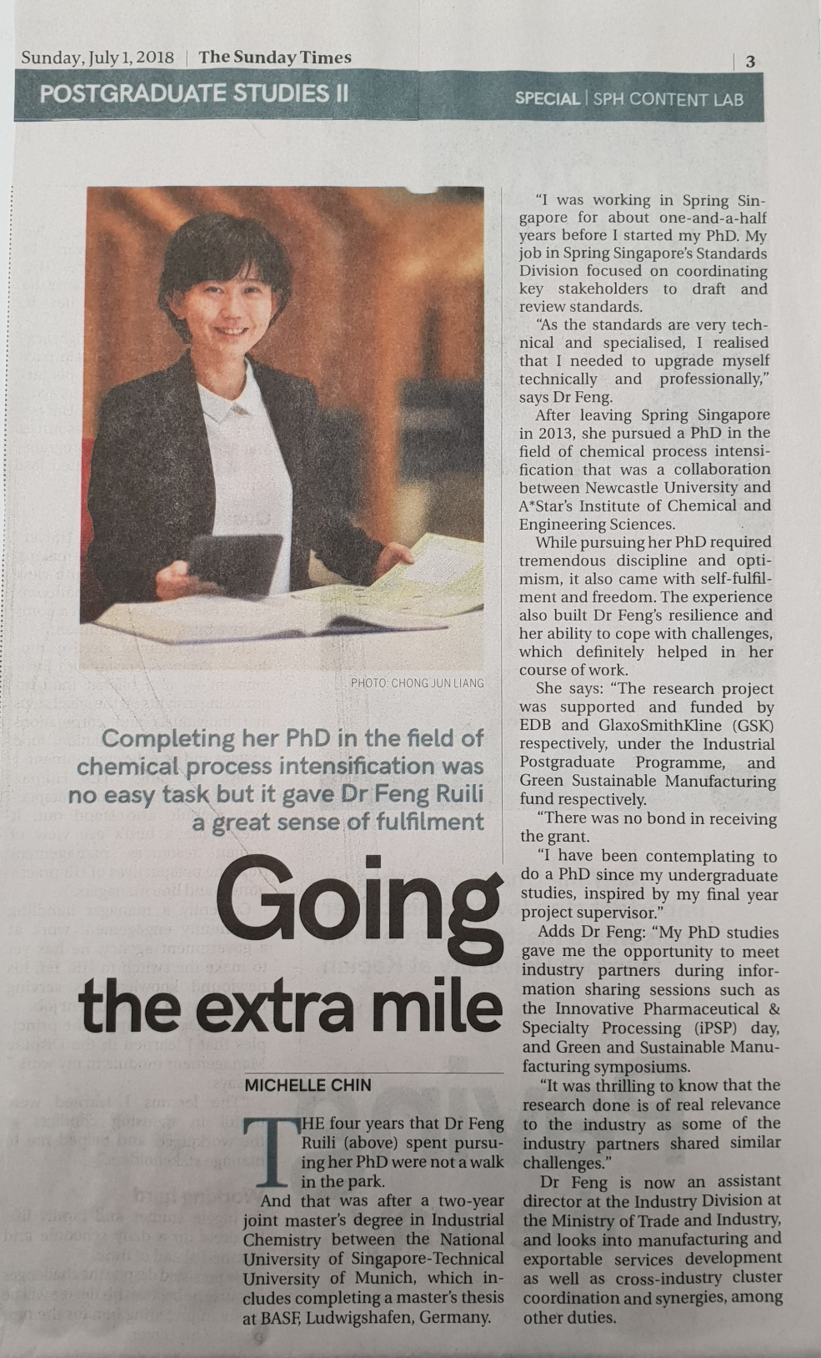
Featured success story

Slide 20
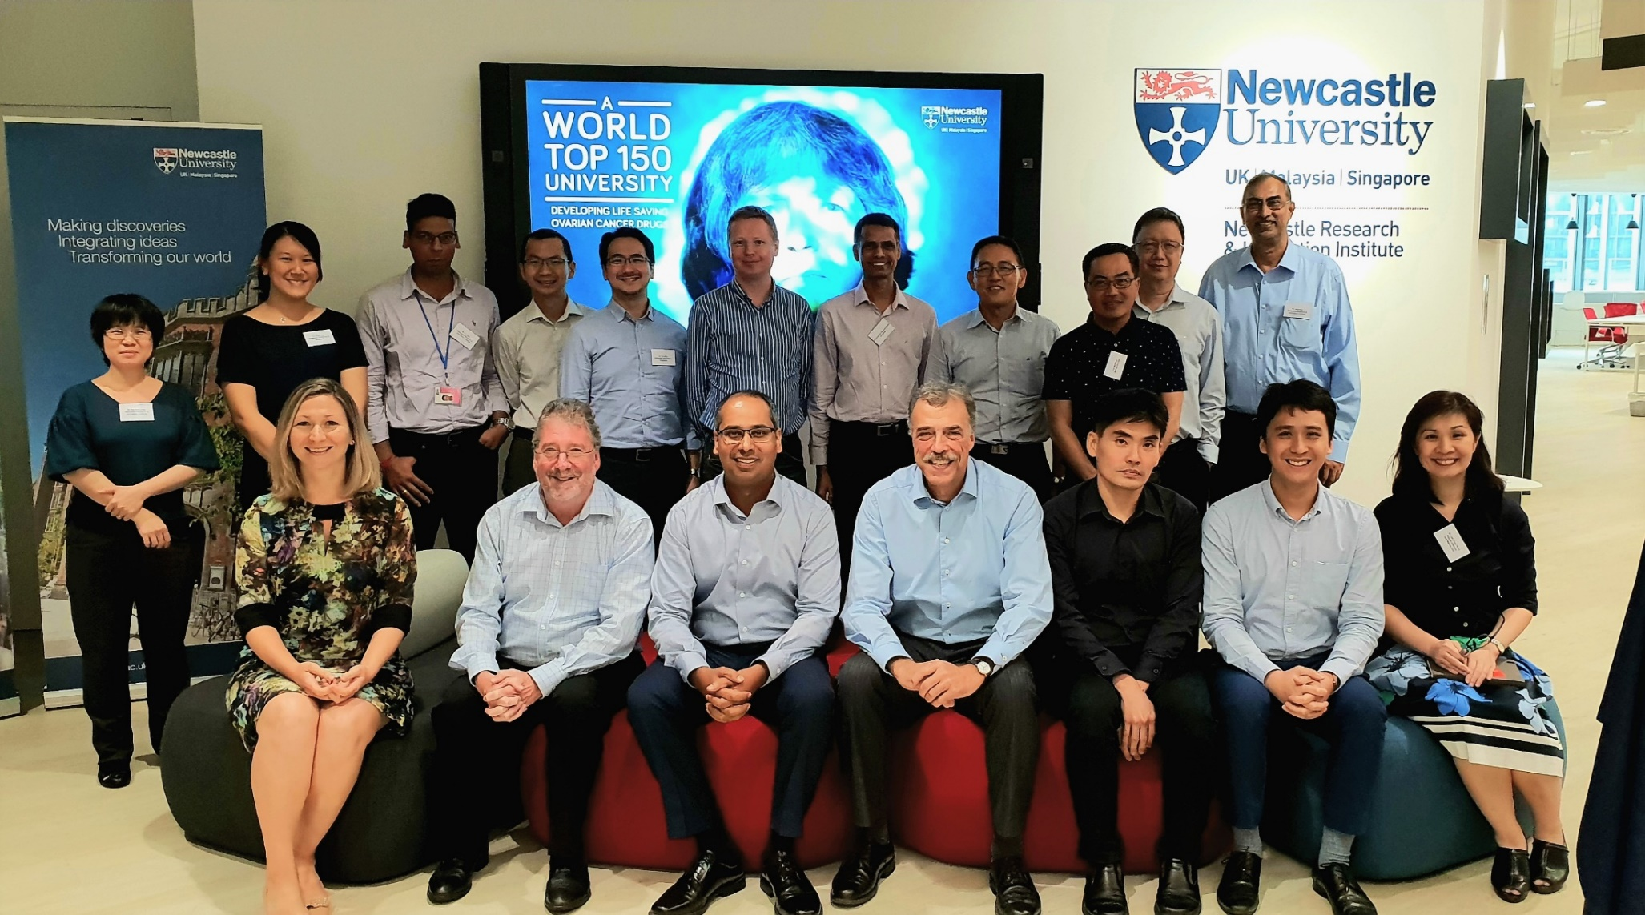
NewRIIS Industry Advisory Board

Slide 21
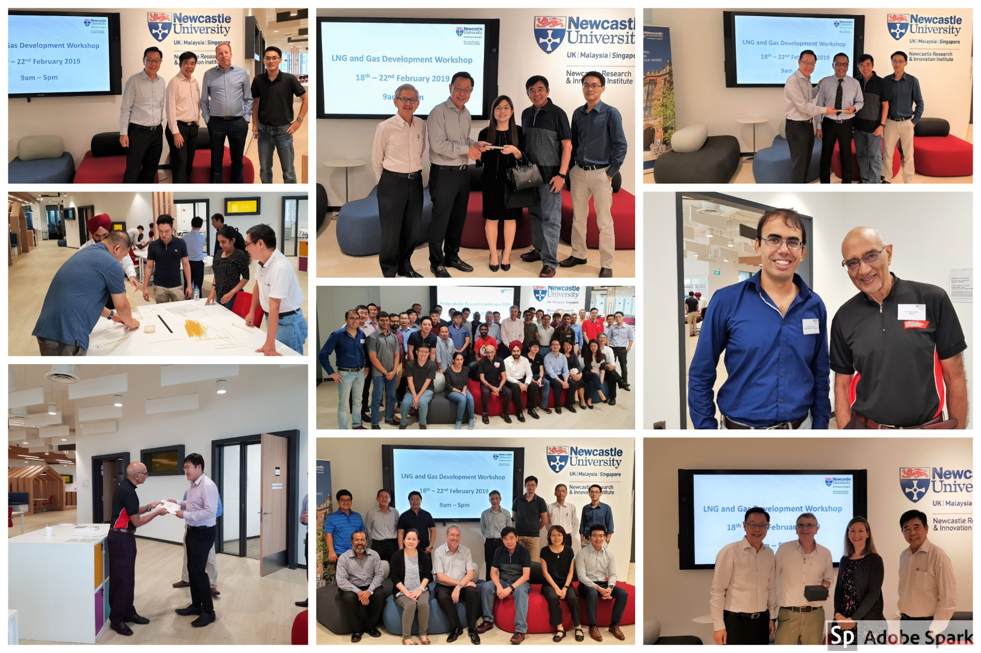
NewRIIS CPD and PG students interaction

Slide 22
The Changing of (Singapore) Higher Education Landscape
“Universities are structured in a way, I would say, as a consequence of the previous industrial revolutions. In order for us to respond to the Fourth Industrial Revolution, some structures will have to go. So universities will have to be prepared to dismantle our current structures in order to make way for initiatives that can promote future preparedness.”
— Prof Tan Eng Chye, NUS President

Slide 23
Thank you

Slide 24
