Slide 1
Helicopter parenting: should we wrap them up in cotton wool or should we let them fail?
Dr Trevor James

Slide 2
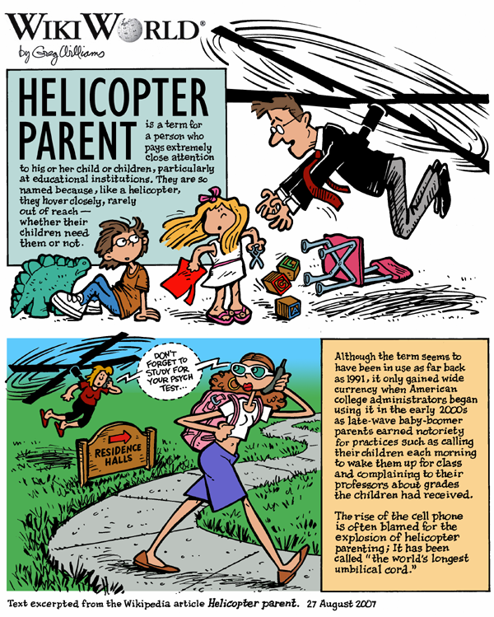
https://upload.wikimedia.org/wikipedia/commons/6/67/Helicopter_WikiWorld.png

Slide 3
https://upload.wikimedia.org/wikipedia/commons/6/67/Helicopter_WikiWorld.png

Slide 4
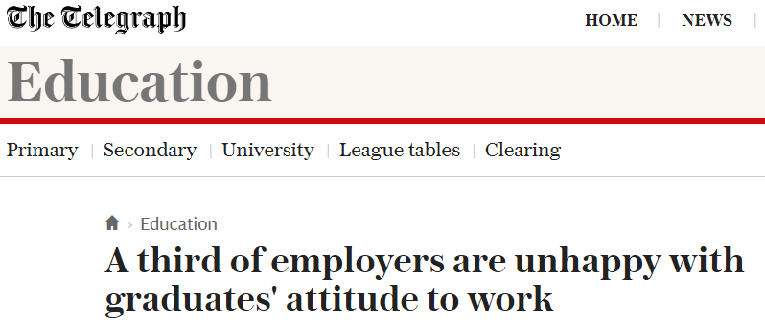

Crescens George, chief operating officer of Be Wiser Insurance group, told The Telegraph that graduates are not prepared for “the real world of work”, and often require “ego-massaging”.
Professor Cary Cooper of the Manchester Business School said that he agreed with the report that some graduates lack social skills and the ability to conduct face-to-face conversations. “They have been raised on Facebook and texting," he continued.

Slide 5
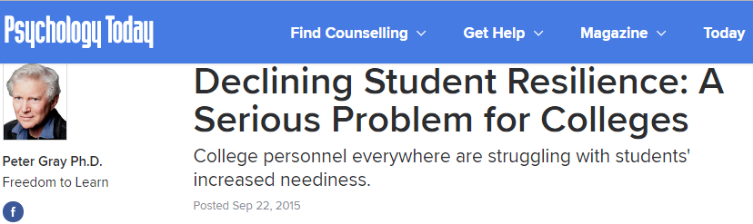
‘…we learned that emergency calls to Counseling had more than doubled over the past five years. Students are increasingly seeking help for, and apparently having emotional crises over, problems of everyday life.’
‘Recent examples mentioned included a student who felt traumatized because her roommate had called her a “bitch” and two students who had sought counseling because they had seen a mouse in their off-campus apartment. The latter two also called the police, who kindly arrived and set a mousetrap for them.’

Slide 6
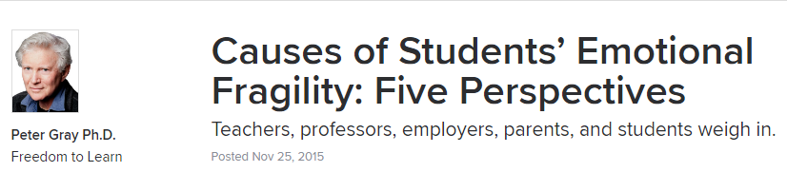
Primary and secondary school teachers consistently repeated similar experiences:
(School teacher) ‘I'd love to be able to fail when deserved, but…We are measured on our pass/fail rate (too many fail and we are fired). We are measured on our student survey results (fail a student, they complain, we get fired).’
‘I am a high-school guidance counselor and have noticed a drastic difference in students' ability to cope and handle adversity. I recently had a student email me at 9 p.m. because she couldn't handle the B she just saw posted by her teacher.’

Slide 7
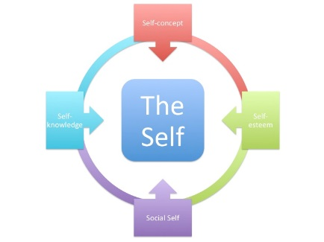

How can early experiences cause issues with resilience in later life?
Evaluation apprehension and academic performance
Our self-concept is made up of multiple domains, e.g. being a student (Crocker & Wolfe, 2001)
Many studies have shown that students feel threatened by having their academic ability questioned (Aronson, 1999; Inzlicht & Ben-Zeev, 2000; Steele & Aronson, 1995; Stone et al. 1999)
Restoring the self-concept improves performance, even if it’s not about academia (Cohen at al. 2006)
Having a self-concept that focuses on being a good student can lead to evaluation apprehension
Evaluation apprehension can negatively affect our performance on any task, and in academic it can explain the effects of stereotype threat.
High achieving students are particularly vulnerable to EA and may feel increased pressure in current economic climate which results in increased performance anxiety

Slide 8

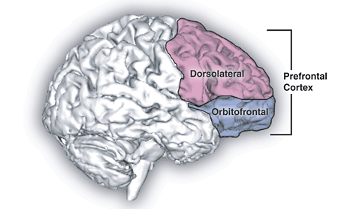
How can early experiences cause issues with resilience in later life?
Learner autonomy and Self-Determination Theory (Ryan & Deci, 2000)
Schiffrin et al. (2013) found that having over-controlling parents was linked with higher levels of childhood anxiety and depression. This relationship was explained by a lack of perceived personal control and autonomy by the child.
Brain development and interference of the PFC
Our most highly developed brain region (the prefrontal cortex) is sensitive to neurochemicals. In particular, stress has been shown to impair the PFC while at the same time strengthening responses in the amygdala (a more primitive part of the brain) (Arnstein, 2009)
Stress has been shown to impair task performance that relies on the PFC, e.g. spatial awareness (Cerqueira et al. 2007)
Low personal control has a direct effect on stress in primates (Mineka, Gunnar, & Champoux, 1986; Sapolsky, 1989)

Slide 9
Existing helicopter parenting scales
The first scale developed by LeMoyne and Buchanan (2011) assessed historic behaviours, e.g. “I sometimes felt that my parents didn’t feel I could make my own decisions.”
Subsequent scales developed assess current behaviours of parents, e.g. “My parent solves any crisis or problem I might have” (Padilla-Walker and Nelson, 2012) and “When I am at home with my mother, I have a curfew” (Schiffrin et al, 2013).
But, are these scales measuring protective behaviours, or are they measuring over-parenting?
Cullaty (2011) made the distinction that highly involved and highly supportive parenting styles were not the same thing, as many participants who reported low involved parents still felt highly supported by them.

Slide 10
Existing helicopter parenting scales
There are at least three reasons to develop a new scale:
Most scales include measures of over-parenting in the their helicopter parenting scale, e.g. ‘My parents plan my diet.” Conceptually, these are different things.
Most do not ask about past experiences (except LeMoyne and Buchanen; 2011)
Most scales are not multi-dimensional, e.g. they focus heavily on one aspect (parents) and do not ask about school experiences.
We decided to create a scale to measure this specific form of sheltering: Protection from Adversity and Sheltering Scale (PASS)

Slide 11
Protection from Adversity and Sheltering Scale (PASS) – Pilot study
We (school of psychology educational research group) advertised a 7-week summer internship to our stage 2 students in 2018
12 students wrote a statement on why they were interested in educational research and why it would benefit them
Amy and I interviewed the students (and looked at grades!) and chose a student (Elle Mawson)
Elle received £200 a week where she gathered past literature, helped to develop the scale conceptually, and collected data (e.g. from Partner’s)
Students (N = 204) were offered a chance to win a £50 Amazon voucher

Slide 12
Protection from Adversity and Sheltering Scale (PASS) – Pilot study
Based on aforementioned theories and past literature, as well as Elle’s experiences at Gosforth Academy, and our experiences of teaching over many years, we generated 89 initial question items related to past experiences of adversity and parental academic involvement.
Using factor analysis we identified 6 construct domains consisting of 33 items overall (with factor loadings):
School environment (7 items, .793)
Academic identity (8 items, .781)
Intolerance of Academic Uncertainty (5 items, .730)
Academic entitlement (4 items, .623)
Experience of being challenged academically (6 items, .760)
Academic instant gratification (4 items, .712)

Slide 13
Figure 1. Six emergent factors forming the 33 item PASS with exemplar items and alpha reliability
Being a strong student is one of the things I like best about myself (.786)
I think teachers could put in more effort to help students (.623)
Academic Identity
Growing up, I regularly had to argue to justify my opinions (.760)
Academic Entitlement
Academic Conflict
PASS
Academic Instant Gratification
School Environment
I do not mind waiting for feedback on my assignments (.712)
Intolerance of
Academic Uncertainty
My school placed an emphasis on providing a continuously positive environment (.706)
I find it difficult to go forward with a piece of work if I am uncertain about some aspect of that work (.730)

Slide 14
Protection from Adversity and Sheltering Scale (PASS)
We then collected data on a number of outcomes:
Existing measures of Academic Resilience (Cassidy, 2016), Learner Autonomy (MacAskill & Taylor, 2010), and Intolerance of Uncertainty (Carleton et al. 2007)
University performance (estimated grades)
Frequency of accessing student support services (e.g. tutor or well-being)
4 NSS styled questions, e.g. clear marking criteria, fair marking, happy with feedback time, helpful feedback

Slide 15
Protection from Adversity and Sheltering Scale (PASS)
+
Academic Resilience (r(110) = .330, p < .001)
-
Learner Autonomy (r(110) = -.186, p = .052)
+
Intolerance of Uncertainty (r(110) = .179, p = .061)
School Environment
Support seeking (r(77) = .042, p = .715)
NSS (r(78) = .046, p = .690)
Performance (r(72) = .058, p = .628)

Slide 16
Protection from Adversity and Sheltering Scale (PASS)
Academic Resilience (r(110) = .133, p = .167)
-
Learner Autonomy (r(110) = -.373, p < .001)
Intolerance of Uncertainty (r(110) = -.050, p = .603)
Academic Identity
Support seeking (r(77) = -.120, p = .298)
NSS (r(78) = -.109, p = .342)
-
Performance (r(72) = -.268, p = .023)

Slide 17
Protection from Adversity and Sheltering Scale (PASS)
+
Academic Resilience (r(111) = .299, p = .001)
-
Learner Autonomy (r(111) = -.326, p < .001)
+
Intolerance of Uncertainty (r(111) = .386, p < .001)
Academic Intolerance of Uncertainty
+
Support seeking (r(78) = .220, p = .050)
NSS (r(78) = .059, p = .610)
Performance (r(73) = .168, p = .154)

Slide 18
Protection from Adversity and Sheltering Scale (PASS)
Academic Resilience (r(110) = -.001, p = .993)
Learner Autonomy (r(110) = .036, p = .709)
Intolerance of Uncertainty (r(110) = -.073, p = .446)
Academic Instant Gratification
Support seeking (r(77) = .061, p = .598)
-
NSS (r(78) = -.370, p < .001)
+
Performance (r(72) = .246, p = .037)

Slide 19
Protection from Adversity and Sheltering Scale (PASS)
-
Academic Resilience (r(110) = -.223, p = .019)
Learner Autonomy (r(110) = -.053, p = .582)
-
Intolerance of Uncertainty (r(110) = -.258, p = .007)
Academic Entitlement
Support seeking (r(77) = -.076, p = .509)
-
NSS (r(78) = -.501, p <.001)
+
Performance (r(72) = .215, p = .070)

Slide 20
Protection from Adversity and Sheltering Scale (PASS)
Academic Resilience (r(111) = -.081, p = .400)
Learner Autonomy (r(111) = -.017, p = .856)
Intolerance of Uncertainty (r(110) = -.041, p = .670)
Academic Conflict
Support seeking (r(78) = -.164, p = .151)
-
NSS (r(78) = -.313, p = .005)
Performance (r(72) = -.075, p = .527)

Slide 21
Summary of findings
Early academic experiences during school years can predict factors at university
This includes resilience during studies, learner autonomy, and intolerance of uncertainty (e.g. with regards to novel assessments)
There is some relationship between early academic experiences and performance, and a stronger link with NSS satisfaction towards marking and feedback
Sample size in the pilot study was limited and scale development was limited to exploratory analyses; no conclusions can be drawn at this stage, but early findings suggest this a promising area of research

Slide 22


What next?
We are currently gathering another 200+ responses with collaborators at Royal Holloway, University of London. This will allow further scale development and hypothesis testing.
We are also working with Sunderland and Northumbria to get a broader picture. Ideally, we would want to also collect data from Teesside and Durham to get a snapshot of academic sheltering in the North East.
On the basis of Elle’s summer research work, she was selected to present findings as part of the British Conference of Undergraduate Research (Cardiff, April)
Elle is currently doing a Newcastle research placement and will enter our year 3 next academic year

Slide 23

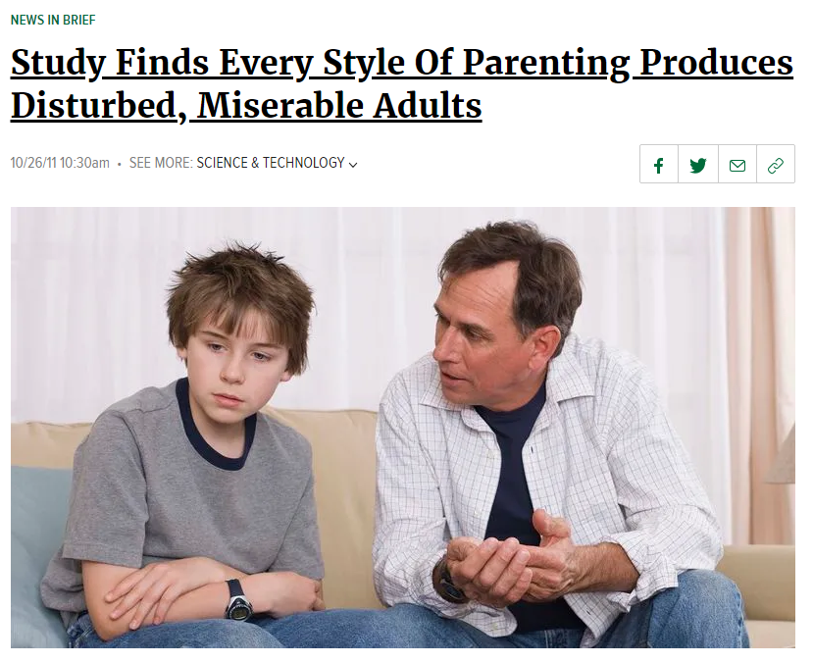
A study released by the California Parenting Institute Tuesday shows that every style of parenting inevitably causes children to grow into profoundly unhappy adults.
"Our research suggests that while overprotective parenting ultimately produces adults unprepared to contend with life's difficulties, highly permissive parenting leads to feelings of bitterness and isolation throughout adulthood,“…Despite great variance in parenting styles across populations, the end product is always the same: a profoundly flawed and joyless human being."
The study did find, however, that adults often achieve temporary happiness when they have children of their own to perpetuate the cycle of human misery.

Slide 24
Helicopter parenting: should we wrap them up in cotton wool or should we let them fail?
Dr Trevor James

