Slide 1
Co-producing campus-community employability & engagement
HEI context: tensions
Growth in credit-bearing volunteering: mutually beneficial service learning?
NSJF pilot study (with VODA): listening to staff and VCSE partners
Lessons from Geo2138/Geo3143: developing student experience; scope to co-produce transformation
Concluding remarks

Slide 2
HEI context and tensions
External partnerships enshrined in NU Vision, E&P
HEI ‘third mission’ of public good via charitable status
Engagement built on justice, not charity
(Heron 1996; Morton 1995)
Community connections (volunteering, social action and transformation) that go beyond individual/instrumental: coordinated activities and systematic embeddedness
Feelings of empowerment and collective social responsibility: a local politics of care
(Omoto and Snyder 2009)

Slide 3
Growth in credit-bearing volunteering: mutually beneficial service learning?
Definitions and attributes: experiential service learning
Context at Newcastle University
NSJF pilot study with VODA, survey of relationships:
NU survey of credit-bearing placement types
Building external relationships: what works; what doesn’t work; resource
A partial picture but reveals scope to scale up subject-specific experience of service learning

Slide 4
UG placement education currently on offer at Newcastle University - emphasising external partnership with voluntary and community sector
UG/PGT placement type: | Delivered by/WAM Resource | Approx. students annually
General employability via Career Development Module (CDM) (non-subject-specific transferable skills volunteering, tutoring, service) | Careers Service | c.270 University
Subject-specific experiential service learning (e.g. GEO2138, GEO3143, POL2096, POL3103, BUS3007) includes volunteering and PAR | Degrees; Schools | c.60 HaSS partial
UG Pro-bono vocational projects and services (credit bearing and extra-curricular volunteering) (e.g. Street Law, APL¹, IHS VOICE) | Degrees; Schools; Institutes | c.80 HaSS & IHS partial
UG Professional Placements (full year) (e.g. SAgE, FMS) | Faculties Schools | -
Other types of placement, paid internships, year abroad etc. | Careers Service | -
1. modest by comparison with e.g. UCL partnerships via Just Space
https://justspace.org.uk/
https://doinggoodleeds.org.uk/leeds-acts/
https://www.ncl.ac.uk/nuls/probono/street_law/

Slide 5
Building external relationships: essential to experiential education and service learning
What are the main barriers to building external relationships? NU NSJF survey: respondents could select more than 1 statement out of 5 | N=25
Limited student/staff availability (timetables) | 22
Lack of funding/institutional support | 14
Unclear whether/how partnerships are valued (workload, impact, REF) | 10
Ethics and risk assessment burden | 9
Waiting for introduction/support | 5
“Time it takes to develop and maintain relationships” “Student workload and semester timings” “The precarious nature of the voluntary/community sector funding currently”
What are the key benefits you would look for in building external relationships? NU NSJF: respondents could select more than 1 statement. | N=25
Access to opportunities for real-world research (participants, data etc.) | 24
Opportunity to demonstrate social responsibility (as volunteers, as trustee) | 20
Student placement opportunities | 14
Collaboration on one-off events | 14
Access to VCS facilities (projects, training, premises) | 8
“Mutual learning opportunities” “Reciprocal relationships
“Opportunities for more problem-based learning” “Doing useful research”

Slide 6
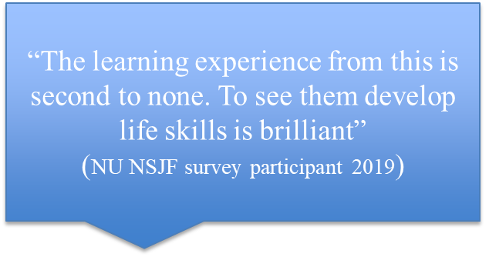
“The from this is second to none. To see them develop life skills is brilliant”
(NU NSJF survey participant 2019)
“The students made us step up – honestly. Being a volunteer led organisation, we had become accustomed to some bad habits: they were prompt, professional and reliable”.
“I believe Universities are hugely underutilised resources. Community projects rely on enthusiasm and involvement from people like your students”
(VCSE Partner feedback 2017)
“Overall the placement was a very positive experience. The enthusiasm shown by the students taking part brought a really positive energy to the project” “Lessons we learned were partly about timing; not having clear aims at the start. We massively relied on the flexibility shown by you and the students to extend the placement period”
(VCSE Partner feedback 2017)

Slide 7
Lessons from Geo2138/GEO3143
Space, time, environment matters: circle arrangement
Using language/methods to emphasise non-hierarchical interaction (workshops, not lectures/seminars; co-produce ground rules; eating/sharing together)
Shifting ‘content’ from instruction to inspiration: deliver instruction remotely to make space for reflective practice
Multiple evaluations integral to reflection and awareness
Graduate skills viewed over the long-term – drawing on alumni as mentors/champions in service-learning

Slide 8
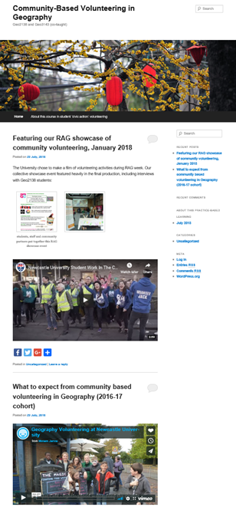
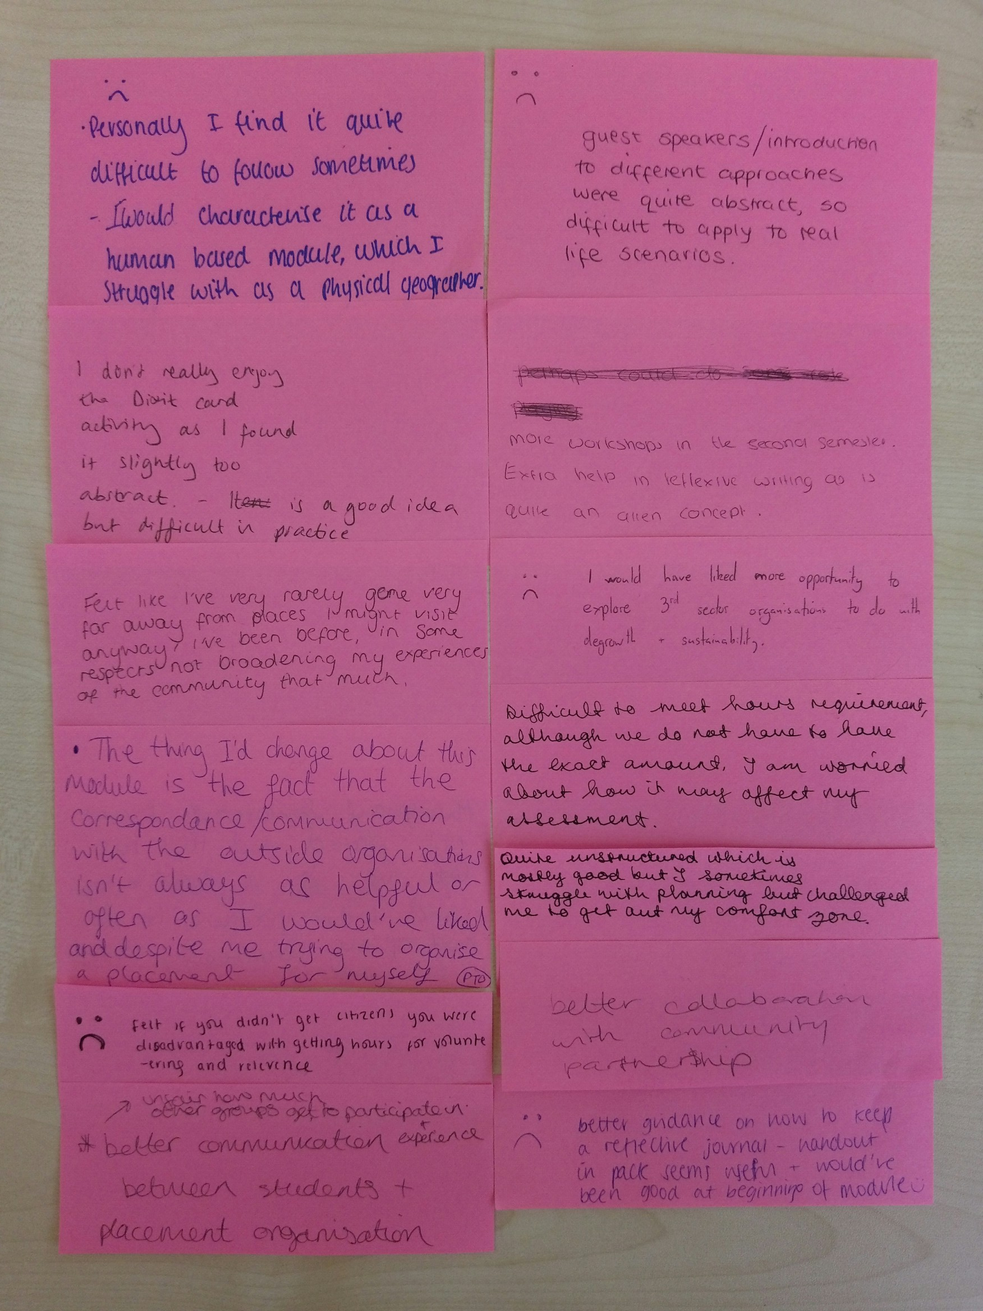
Multiple Evaluation
Passion
Enthusiasm
Real-world problems
Discovering strengths
https://vimeo.com/206724083

Slide 9
Concluding remarks
Graduate skills
Commitment needed from above/centre (Door/Hub, WAM policy, vision and values) and below (staffing, CPD, team-work)
Resource implications: time, space/environment, expenses reimbursed for partners and for students
Opportunities for shared learning: tensions between generic model of support and subject-specific delivery

