Slide 1

2500 students have volunteered with us this year
Over 300 partner organisations in the VCSE sector
Volunteering opportunities are coordinated through:
- Referrals to local charities, voluntary organisations and schools
- Internally led projects, some in collaboration with academic schools
- Grants scheme
- Into Schools
Notes:
Katie…
Go Volunteer is a team of 9 staff. We develop, coordinate and deliver a full range of volunteering opportunities and also employability and skills support. So far this year over 2300 of our students have volunteered through us and we have worked with 200 partner organisations including local charities, community and voluntary groups and schools
We coordinate volunteering predominantly through three ways.
Firstly – traditional brokerage with the VCSE sector.
Information on all of our opportunities are displayed on our website and also promoted through our newsletter and social media

Slide 2
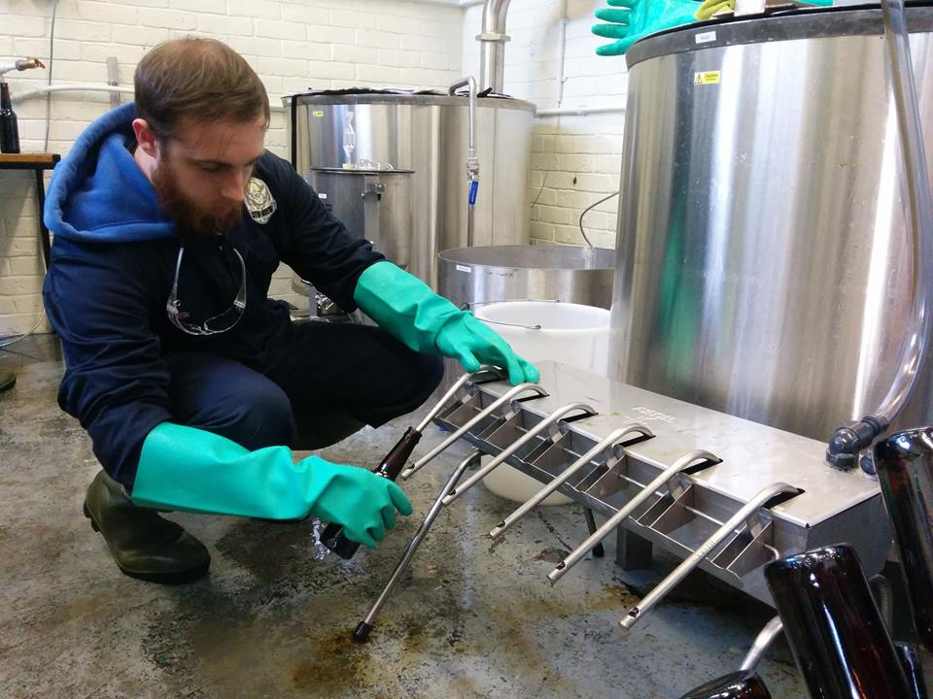
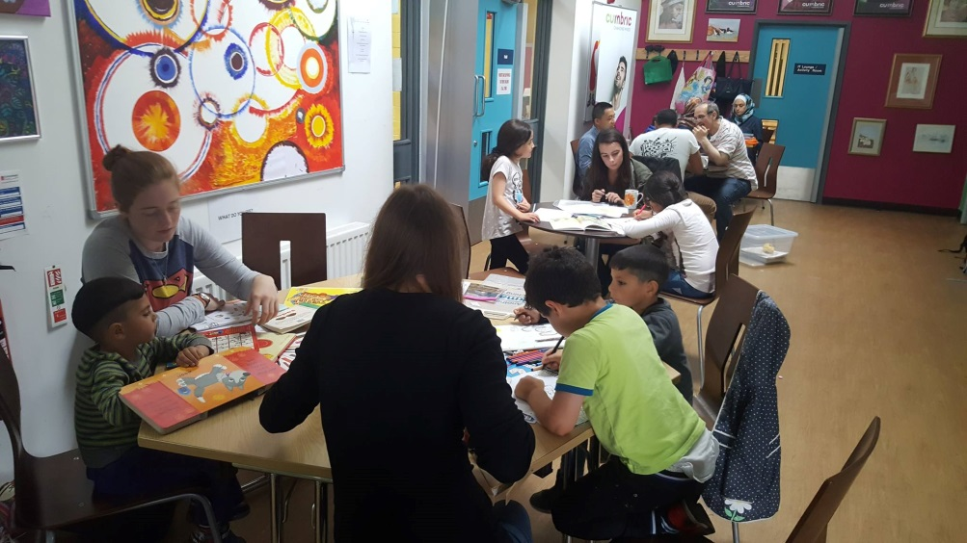
I’ve wanted to be a primary school teacher for as long as I can remember. N.E.S.T has helped me achieve that goal by not only allowing me to gain general teaching experience, but specialist experience with children who have English as an additional language - a skill which is highly desirable in education at the moment.
Alex Forbes, N.E.S.T volunteer, 2018 Newcastle University graduate, teacher in training
Stu-Brew gives me a leg up at assessment days when I have to stand out against 200 other applicants for the same job.
Harry Laing, Stu-Brew President

Slide 3
Further information…
Assist with sourcing placements in the VCSE sector or in one of our internally led projects
Volunteering opportunities tailored to areas of study
Further information about our full range of projects is at: https://www.nusu.co.uk/volunteering/govolunteer/
Alternatively please feel free to arrange a chat with us, we are on the first floor of the Students’ Union building
Contact:
Katie Blundell volunteermanager.union@ncl.ac.uk
Tel: 0191 239 3968
Notes:
We have these opportunities available and we are keen to reach out to students through as many channels as possible and encourage them to take up volunteering.
Always very happy to discuss opportunities for working together. We can…

