Slide 1
Hanno Kossen Teaching Fellow in Chemistry 03/04/2019 ULTSEC Innovation Fund: Nick Walker, Chris Graham Johan Eriksson, Christian Lawson-Perfect, Abbi Mullins, Matthew Sykes
NUMBAS for Chemistry – Changing Assessment of Numerical Skills

Slide 2


Introduction
Student’s might expect:
And they will also get:
… and many employers like it

Slide 3
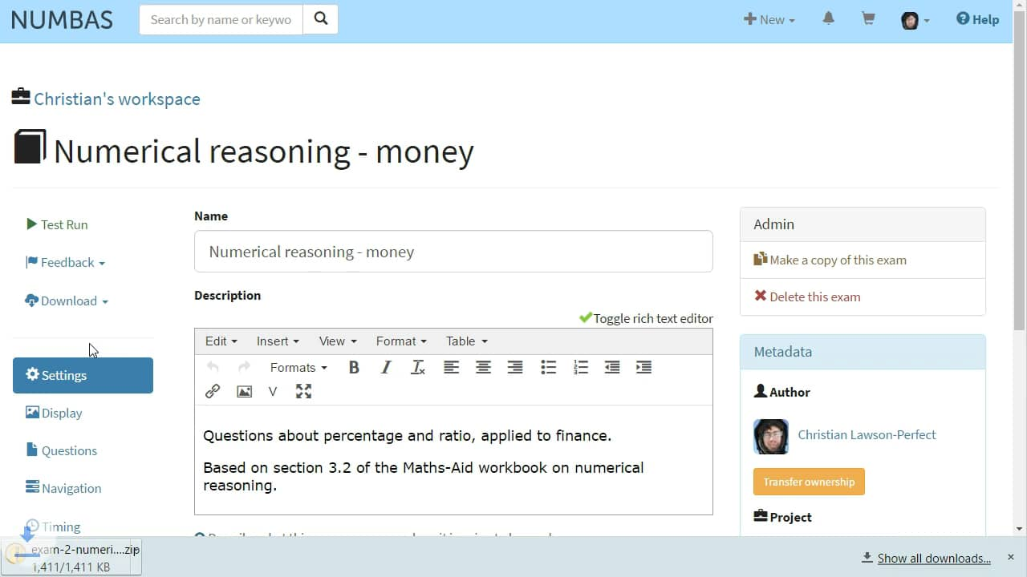
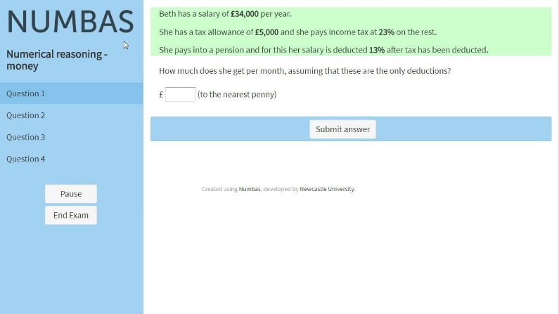
Objectives
Enhance chemistry students’ numeric skills
Boost students’ confidence tackling challenging mathematical problems
Generate practice questions and feedback that support learning cycles
Develop skills in using NUMBAS to deal with all of the above

Slide 4
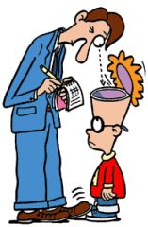
Methods
Number entry and conventional questions (MCQ/Gapfill)
Interface (vs. Blackboard) and functionality (partial credit, visibility)
Using NUMBAS to improve feedback
Instant on formative assessment – tailored to focus on needs
Quick Assessment, quick feedback even when used summatively
“Fair” marking
Clearer assessment criteria (scores per question)
Using student-entered data as variables – mistakes become calculation errors

Slide 5

Evaluation
Stats
Comparatively low N/A rates
Discrimination of marks
Individual question evaluation
Stage survey: n ~ 60, Comments: n ~ 35
Relatively clear connection between learning activity and assessment
More guidance when completing assessment – use formatively?
Learning most from using equations
Not suited to everyone
Students don’t trust the algorithm

