Slide 1


Learning and Teaching Conference
April 2019
Introduction of academic mentors and e-portfolio to support personal and academic development
David Kennedy
School of Medical Education
Notes:
1

Slide 2


Background
Personal tutoring has been ineffective in MBBS for many years and student evaluation was poor.
Tutors were drawn from the Faculty, many of whom had little involvement with the MBBS programme.
Tutor meetings had little focus or perceived value, leading to poor uptake and few relationships being established.
Access to Tutors was problematic for many.
To compensate, academic and pastoral support was offered to students identified as in need by a core of staff in the School.
#nclmed1

Slide 3
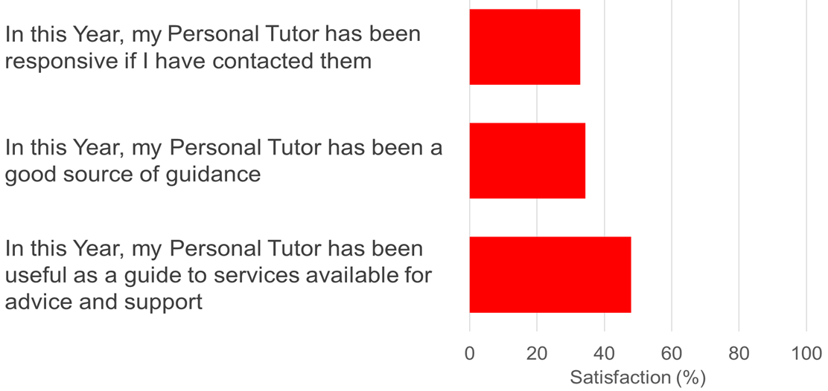
Evaluation – Personal Tutors
n = 192
#nclmed1

Slide 4
e-portfolio usage Semester 1 2016-17
School | Number of students | Number of students meeting the KPI | Percentage
D-SME | 254 | 40 | 15.75%
Overall Total | 6130 | 2967 | 55.06%
 | - School meeting the University KPI of 70%
 | -School has less than 40% of total enrolments with the required number of meetings
The meeting requirement for Stage 1 Semester 1 is that students have one meeting and a further offer of a meeting within the semester.
Lowest performing school in the University against KPI
#nclmed1

Slide 5
Changes for 2018-19
Implementation of a new curriculum from Year 1 in 2018-19.
Reduction in number of lectures with more content to be delivered in small groups and/or via the VLE.
An additional 99 students commencing Year 1 at Newcastle (with a further 24 additional students from 2019-20).
Improvement in academic and pastoral support and guidance through introduction of Academic Mentorship supported by a bespoke e-portfolio.
#nclmed1

Slide 6
Introduction of Academic Mentorship
Academic Mentorship subsumes personal tutoring and is akin to educational supervision in post-graduate training.
Mentors are trained School-based staff who are the students’ primary port of call for advice and support on academic, professional and pastoral matters.
Academic mentors listen to and support students in difficulty, monitor students’ engagement with learning and teaching, support students in their development of learning plans and provide guidance in relation to policies and procedures.
#nclmed1

Slide 7
Academic Mentor meeting schedule
Month | Meeting | Purpose
September | Meeting 1: Introduction & Induction | 1h group discussion with opportunity for one-to-one.
November | Meeting 2: Results and Feedback | 20min one-to-one discussion and action planning following first assessment results.
December | Meeting 3: End of Semester 1 | 20min one-to-one discussion about progress, upcoming assessments and sign-off of mandatory training.
January | Meeting 4: Results and Feedback | 20min one-to-one discussion and action planning for those who are “red” or “amber” in assessments.
February | Meeting 5: Results and Feedback | 20min one-to-one discussion and action planning for those who are “red” or “amber” in assessments.
May | Meeting 6: Appraisal | 20min one-to-one discussion around progress and, completion of sign-offs and action plan for following academic year.
June | Meeting 7: Results and Feedback | 20min one-to-one discussion with those that are “red” in the end of Year assessments and required to resit.
#nclmed1

Slide 8
Development of the supporting e-portfolio
To facilitate academic mentors in supporting their mentees we developed an e-portfolio which provides both parties with a range of tools including:
Information held on the student record, including attendance.
Assessment results and feedback.
Clinical skills and mandatory training records.
Sharing of reflections and learning plans.
The use of the e-portfolio and student evaluation of academic mentorship was analysed to measure impact.
#nclmed1

Slide 9
e-portfolio

Slide 10
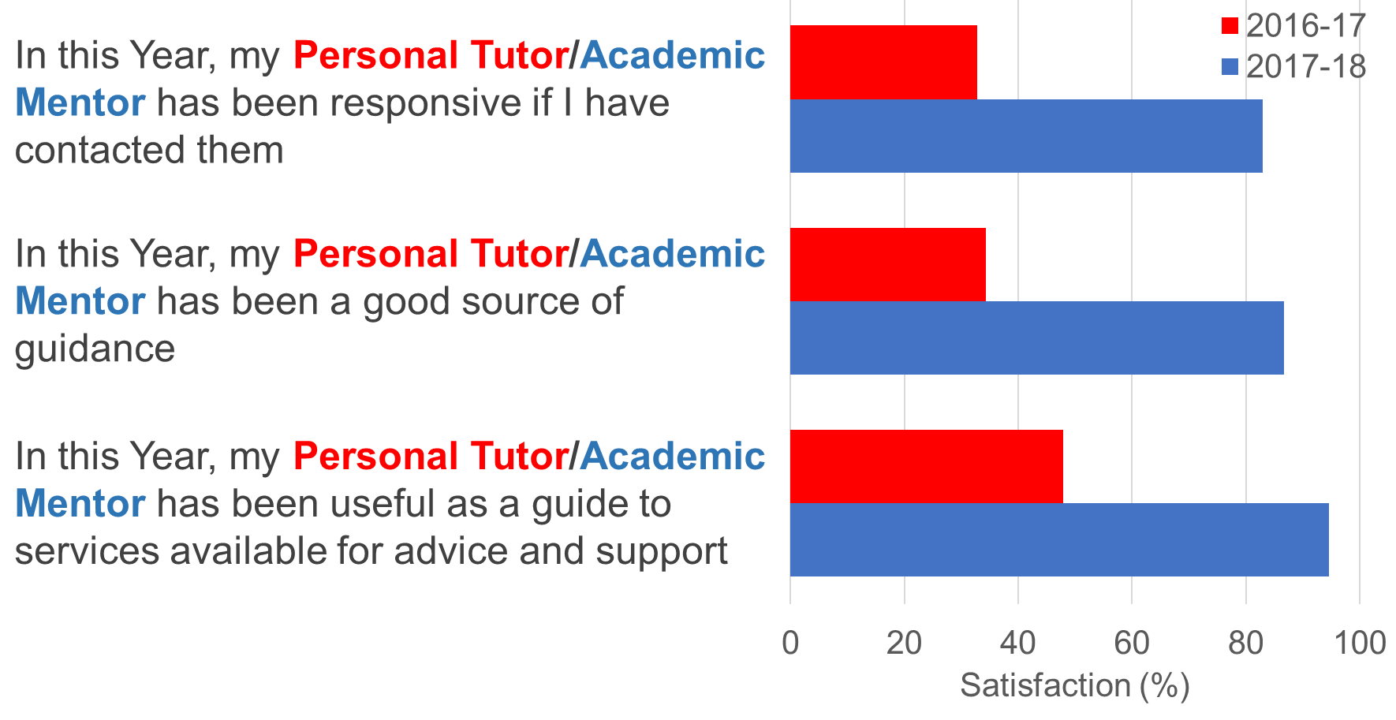
Improved evaluation
2016-17, n = 192
2017-18, n = 269
#nclmed1

Slide 11

Improved evaluation
My mentor was incredibly useful and played a crucial role in ensuring my success this year. She talked me through my results, offered me advice on my learning and also on life in general
The Academic Mentor meetings has allowed me to reflect on my learning style & improve it as well as motivate me when I needed it
I think the academic mentor system for medicine has been absolutely fantastic, no one goes unnoticed!
The academic mentor system is a faultless support network that has never failed me
End of Year 1 evaluation comments on the Academic Mentorship scheme.
#nclmed1

Slide 12
e-portfolio usage Semester 1 2017-18
School | Number of students | Number of students meeting the KPI | Percentage
D-SME | 372 | 371 | 99.73%
Overall Total | 6315 | 3277 | 55.20%
 | - School meeting the University KPI of 70%
 | -School has less than 40% of total enrolments with the required number of meetings
The meeting requirement for Stage 1 Semester 1 is that students have one meeting recorded in the portfolio in the first 4 weeks.
1671 Year 1 meetings recorded in the e-portfolio
Highest performing school in the University against KPI
#nclmed1

Slide 13
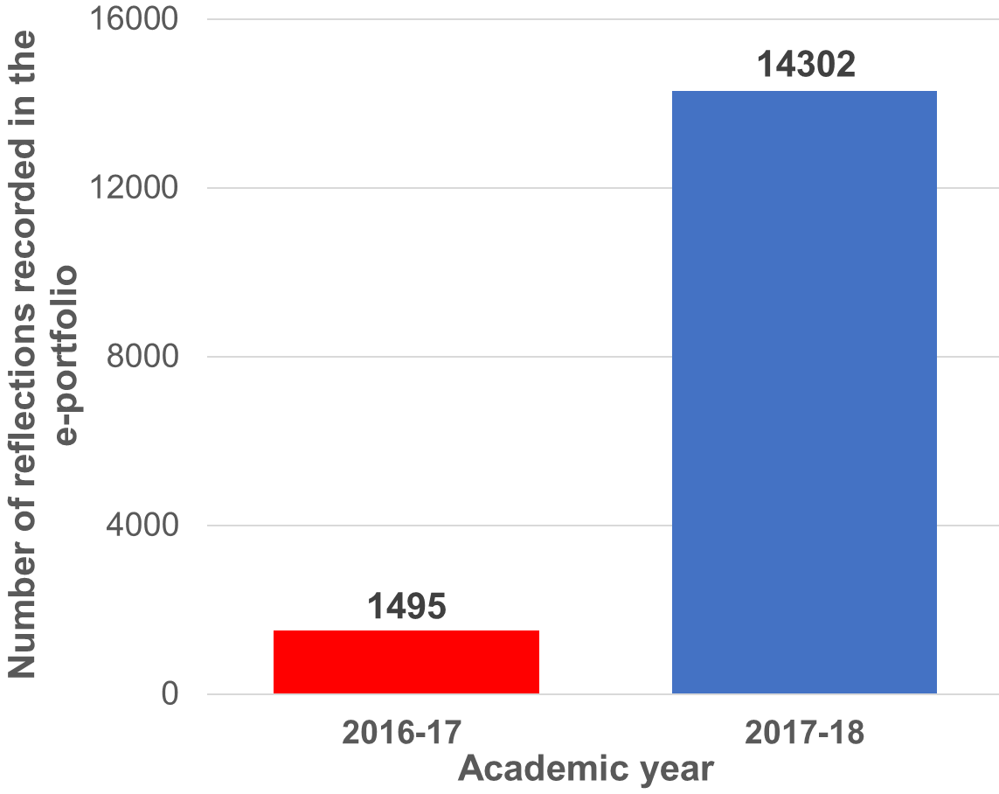
e-portfolio usage
10771 Skills sign-offs recorded
4198 Mandatory training sign-offs completed
#nclmed1

Slide 14
Conclusions
Academic mentorship, and the supporting e-portfolio, enables engage in meaningful discussion supporting students pastorally as and in their personal and academic development.
Students and mentors engage with tools with the e-portfolio to inform discussion around academic progress.
Purposeful, regular and informed meetings between staff and students helps develop a professional personal relationship, despite the large cohort size.
It has helped to identify and remediate any issues early.
#nclmed1

Slide 15

Thank you
Dr David Kennedy, School of Medical Education
Dr Kenneth McKeegan, School of Medical Education
Mr John Moss, Learning Technology Support Unit
Mr John Peterson, Learning Technology Support Unit
Mr Daniel Plummer, Learning Technology Support Unit
#nclmed1

