Slide 1

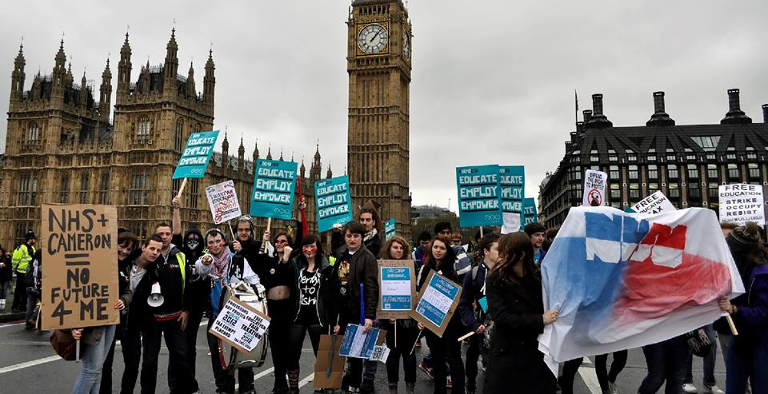


Three views on enhancing student-staff partnership.
Ruth Furlonger – Staff Facilitator, Combined Honours SSC
Natalie Garner – Student Chair, Combined Honours SSC
Joe Barton – Representation & Research Coordinator, NUSU

Slide 2
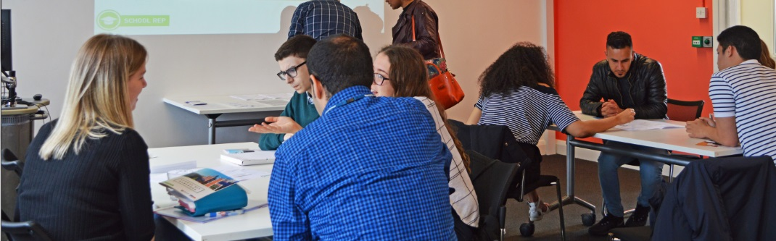
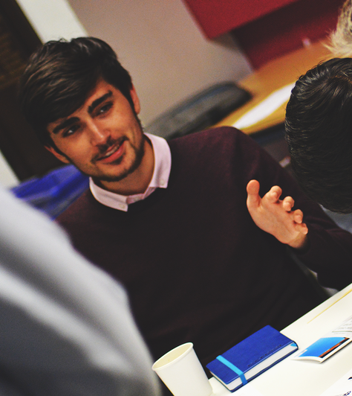
Objectives
Background
Staff perspective
Student perspective
Students’ Union perspective
Q&A

Slide 3
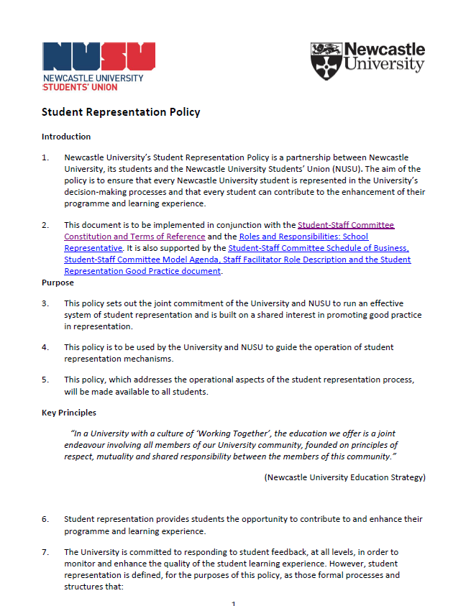
Why enhancement?
Enhancing Representation
Policies essential for developing and establishing academic representation.
Academic Units welcome to enhance and innovate according to their individual needs and culture.

Slide 4
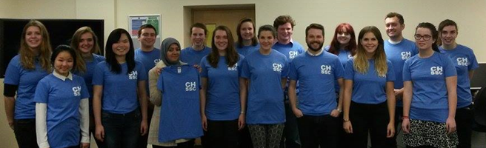
Staff perspective
Enhancing identity & belonging
‘In house’ student-led training to empower reps from day 1.
Identifying and developing key areas reps want to work towards.

Slide 5
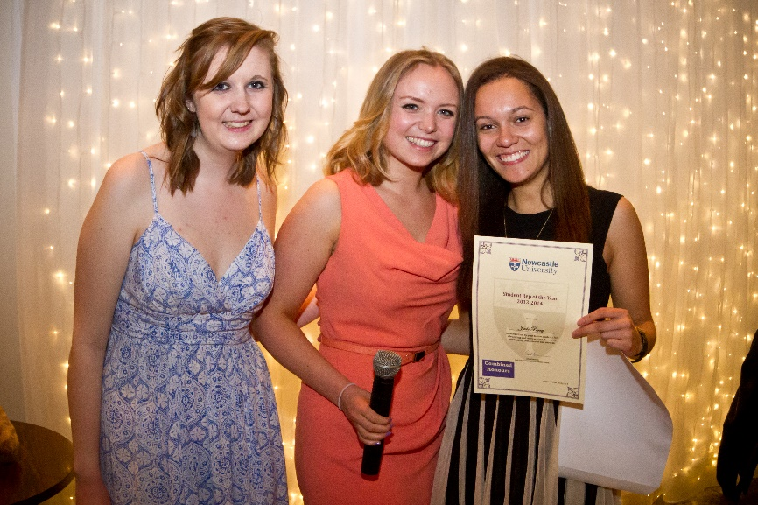
Staff perspective
Building strong relationships
Student chair & secretary = committee leaders; staff facilitator supports their personal development
Close links between reps & constituents: establishing cohort-wide forums twice a year.

Slide 6
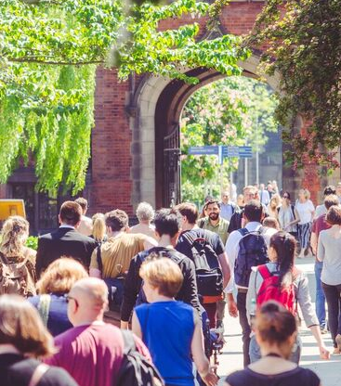
Student perspective
A departure from previous experience
Students in the driving seat.
The opportunity to make a real difference.

Slide 7
Student perspective
Student led initiatives
Working groups.
Need for more recognition?

Slide 8
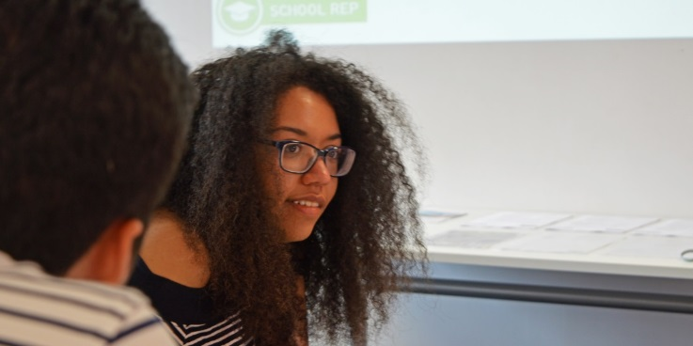
Students’ Union perspective
Encouraging students to lead
School of English UG SVC.
Equality, Diversity and Inclusion: student ownership and shared outcomes.
“In consultation with the Chair of the EDI Committee, I designed a survey which aimed to capture as much information about EDI in the School as we could. The results of the survey were discussed at the EDI Committee, SVC and Board of Studies.
Staff were really receptive to the comments that students made, and we decided to make four key changes based on the survey's results” – Sam Cooke, SVC Chair 2017/18

Slide 9
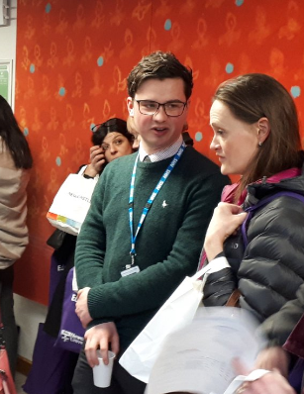
Students’ Union perspective
Enhancing students through representation
School of Dental Sciences SSC
‘Professional Learning through Student Representation Skills’ Award
Matthew Harper, Dental School Rep

Slide 10
Conclusion
The importance of supporting students to lead.
Representation is never perfect.
NUSU is here to help.

Slide 11
Any questions?
Ruth Furlonger (Teaching Fellow in Student Engagement, Combined Honours)
ruth.Furlonger@ncl.ac.uk
0191 20 83546
Natalie Garner (Combined Honours SSC Chair)
n.garner@ncl.ac.uk
Joe Barton (Representation & Research Coordinator)
rrc.union@ncl.ac.uk
0191 239 3990

