Slide 1

Twitter, Blogging & Big Questions
Dr James Stanfield
Lecturer
School of Education, Communication and Language Sciences

Slide 2
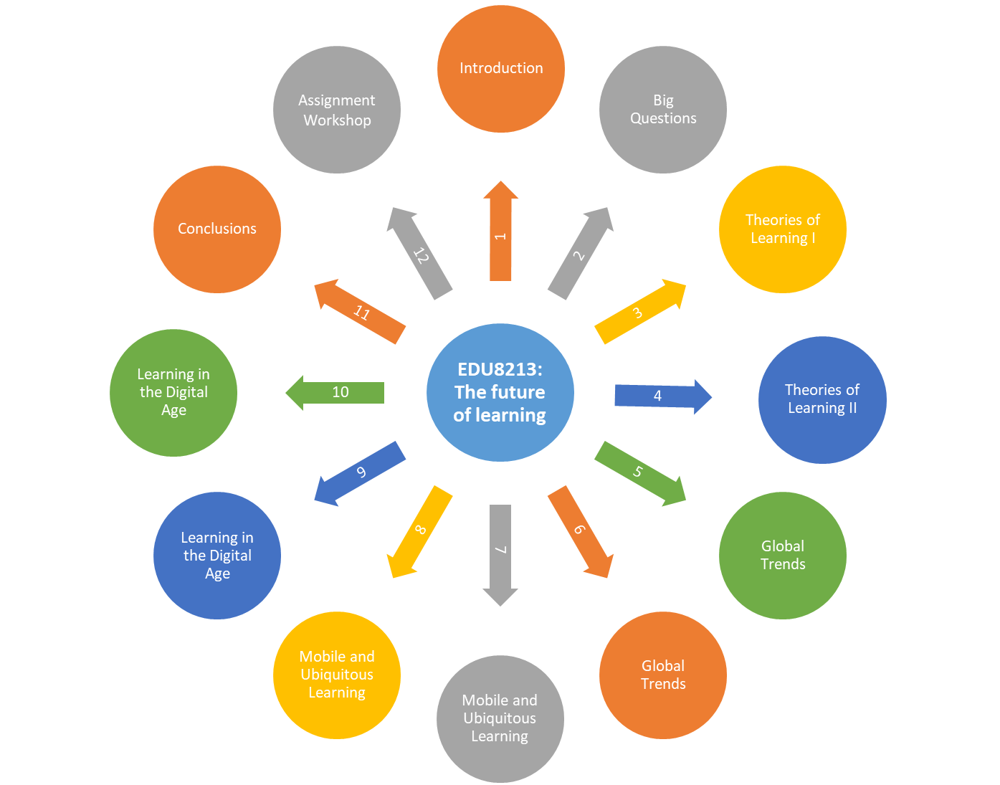
Assessment 3. Essay 2000 words (50%) submitted via blackboard with Ass 1 and 2 by Friday 25th Jan 2019.
Assessment 1. 1000 words (25%) posted on your blog by Monday 29th October
Assessment 2. 1000 words (25%) posted on your blog by Monday 26th November

Slide 3

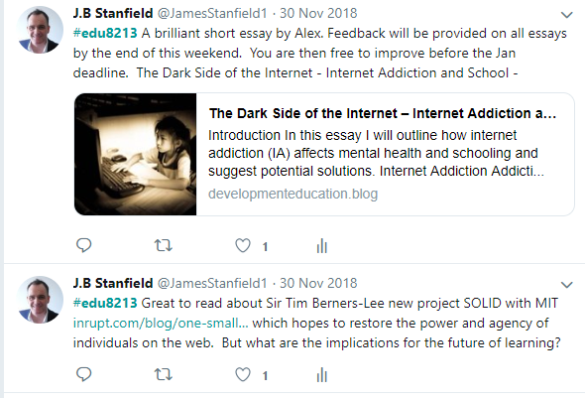
To encourage and congratulate students
To share resources with students
To challenge students
To encourage students to share resources with each other
#edu8213
Why use Twitter?

Slide 4
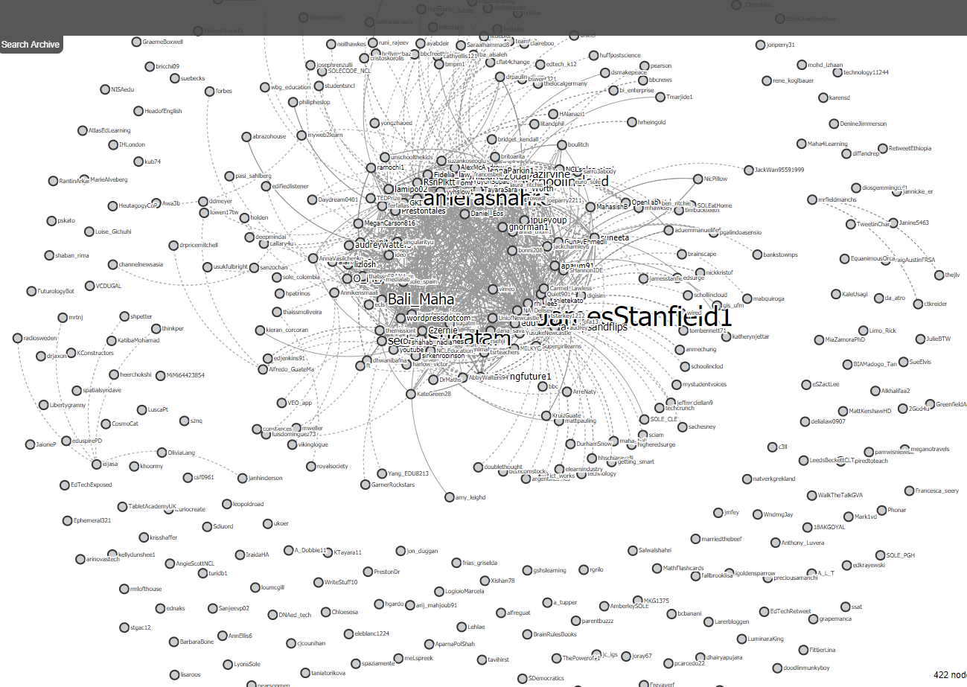
Why use Twitter?

Slide 5
Enables students to design and develop an online profile
Helps students to prepare for the final assessment
Enables students to receive feedback on their writing
Encourages students to address complex and challenging issues
Allows students to share their comments and reflections on the reading
Enables students to learn from their peers
Helps to identify those students who will need additional support
It helps me to learn and keep up to date with the latest literature and developments
Why use blogging:

Slide 6

Method:
Privacy Workshop in Week 1
Each week students are asked to address a big question or comment on the reading
Any interesting issues raised or anything new that I have learnt are then discussed in the seminar
Encouraging feedback is given to all students
Different features of WordPress are introduced each week
Students are asked to post their two short essays on the blog by a certain date if they want to receive feedback
Top tips are left in the feedback and students are encouraged to read each others essays and feedback

Slide 7

Pros & Cons:
Students benefit from reading each others blogs
It gives international students a voice
It helps all students to consider their online presence and how to develop it moving forward
It challenges students to address complex issues
Students welcome the feedback and the opportunity to improve their essays
When marking I am also learning – which is nice
It is time consuming but manageable with a class of 25
Some students will not blog unless it is directly related to their assessment

Slide 8

Final essay:
Students were asked to select one of the following three big questions which were not discussed in any detail in class:
When the internet becomes omnipresent how will we assess student progress?
How can a robot learn to teach children?
What is the value of human presence in the classroom?
Students were encouraged to:
Address the big question which they found to be most challenging
Not to use any of my references – they had to find their own
Share their final essay via their blog

Slide 9

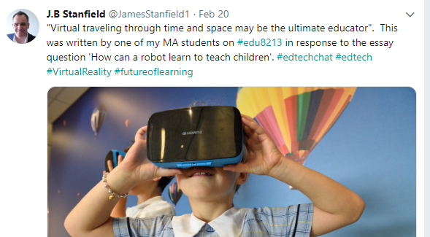

Thank you a lot for everything in the last year! And thank you for challenging me so much- if I was not pushed so much by you, I know how shallow and skin-deep my knowledge about technology and education could be. Just love the way you teach, and thank you for your 'big questions’!
Feedback:
Next steps:

Slide 10
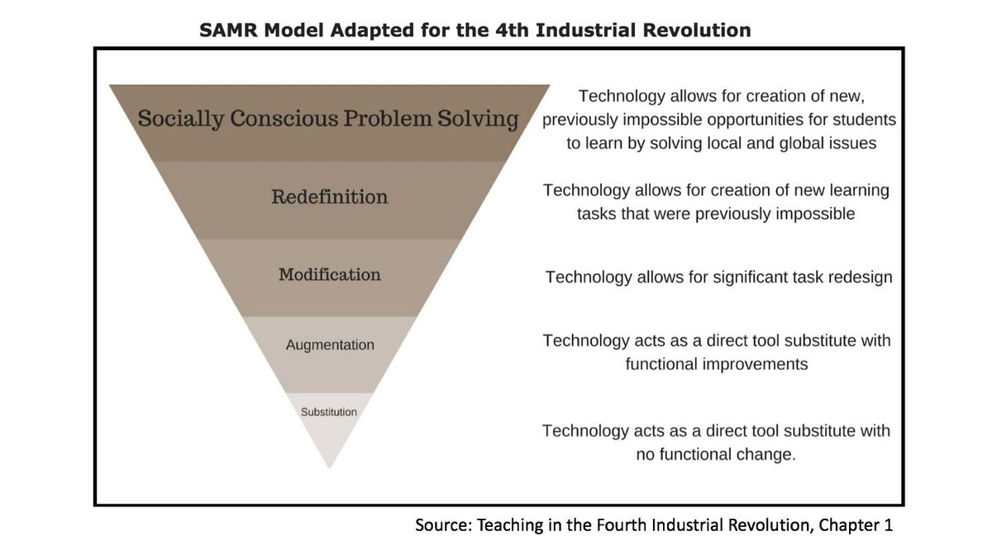

Slide 11
