Slide 1
Introducing Ncl3000
The Careers Service Placement Year Module

Slide 2
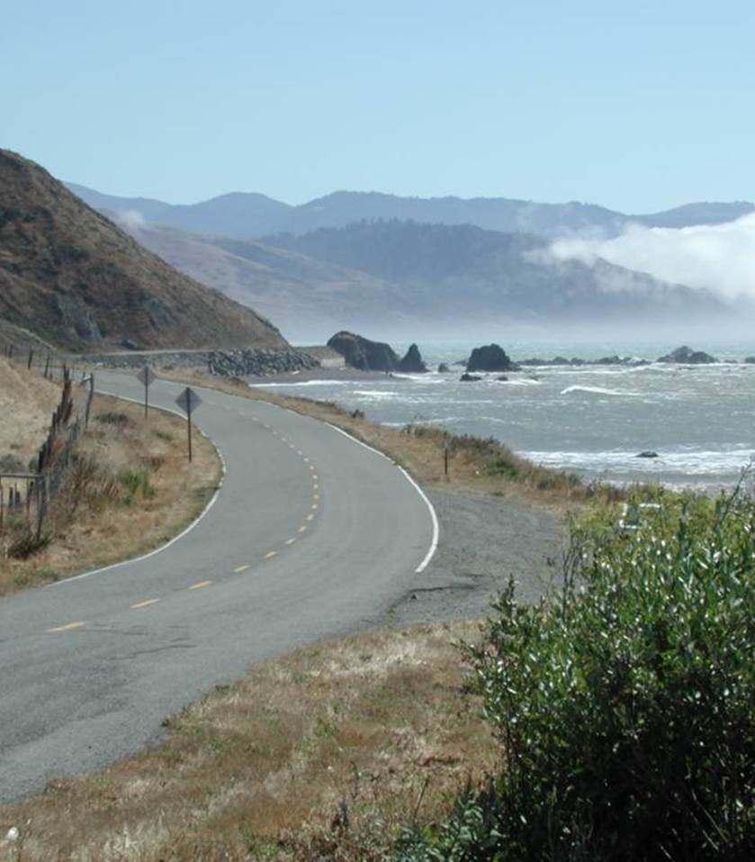
Today’s Roadmap
Module overview
Some key challenges
How we used learning design to address these challenges
Focus on personal and professional development
Bitesize learning via Blackboard
Formative assessment as advance milestones/checkpoints

Slide 3
Key Facts: Lightning round
9-12 month placement (1200 hours in total, minimum 1,131 completed in placement)
Academic module contributing 120 credits
Degree = xxx (e.g., Politics) with Placement Year/Year in Industry

Slide 4
Key challenges: Diversity
2017/18=27 students; 2018/19=77; 2019/20=??
Different degree programmes/disciplines
Different placement organisations and roles
Different stages in Career Planning/Thinking?
Different career trajectories

Slide 5
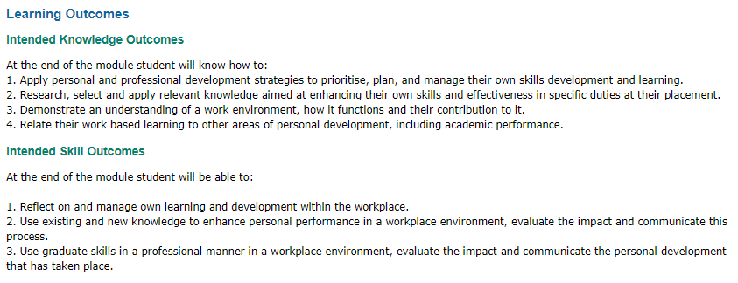
So we:
Focus learning design on core professional practice;
Bring personal and professional development front and centre.

Slide 6
Employability as Lifelong Learning
+
=
Learning to Learn

Slide 7
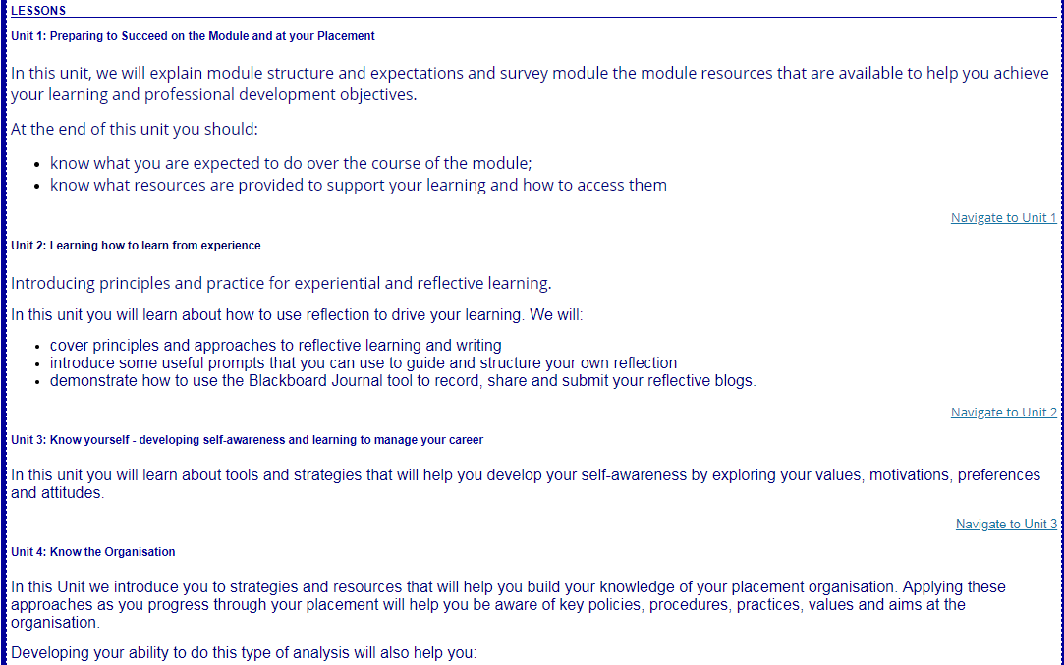
Distance learning with different start and finish dates
Notes:
How can we represent navigating a necessarily linear assessment schedule (Uni teaching/timetable weeks) with uniform cpntact and submission schedule alongside students’ staggered placement schedule. Find visual representation for uniform schedule. Our response has been to create resources for self-paced learning.

Slide 8
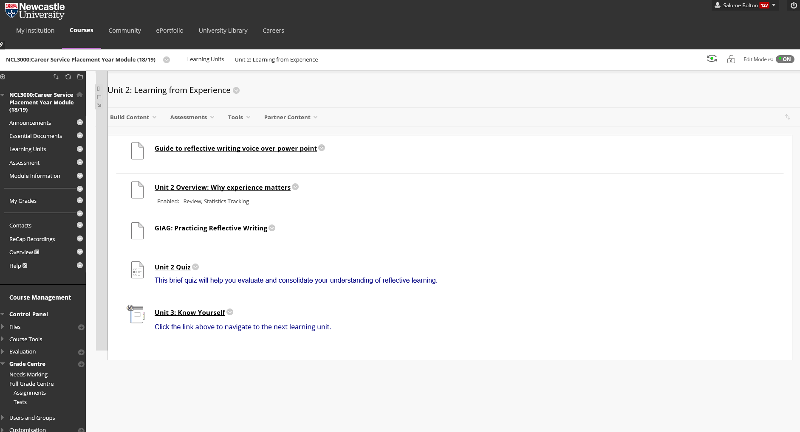
Bitesize and self-paced (with key milestones)

Slide 9
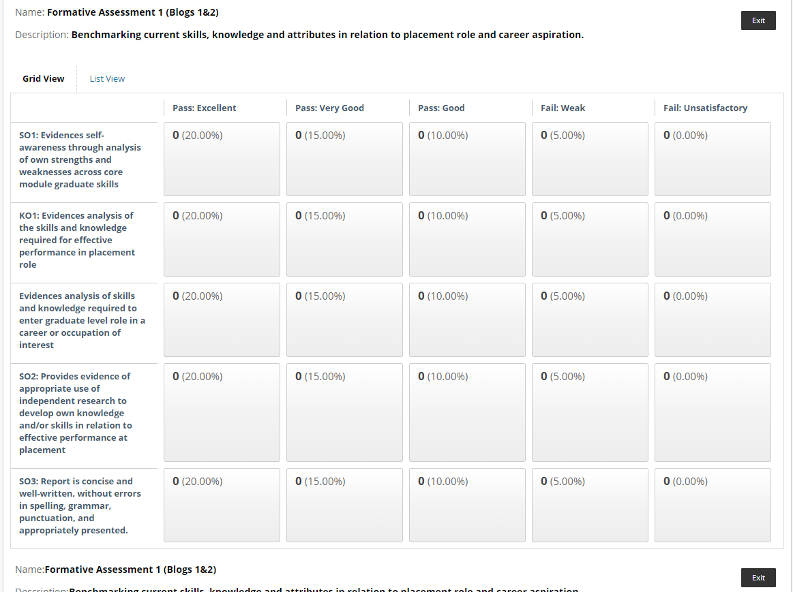
Key Milestones: 3 Formative Assessment Points

Slide 10
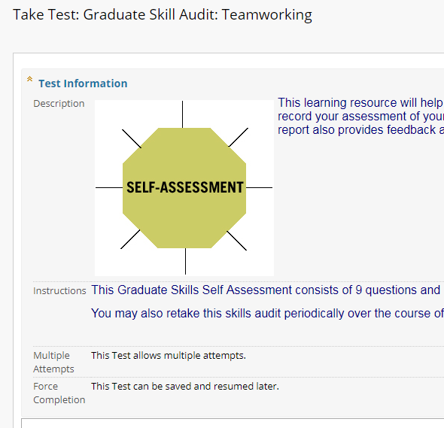
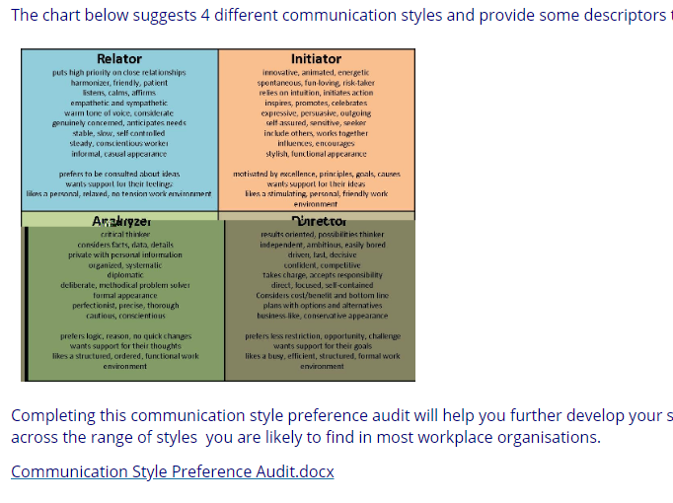
Other resources

Slide 11
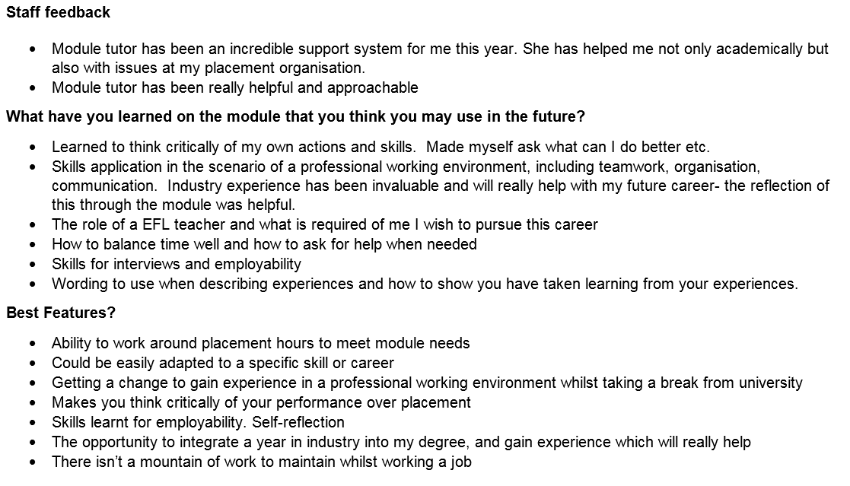
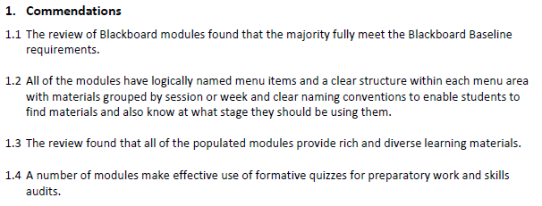
Pros & Cons/ Evaluation so far

Slide 12
Review: where we’ve been
Module Overview
Key Facts
(Some) Key Challenges
Focus on PDP is key
Practical implementation strategies
The journey so far . . .
Notes:
Recap
We’d be happy to talk about what we’ve learned through developing these resources (Good, Bad, Ugly), explore whether any of these resources or approaches might be useful for others (and not just placement modules), and what we see as next steps?

Slide 13
Questions?

