Slide 1


Integrating learning technologies for 3D visualisation
Abdullah Ben awadh
Institute of Neuroscience, Newcastle University
A.Ben-Awadh2@newcastle.ac.uk
@a_benawadh
Supervisors: Dr Iain Keenan,
Dr Jill Clark, Dr Gavin Clowry, Prof Susan Lindsay
ALLPPT.com _ Free PowerPoint Templates, Diagrams and Charts

Slide 2
Rationale
An understanding of 3D anatomical relationships is fundamental in the training of medical students
Interpretation of 3D anatomical features in 2D cross-sectional clinical images can be challenging
Digital visualisation technologies can be valuable for student learning
(Bajka et al., 2004; Choudhury, Gouldsborough, & Gabriel, 2010; Palombi, Pihuit, & Cani, 2011; Webb & Choi, 2014)

Slide 3
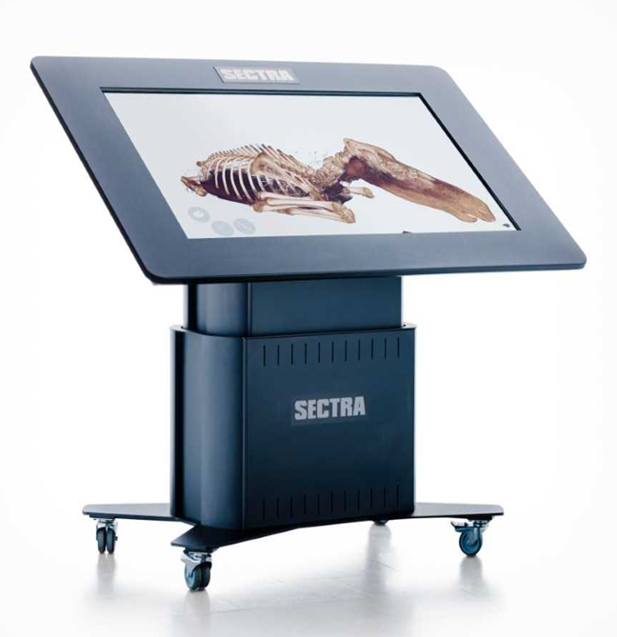
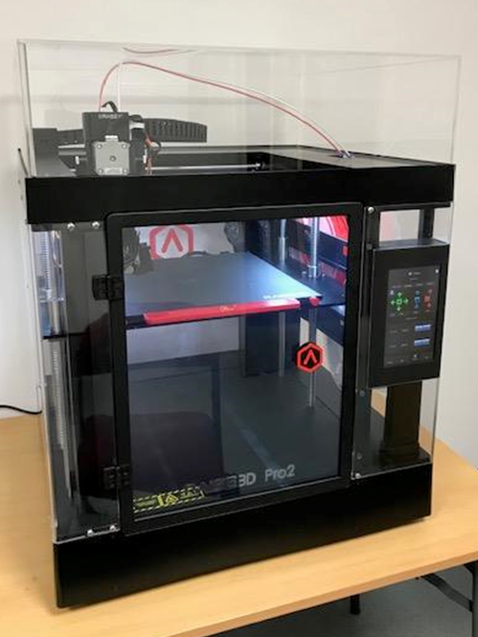
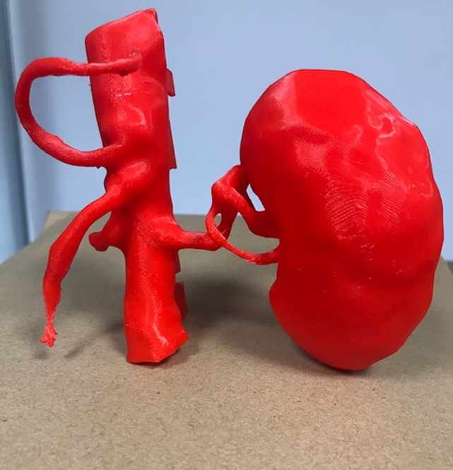
3D digital visualisation technologies
2- Three- Dimensional Printing (3DP)
1- Sectra visualisation table

Slide 4
Methods
Sample: Year 1 MBBS students
Year 1 gross anatomy - 90mins practical session
Sectra + 3DP models (thorax) – 10min activity
VHD 2D images (abdomen) – 10 min activity
Experimental pre-post testing
7 point Likert-type questionnaires (strongly disagree –strongly agree)
Statistical Analysis

Slide 5
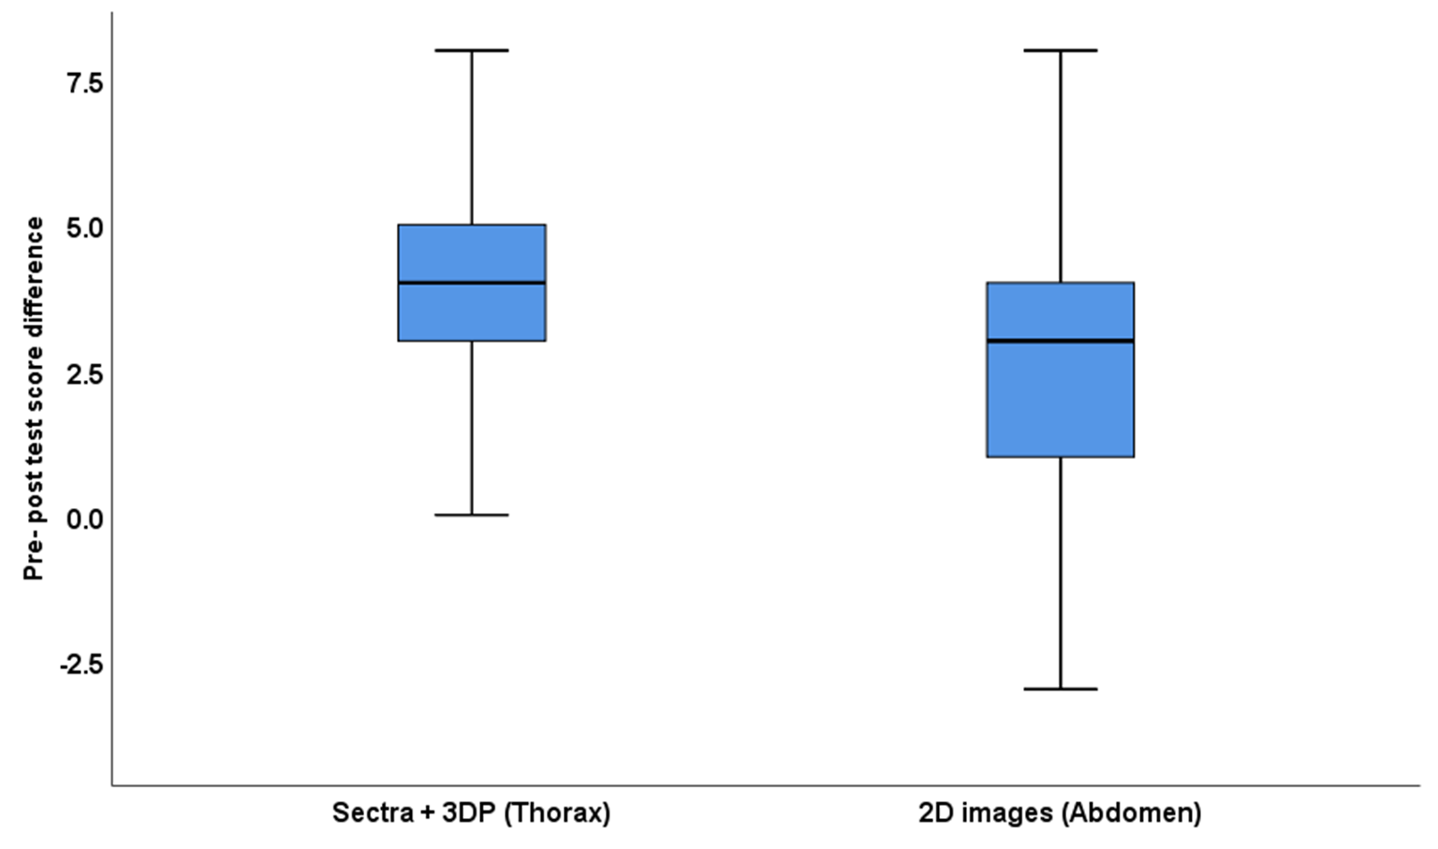
Student performance
Students performance using Sectra and 2D images
*
n= 229
* p < 0.001

Slide 6
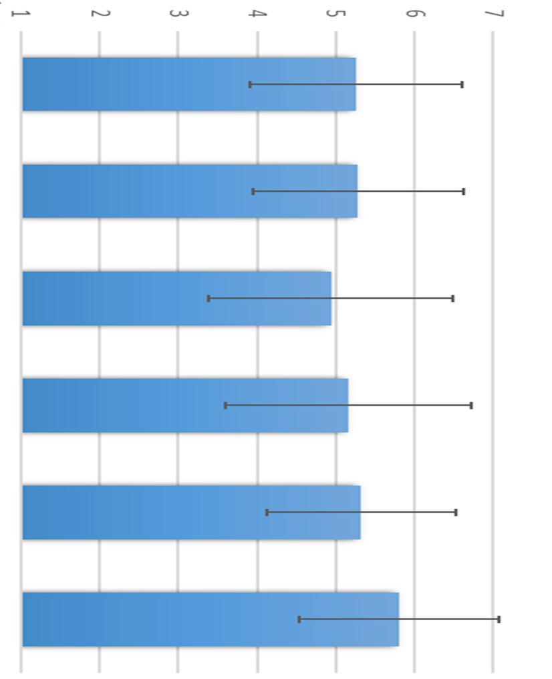
Mean response to Likert-type items
Sectra usage (1st year MBBS) n=319
Did you find the session useful?
Did Sectra help your 3D understanding
of anatomical regions?
Do you feel more confident after using the Sectra to identify structures in cross-sectional images?
Did you find the 3D render option useful?
Has interaction and manipulation of images on Sectra improved your anatomy learning and understanding?
Is Sectra a useful self-directed learning resource for studying clinical images?

Slide 7
Summary
Medical students had positive perceptions of Sectra and 3DP models
Students performance had a highly significant improvement using 3D technologies
3D learning technologies can effectively supplement traditional approaches

Slide 8


Thank you! Questions?
@a_benawadh

