Slide 1

From fake news to shrewd views: working with the Library to develop students’ academic skills
Newcastle University Library liaison team
@nclroblib
University Library
Explore the possibilities

Slide 2
Outline for today
Academic and research skills resources
Employability
Reading lists online
Explore for yourselves
What we’ve been up to
Feedback and discussion
Have a look at our resources

Slide 3
Academic and Research Skills

Slide 4
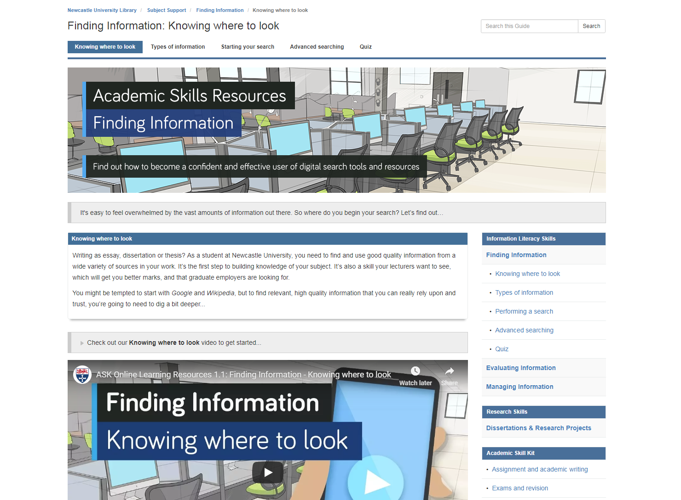
Academic skills learning resources
Information literacy provision was good, but inconsistent and difficult to find
Refocused and created new skills guides (Finding • Evaluating • Managing)
One-stop shop
Video, text and interactive tools
High quality, improved visibility

Slide 5
Feedback
Well Spoken
Step-by-step
Relevant
Educational
Good quality
Excellent content
Well thought out
Informative
Interesting
Fast
Useful
Short and simple
Straight to the point
Clear and concise
Not too long winded
Detailed yet simple
Professionally done
Helpful
Easy to understand

Slide 6
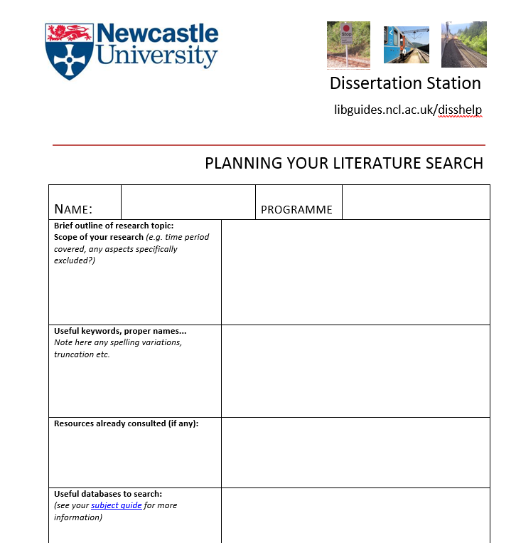
Research skills
Dissertation/project planners
Previous provision was a dated libguide and Word form
Developed new online guide with WDC team
Interactive tools to simplify literature search and project proposal planning
Takes a stepped approach to keep process simple and manageable
Plans can be saved, emailed, developed, reviewed

Slide 7
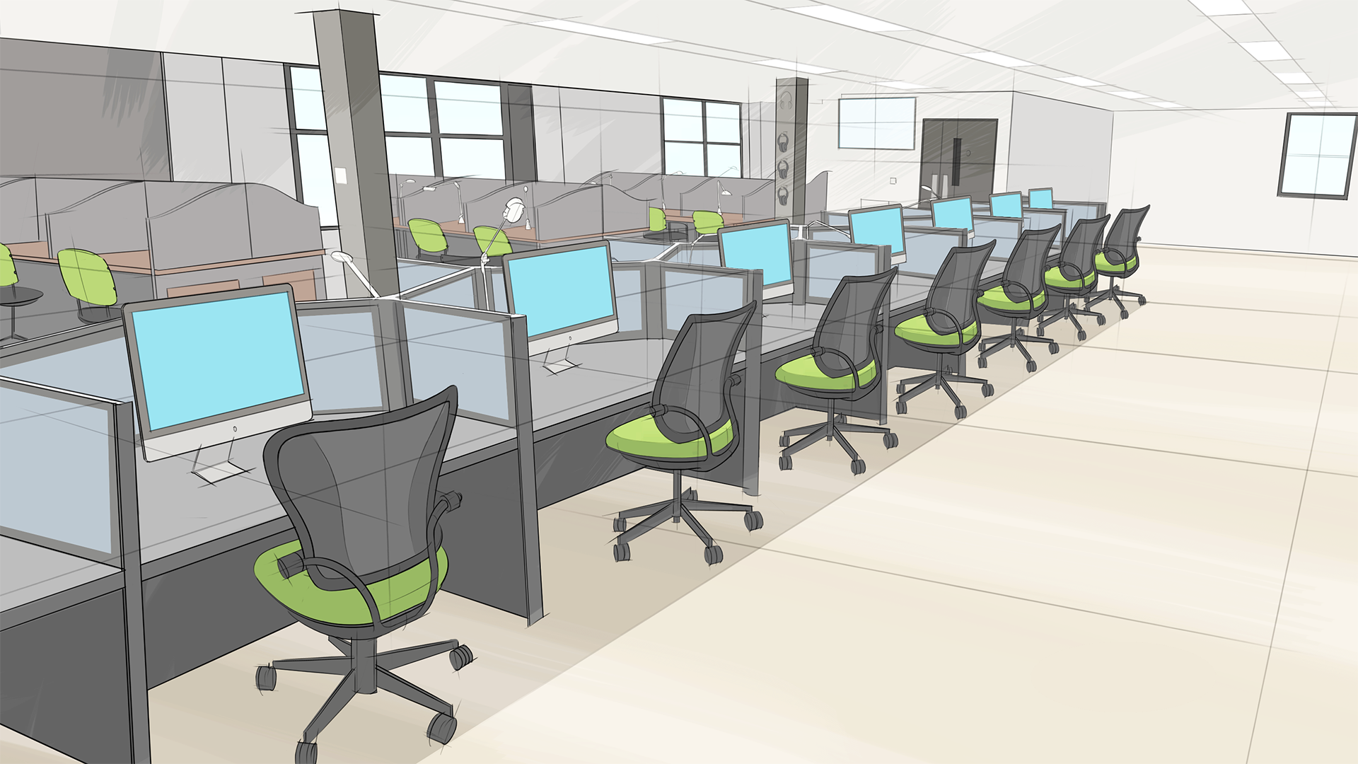

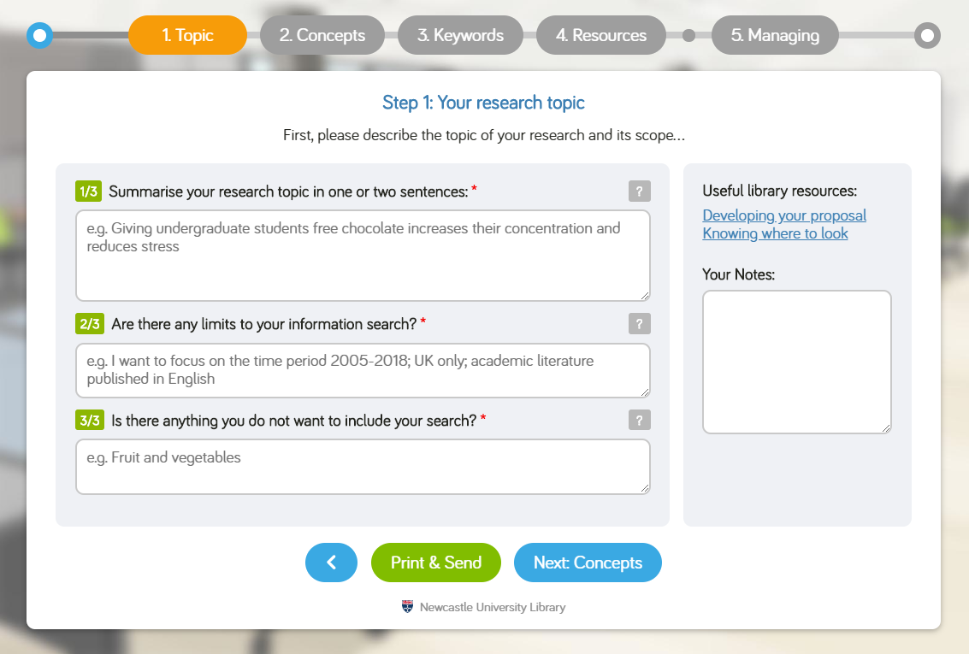
New planners
libguides.ncl.ac.uk/dissertations

Slide 8

Using the new resources
Liaison team using them in teaching at all levels: face-to-face, online and flipped classroom
Supporting individual enquiries and appointments
Embedded in BB modules
Promoted via our marketing and comms teams
Can you help us?...
www.ncl.ac.uk/library/subject-support

Slide 9
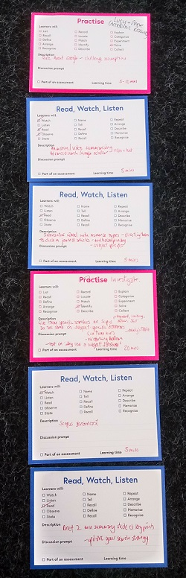
Research skills
HSS8002 module
Longstanding information skills module for PGR/research masters students
Growing in content, complexity, cohort
Difficult catering for mixed experience, subject areas, availability, information needs
Negative feedback re lack of flexibility and tailoring
HaSS Faculty using blended delivery for PGR training modules
Five month project….for delivery October 2018
Collaboration with LTDS

Slide 10
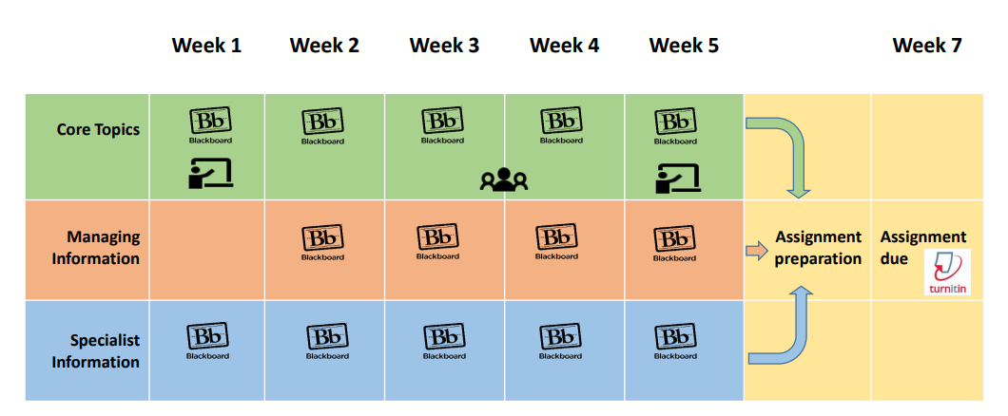
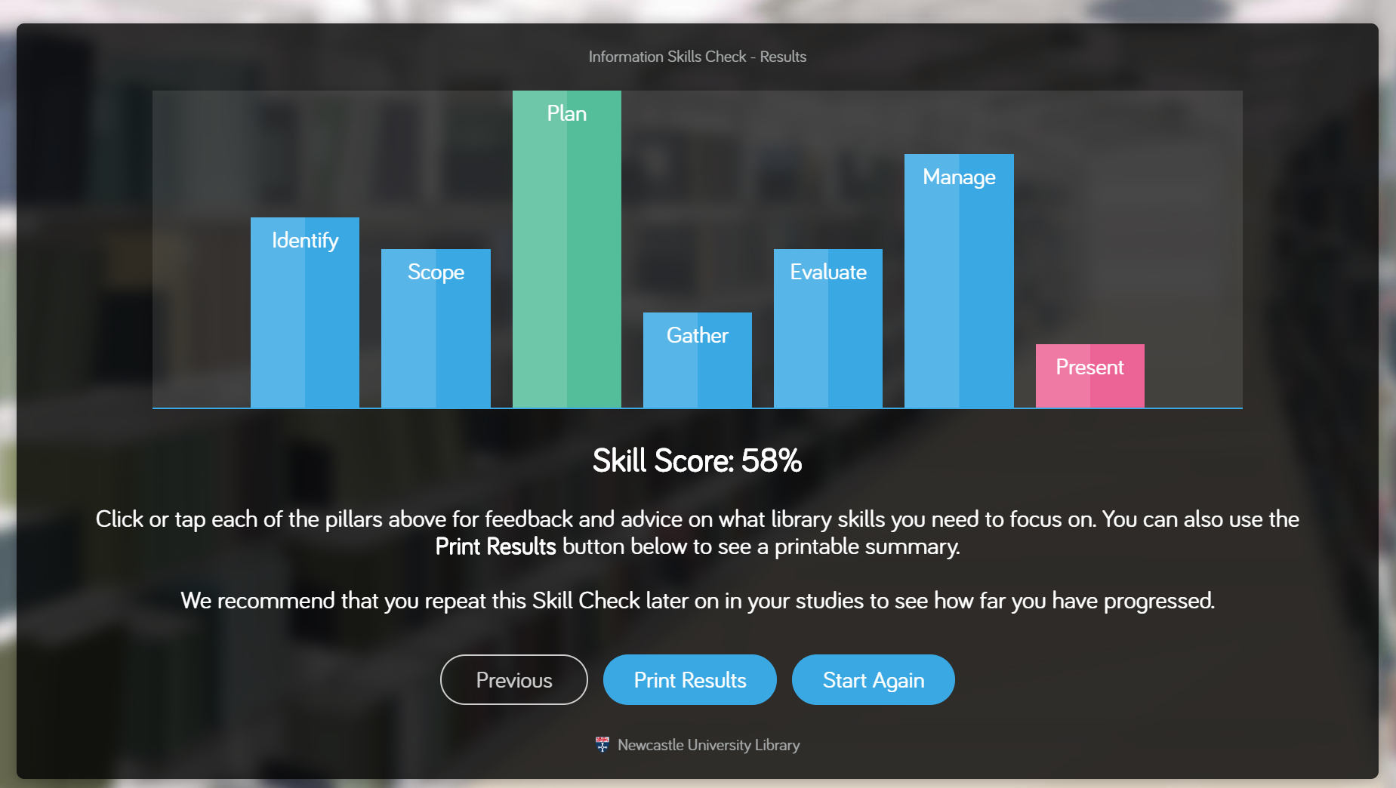
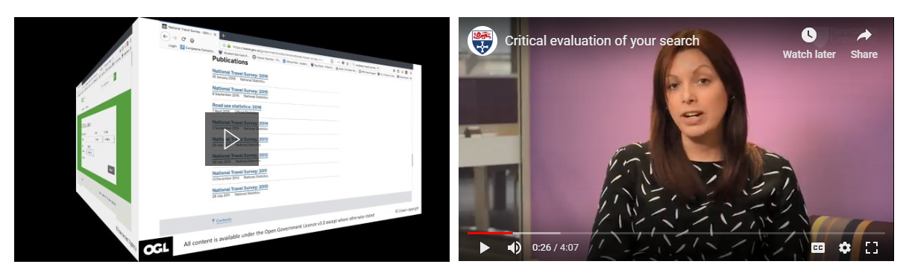

Slide 11
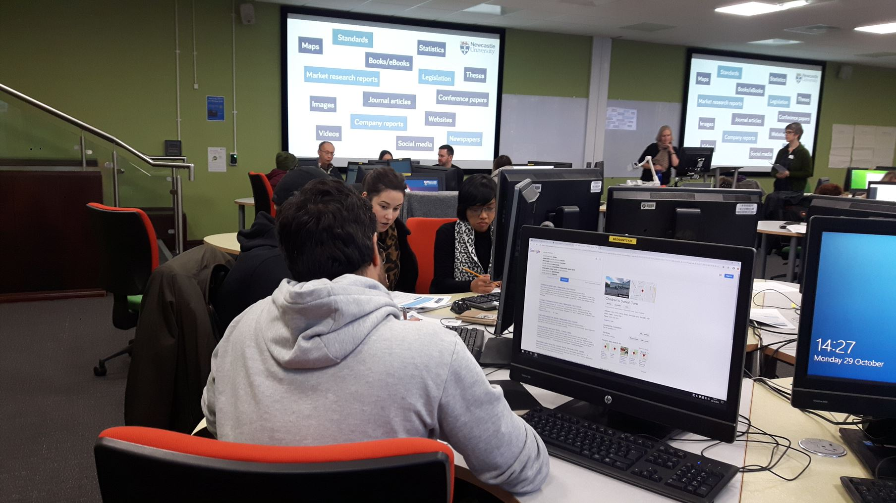
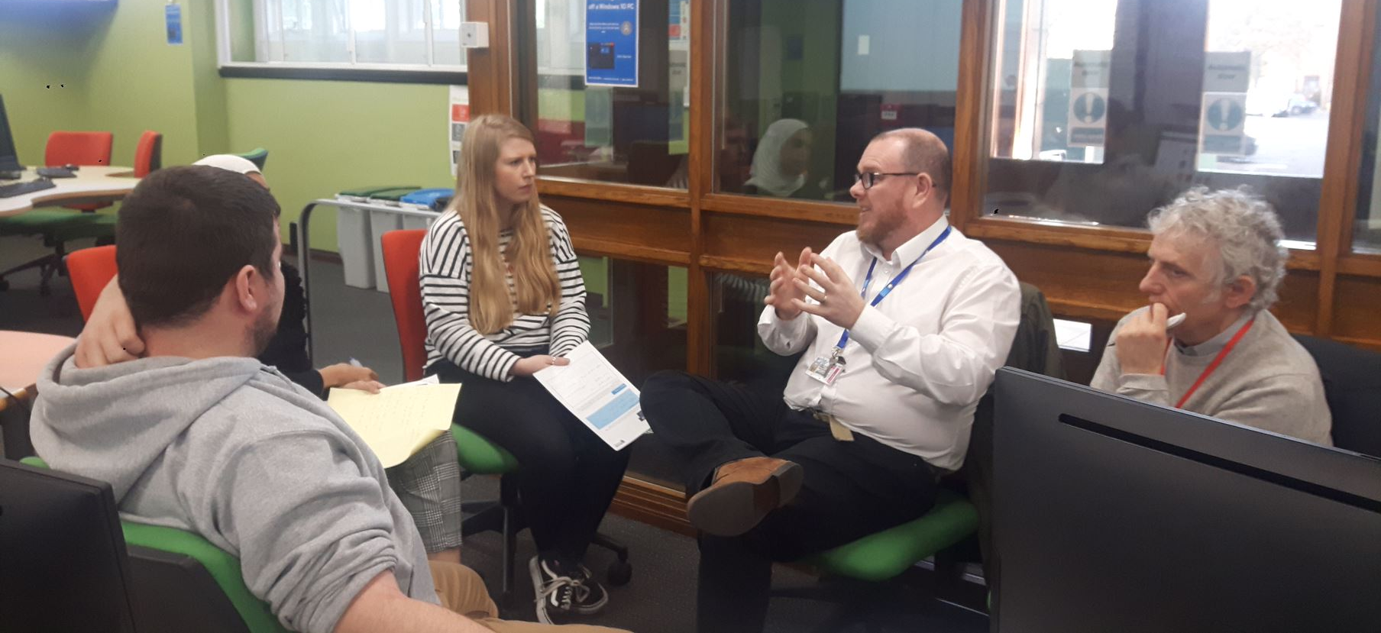
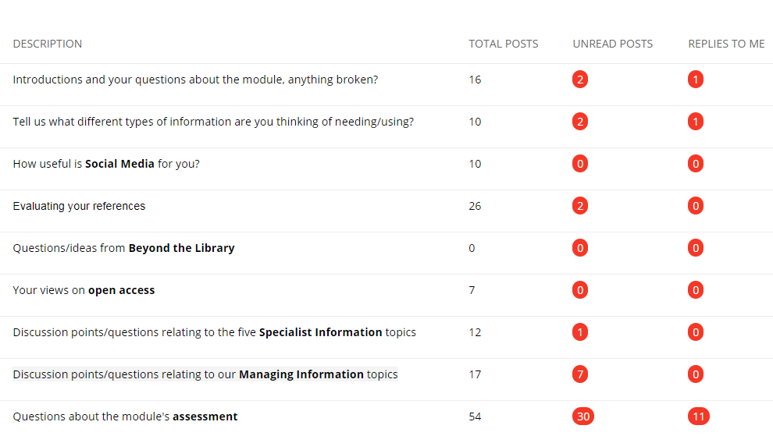

Slide 12
Outcomes and next steps
First ‘blended’ run of the module complete
Analysing Evasys feedback, BB metrics, assessment performance
Quantitative and qualitative feedback improved; positive skills checker mapping; improved assessment understanding
Improving navigation and ‘human’ aspect for next year
Repurposing for other teaching in all Schools
Fully online for distance delivery (London/Brazil/Thailand) 2019/20
Easy to navigate, with good balance of text, activity and video
Being able to work at my own pace and having the workshop to discuss challenges
Every student will come away having learned some new skills for finding resources

Slide 13
Reading Lists Online

Slide 14
Reading lists online
System called Leganto from Ex Libris to create and manage online reading lists, launched in September 2017
Online reading lists for students and staff within their module area on Blackboard
Over past two years, library project specifically looking at reading lists and associated workflows for receiving, ordering and processing
www.ncl.ac.uk/library/services/reading-lists

Slide 15
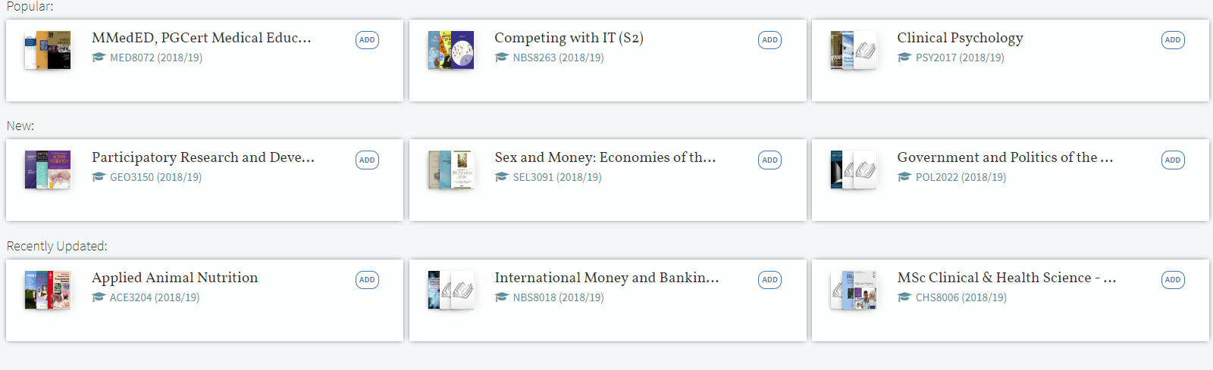
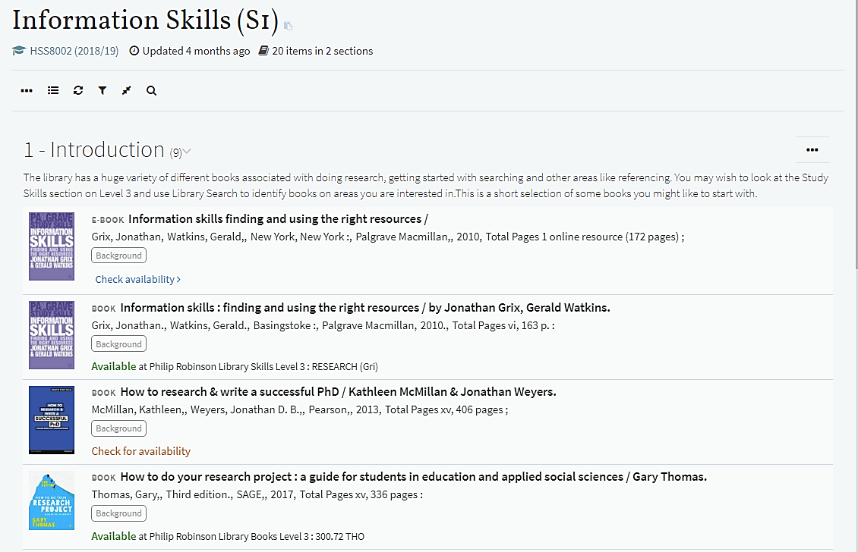
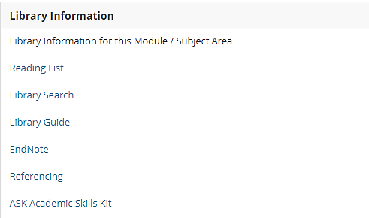
Viewing online reading lists
Viewing reading lists online

Slide 16

New developments
Students can discuss and suggest resources
Reading list system can provide statistics which could indicate “engagement” by students
Create your list in Leganto and export it to your module guide or handouts. This saves you time: only need to create the list in one place
You can submit requests for CLA scans through Leganto without needing to email members of the Library team
New email address to send reading lists and liaise with members of the team who process the lists: readinglists@ncl.ac.uk

Slide 17
Employability

Slide 18
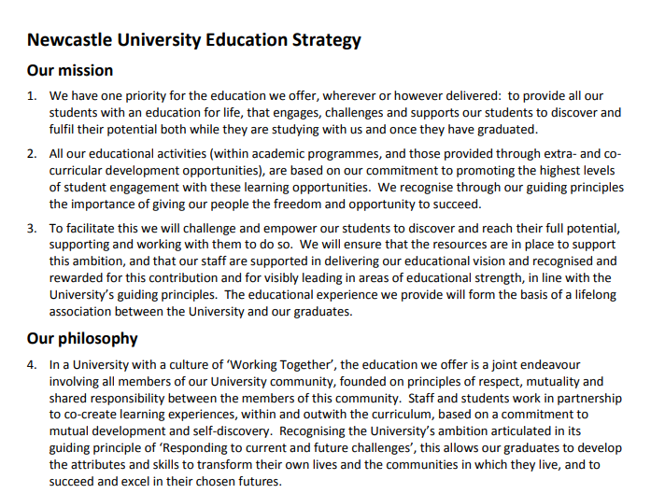
Employability
The role of information literacy
“The ability to think critically and make balanced judgements about any information we find and use. It empowers us as citizens to reach and express informed views and to engage fully with society.” CILIP 2018
University Education Strategy Graduate (Skills) Framework
Notes:
https://infolit.org.uk Background to objective – an on-going commitment to promoting IL as a graduate skill, brought sharply into focus by HE agenda on employability.

Slide 19
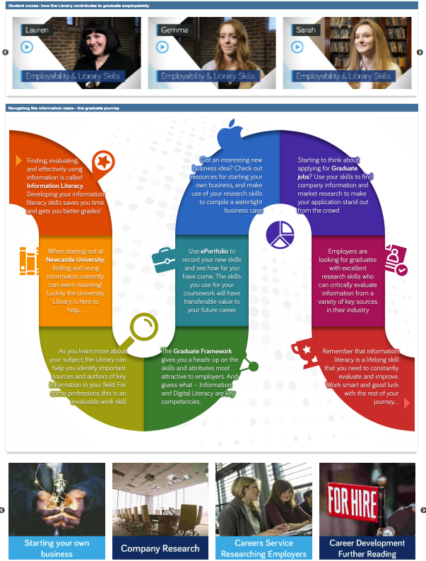
Employability LibGuide
Testimonial videos - Student voice
Infographic - student journey through IL
Links to other services
libguides.ncl.ac.uk/employability
Notes:
Sought a tangible promotional tool that could be used by other Professional Service and academic staff alike. Consulted with Careers over vocabulary and links.

Slide 20
Employability
New developments
Using guide to spark conversations, E&E champions etc.
Actively promoting employability opportunities and events
Potential to link to new Graduate Framework
More videos
Your views…

Slide 21


Education Partnership Agreement
Outlines how we are developing digital and information literacies in partnership with academic colleagues
What the Library Liaison team will do
What academic staff can do
What students can do
Stage-by-stage details of what students should be able to do, relating to finding, evaluating and managing information
Staff can use for MOFS and lesson plans
Students can use to chart their own progression
https://www.ncl.ac.uk/library/services/academic-staff/#teaching-support
Notes:
Drawing all of this together, how can you work with us to develop our students’ skills and competencies? We have published an Education Partnership Agreement where we seek to make this clear. We are looking for your comments and feedback on how to implement this, hyperlinking it to worked examples in your discipline in future, and in what formats this information would be most useful for you and your students. For example, do you have modules which involve self-assessment and for students to chart a journey? How can we make this available to them to help? Please send all thoughts to your Liaison Librarian.

Slide 22
Over to you!
Explore and feed back

