Slide 1

Project-Based Teaching and Learning using Cloud Computing
Raghda M. Zahran
ECLS & Open Lab

Slide 2
Findings about Tech-Enhanced T&L^{[1-4]}
Higher education is about developing novel and authentic knowledge.
Access and teachers’ self-efficacy are the most significant barriers to tech-enhanced learning.
Enhancement connotes modifications and partial reliance on technology.

Slide 3
Tech Phenomenon^{[5]}
EU
Cloud Strategy
2012
US
Cloud First Policy
2009
r
Australia
Cloud Computing Policy
2010
Figure 1. Cloud Policy Enactment
Notes:
Notes
Surprisingly, governments are enforcing the shift to the cloud like no other technology.
The US government, for example, issued a “Cloud First” policy in 2009 (Kundra, 2011; Figliola & Fischer, 2015).
The European Cloud Partnership (ECP) Steering Board has adopted a “Cloud Partnership” (European Commission, 2014).
Those initiatives aimed at reducing the total cost of technology and improving the management of software and hardware services.
Aim: superior value for money and greater confidence in the ICT services.
Since governments are leading this shift on a large scale, we expect it to affect education (Saadatdoost, Sim, Jafarkarimi, & Saadatdoost, 2015; Sultan, 2010). This assumption may have emanated from the primary objective of higher education, which is preparing learners for future jobs (Saavedra & Opfer, 2012).
Opponents to this objective (e.g. Schultz & Higbee, 2007) argue that education does not have to lead to a vocation.
However, in my study, I focus on using CC for Information and Communications Technology (ICT) education which has a direct connection to the industry as a new model for higher education (e.g. Laurillard, Rethinking University Teaching, 2001; Erturk & Maharjan, 2014).

Slide 4
What is Cloud Computing? ^{[6]}
Software
Cloud computing is a model for enabling ubiquitous, on-demand, and elastic access to shared pool of configurable computing resources.
(e.g., networks, servers, storage, applications, and services)
SaaS
Infrastructure
Platform
EaaS
IaaS
PaaS
‘Everything as a Service’
DaaS
Desktop
Figure 2. Cloud Model – Adapted from Mell, P., & Grance, T. [6] definition
Notes:
Related Term:
Multi Clouds - New modelling techniques and mechanisms are needed to compose and coordinate resources across heterogeneous clouds
Edge computing (fog computing) - technologies that integrate the limited memory, storage and computation of fog nodes that are closer to where data are generated into the cloud architecture

Slide 5
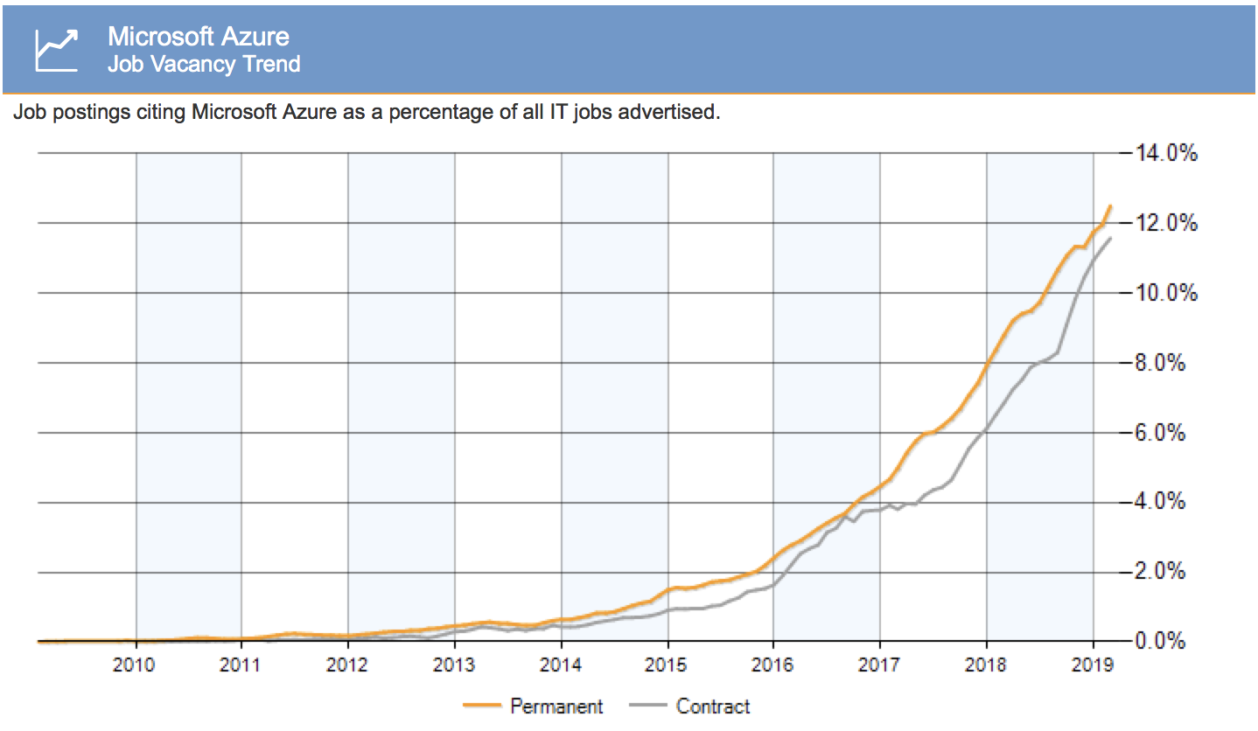
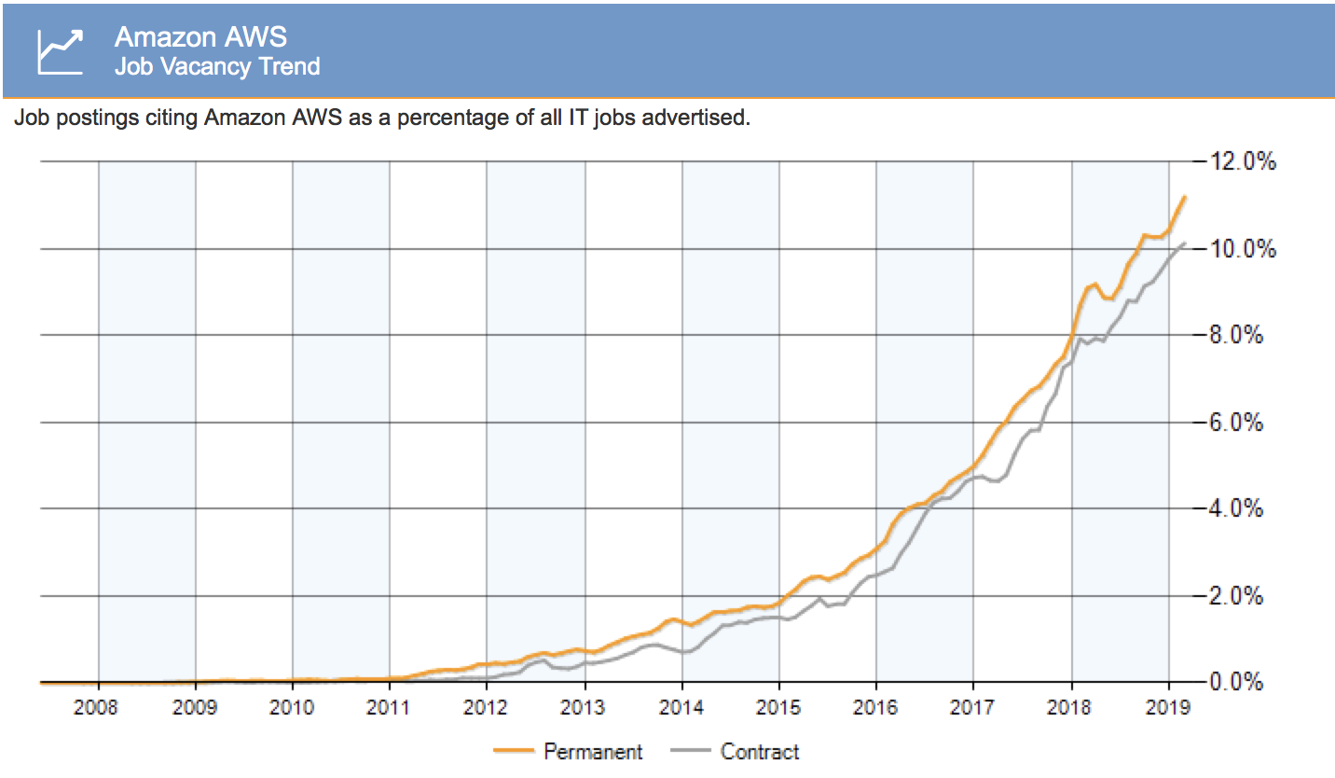
Why does it matter?^{[7]}
The current international job markets demand professionals with cloud skills as shown in the global rise of vacancies
Figure 3. Azure and AWS Job Vacancy Trend (itjobswatch )^{[7]} Date Extracted 31st March 2019
Notes:
https://www.itjobswatch.co.uk/

Slide 6
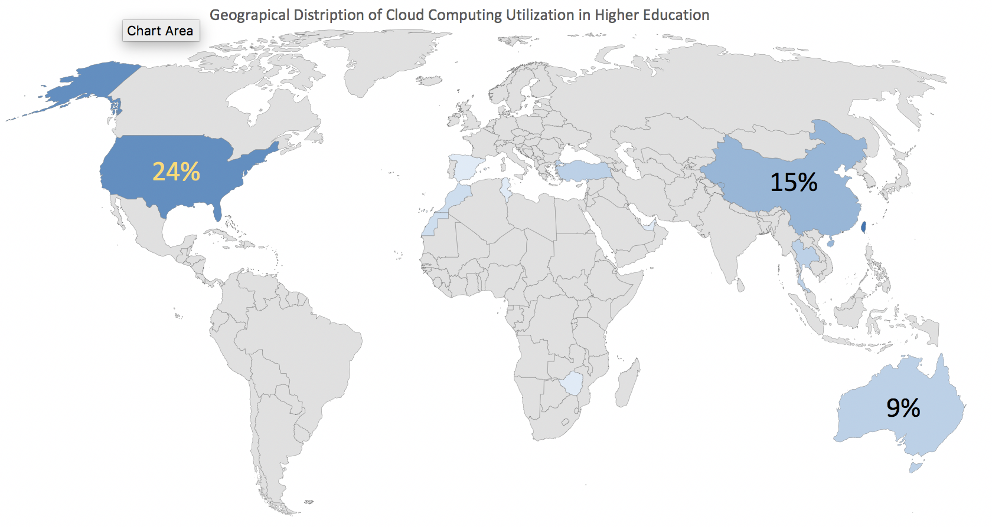
How is it used in T&L?
When combined with "Problem-Based Learning" and "Project-Based learning", cloud computing platforms and services provide expansive learning environments.
Figure 4. Utilization Themes of CC that Surfaced in the MMSR Corpus 2016-2018
Notes:
A cloud computing platforms allows you to create virtual computer services (single or multiple) based on your requirements. The interface allows you to use and create templates with the required software. You can also control, monitor, and share resources with other users. It can be helpful in preparing a technology-enabled environment.
Microsoft Azure, Amazon AWS, and Google Cloud provide similar services.
Academics can use cloud computing to create environments for research and classroom activities, projects, assignments, assessments, and challenges.
Students can use given cloud-based services to solve problems or create their own services to develop a solution such as a web or mobile applications, a business intelligence tool, a monitoring and notification service…etc.

Slide 7
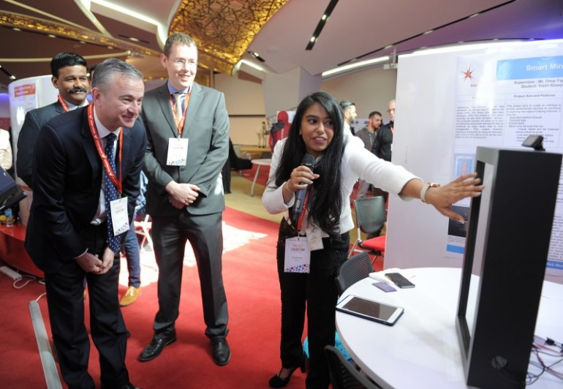
What is the role of academics?
Academics’ role is provisioning meaningful and quality learning
By Facilitating :
student and community engagements
expansive learning environments
critical reflections on T&L
Figure 5. Academics’ and Students’ Engagement (Photo Credit Habib Jaafar)

Slide 8



Project-Based Teaching and Learning using Cloud-Based Services
Manage
Deploy Learning
Activities
DEPLOY
New Teaching
Strategy
Engage with
Contextual Problems
Monitor
SCAN
DEFINE
ILOs
SEIZE
Tech Services
REFLECT
On
LEARNING
Assess
REFLECT
On
TEACHING
RENEW
DESIGN
Define
Intended
Learning Outcomes
Content
Reflect on Practice
T&L Strategy
Reflect on Learning
Instructional Design
Figure 6. Proposed Model for Project-Based T&L that Utilises Cloud Computing
Notes:
Notes:
Contextual problems are problems which the problem situation is experimentally real to the students (Gravemeijer & Doorman,1999). These problems are formulated in a particular context which the respondent is expected to understand the context and apply appropriate mathematical knowledge to solve the problem.
Critical Learning Reflection has been advocated by reciprocal and reflective teaching and learning (e.g. Laurillard, Rethinking University Teaching, 2001, Brookfield, Teaching Critical Thinking, 2012, Brookfield & Preskill, Discussion as a Way of Teaching, 1999)
Critical Teaching Reflection has been advocated by Brookfield (Becoming Critically Reflective Teacher, 1995)

Slide 9
Affordances and Issues
Expansive T&L environments
Deploy virtual services
Manage policies and users
Monitor deployment
Assess solution
Control is a pressing issue
Service Availability
Cost overrun
Data integrity
Learner
Learner
Academic
Learner
Learner
Figure 7. Adapted from Microsoft Azure DevTest Labs
Notes:
Notes
One of the key benefits of cloud computing is the opportunity to replace up-front capital infrastructure expenses with low variable costs that scale with your business.
With the Cloud, users no longer need to plan for and procure servers and other IT infrastructure weeks or months in advance. Instead, they can instantly spin up hundreds or thousands of servers in minutes and deliver results faster.
Services can be rapidly provisioned and released with minimal management effort or service provider interaction.

Slide 10
What's next?
Initial Findings
What we need
Tech-enhanced T&L connotes modifications and partial reliance on technology.
Higher education is about developing novel and authentic knowledge.
Access and teachers’ beliefs are the most significant barriers to tech-enhanced learning.
Tech-Transformed T&L connotes changes and informed reliance on technology.
Higher education needs to reinforce contextualized knowledge development.
Academic Autonomy: the most profound enabler to tech-transformed T&L.

Slide 11
References
[1] Ertmer, P. A., & Ottenbreit-Leftwich, A. (2013). Removing obstacles to the pedagogical changes required by Jonassen’s vision of authentic technology-enabled learning. Computers and Education, 175-182.
[2] Ottenbreit-Leftwich, A. T., Glazewski, K. D., Newby, T. J., & Ertmer, P. A. (2010). Teacher value beliefs associated with using technology: Addressing professional and student needs. 55(3), 1321-1335.
[4] Tondeur, J., Braak, J. v., Sang, G., Voogt, J., Fisser, P., & Ottenbreit-Leftwich, A. (2012). Teachers to integrate technology in education: A synthesis of qualitative evidence. Computers and Education, 0360-1315.
[3] Tondeur, J., Braak, J. v., Ertmer, P., & Ottenbreit-Leftwich, A. (2017). Understanding the relationship between teachers’ pedagogical beliefs and technology use in education: a systematic review of qualitative evidence. Educational Technology Research and Development, 65(3), 555-575.
[5] Business Software Alliance (BSA). (2018). Cloud Score Card. Washington, DC, USA: Galexia.
[6] Mell, P., & Grance, T. (2011, Sep). Definition of Cloud Computing . Retrieved May 1, 2017, from The National Institute of Standards and Technology: http://nvlpubs.nist.gov/nistpubs/Legacy/SP/nistspecialpublication800-145.pdf
[7] https://www.itjobswatch.co.uk/

Slide 12
Thank You
Raghda Marie Zahran
r.m.s.zahran2@newcastle.ac.uk
Notes:
Raghda is a postgraduate researcher in the School of Education, Communication and Learning Sciences (ECLS) at Newcastle University. Raghda brings with her +18 years of experience in industry and higher education. Her work focuses on academics’ responses to emerging technology and the affordance of these technologies to disrupt teaching and learning in the higher education. Raghda’s experience developed in teaching and moderating ICT courses (e.g. systems analysis and design and object oriented programming), coordinating and supervising capstone projects, managing academic programs, and training staff and academics.

