Slide 1
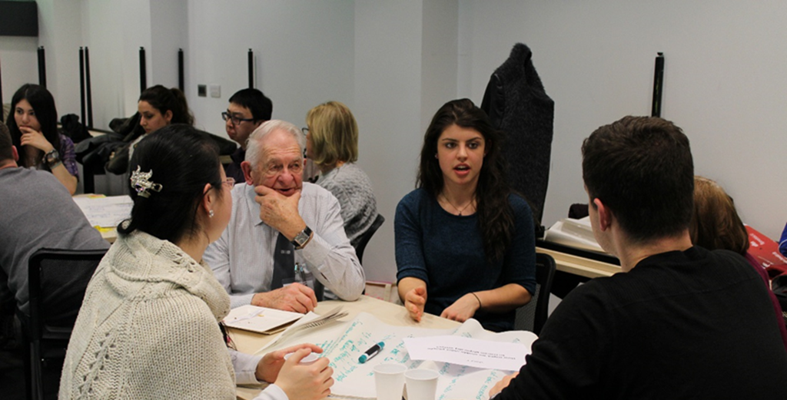
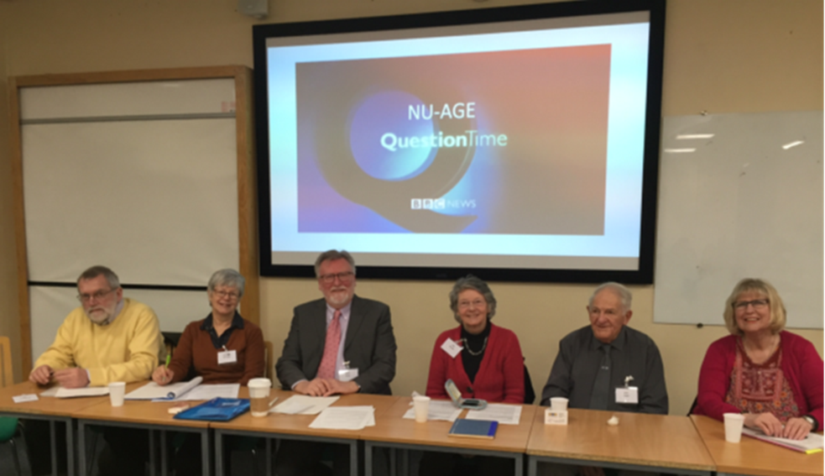
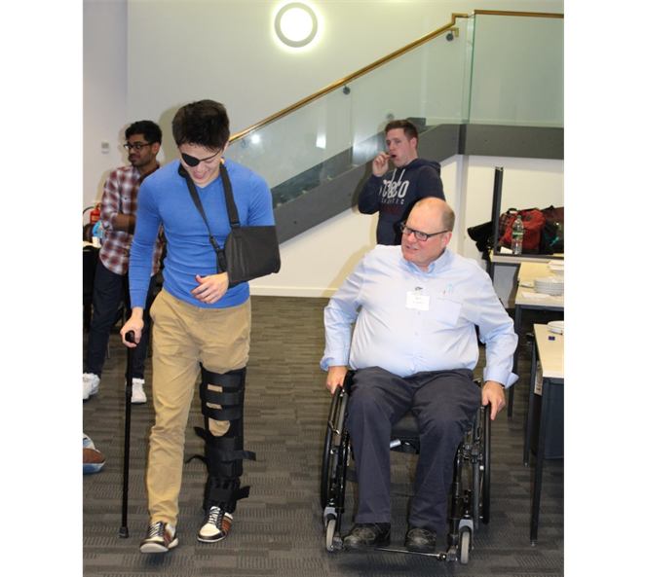
Is there a place for the public in higher education?
Ellen Tullo and Luisa Wakeling

Slide 2
NUAGE partnership
Normally research and PPI/E
Adopting a “patient” or “client” role.
With responsibility to civic society, is it time we involved the public meaningfully to capture the realities of our taught disciplines as experienced by people in the community?
Newcastle University Ageing Generations Education (NUAGE)
To approach the subject of ageing broadly- multidiscipline.
To challenge ageism and negative stereotypes.
To introduce aspects of ageing research at Newcastle University, encouraging students to reflect on how they might consider ageing in their future career or own research.
Valuing Our Intellectual
Capital and Experience
Notes:
The university has a public group VOICE – define. This group of people tend to get involved in PPI/E and in teaching circumstances usually adopt a patient or client role. With responsibility to …
In collaboration with older members of VOICE we developed the NUAGE module to approach ...

Slide 3
NUAGE engagement through partnership
EXBEX ‘Experts by experience’
Engaging older people through partnership
Design stage:
Student needs assessment
Public preferences
Draft and refine curriculum
Pilot
Implementation stage:
Create learning materials
Teaching delivery
Facilitating group discussions
Interaction with students
Evaluation stage:
Outcomes selected
Methods chosen
Data collection and analysis
Report writing
Dissemination
Sustained and meaningful!
Notes:
Older adults from the general population (6-8 per module) designated themselves Experts by Experience (EXBEX). EXBEX are instrumental in shaping the curriculum, offer informed advice for improving future iterations, and mentor new EXBEX members. They are consultees for staff during planning, quality control and delivery of multidisciplinary teaching.

Slide 4
What the public can do and the benefits of involving them in teaching about ageing as explained by our member of the public Mr John Lloyd…
Notes:
Explained by our member of the public Mr John Lloyd, this is a short video of what the public can do and the benefits of involving them in teaching about ageing.

Slide 5
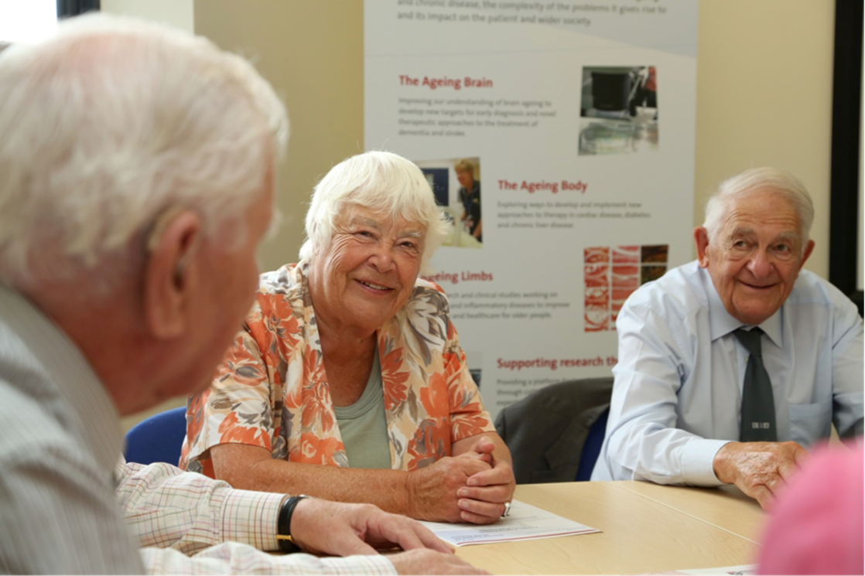
Does your subject have an expert in the
community?
Do you involve the public at any stage?
Can you involve them earlier in module design?
Could they be involved in assessment or evaluation?

