Slide 1
Diversifying online examination provision
Dr Rebecca Gill
Learning Enhancement and Technology Adviser, Learning and Teaching Development Service
Notes:
Change pics here

Slide 2
Education Strategy
Develop and implement comprehensive approaches to online assessment, marking and feedback, making online summative assessment possible across a wide range of assessment types and enabling the wider adoption of electronic submission and marking of all appropriate student assignments.

Slide 3
Diversifying and expanding online exam provision
2017/18
Pilot phase 1: feasibility study
2018/19
Pilot phase 2: implementation
2019/20 – 2021/22
Phase 3: expansion

Slide 4
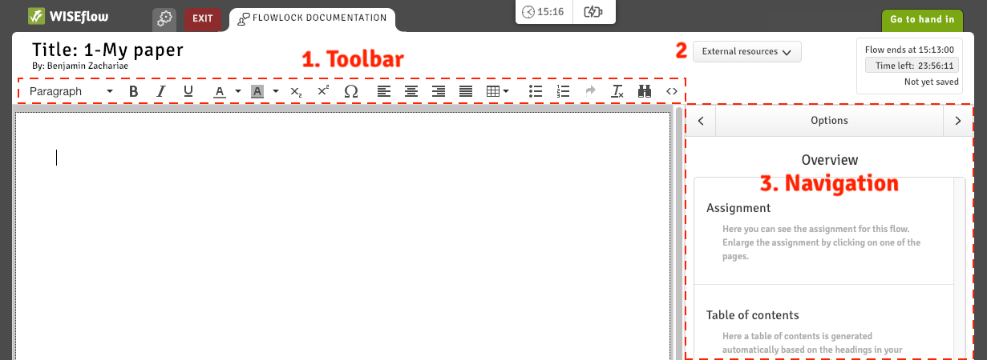
WISEflow written exam interface
Notes:
Image from ‘Get started guide for the participant’ https://uniwise1.sharepoint.com/:w:/r/sites/Support-Centre/_layouts/15/Doc.aspx?sourcedoc=%7B90987d81-019f-469b-a660-f07f5085d90c%7D&action=default

Slide 5
Online written exams: what do students think?
I much prefer typing to written work as I know that my work is now perfectly legible and therefore my work can be marked to reflect my actual attainment.
Psychology stage 2 student
As a student with learning difficulties, dyslexia, it is one of the requirements I usually need for written sections. Therefore much easier for myself than paper.
Biology stage 1 student
I enjoyed having the freedom to edit the structure of the essay without having to cross things out and rewrite it. This is much more like the approach I would use when writing a long essay
French stage 2 student
it was so much easier to edit my work. Writing is a cyclical process, so being able to go back and amend my previous paragraph was really helpful
Operations Management stage 2 student

Slide 6
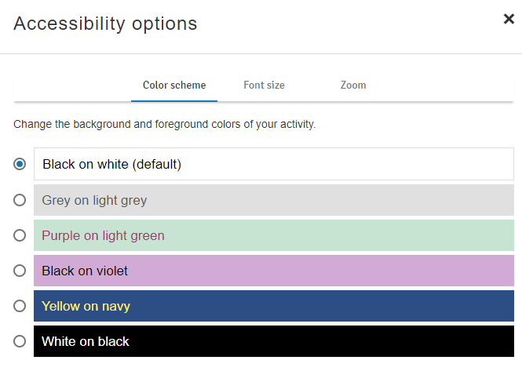
WISEflow accessibility features

Slide 7
Accessibility: opportunities and challenges
Assistive software
Bring your own device
Noise
Students who don’t have a suitable laptop

Slide 8
Accessibility: opportunities and challenges
Assistive software
Bring your own device
Noise
Students who don’t have a suitable laptop

Slide 9
Accessibility: opportunities and challenges
Assistive software
Bring your own device
Noise
Students who don’t have a suitable laptop
Being able to type on a keyboard I am used to was great, although I had more anxiety before the exam about something going wrong with my laptop
Psychology Stage 2 student

Slide 10
Accessibility: opportunities and challenges
Assistive software
Bring your own device
Noise
Students who don’t have a suitable laptop

Slide 11
Accessibility: opportunities and challenges
Assistive software
Bring your own device
Noise
Students who don’t have a suitable laptop
It was much easier to concentrate on laptops as there was not as much of a noise created from people typing as there was on the university computers
Psychology Stage 2 student

Slide 12
Accessibility: opportunities and challenges
Assistive software
Bring your own device
Noise
Students who don’t have a suitable laptop

