Slide 1

Art of the Possible: online resources to help support students’ academic skills
Newcastle University Library liaison team
@nclroblib
University Library
Explore the possibilities

Slide 2
Outline for today
Academic skills resources
Explore for yourselves
What we’ve been up to
Feedback and discussion
Take a look at our resources
Research skills resources

Slide 3
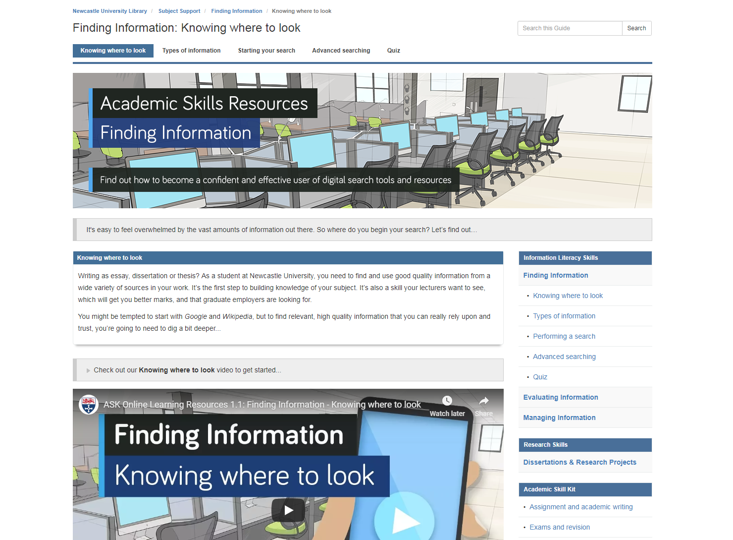
Academic skills learning resources
Information literacy provision was good, but inconsistent and difficult to find
Refocused and created new skills guides (Finding • Evaluating • Managing)
One-stop shop
Video, text and interactive tools
High quality, improved visibility

Slide 4
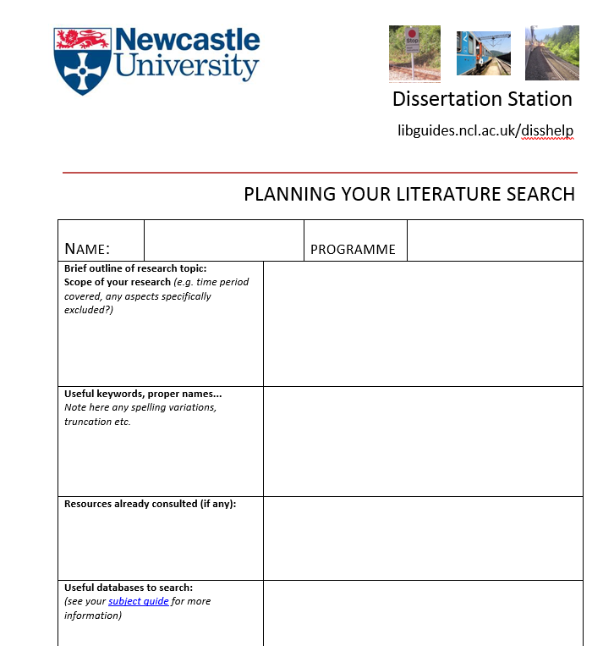
Research skills: UG/PGT
Dissertation/project planners
Previous provision was a dated libguide and Word form
Developed new online guide with WDC team
Interactive tools to simplify literature search and project proposal planning
Takes a stepped approach to keep process simple and manageable
Plans can be saved, emailed, developed, reviewed

Slide 5

Using the new resources
Liaison team using them in teaching at all levels: face-to-face, online and flipped classroom
Supporting individual enquiries and appointments
Embedded in BB modules
Promoted via our marketing and comms teams
Can you help us?...
www.ncl.ac.uk/library/subject-support

Slide 6
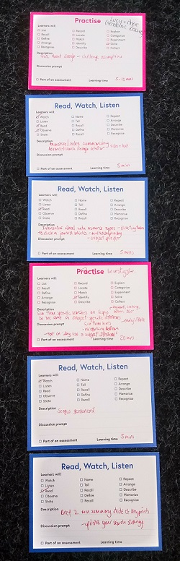
Research skills: PGR
HSS8002 module
Longstanding information skills module for PGR/research masters students in HASS
Growing in content, complexity, cohort
Difficult catering for mixed experience, subject areas, availability, information needs
Negative feedback re lack of flexibility and tailoring
HaSS Faculty using blended delivery for PGR training modules
Five month project….for delivery October 2018
Collaboration with LTDS

Slide 7
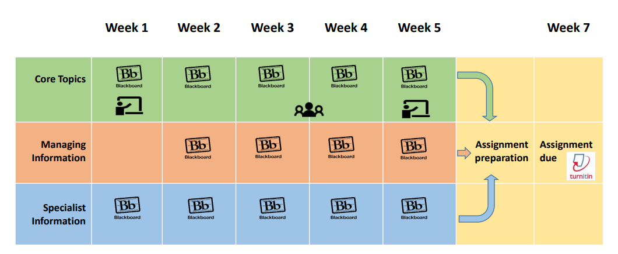
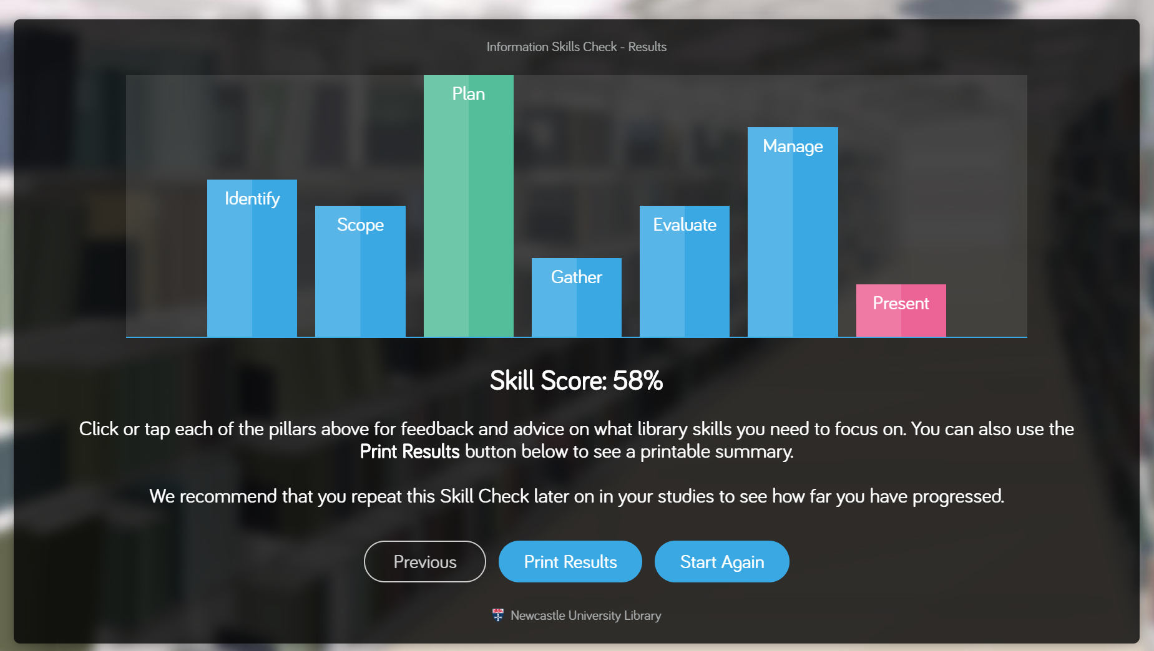
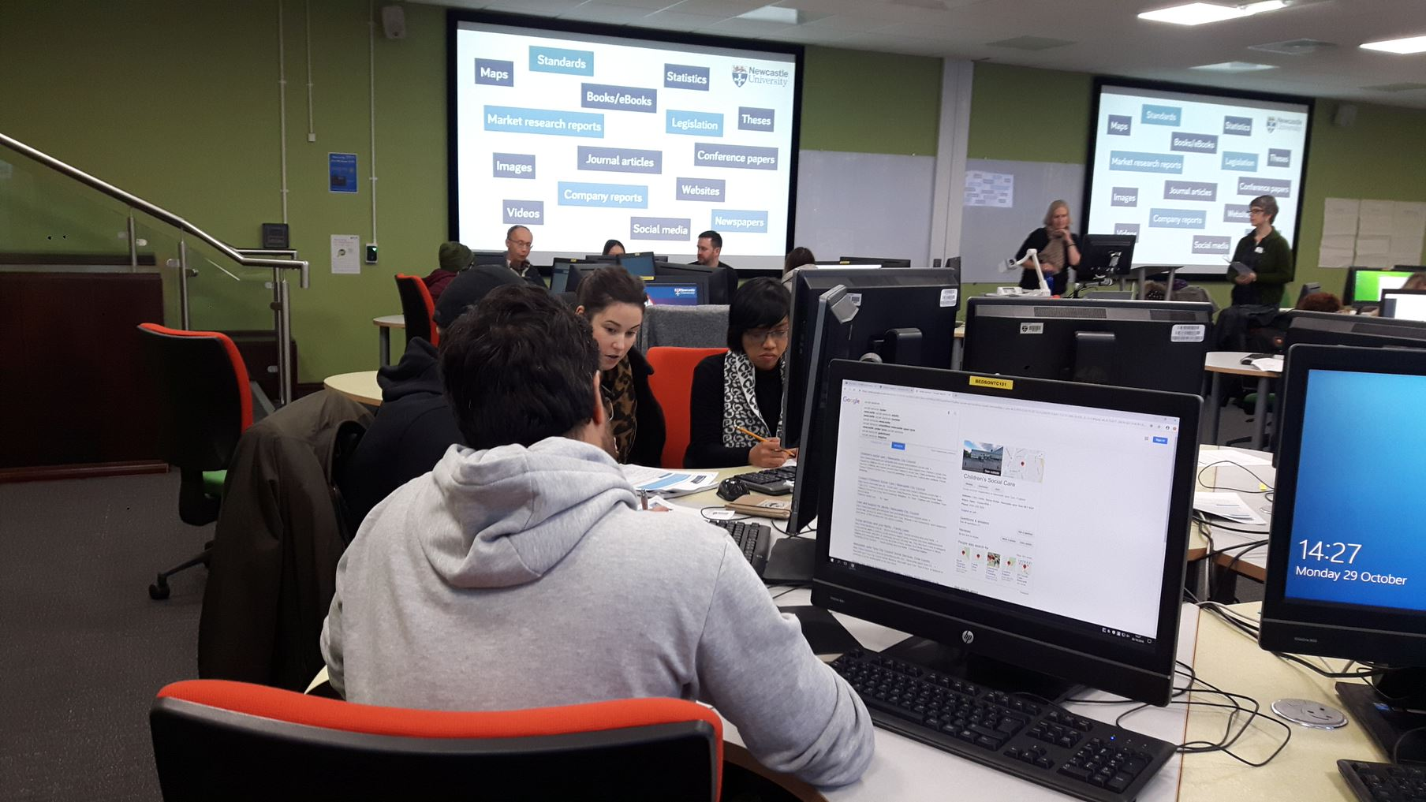
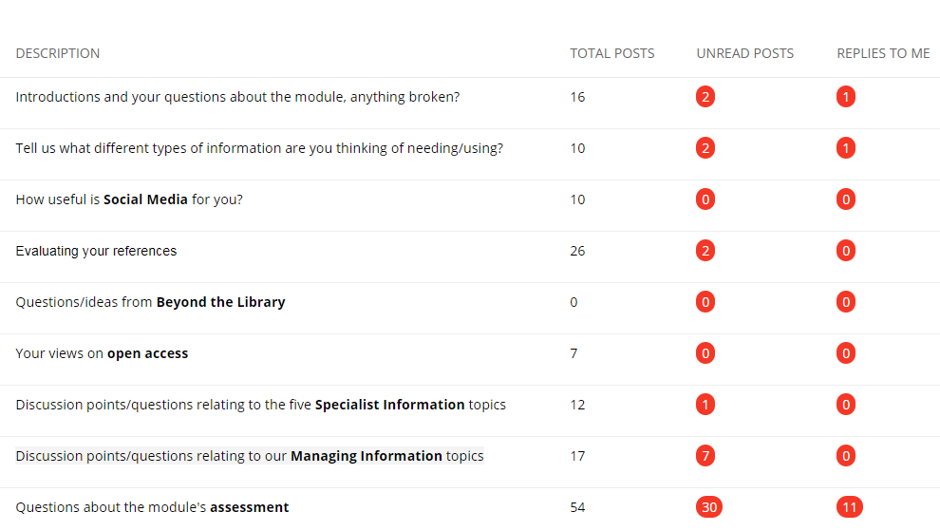

Slide 8
Outcomes and next steps
First ‘blended’ run of the module complete
Analysed Evasys feedback, BB metrics, assessment performance
Quantitative and qualitative feedback improved; positive skills checker mapping; improved assessment understanding
Improving navigation and ‘human’ aspect
Repurposing for other teaching in all Schools
LTDS case study
Fully online for distance delivery (London/Brazil/Thailand) 2019/20
Easy to navigate, with good balance of text, activity and video
Being able to work at my own pace and having the workshop to discuss challenges
Every student will come away having learned some new skills for finding resources

Slide 9
Over to you!
Explore and feed back:
blogs.ncl.ac.uk/subject-support

