Slide 1


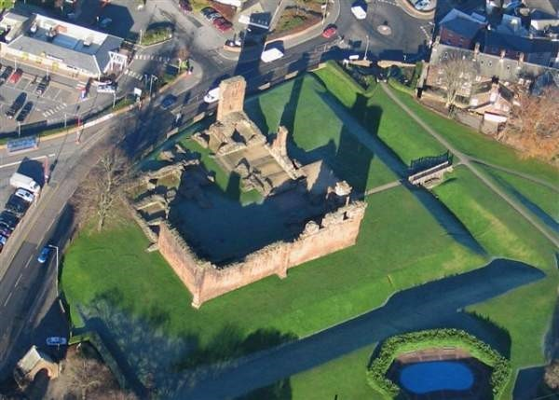

The Newcastle Model of Care MND Centre “hub & community spokes.”
Frances Kelly
Nurse Specialist MND

Slide 2
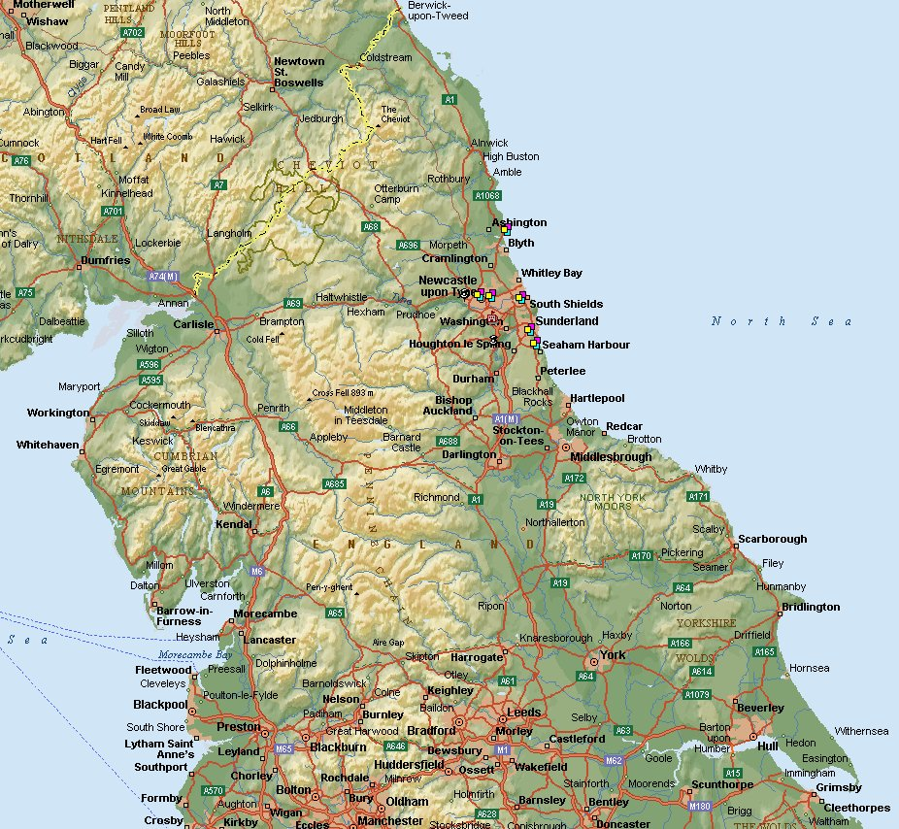
Our Catchment Area

Slide 3
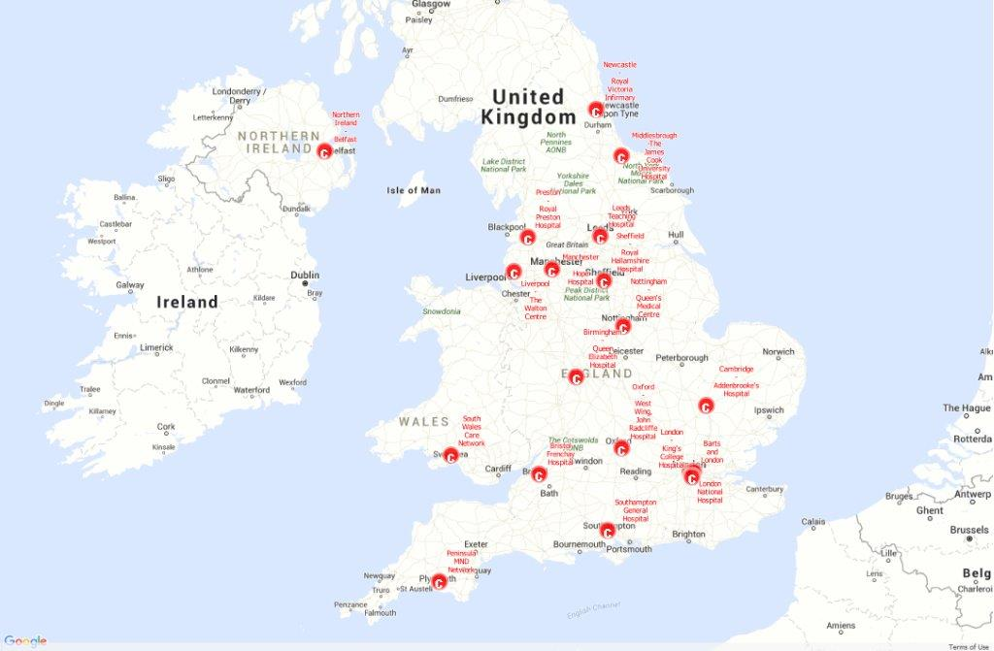
MND CARE CENTRES

Slide 4
Newcastle MND Team
Neurologist
Dr. Tim Williams
MND Coordinators
Sarah Woolhead
Sr. Bernie Chapman
Sr. Frances Kelly
Cumbria MND Locality Lead
Joni Mitchell
MND Secretary
Marian Dent
Physiotherapist
Kelly Smith
Palliative O.T.
Lisa Cairns
Benefits Advisor
Rosemary Bell

Slide 5
Palliative Care
Primary Care
PEG Teams
N.E. Assisted
Ventilation
Service
MND TEAM
12
community MND MDTs
O.T. & Social Services
Benefits
Wheelchair services

Slide 6
How many patients? Newcastle MND Care Centre
Case load 155 MND Patients
63 New MND patients
Slowly progressive phenotypes
P.L.S. & P.M.A.
64 MND patient deaths
A.L.S. patients
variable progression

Slide 7
New MND Patients
Diagnosis by Care Centre director of all MND Pts in region. One hour appointment in small diagnostic clinic.
MND Coordinator sees the patient & family immediately.
Coordinator post diagnosis review at home after 1 week.

Slide 8
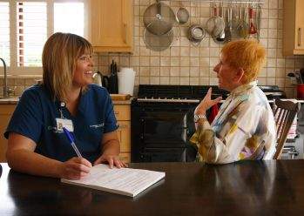
Relaxed patient support

Slide 9
MND Coordinator Home Visits
Home Visits to explore/resolve continuing problems or crises.
Counselling/ palliative role of MND Coordinator.
Joint home visits with district nurse/therapist.
case conferences CHC meetings
Patients Unable to Attend Clinic
Continuity of specialist patient care in late and end stage disease.
Guidance/joint working with community staff.

Slide 10
MND Therapist Home Visits
Occupational Therapist
Physiotherapist
Hypnosis
Bespoke collars
Patient Bucket list
Advisory role/ joint visiting with O.T. colleagues.
Early respiratory failure: Lung volume recruitment.
Mobile arm supports.
Collar & splint assessment
Advisory role/ joint visiting with Physio colleagues.

Slide 11
MND PATIENT REVIEW
Review clinic 2-6 monthly depending on disease
progression and phenotype.
Newcastle clinic Penrith clinic
Telephone clinic Home visit
Equity of Patient care throughout the region.
Patient review

Slide 12
MND & N.E. Assisted ventilation Service Clinics at Penrith
MND Review Clinic 6 times a year
All new patients are diagnosed in Newcastle.
NEAVS Review Clinic 6 times a year
Dr. Williams refers pts with respiratory signs & symptoms who wish to consider NIV for assessment by NEAVS during clinic.

Slide 13
Cumbria MND Locality Lead
Funding: Ice bucket challenge
Hosted by: Eden Valley Hospice
Carlisle Workington
23 pts 13 pts
Grade 7 :Part time (3 days week)
Neurology training/case supervision
by Newcastle MND Care Centre
MND
PATIENTS

Slide 14
Acceptance
of diagnosis
Planning for a
“good death”
No Treatment
Acceptance
of diagnosis
Paralysed pt unable to travel to clinic
Challenges:
of Patient Management
Time
Progressive fatal disease
Regional service:
Urban/rural
Ensuring
Good Care

Slide 15
Supporting the patient to make informed choices
HOME ADAPTIONS
Communication Aid
Advance Decisions to Refuse Treatment
Non Invasive Ventilation
N.I.V.
Percutaneous Gastrostomy
P.E.G.
Patient
Choice

Slide 16
CARE CENTRES & the MNDA working for the PlwMND
Care Centre
Regional Care
Delivery Advisor
MNDA
Equipment
Loans
PlwMND
Education
MND CONNECT
MNDA
Branches
MNDA
Financial
Support
Association
Visitors
N.I.C.E. MND
Guideline

Slide 17
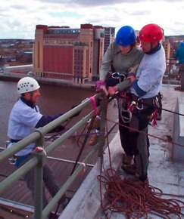
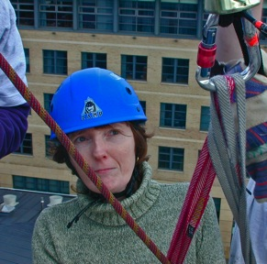
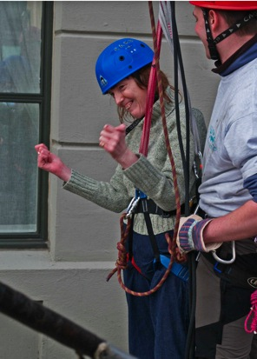
Liz Shipley

Slide 18
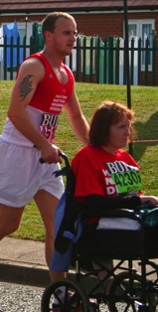
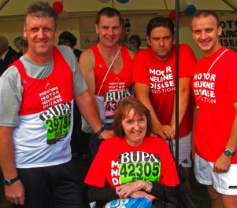
Liz with her Hebburn team of firemen. Great North Run 2009.
LIZ

