Slide 1
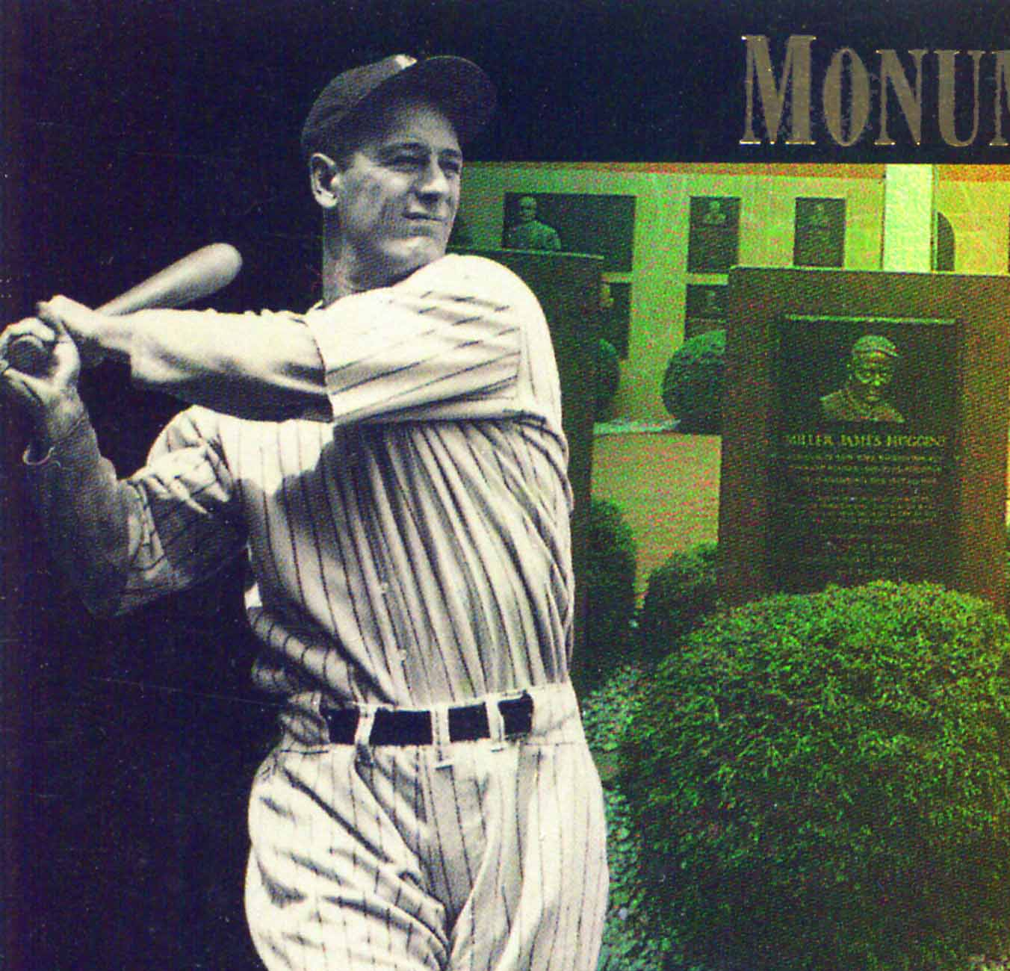
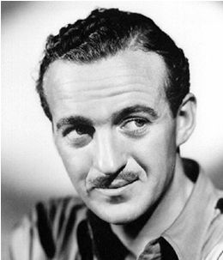
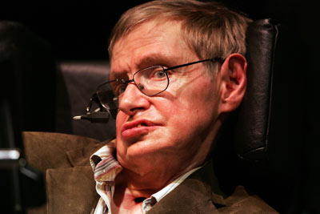
Respiratory muscle weakness and failure in MND

Slide 2
What is MND
Invariably fatal, so:
management principles
Management is palliative from diagnosis
“Treatments” or clinical and therapeutic interventions (e.g. gastrostomy, respiratory support, secretion control, spasticity relief, communication aids etc) are for (i) symptom relief and (ii) to improved or maintained quality of life
NOT SURVIVAL

Slide 3
Prognosis
Av survival: 24-36 months from symptom onset or ~18 months from diagnosis
50% dead at 30 months from onset
10-20% live ≥ 5yrs
5-10% live ≥ 10yrs
- V. occasional patients live 20 yrs
Death almost always from respiratory failure

Slide 4
Dictators of Prognosis
Age
Disease phenotype – PBP etc
Diagnostic Delay
MND specialist clinics
Respiratory function

Slide 5
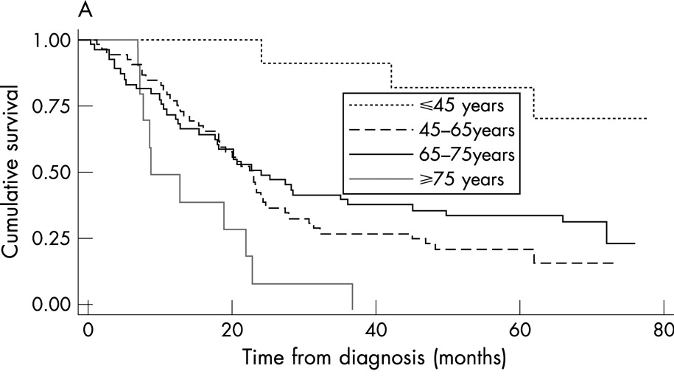
Zoccolella S et al. J Neurol Neurosurg Psychiatry 2008;79:33-37
Notes:
Cumulative survival of amyotrophic lateral sclerosis (ALS) from diagnosis by different prognostic indicators: age (A), presence of bulbar signs at diagnosis (B), site of symptom onset (C) and El Escorial category at diagnosis (D).

Slide 6
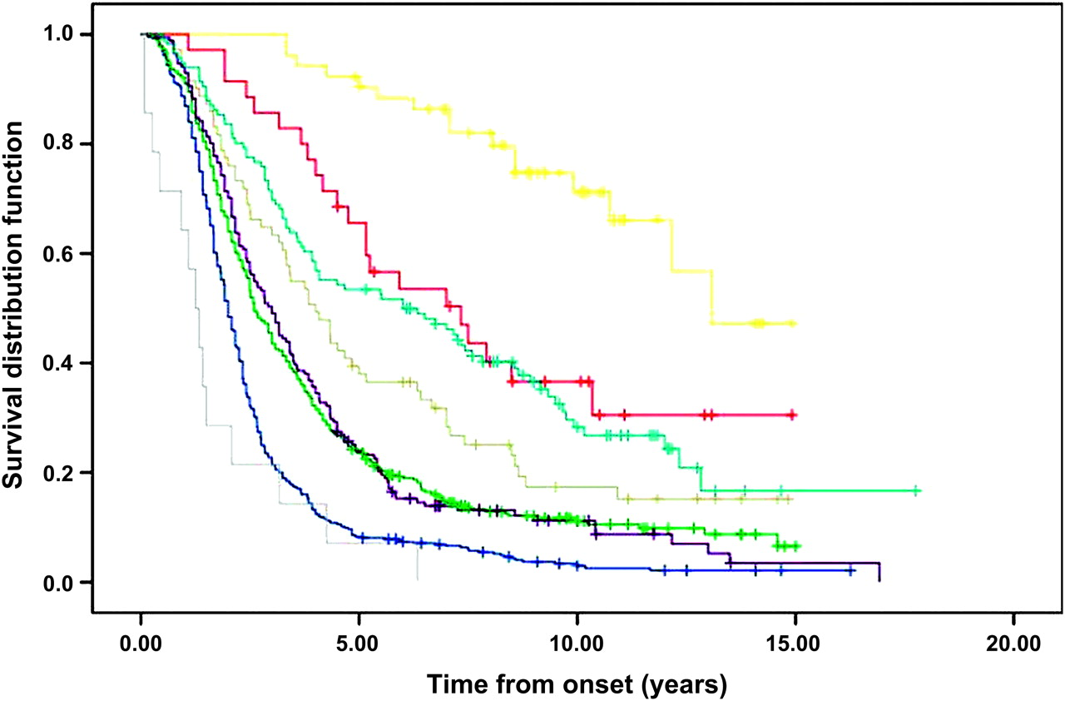
Survival according to MND phenotype
PUMN/PLS
PLMN/PMA
Resp
ALS
PBP
Chiò A et al. J Neurol Neurosurg Psychiatry 2011;82:740-746
Notes:
Tracheostomy free survival, according to amyotrophic lateral sclerosis (ALS) phenotype. Yellow, PUMN; red, PLMN; light blue, pyramidal ALS; grey, flail arm; violet, classic ALS; green, flail leg; blue, bulbar; cyan, respiratory. Crosses are censored patients. PLMN, pure lower motor neuron phenotype; PUMN, pure upper motor neuron phenotype.

Slide 7
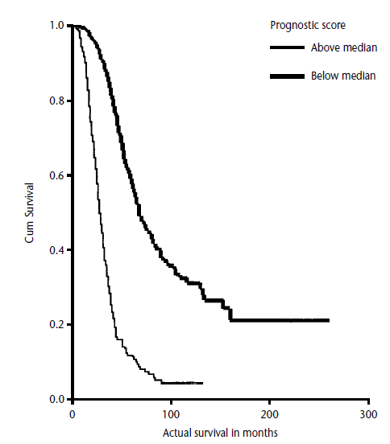
Time to Diagnosis
Thick line >6 months
Thin line <6 months
Turner et al 2002, ALS & FTD

Slide 8
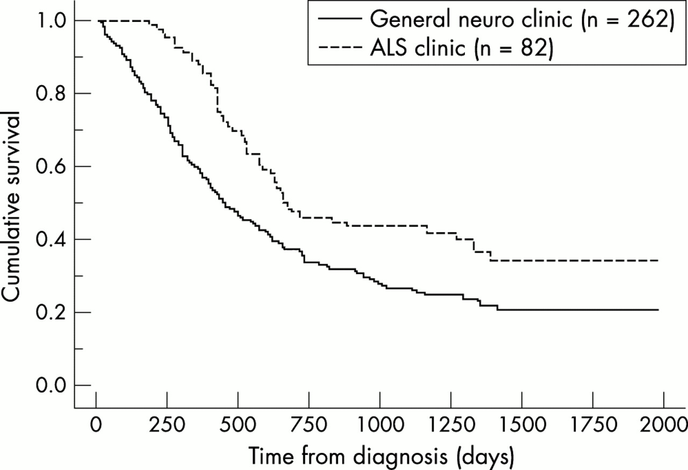
Effects of MDT MND Clinic
Traynor et al. JNNP2003;74:1258-1261

Slide 9
Dictators of Prognosis
Respiratory function:
- dictates survival and quality of life

Slide 10
FVC and Survival
n = 28
Fallat, Arch Neurol, 1979

Slide 11
Short Form 36
r = 0.73, p < 0.0002
Bourke et al, Neurology, 2001
Notes:
N = 23

Slide 12
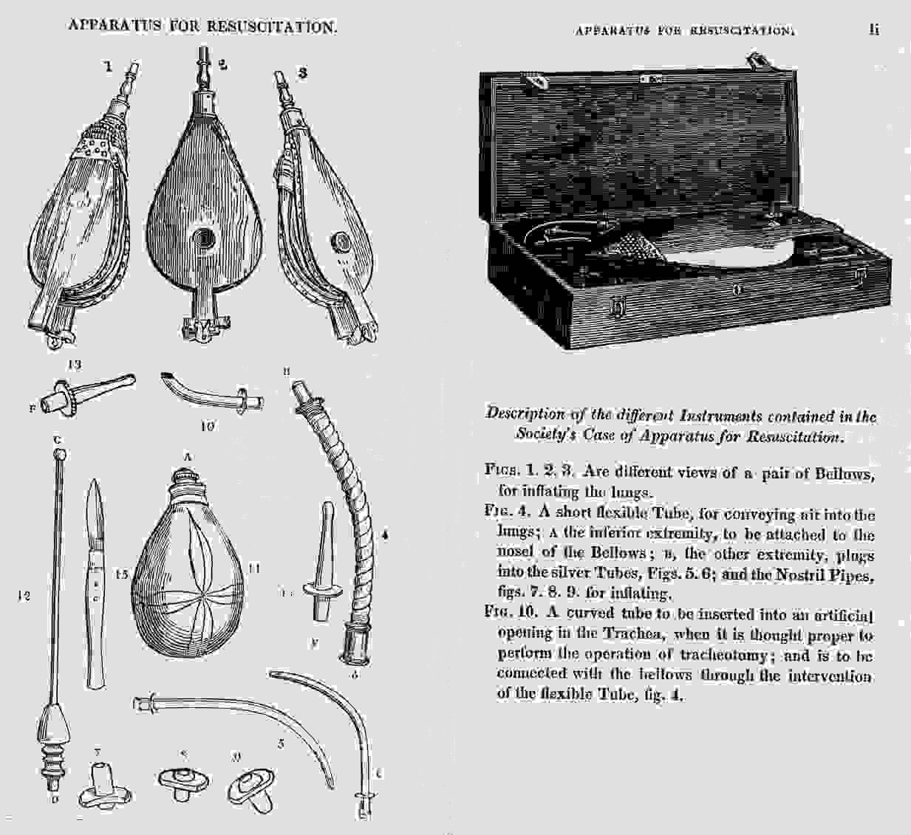

Slide 13
“Then he went and lay upon the child, putting his mouth upon the child’s mouth, his eyes upon the child’s eyes, and his hands upon the child’s hands; and as he stretched himself upon the child; the flesh of the child became warm”
II Kings IV:34
Notes:
The books of Kings trace the history of the Isrealites from their height under Solomon in 796 BC to their fall at the hands of the Babylonians.

Slide 14
Survival: NIV vs No Ventilation
NIV
Controls
n = 18
Pinto, J Neurol Sci, 1995
Notes:
“Diurnal abnormalities in gas exchange”
Prospective Not randomised.
Groups unequal:
VC: NIV = 48.3%, std care = 64.4%.
PaO₂: NIV = 80.8 mmHg, std care = 93.3 mmHg.
Efficacy analysis: n = 18

Slide 15
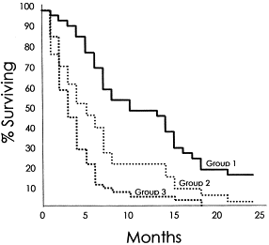
Survival and compliance with NIV
Group 1 > 4 hr/d
(n = 38)
Group 2 < 4 hr/d
(n = 32)
Group 3 declined or intolerant of NIV
(n = 52)
Kleopa, J Neurol Sci, 1999
Notes:
Symp, VC< 50%, fall VC 15% / 3 mths
Characteristics influencing tolerance of NIV may also affect survival.
QoL not assessed – may merely be prolonging suffering.
Compliance poor.

Slide 16
SF-36 Mental component summary
SAQLI symptoms domain
∗
∗
∗
∗
6
5
0
∗
∗
∗
∗
4
5
5
SF-36 MCS
SAQLI symptoms
4
0
4
3
5
3
∗
p
<
0
∗
p
<
0
.
0
0
1
.
0
5
3
0
2
Pre
1
3
5
7
Pre
1
3
5
7
NIV
Months on NIV
NIV
Months on NIV
Bourke et al. Neurology 2003;61:171-177
Notes:
This graph illustrates the large and sustained improvement seen in the SF36 MCS score & SAQLI symptoms domian.

Slide 17
Why …………
“Patients may not be offered or accept NIV due to a fear that prolonged survival in the face of increasing disability in a terminal disease may be burdensome and diminish, rather than improve quality of life …….”
Are we extending life & palliating symptoms or prolonging death and suffering?

Slide 18
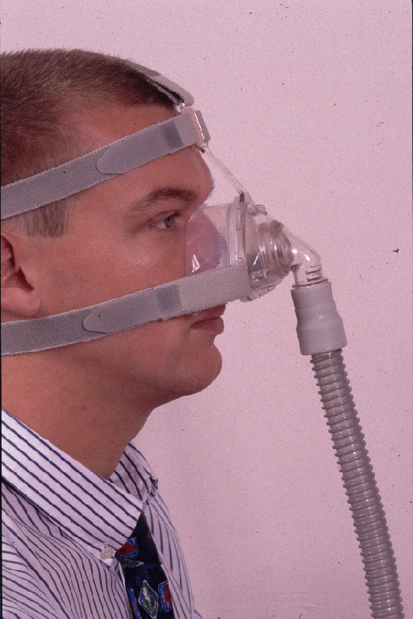
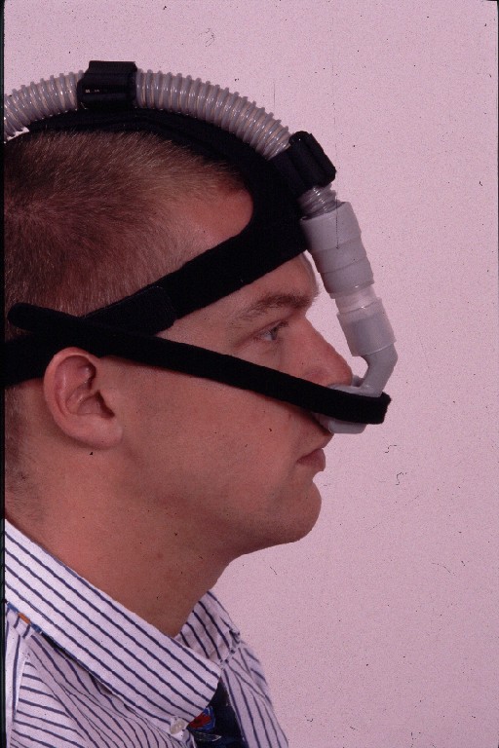
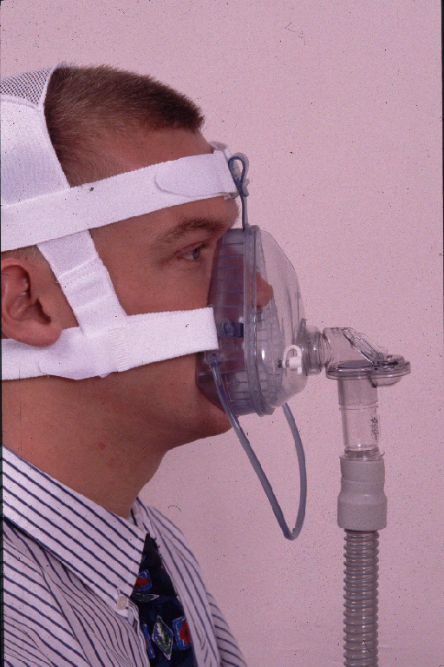
Notes:
There has been considerable improvement in the masks available, initially designed for the larger OSA / CPAP market, which is one of the key aspects affecting compliance with treatment.

Slide 19
Time SF36 MCS > 75% baseline
Good bulbar function
Poor bulbar function
1.00
1.00
NIV 199
Controls 4
p = 0.001
NIV 127
Controls 121
p = ns
0.75
0.75
0.50
0.50
0.25
0.25
0.00
0.00
0
200
400
600
800
0
300
600
900
1200
Days
Notes:
Good bulb median: NIV = 199, std care = 4
Poor bulb median: NIV = 127, Std care = 121

Slide 20
Survival & NIV
Good bulbar function
Poor bulbar function
1.00
1.00
NIV 216
Controls 11
NIV 222
Controls 245
0.75
0.75
p = 0.006
p = ns
0.50
0.50
0.25
0.25
0.00
0.00
0
200
400
600
800
0
375
750
1125
1500
Days
Notes:
Good bulb: median survival NIV = 216, Std care = 11
Poor bulb: NIV = 222, Std care = 245

Slide 21
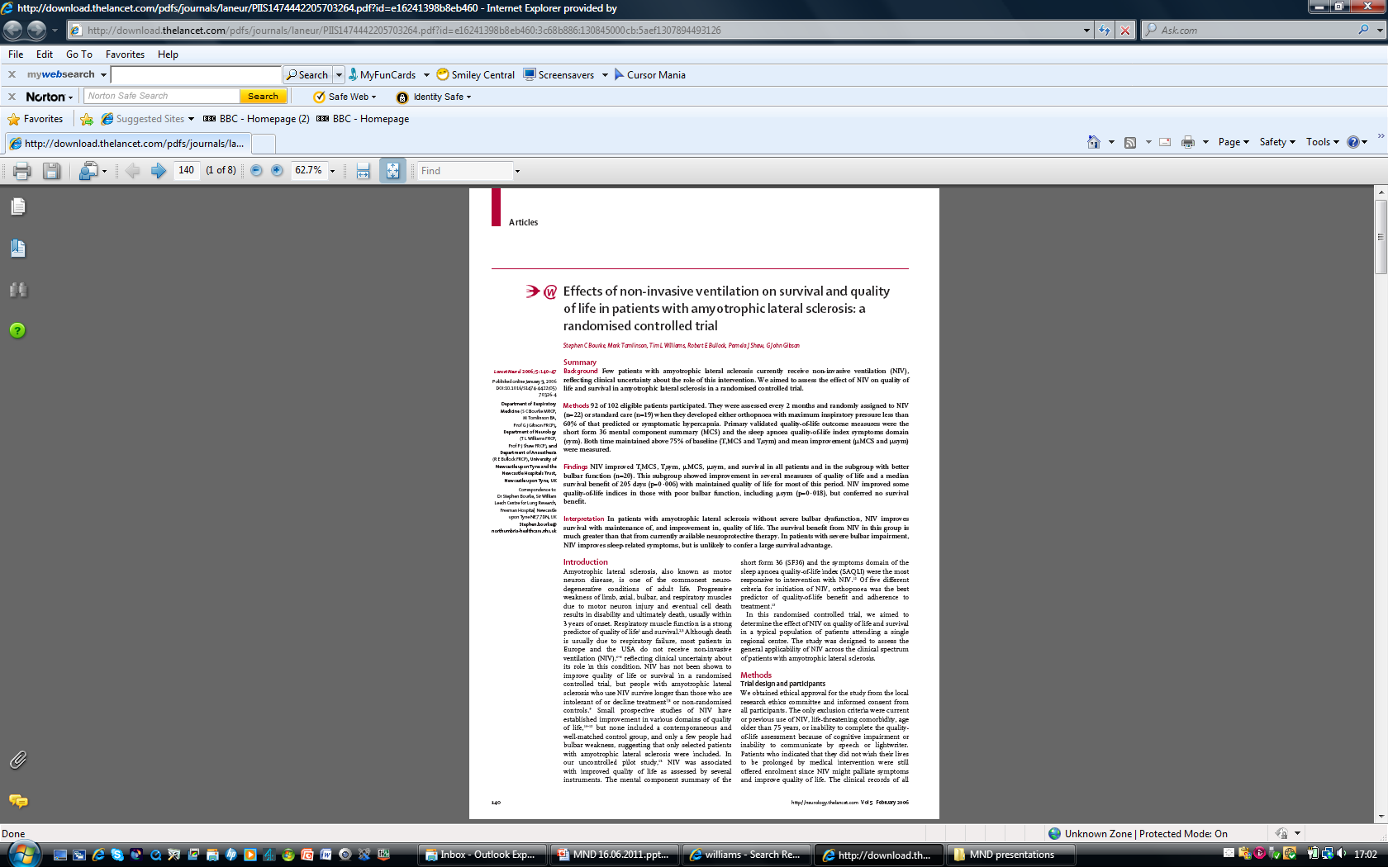

Slide 22
Conclusions of RCT
Significant overall sustained improvement in QoL.
Survival benefit of ~ 7 months, i.e. twice that seen with Riluzole.
All survival benefit seen in “better” bulbar function group.

Slide 23
SF-36 Mental component summary
SAQLI symptoms domain
∗
∗
∗
∗
6
5
0
∗
∗
∗
∗
4
5
5
SF-36 MCS
SAQLI symptoms
4
0
4
3
5
3
∗
p
<
0
∗
p
<
0
.
0
0
1
.
0
5
3
0
2
Pre
1
3
5
7
Pre
1
3
5
7
NIV
Months on NIV
NIV
Months on NIV
Bourke et al. Neurology 2003;61:171-177
Notes:
This graph illustrates the large and sustained improvement seen in the SF36 MCS score & SAQLI symptoms domian.

Slide 24
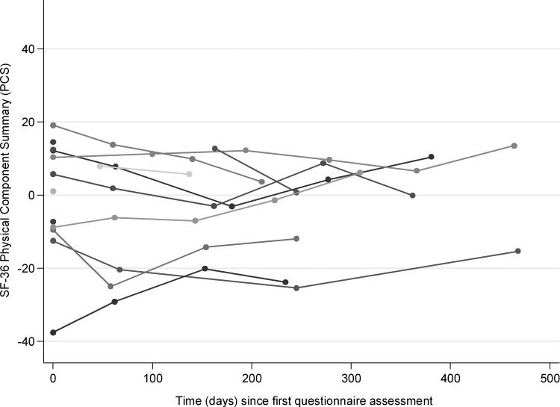
Carer’s SF-36 Physical Component Summary
Baxter et al. J Pall Med. 2016; 16:1602

Slide 25
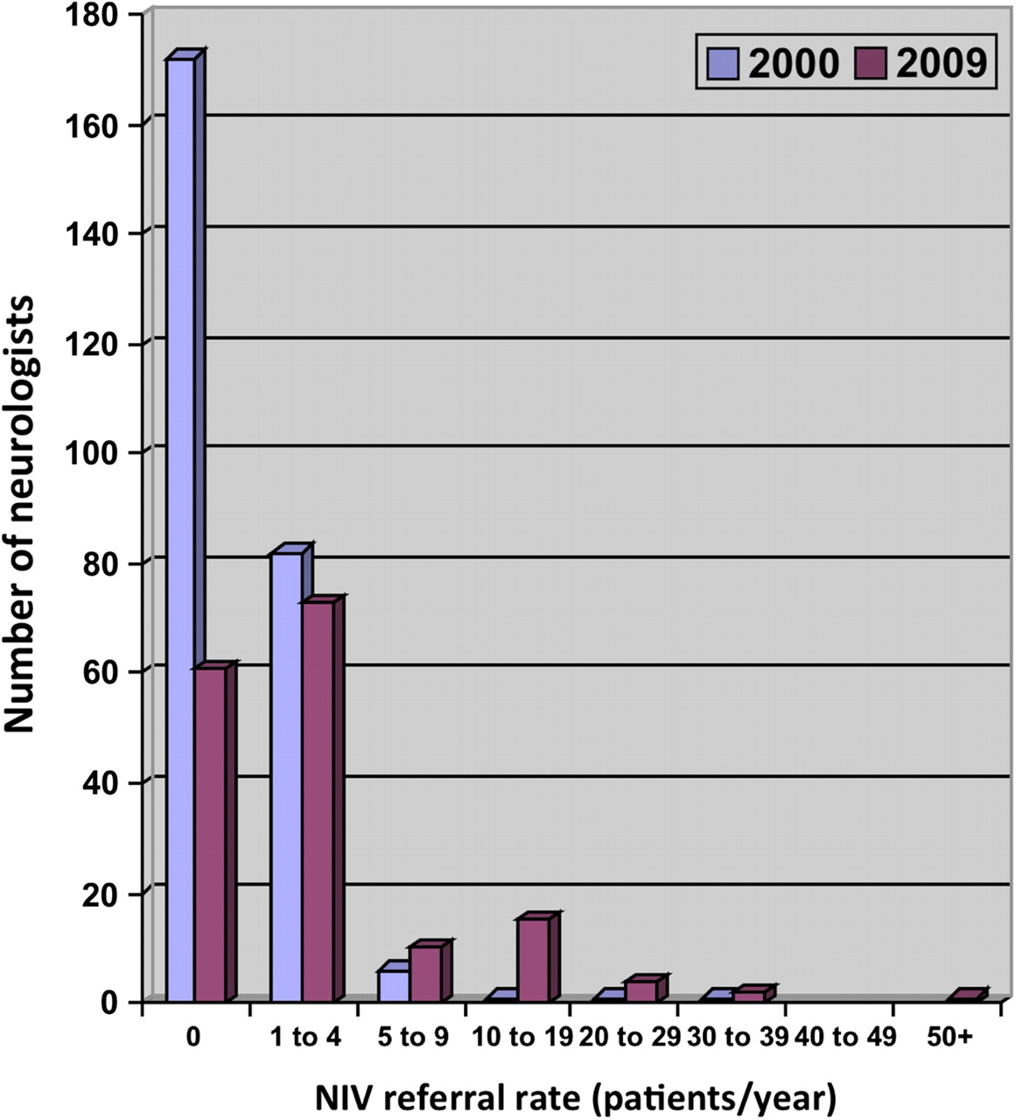

NIV Referral Patterns
O'Neill et al. JNNP: 2011
©2011 by BMJ Publishing Group Ltd
Notes:
Non-invasive ventilation (NIV) referral pattern.

Slide 26
Monitoring Respiratory Function
NICE guidance/recommendations:
The following should be monitored:
SaO₂
FVC
SNIP
Peak cough flow – cough into face mask directly connected to peak flow meter
<200 l/min suggests possible difficulty with secretion clearance

Slide 27
Indications for NIV in MND
Orthopnoea
Symptoms of hypoventilation:
-unrefreshing sleep -morning headache
-multiple awakenings (nocturia)
-confusion -fatigue
-poor appetite
PLUS:
Falling FVC (typically <70% predicted)
Sniff nasal pressure (SNIP) <30 cm H₂O
Low SaO₂ – never used!

Slide 28
Where does NIV and respiratory support fit in the management of MND?
NIV not tolerated by 25% of patients trialled
Bulky, relatively non-mobile (increasingly less so) equipment.
Mask/interface problems common.
Significant increase in carer burden
MND patients with bulbar onset (20%) generally not helped by NIV.

Slide 29
Where does NIV and respiratory support fit in the management of MND?
In the right setting NIV provides excellent palliation and prolongs useful and meaningful survival
The evidence base for its use in MND exists and has NICE approval

Slide 30
Where does NIV and respiratory support fit in the management of MND?
NIV is for symptoms not survival or poor tests of respiratory function
NIV is not for all
Pros and cons discussed
Not for those with advanced physical disability at the end of their disease

Slide 31
Introducing NIV
Every attempt to do this electively
Increasing numbers of patients being considered for NIV - 30-50% depending upon centre.
Increasing interest from patients in moving from elective NIV to elective invasive ventilation (IV).
Presently, 6 patients with longterm IV in region, none of whom truly commenced this intervention electively!

