Slide 1

Diagnosing MND: what I say to patients and their families
Tim Williams, MND Care Centre Director, Newcastle

Slide 2
MND – how much is there?
Incidence: 2-4/100,000/pa
constant worldwide
Prevalence: 4-6/100,000
4,500-5000 pts in UK
3-4 pts MND pts die each day
Approx 160 pts at Newcastle centre
~75 new pts per annum

Slide 3
MND – what’s the risk?
Life time risk:
MND: 1 in 400-800
0.25% if live to 80
2.5% (1 in 40) if 1 parent affected
Dementia: 1 in 8
Parkinsonism: 1 in 15

Slide 4
MND cases – where from?
~ 75% from fellow neurologists
~ 20% from other specialists: care of the elderly/medicine, ENT surgery, orthopaedics, neurosurgery,
~ 5% from primary care

Slide 5
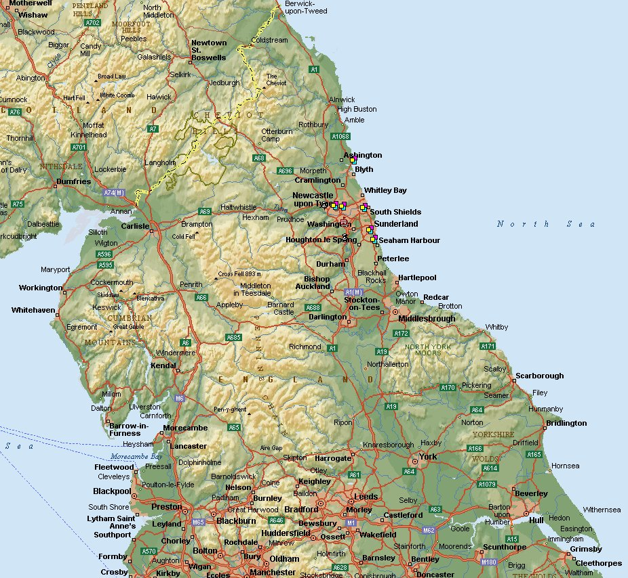
Our Patch
®

Slide 6
MND presentations:
~ 80% spinal or limb onset
ALS – amyotrophic lateral sclerosis
PMA - progressive muscular atrophy or predominantly LMN (pLMN, flail arm, flail leg),
PLS - primary lateral sclerosis or predominantly UMN (pUMN)
~ 20% speech onset
Bulbar onset MND
PBP - progressive bulbar palsy

Slide 7
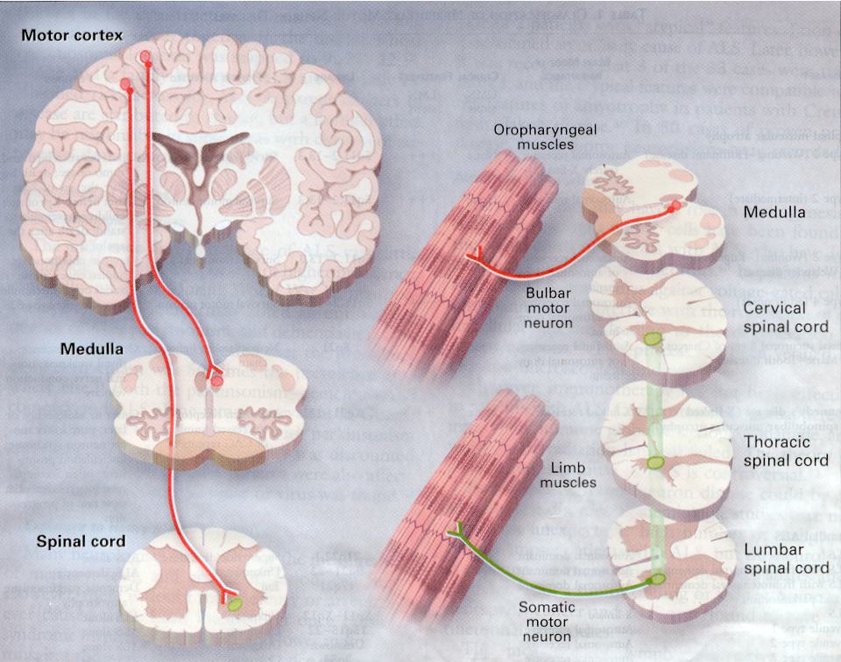

Slide 8
BRAIN
upper motor neurone
MUSCLE
SPINAL CORD
lower motor neurone

Slide 9
What I tell patients, their families and carers
I confirm the diagnosis of MND
No alternative inflammatory, infective, structural or metabolic cause
MND is a neurodegenerative disorder – similar but much less common than Alzheimer’s or Parkinson’s disease

Slide 10
Neurodegenerative disease
Characterised by:
selective(?) irreversible loss of a specific group(s) of neurones.
onset in late/middle life (60 plus, 17-90’s).

Slide 11
Age-related neurodegenerative diseases
Alzheimer’s Disease
Parkinson’s Disease
MND

Slide 12
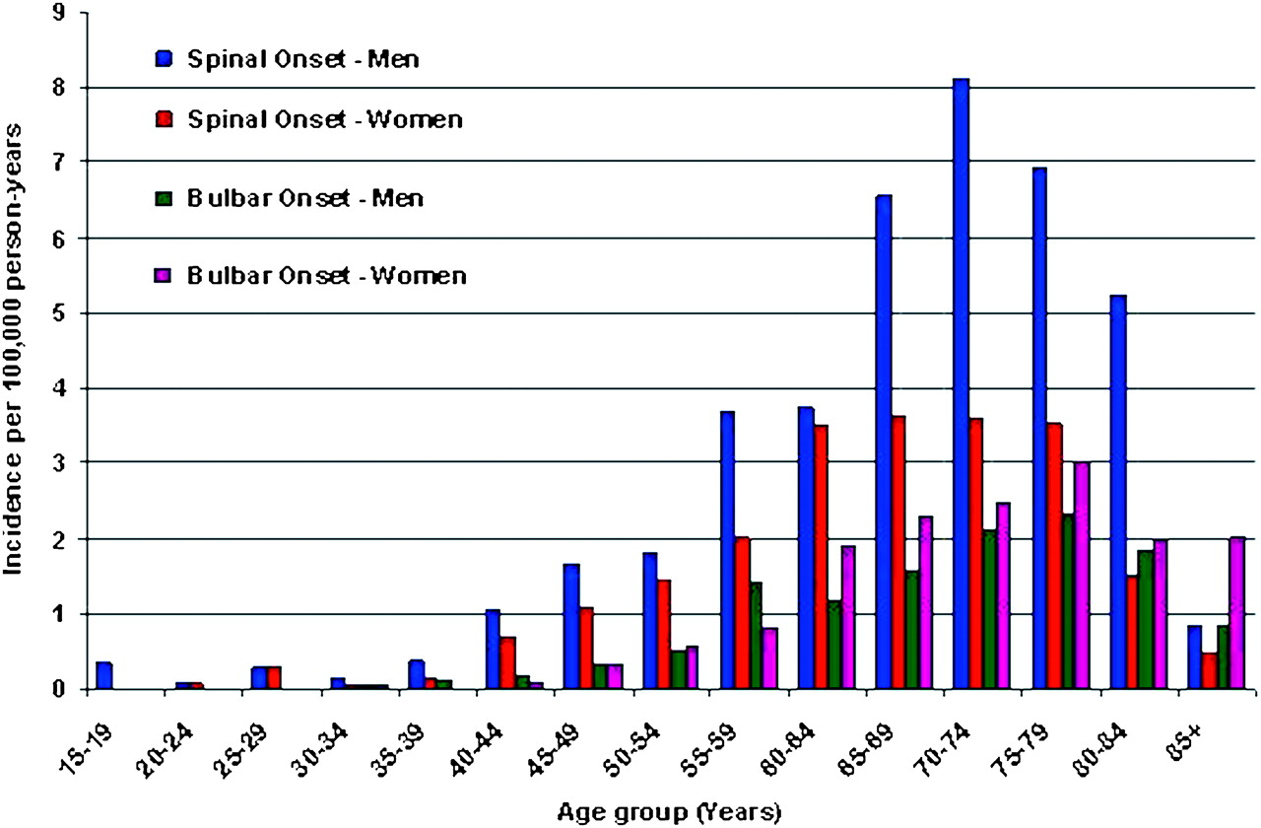
Age and gender specific incidence of MND
Logroscino G et al. J Neurol Neurosurg Psychiatry 2010;81:385-390
©2010 by BMJ Publishing Group Ltd
Notes:
Age and gender specific incidence rates of amyotrophic lateral sclerosis (ALS) in Europe during the 2 year period 1998–1999, classified according to site of onset. Generalised-onset ALS is classified as bulbar onset ALS by convention.

Slide 13
Neurodegenerative disease
Characterised by:
selective(?) irreversible loss of a specific group(s) of neurones.
onset in late/middle life (60 plus, 17-90’s).
relentlessly progressive
no clear understanding of aetiology.

Slide 14
Aetiology
Unknown!
~95% “sporadic”
Likely complex interaction between genetically determined predisposition and environmental trigger(s)
~5% genetically determined

Slide 15
MND: Occasionally a genetic disease
Usual
Rare

Slide 17
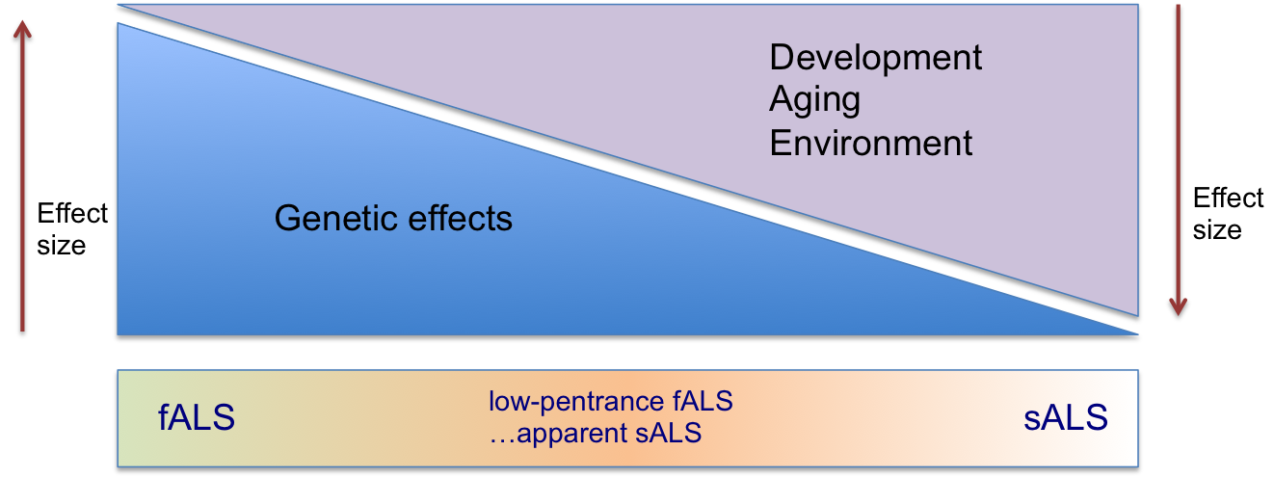
The genetic risk of MND

Slide 18
Neurodegenerative disease
Characterised by:
selective(?) irreversible loss of a specific group(s) of neurones.
onset in late/middle life (60 plus, 17-90’s).
relentlessly progressive
no clear understanding of aetiology.
no disease modifying treatments

Slide 19
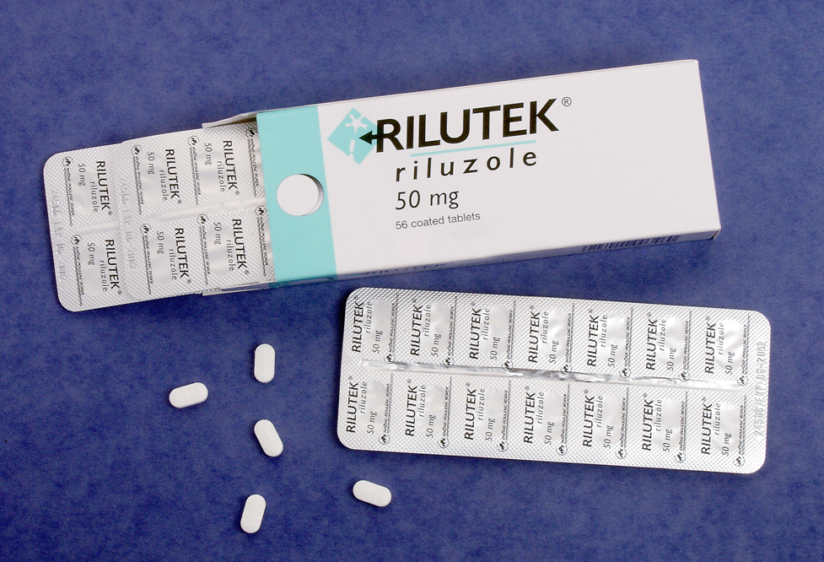

Slide 20
What I tell patients, their families and carers
I confirm the diagnosis of MND
No alternative inflammatory, infective, structural or metabolic cause
MND is a neurodegenerative disorder – similar but much less common than Alzheimer’s or Parkinson’s disease
MND is invariably fatal

Slide 21
Why say clearly that MND is fatal?
Not usually relevant or of vital immediate importance at first appointment, but:
no elephants in the room (death and taxes)
tempers or influences the decisions we will make together in the future regarding disease management

Slide 22
Prognosis
Average survival 30-36 months from symptom onset (18-24 months from diagnosis)
50% dead at 30 months
10-20% live ≥ 5yrs
5-10% live ≥ 10yrs
V. occasional patients live 20 yrs (or more)

Slide 23
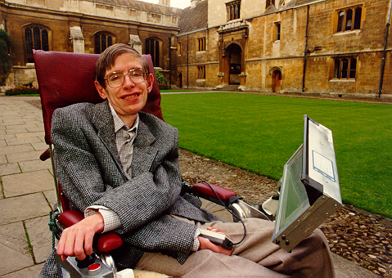

Slide 24
Prognosis
I don’t use statistics (directly) or give numbers
I explain that I have never met the “average” or “typical” patient because they don’t exist
I don’t find classic phenotypes (ALS, PBP, PMA, PLS) useful for prognosis.
I explain I/we will share clinically important changes that affect prognosis
I try to give each patient a view on their individual rate of progression (s0-called personalised medicine)

Slide 25
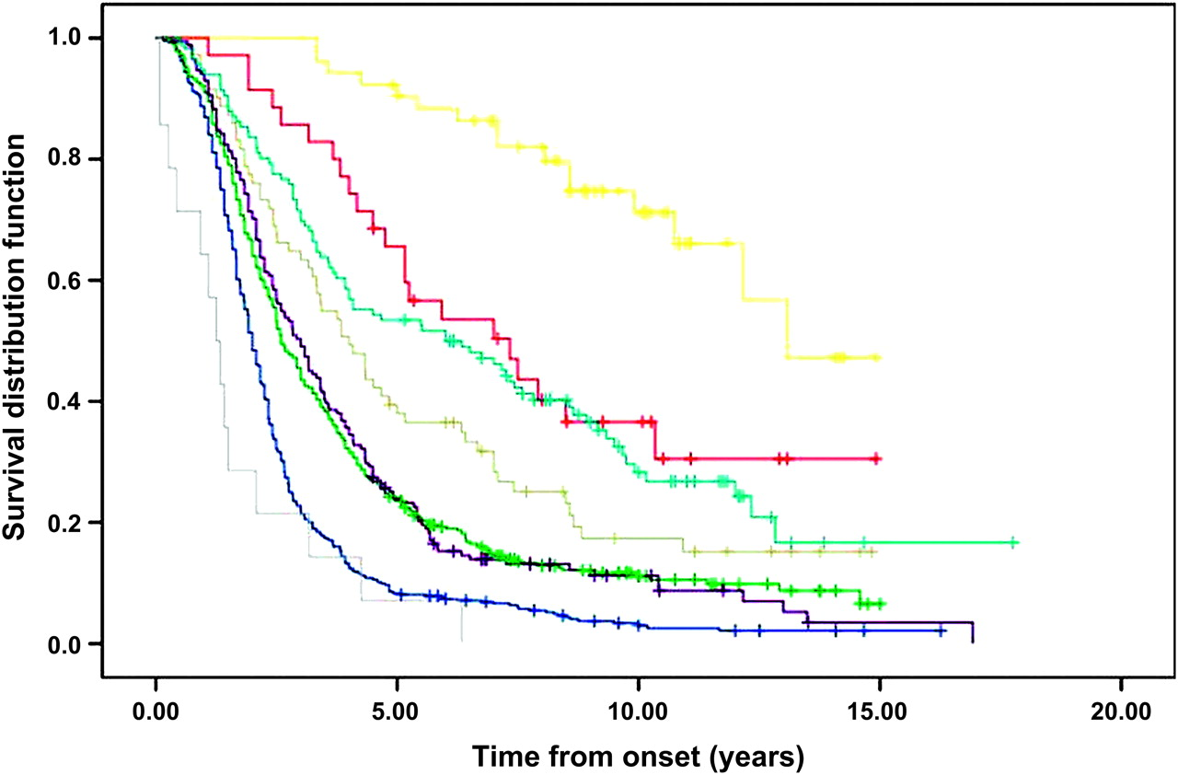
Survival according to phenotype
PUMN/PLS
PLMN/PMA
RESP
ALS
PBP
Chiò A et al. J Neurol Neurosurg Psychiatry 2011;82:740-746
Notes:
Tracheostomy free survival, according to amyotrophic lateral sclerosis (ALS) phenotype. Yellow, PUMN; red, PLMN; light blue, pyramidal ALS; grey, flail arm; violet, classic ALS; green, flail leg; blue, bulbar; cyan, respiratory. Crosses are censored patients. PLMN, pure lower motor neuron phenotype; PUMN, pure upper motor neuron phenotype.

Slide 26
Disease phenotype dictates prognosis
ALS/PBP
UMN
LMN
Limb onset ALS – 35/12
Bulbar onset – 27/12
Flail limb - 60+/12
PLS
PMA

Slide 27
Personalised prognosis
How do you compare with the last >1,000 patients seen over the last 17 yrs
Where do you fit on the spectrum – UMN vrs LMN involvement

Slide 28
Disease phenotype dictates prognosis
ALS/PBP
UMN
LMN
Limb onset ALS – 35/12
Bulbar onset – 27/12
Flail limb - 60+/12
PLS
PMA

Slide 29
Personalised prognosis
How do you compare with the last >1,000 patients seen over the last 17 yrs
Where do you fit on the spectrum – UMN vrs LMN involvement
Are there any clinical features of prognostic importance, e.g. just 1 limb, flail arm or leg

Slide 30
Managing relentlessly progressive disease
The mainstay of management is the timely provision of help and support to maintain independence
Most patients/families want to remain in their own homes independently – not much to ask!
The MND centre will help to coordinate care with the multiple disciplines likely to be involved

Slide 31
Managing relentlessly progressive disease
We will consider and discuss appropriate and timely interventions
But……
the ultimately fatal nature of MND should temper management decisions

Slide 32
Treatment (drugs, pills and potions)
Limited and the last aspect of management I discuss.
Riluzole is the only licensed therapy

Slide 33
Neurodegenerative disease
Characterised by:
selective(?) irreversible loss of a specific group(s) of neurones.
onset in late/middle life (60 plus, 17-90’s).
relentlessly progressive
no clear understanding of aetiology.
no disease modifying treatments

Slide 35
Treatment (drugs, pills and potions)
Limited, and the last aspect of management discussed
Riluzole the only licensed therapy
Has a modest (10%) effect on/slowing of disease progression
Won’t give back strength & won’t stop progression
Doesn’t have a symptomatic effect, but does have side effects!

Slide 36
Other stuff I discuss at diagnostic or first appt (if prompted)
That I think about two stages in coming to terms with MND:
Accepting the diagnosis of MND – relatively easy (he says!)
What the diagnosis means e.g. progression & death – the difficult bit
Treatments & Trials
What we’re involved in and why
Trials/treatments you might read about

Slide 37
Other stuff I don’t discuss at diagnostic or first appt (unless prompted)
End of life
Gastrostomy
Resp failure and support
Genetics where there is no familial history – its too complicated!

Slide 38
And then……….
The patients, their families and carers are psychological wrecks and I pass them through to one of the care coordinators!!

