Slide 1
Mechanical Ventilation in MND
Ben Messer
May 2017

Slide 2
Contents
Key respiratory issues in MND
Withdrawal of mechanical ventilation
APM guidelines
  Important bits
  Lessons from ICU
Case series
Important lessons
Discussion

Slide 3
Abbreviations
MV = Mechanical Ventilation
NIV = Non-Invasive Ventilation
TV = Tracheostomy Ventilation
FVC = Forced Vital Capacity

Slide 4
American Academy of Neurology Practice 1999
5 main respiratory issues in MND
  What are the early indicators of RF?
  Does NIV affect respiratory function or survival?
  Does NIV/TV improve QoL?
  Does experience with NIV help guide TV?
  What’s the optimal method for withdrawal of MV?

Slide 5
American Academy of Neurology Practice 2009
What are the optimal pulmonary function tests to detect respiratory insufficiency?
Does NIV improve respiratory function or increase survival?
How do invasive and non-invasive ventilation affect quality of life?
What factors influence acceptance of invasive and non-invasive ventilation?
What is the efficacy of targeted respiratory interventions for clearing secretions?

Slide 6
American Academy of Neurology Practice 1999/2009
What are the early indicators of RF?
Does NIV improve respiratory function or increase survival?
How do invasive and non-invasive ventilation affect quality of life?
What factors influence acceptance of invasive and non-invasive ventilation?
What is the efficacy of targeted respiratory interventions for clearing secretions?
What’s the optimal method for withdrawal of MV?

Slide 7
American Academy of Neurology Practice 1999/2009
What are the early indicators of RF?
Does NIV improve respiratory function or increase survival?
How do invasive and non-invasive ventilation affect quality of life?
What factors influence acceptance of invasive and non-invasive ventilation?
What is the efficacy of targeted respiratory interventions for clearing secretions?
What’s the optimal method for withdrawal of MV?

Slide 8
Early Indicators
Orthopnoea commonly used
  Only 50% predictive of abnormal pCO2
  3/38 patients had hypercapnia without it
Data not reported but orthopnoea predictor of respiratory failure
    Lancet Neurol 2006;5: 140-7

Slide 9
Early Indicators
Rate of decline of FVC predicts need for MV
    ALS 2007; 8: 36-41
FVC at baseline predicts survival (>75% 4.1yrs, <75% 2.9 years)
    J Neurol Neurosurg Psychiatry 2006; 77: 390-2
Supine FVC may be more sensitive to predict diaphragm weakness
    Chest 2002; 121: 436-42

Slide 10
Early Indicators
Sniff Nasal Pressure correlates with nocturnal hypoxaemia and hypercapnia
Overnight desaturation on oximetry adversely affects survival
    Rev Neurol 2002; 158: 575-8

Slide 11
Early Indicators
Conclusion
  Respiratory failure unlikely if FVC >75% predicted
  Monitor regularly when falls below this value
  Respiratory failure inevitable if FVC<30% predicted
    Non-invasive Ventilation 2nd Edition. J-F Muir, N Ambrosino and AK Simonds

Slide 12
What we do

Slide 13
Disturbed sleep
Orthopnoea
Morning headaches
SIGNS AND SYMPTOMS
Breathlessness
Daytime somnolence
Poor concentration
Weight loss
Weakness and apathy
Recurrent chest infections
Impaired swallow

Slide 14
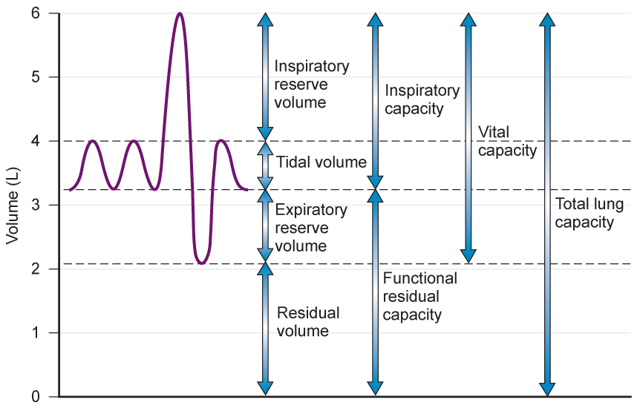

Slide 15
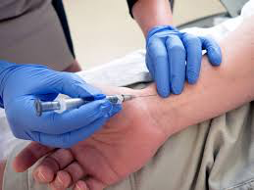

Slide 16
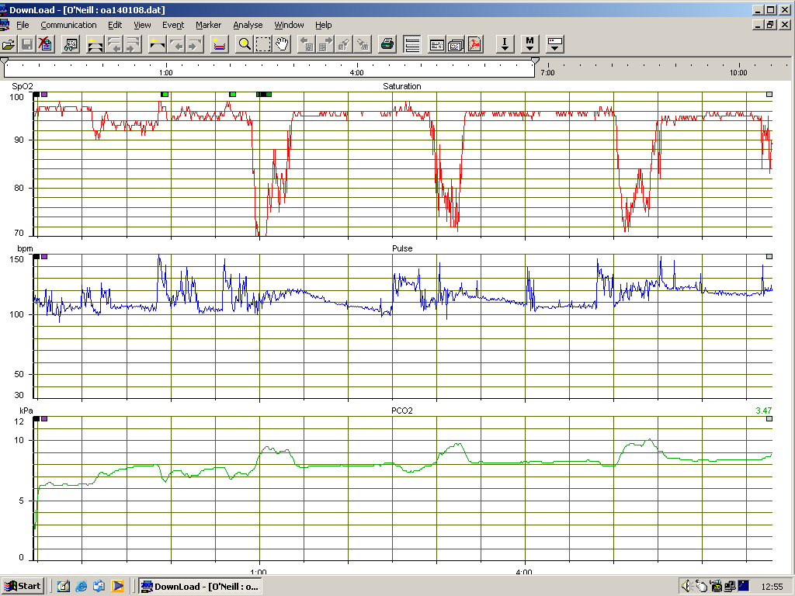

Slide 17
American Academy of Neurology Practice 1999/2009
What are the early indicators of RF?
Does NIV improve respiratory function or increase survival?
How do invasive and non-invasive ventilation affect quality of life?
What factors influence acceptance of invasive and non-invasive ventilation?
What is the efficacy of targeted respiratory interventions for clearing secretions?
What’s the optimal method for withdrawal of MV?

Slide 18
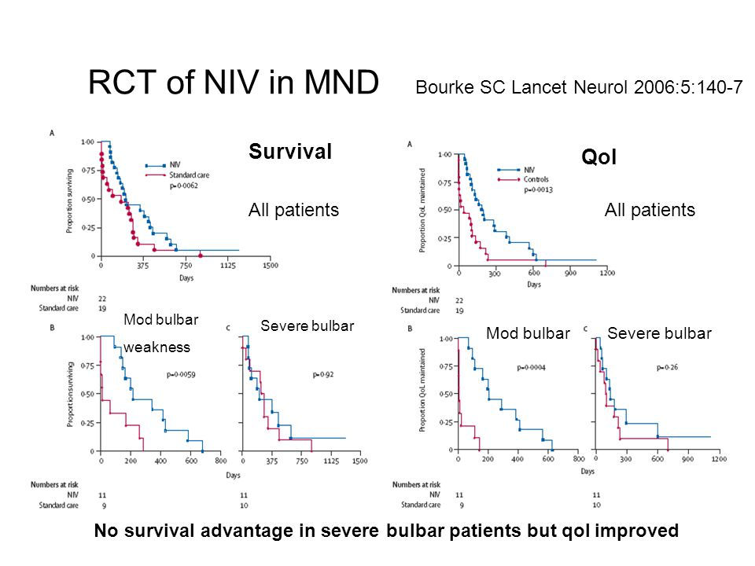

Slide 19
NIV & survival/Pulmonary function tests
Slower rate of decline in FVC in NIV group
Especially in those using NIV > 4 Hours per day

Slide 20
NIV & survival
Conclusion
The available data are in favour of NIV improving survival and rate of decline in pulmonary function as assessed by FVC

Slide 21
American Academy of Neurology Practice 1999/2009
What are the early indicators of RF?
Does NIV improve respiratory function or increase survival?
How do invasive and non-invasive ventilation affect quality of life?
What factors influence acceptance of invasive and non-invasive ventilation?
What is the efficacy of targeted respiratory interventions for clearing secretions?
What’s the optimal method for withdrawal of MV?

Slide 22
NIV & QoL
Study from Newcastle
QoL
  Improved globally by NIV (SF-36)
  With poor bulbar function-no difference in SF-36
    Lancet Neurol 2006;5: 140-7

Slide 24
NIV & QoL
9 patients with sleep disturbance and hypersomnolence
  Improved ESS (9->4) at 6 weeks
  Improved cognitive functioning
    J Neurol Neurosurg Psychiatry 2001;71: 482-7

Slide 25
MV & QoL
German postal survey of 102 patients
32 NIV, 21 TV
All but one TV patient 24/7 ventilated
Only 2/32 NIV 24/7 ventilated
NIV 14 months TV 35 months use prior to the survey

Slide 26
MV & QoL
94% NIV would choose it again Vs 81% TV
97% Caregivers would advise a relative to have NIV Vs 75% for TV
94% Caregivers would opt for NIV for themselves Vs 50% for TV
30% of caregivers in TV rated their QoL as lower than the MND patient

Slide 27
MV & QoL
13 patients interviewed 19 months after tracheostomy
14 controls only 2 ventilated via NIV
No differences in QoL
TV patients lower physical abilities but length of disease 57 months Vs 32 months
    Journal of Critical Care (2011) 26, 329.e7–329.e14

Slide 28
MV & QoL
Conclusion
NIV seems to improve QoL in those without severe bulbar dysfunction
Tracheostomy appears acceptable to most patients
Major carer implication

Slide 29
What we do
Care package
  Time in hospital (elective Vs emergency)
Swallow
Worsening dependence on MV
Procedural/GA risks
Ability to communicate wishes about end of life

Slide 30
American Academy of Neurology Practice 1999/2009
What are the early indicators of RF?
Does NIV improve respiratory function or increase survival?
How do invasive and non-invasive ventilation affect quality of life?
What factors influence acceptance of invasive and non-invasive ventilation?
What is the efficacy of targeted respiratory interventions for clearing secretions?
What’s the optimal method for withdrawal of MV?

Slide 31
Factors influencing acceptance of NIV
Improved compliance with:
  Male
  Affluence
  Engagement with other treatments
    PEG
    Riluzole
      Neurology 2009;73:1218–1226

Slide 32
Factors influencing acceptance of NIV
  Symptoms
  Less than moderate bulbar dysfunction
  75% without FTD Vs 38% with FTD
      Neurology 2009;73:1218–1226

Slide 33
American Academy of Neurology Practice 1999/2009
What are the early indicators of RF?
Does NIV improve respiratory function or increase survival?
How do invasive and non-invasive ventilation affect quality of life?
What factors influence acceptance of invasive and non-invasive ventilation?
What is the efficacy of targeted respiratory interventions for clearing secretions?
What’s the optimal method for withdrawal of MV?

Slide 34
Targeted respiratory interventions
MI-E improves PCF by:
  17% in controls
  26% in bulbar patients
  28% in non-bulbar patients
    Neurology 2009;73:1218–1226

Slide 35
What we do
Assess clinically
  Chest infections
  Cough quality
Measure MIP/MEP
Future
  nasendoscopy

Slide 36
American Academy of Neurology Practice 1999/2009
What are the early indicators of RF?
Does NIV improve respiratory function or increase survival?
How do invasive and non-invasive ventilation affect quality of life?
What factors influence acceptance of invasive and non-invasive ventilation?
What is the efficacy of targeted respiratory interventions for clearing secretions?
What’s the optimal method for withdrawal of MV?

Slide 37
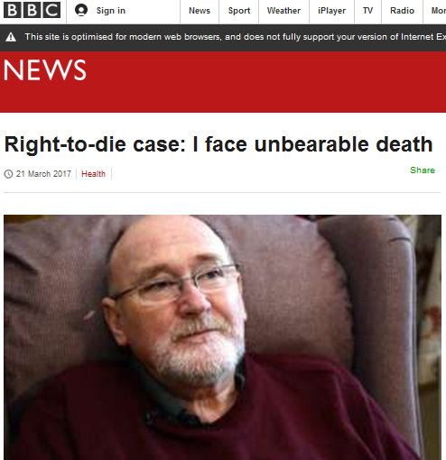

Slide 38
Withdrawal of MV
Ongoing treatment against a patient’s wish is a criminal offence

Slide 39
Withdrawal of MV
Ventilator
  Prolongs dying
  Makes dying unnatural

Slide 40
Withdrawal of MV
Dyspnoea
  Inevitable in ventilator-dependent patient

Slide 41
Withdrawal of MV
In nocturnal NIV patient who can communicate this is easy
In reality this is more difficult…

Slide 42
Lessons from ICU
No fixed approach
  Bespoke

Slide 43
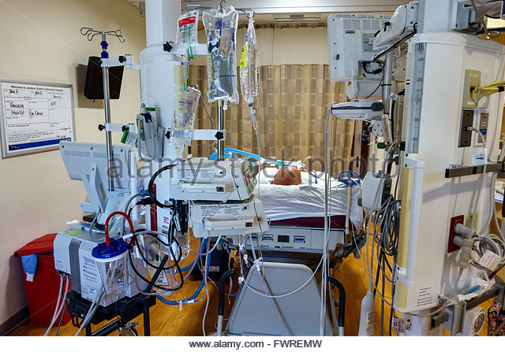

Slide 44
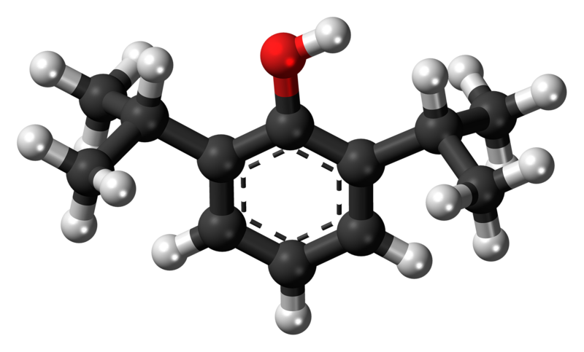

Slide 45
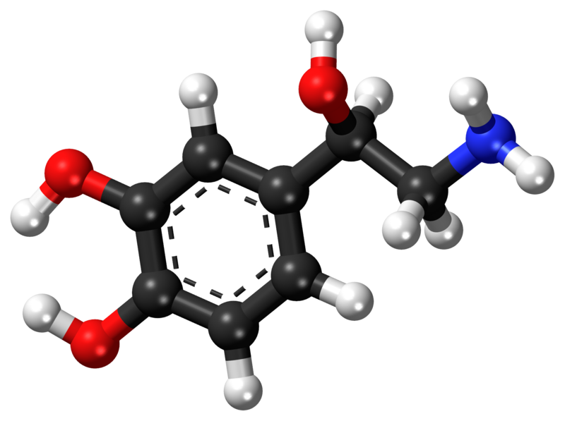

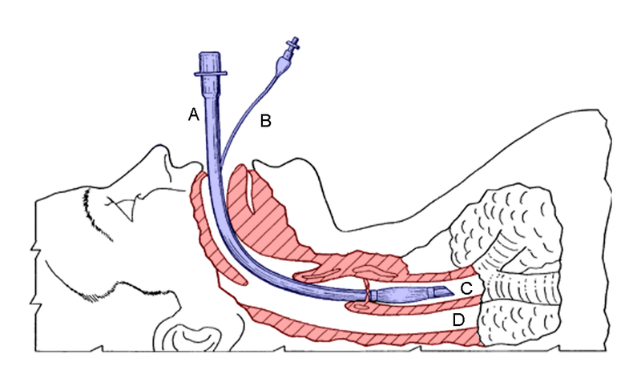

Slide 46
Lessons from ICU
N Engl J Med 2014; 370: 2506-14
Dying with dignity in the ICU

Slide 47
Lessons from ICU
Discontinuation of mechanical ventilation
  Confers risk of dyspnoea
  Death may occur quickly
  Preemptive sedation is typically needed to blunt air hunger

Slide 48
Lessons from ICU
Weaning from mechanical ventilation
  Confers low risk of dyspnoea
  May prolong the dying process
  Particularly if the patient requires low levels of support

Slide 49


Slide 51
APM guideline
A patient should be made aware that assisted ventilation is a form of treatment and they can choose to stop it at any time. They should be in no doubt that this is legal and that healthcare teams will support them

Slide 52
APM guideline
Senior clinicians should validate the patient’s decision and lead the withdrawal

Slide 53
APM guideline
Withdrawal should be undertaken within a reasonable timeframe after a validated request

Slide 54
APM guideline
Symptoms of breathlessness and distress should be anticipated and effectively managed

Slide 55
APM guideline
After the patient’s death, family members should have appropriate support and opportunities to discuss the events with the professionals involved

Slide 56
APM guideline
For a patient dying from MND, it is their legal right to decide to refuse assisted ventilation, and the duty of care of professionals to manage the physical and emotional impact of this decision on the patient and family members

Slide 57
APM guideline
The principles for the management of symptoms are generalisable but the precise methodology requires individual tailoring to the patient

Slide 58
APM guideline
Providing anticipatory medication to avoid discomfort and distress is a fundamental medical responsibility and parallels the use of both local and general anaesthesia or sedation prior to invasive interventions

Slide 59
APM guideline
The degree of sedation required for effective management of symptoms for these patients (highly ventilator dependent patients) is that which achieves a reduced conscious level with no response to voice or painful stimulus

Slide 60
Case Series
55 year old man
Established on NIV January 2014
Elective tracheostomy and PEG performed in October 2014
EHCP

Slide 61
EHCP
When ......has lost consciousness as a result of his MND or complications of this, he has requested that his ventilation via tracheostomy to be discontinued to allow him to die naturally

Slide 62
EHCP
The point at which ...... has reached prolonged loss of consciousness (i.e. not regaining consciousness over a 24 hour period or family feel that he has lost consciousness due to illness progression rather than just sleeping) should prompt review by healthcare professionals to determine if ..... is dying

Slide 63
EHCP
The assessment should be completed by two separate healthcare professionals in discussion with ....'s family to ensure a multidisciplinary team decision has been made regarding diagnosis of dying

Slide 64
EHCP
Only once the decision has been made that ........ has lost consciousness and is dying, the process of discontinuing the ventilation via the tracheostomy may commence

Slide 65
Case Series
Withdrawal took place March 2015
  Unresponsive with chest infection

Slide 66
Case Series
56 year old man
NIV established January 2015
Not fully NIV dependent

Slide 67
Case series
EHCP stated that he would want HMV withdrawn if speech or swallow became impaired, or mobility deteriorated to a point when he was unable to assist with hoist transfers
This took place August 2015
  Conscious on day of withdrawal

Slide 68
Case Series
63 year old lady
Commenced NIV July 2014
Completely NIV dependent by November 2015

Slide 69
Case Series
Admitted to hospice for palliative management
Options explored and agreed during this phase and HMV withdrawal requested as part of these discussions
This took place December 2015

Slide 70
Case Series
31 year old man
NIV established May 2016
Became fully NIV dependent July 2016 (pneumonia)

Slide 71
Case Series
Home discharge, with a request for withdrawal of HMV to take place once at home
This took place September 2016
  Completely conscious on day of withdrawal

Slide 72
Case Series
50 year old man
NIV established May 2013
NIV dependent by October 2014
Tracheostomy
  Semi-elective

Slide 73
Case Series
Home August 2015
ADRT in place
Treatment withdrawal took place January 2017 following further deterioration

Slide 74
Patient | Level of consciousness | Drugs used via infusion | Total given via bolus
A | Unresponsive |  | Morphine 2 X 2.5mg Midazolam 2 X 2.5mg
B | Responsive to voice | Morphine 10mg / 24 hour Midazolam 10mg / 24 hour | Morphine 1 X 2.5 mg, 3 X 5mg Midazolam 1 X 2.5 mg, 1 X 5 mg, 2 X 15mg
C | Responsive to voice | Morphine 10mg/24 hours Midazolam 30mg/24 hours | Morphine None Midazolam 4 X 5mg
D | Completely conscious with capacity | Morphine 30mg / 24 hours Midazolam 40mg / 24 hours | Morphine 3 X 10mg Midazolam 10 X 10mg
E | Responsive to pain | Morphine 15mg / 24 hour Midazolam 10mg /24 hour | Morphine 2 X 2.5mg Midazolam 2 X 2.5mg

Slide 75
 | Decision to commencement of withdrawal time | Ventilator settings at start of withdrawal process | Ventilator settings prior to discontunatiuon of MV | Time period of overall process of withdrawal of MV | Time to death following withdrawal MV
Patient A | 4 days (planned at request of family) | Insp pressure 22 PEEP 6 BPM 14 Insp time 1.4 Insp trigger 3 | Insp pressure 10 PEEP 3 BPM 8 Insp time 1.4 Insp trigger 3 | 1 hour | Moments
Patient B | 24 hours | IPAP 17 EPAP 3 Ti 1.6 BPM 12 Trigger 4 | IPAP 8 EPAP 3 Ti 1.6 BPM 8 Trigger 4 | 1 hour | 32 hours
Patient C | 2 days | IPAP 14 EPAP 3 Ti 1.4 BPM 14 Trigger 2 | IPAP 8 EPAP 3 Ti 1.4 BPM 8 Trigger 2 | 1 hour | 20 minutes
Patient D | 11 days (request of patient) | IPAP26 EPAP3 Ti 1.50 BPM 15 Trigger 1 | IPAP 12 EPAP 3 Ti 1.3 BPM 8 Trigger 5 | 7 hours | 2 hours
Patient E | 24 hours (following deterioration and loss of consciousness) | Insp pressure 20 PEEP 4 BPM 20 Insp time 1.5 Insp trigger 3 | Insp pressure 12 PEEP 4 BPM 8 Insp time 1.5 Insp trigger 3 | 6 hours, 40 minutes | 10 minutes

Slide 76
 | Decision to commencement of withdrawal time | Ventilator settings at start of withdrawal process | Ventilator settings prior to discontunatiuon of MV | Time period of overall process of withdrawal of MV | Time to death following withdrawal MV
Patient A | 4 days (planned at request of family) | Insp pressure 22 PEEP 6 BPM 14 Insp time 1.4 Insp trigger 3 | Insp pressure 10 PEEP 3 BPM 8 Insp time 1.4 Insp trigger 3 | 1 hour | Moments
Patient B | 24 hours | IPAP 17 EPAP 3 Ti 1.6 BPM 12 Trigger 4 | IPAP 8 EPAP 3 Ti 1.6 BPM 8 Trigger 4 | 1 hour | 32 hours
Patient C | 2 days | IPAP 14 EPAP 3 Ti 1.4 BPM 14 Trigger 2 | IPAP 8 EPAP 3 Ti 1.4 BPM 8 Trigger 2 | 1 hour | 20 minutes
Patient D | 11 days (request of patient) | IPAP26 EPAP3 Ti 1.50 BPM 15 Trigger 1 | IPAP 12 EPAP 3 Ti 1.3 BPM 8 Trigger 5 | 7 hours | 2 hours
Patient E | 24 hours (following deterioration and loss of consciousness) | Insp pressure 20 PEEP 4 BPM 20 Insp time 1.5 Insp trigger 3 | Insp pressure 12 PEEP 4 BPM 8 Insp time 1.5 Insp trigger 3 | 6 hours, 40 minutes | 10 minutes

Slide 77
 | Decision to commencement of withdrawal time | Ventilator settings at start of withdrawal process | Ventilator settings prior to discontunatiuon of MV | Time period of overall process of withdrawal of MV | Time to death following withdrawal MV
Patient A | 4 days (planned at request of family) | Insp pressure 22 PEEP 6 BPM 14 Insp time 1.4 Insp trigger 3 | Insp pressure 10 PEEP 3 BPM 8 Insp time 1.4 Insp trigger 3 | 1 hour | Moments
Patient B | 24 hours | IPAP 17 EPAP 3 Ti 1.6 BPM 12 Trigger 4 | IPAP 8 EPAP 3 Ti 1.6 BPM 8 Trigger 4 | 1 hour | 32 hours
Patient C | 2 days | IPAP 14 EPAP 3 Ti 1.4 BPM 14 Trigger 2 | IPAP 8 EPAP 3 Ti 1.4 BPM 8 Trigger 2 | 1 hour | 20 minutes
Patient D | 11 days (request of patient) | IPAP26 EPAP3 Ti 1.50 BPM 15 Trigger 1 | IPAP 12 EPAP 3 Ti 1.3 BPM 8 Trigger 5 | 7 hours | 2 hours
Patient E | 24 hours (following deterioration and loss of consciousness) | Insp pressure 20 PEEP 4 BPM 20 Insp time 1.5 Insp trigger 3 | Insp pressure 12 PEEP 4 BPM 8 Insp time 1.5 Insp trigger 3 | 6 hours, 40 minutes | 10 minutes

Slide 78
Lessons
Preparation
  Read APM guidance
    Many need reassurance (including the family)

Slide 79
Lessons
Preparation
  Meet and establish roles

Slide 80
Lessons
Preparation
  One lead clinician

Slide 81
Lessons
Preparation
  Timing
    Evening often easier for staff
    However-drug availability overnight

Slide 82
Lessons
Drugs
  Separate roles between PCT/HMV teams

Slide 83
Lessons
Drugs
  Room for drawing up drugs

Slide 84
Lessons
Drugs
  Expect high doses

Slide 85
Lessons
Drugs
  Substitute PO meds with infusions well in advance of withdrawal

Slide 86
Lessons
Drugs
  Pre-insertion of two SC lines

Slide 87
Lessons
Ventilation
  RR first before pressures

Slide 88
Lessons
Ventilation
  Disable alarms

Slide 89
Lessons
Ventilation
  Leave mask on after withdrawal

Slide 90
Lessons
Ventilation
  We are not there to stop the patient breathing

Slide 91
Lessons
Physiology
  Do not titrate anti-dyspnoea meds to RR

Slide 92
Lessons
Physiology
  Two patients opened eyes at the moment of death

Slide 96
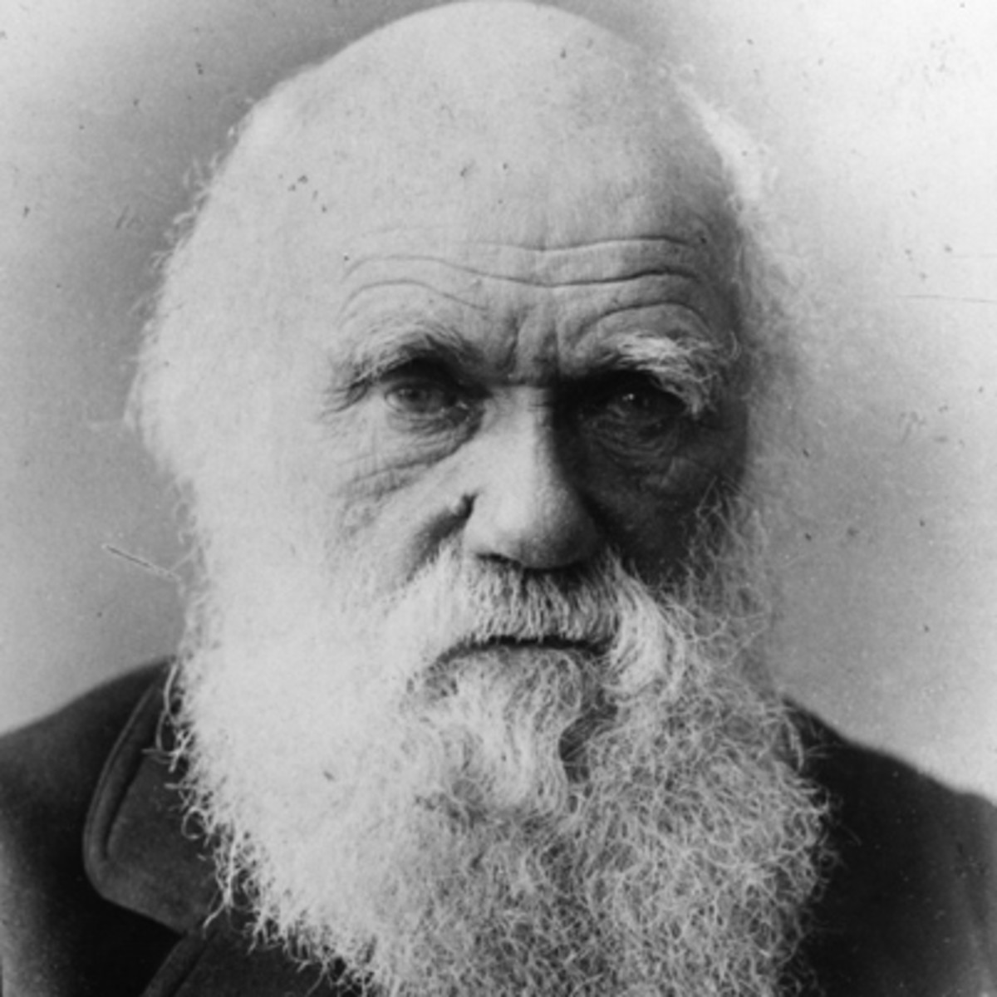
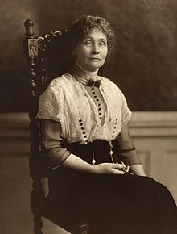

Slide 97
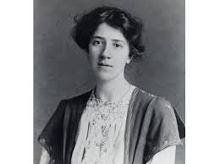


Slide 98

Questions?

