Slide 1
Provision of Specialist Palliative Care in North Cumbria
Dr.Sundar Balasubramanian
L.Consultant in Palliative Care.
Cumbria Partnership Trust.
Carlisle.

Slide 2

Myth No.1
Palliative care equates to End of Life Care

Slide 3
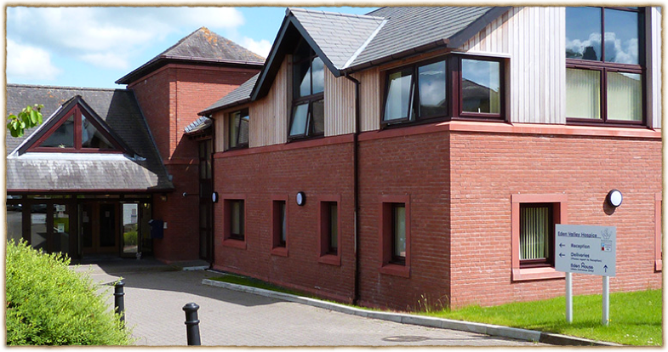
Myth No:2
Hospice is a one way ticket.

Slide 4
Integration of Services & Provision of Palliative care for MND patients in North Cumbria( Eden Valley Hospice & Community).
Support provided by the day hospice for patients and their carers.
Advance Care Planning.
Palliation and management of symptoms in MND patients

Slide 5
Integration of Services
6 MND Professional forums /year in carlisle
Representation from Palliative Care, MND team, Clinical Neuropsychology, Physio, OT’s, Social Worker, Complimentary Therapists,orthotics,SALT &Dieticians.
newly appointed MND coordinator.

Slide 6
MDT-Professional forum
discuss the psychological and emotional impact of MND on the person whether they have any psychological or support care needs.
discuss about how they are coping with the diagnosis and prognosis, including any concerns regarding physical symptoms that they might have expressed to the health care professionals.
Following the meeting, we are a part of the joint clinic with Dr.Williams and his team

Slide 7
At what stage in the illness ( MND), do you think patients need to be referred to Palliative care services?

Slide 8
Involvement of Specialist Palliative care in the care of people with MND
Relatively rare but has devastating effects with quick progression and a poor prognosis.
O’Brien et al showed that many symptoms of patients with MND are similar to those experienced by patients with advanced cancer.
The hospice approach puts an emphasis on living rather than dying (REMEMBER THE MYTH)
The approach is based on CARE as opposed to CURE.
MND is ‘NOT’ automatically linked in people’s mind with palliative care and the hospice movement, but an increasing number of people with the condition are benefiting from the services offered by the hospices.

Slide 9
Advance Care Planning(ACP)
The EOL strategy (DoH)suggests that ACP can be helpful in finding out patient preferences regarding their care and setting, and can take the form of a statement of wishes/preferences or may be an advance decision to refuse a specific treatment.
(It also states that people do not need to plan in this way if they do not want to.)

Slide 10
The opportunity to talk openly with loved ones,having received a terminal diagnosis, is often welcomed by patients who are keen to put their affairs in order and minimise the distress for their families and loved ones. These patients often benefit from having a DNACPR form

Slide 11
Journal
Assisting patients with MND to make decisions about their care. (International Journal of Palliative Nursing,2015)

Slide 12
A more flexible approach focusing on the agenda set by the patient,underpinned by the therapeutic and trusting relationship, can avoid distress for the patient,while ensuring good care and the best outcome for the patient.

Slide 13
Day care/Sunflower group
6 week programme is designed to help carers cope with some of the difficulties that result from supporting and caring, and provides an opportunity to meet other carers in a similar position

Slide 14
Management of Symptoms
How people respond to the disease will depend most significantly upon previous lifestyle and aspirations ( the loss of which can cause feelings of ‘bereavement’)
Effective symptom control: Main goal.
Support from multitude of services/MDT

Slide 15
Respiratory impairment
Episodes of dyspnoea and anxiety may respond to the use of Benzodiazepines and Opioids.
Just in case kit to alleviate fear associated with dyspnoea,choking and panic.
Positioning of the patient is crucial to reduce pressure on the diaphragm from abdominal organs.( 10% head up tilt/sitting up)

Slide 16
chocking
Death through chocking in MND is extremely rare.
The word ‘Chocking’ misused in the context of MND, invoking feelings of feared anxiety in patients and carers

Slide 17
Sialorrhoea
Result of impaired swallowing or poor lip seal.
Distressing/Embarrassing- With draw from the society.
Can also lead to aspiration-Chest infection.
Anticholinergics+ Non pharmacological interventions

Slide 18
Nutrition
Reduced upper body strength and dexterity can lead to difficulties with eating and drinking.
Support from SALT for assessment and intervention.
If PEG tube needs to be considered ,patients FVC should be greater than 50%.

Slide 19
Mobility
Muscle wasting &weakness-leads to impaired mobility, repeated falls and risk of injury-wheel chair/specialised seating systems.
Anti spasmodics and physiotherapy may reduce stiffness and spasticity.

Slide 20
42 year old lady diagnosed with MND, complains of severe abdominal pain, which started around the umbilicus and travelled towards the right lilac fossa. She has associated vomiting. What is the possible diagnosis?

Slide 21
Pain
Range of factors
Immobility, Pressure on the skin &joint stiffness.
According to WHO analgesic ladder.

Slide 22
cognition
Around 35% experience mild cognitive change-affect executive functions like planning, decision making.
A further 15% show signs of front temporal dementia, which results in behavioural changes.
Thought generation, word finding, planning, learning new activities and concentration are affected.
Areas of deficit identified and suitable strategies to be developed.

Slide 23
continence
constipation due to various factors.
risk of UTI- can be detrimental.

Slide 24
communication difficulties
distressing to loose voice
as a result of increased bulbar muscle involvement and reduced respiratory function.
voice banking- synthetic version.

Slide 25
Emotional Lability
65 year old man diagnosed with MND attends the day hospice. Many a times he laughs uncontrollably. It could sometimes sound inappropriate and he is left embarrassed. How would you treat it?

Slide 26
Emotional Lability
Pseudo bulbar effect- laughs or cries easily.
Need to be reassured that it is a symptom of the disease and not a sign of cognitive involvement.
Fluoxetine .

Slide 27
work &finance
Increasing disability can lead to loss of self esteem, increased frustration and fears about finances
PIP/ Attendance allowance- Non means tested.

Slide 28
End of Life care
Important to recognise the terminal stages.
May need medications via syringe driver/ Just in case medications.

Slide 29
social services homeware for people with MND
SW at the hospice.
Many patients do not access this service.
Internal issues: Retaining control & normality within the home.
External issues: Limited understanding of the disease amongst service providers and the lack of awareness of service entitlement amongst patients and carers.

Slide 30
Staff support
Frustrations and difficulties inherent in working with people with such a distressing illness. Staff need support for several reasons
heavy and time consuming burden of physical care.
Being the butt of patient’s frustrations at not being able to help themselves can be personally demoralising if not interpreted within the correct context.

Slide 31
Remember the Myth
Consider referral to Specialist Palliative care team for people with current or anticipated significant or complex needs, e.g., psychological or social distress, troublesome or rapidly progressing symptoms ,complex future care planning needs and for End of Life care.

Slide 32
useful contact numbers
Eden Valley Hospice(EVH): 01228 810801
Medical Secretary:01228 608248
Community Nurse Specialists: 01228 602098
Day Hospice/ Sunflower group: 01228 817623

Slide 33
Reference
Palliative care in MS and MND, British Journal of Hospital Medicine, Jan 2010, Vol71
Hospice care in MND, Nursing standard, Vol9,1994
Assisting patients with MND to make decisions about their care, International journal of Palliative Nursing, 2015, vol 21.
Social services home care for people with MND:why such services are refused?
Ethical issues in Palliative Care-an overview; Palliative Medicine 1993;7 (suppl 2);15-20
MND:an overview; Learning Zone CPD vol26 no 46;2012

