Slide 1

The evidence that exists on participatory scenarios in ecological restoration: a systematic map
Eleanor Durrant, Pete Howson, Bekah Puttick, Samantha Potts, Yara Shennan-Farpón, Novieta Sari, Nicholas Allen, Yeongeun Jo, Matthew Grainger, Yit Arn Teh, Marion Pfeifer
Published in:
Environmental Evidence
Authors:

Slide 2
Introduction
Participatory scenarios
What are they?
Representations or storylines of possible futures in which individuals/groups/organisations have had a role in decision-making at some point throughout the process.
Why are they useful in restoration planning?
Identify collaborative solutions
Accommodate stakeholder diversity and give a sense of ownership
Explore trade-offs in outcomes, future uncertainties, the impact of interventions, prioritise resources and reduce costs
When should stakeholders participate?
Guidance from Metzger et al., 2017 suggests stakeholders should participate throughout the whole process, from method planning to creation of scenarios and review of outcomes.

Slide 3
Research Objectives
Research questions
What evidence that exists on participatory scenarios in ecological restoration?
1.What are the characteristics of the current evidence base – location, scale, design, restoration intervention type?
2.What types of study designs are used for participatory scenarios in restoration planning?
3.What types of outcomes are explored using participatory scenarios?
4.How are trade-offs in outcomes explored in participatory scenarios?
5.What is the role of participants in the scenario process and outcome determination?

Slide 4
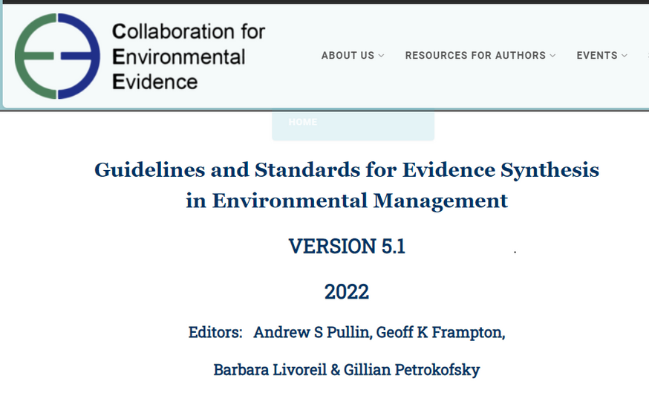
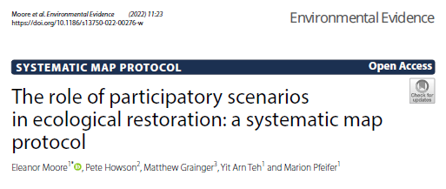
Methods
Methodology - Systematic map
“Systematic Maps are overviews of the distribution and abundance of evidence“

Slide 5
Methods
Review findings
ROSES Flow Diagram for Systematic Maps. Version 1.0

Slide 6
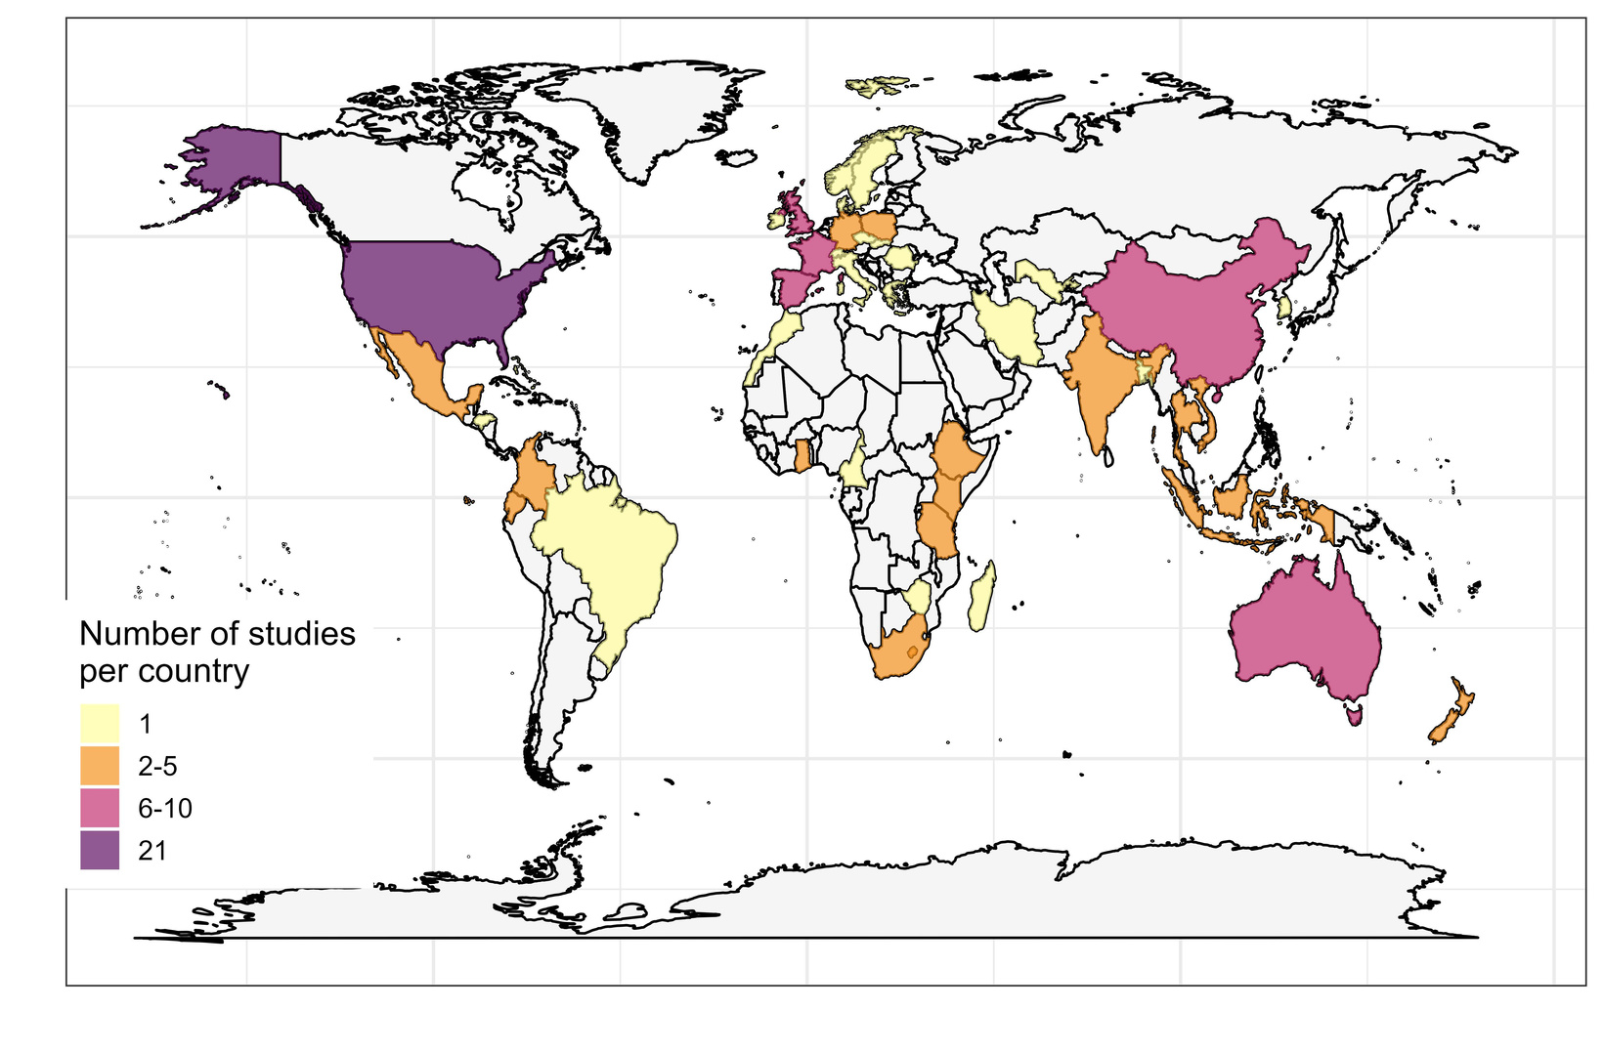
Review findings - RQ1
Characteristics of the evidence base
40 studies (38%) listed authors from multiple professions.
Most studies conducted in the United States of America (21/116, 20%), followed by France (n=9/116, 8%) and Spain (n=8/116, 7%)
The primary focal environment in most studies were mixed farms and natural vegetation (n=37, 33%), followed by forest (n=28, 25%), and coastal and estuarine-related systems e.g. mangroves, sandbanks (n=15, 14%).

Slide 7
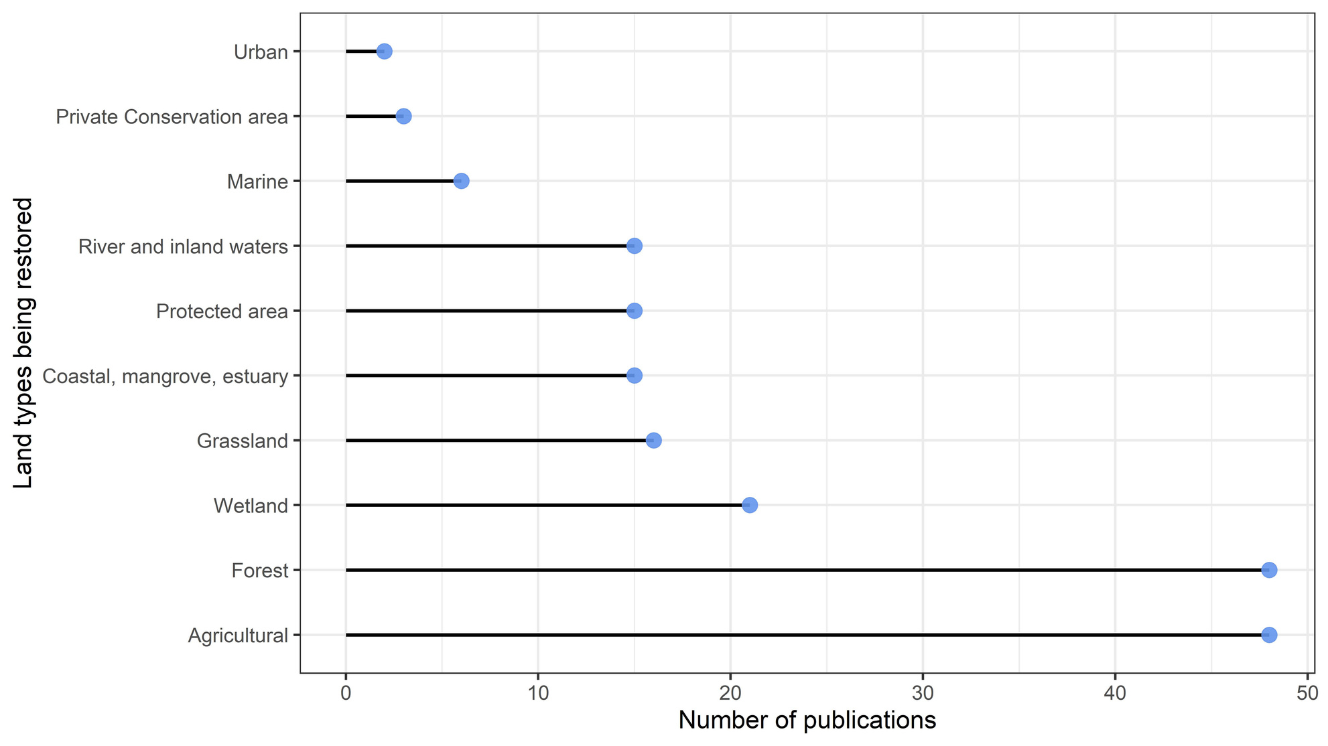
Review findings - RQ1
Chacteristics of the evidence base
The dominant driver of degradation was land conversion (n=55, 23%), followed by urbanisation (n=33, 14%) and demographics (n=26, 11%).
Most restoration was focussed on agricultural land (n=48) and forests (n=48)
Habitat restoration was the most popular ecological restoration objective (n=70, 39%), followed by ecosystem services (n=61, 34%).
For non-ecological restoration objectives, economic benefits (n=19), livelihood resilience (n=17), climate change adaptation and mitigation were the most popular (n=16).

Slide 8
Review findings - RQ2
Study designs
Publications were varied in their methods and took a mixed-methods approach (n=65, 61%)
Many built on or combined scenarios with established scientific methods or frameworks such as multi-criteria analysis (n=10) or InVEST ecosystem services valuation models (n=11).
Notes:
When creating scenarios, 43 studies did this qualitatively and 35 did this quantitatively, with the remainder using semi-quantitative methods (e.g. multi-criteria analysis , n=16), or a mix (n=3).
Most qualitative studies employed workshops to create scenarios with participants (n=36, 84%) and 17 studies (40%) used maps as a methodological aid. 14 qualitative scenarios were made spatially explicit during creation, while 26 were made spatially explicit post-creation (Figure 5). 33 (78%) publications quantified the qualitative scenarios, or specific outcomes after creation. Of the quantitative scenarios, 27 of these were also spatially explicit during creation (77%). Besides using modelling techniques, a few also used workshops (n=11) and group discussions (n=8) to engage participants when creating scenarios

Slide 9
Review findings - RQ3 & 4
Outcomes and trade-offs
Category | Sub-category
Ecological | Biodiversity Ecosystem health Water quality
Social | Recreation Culture Governance
Economic | Production of goods such as food and timber Costs of scenario interventions.
Land use land cover | Mixed environments of farms and natural vegetation Forests
88% (n=98) of texts studied environmental outcomes
61% (n=68) of texts studied economic outcomes
53% (n=59) of texts studied land use land cover
37% (n=41) of texts studied social outcomes
78% of studies (n=86) examined more than one category of outcome.
Only 11% of social outcomes were quantified compared to 47% environmental and economic outcomes.
Notes:
When creating scenarios, 43 studies did this qualitatively and 35 did this quantitatively, with the remainder using semi-quantitative methods (e.g. multi-criteria analysis , n=16), or a mix (n=3).
Most qualitative studies employed workshops to create scenarios with participants (n=36, 84%) and 17 studies (40%) used maps as a methodological aid. 14 qualitative scenarios were made spatially explicit during creation, while 26 were made spatially explicit post-creation (Figure 5). 33 (78%) publications quantified the qualitative scenarios, or specific outcomes after creation. Of the quantitative scenarios, 27 of these were also spatially explicit during creation (77%). Besides using modelling techniques, a few also used workshops (n=11) and group discussions (n=8) to engage participants when creating scenarios

Slide 10
Review findings - RQ3 & 4
Outcomes and trade-offs
92% of texts addressed trade-offs in outcomes
Trade-offs were mostly addressed after scenario construction (n=79, 75%) and usually within the text (n=86), using a visual depiction (n=34), workshops (n=23) or mathematical modelling (n=13).
51 publications addressed spatial variation in trade-offs, generally through spatially explicit mapping. 23 texts addressed trade-offs between stakeholders, generally through qualitative discussion. Only 9 publications addressed trade-offs across time through comparison of different time steps.
31 adopted a participatory approach when analysing trade-offs, usually through discussion in workshops.
Notes:
When creating scenarios, 43 studies did this qualitatively and 35 did this quantitatively, with the remainder using semi-quantitative methods (e.g. multi-criteria analysis , n=16), or a mix (n=3).
Most qualitative studies employed workshops to create scenarios with participants (n=36, 84%) and 17 studies (40%) used maps as a methodological aid. 14 qualitative scenarios were made spatially explicit during creation, while 26 were made spatially explicit post-creation (Figure 5). 33 (78%) publications quantified the qualitative scenarios, or specific outcomes after creation. Of the quantitative scenarios, 27 of these were also spatially explicit during creation (77%). Besides using modelling techniques, a few also used workshops (n=11) and group discussions (n=8) to engage participants when creating scenarios

Slide 11
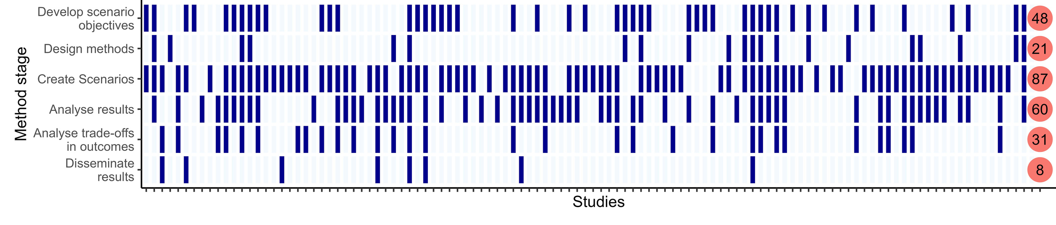
Review findings - RQ5
Role of participants
Members of the local community and conservation groups/non-governmental organisations, co-management groups were the most included stakeholder groups.
On average, stakeholders participated in 2 stages.
18 studies had 4 of more stages of participation in the scenario process, these studies tended to have specified, regular, and structured communication and participation channels such as through workshops, meetings, steering groups or working sessions.
Notes:
When creating scenarios, 43 studies did this qualitatively and 35 did this quantitatively, with the remainder using semi-quantitative methods (e.g. multi-criteria analysis , n=16), or a mix (n=3).
Most qualitative studies employed workshops to create scenarios with participants (n=36, 84%) and 17 studies (40%) used maps as a methodological aid. 14 qualitative scenarios were made spatially explicit during creation, while 26 were made spatially explicit post-creation (Figure 5). 33 (78%) publications quantified the qualitative scenarios, or specific outcomes after creation. Of the quantitative scenarios, 27 of these were also spatially explicit during creation (77%). Besides using modelling techniques, a few also used workshops (n=11) and group discussions (n=8) to engage participants when creating scenarios

Slide 12
Implications
Implications for policy/management
The flexibility of using participatory scenarios for restoration planning: geographies, environments, multi-disciplinarily, mixed-methodologies.
Participatory scenarios allow for the integration of different knowledge and method types, alongside facilitating the use of qualitative or semi-quantitative data when this is more appropriate or quantitative data is not widely available.
Scenarios are a good method for evaluating trade-offs across different methods such as workshops, mapping, or mathematical modelling.
Decision-makers can push for greater levels of participation from the offset of restoration projects, particularly in the stages before and after scenario creation
Systematic methods for participant selection e.g. stakeholder analysis, to ensure the whole range of perspectives and interests are represented
Notes:
The flexibility of using participatory scenarios for restoration planning, evidence was distributed across 43 countries and many different types of environment. Study authors were often from different disciplinary and professional backgrounds, and this was evident in the wide range of approaches taken, with the majority of studies using mixed-methodologies
This evidences that participatory scenarios allow for the integration of different knowledge and method types, alongside facilitating the use of qualitative or semi-quantitative data when this is more appropriate or quantitative data is not widely available. This is advantageous to ensure that scenarios are adaptable to stakeholder needs, resources available and the objectives and outcomes that are being explored.
92% of texts addressed trade-offs in outcomes, supporting that scenarios are a good method for evaluating trade-offs across different methods such as workshops, mapping, or mathematical modelling.
only 2 texts did this and very few studies took a participatory approach to method design and results dissemination. Moreover, only 31% of the texts analysed trade-offs in a participatory manner. To better use participatory scenarios as a tool for ecological restoration planning, decision-makers can push for greater levels of participation from the offset of restoration projects, particularly in the stages before and after scenario creation
Participants were most often chosen purposefully by the study team, despite advantages to this such as the ability to select the most beneficial participants, this method can also be vulnerable to researcher bias and an inability to generalise (62). Systematic methods such as stakeholder analysis to ensure the whole range of perspectives and interests are represented is recommended in the literature

Slide 13
Implications
Implications for research
It is difficult to understand how useful scenarios are for restoration planning because few texts reported on how scenarios fed into the process. Of those that did, it was common that they supported management plans or were being used by decision-makers.
Further research is needed to understand the effectiveness of participatory scenarios in restoration planning - this would need to be done by conducting primary research into the included studies in this review with study teams and the restoration decision-makers.
To improve the evidence base, future participatory scenarios should clearly evaluate their effectiveness in the restoration planning process and their success in meeting their participatory objectives.
Notes:
The flexibility of using participatory scenarios for restoration planning, evidence was distributed across 43 countries and many different types of environment. Study authors were often from different disciplinary and professional backgrounds, and this was evident in the wide range of approaches taken, with the majority of studies using mixed-methodologies
This evidences that participatory scenarios allow for the integration of different knowledge and method types, alongside facilitating the use of qualitative or semi-quantitative data when this is more appropriate or quantitative data is not widely available. This is advantageous to ensure that scenarios are adaptable to stakeholder needs, resources available and the objectives and outcomes that are being explored.
92% of texts addressed trade-offs in outcomes, supporting that scenarios are a good method for evaluating trade-offs across different methods such as workshops, mapping, or mathematical modelling.
only 2 texts did this and very few studies took a participatory approach to method design and results dissemination. Moreover, only 31% of the texts analysed trade-offs in a participatory manner. To better use participatory scenarios as a tool for ecological restoration planning, decision-makers can push for greater levels of participation from the offset of restoration projects, particularly in the stages before and after scenario creation
Participants were most often chosen purposefully by the study team, despite advantages to this such as the ability to select the most beneficial participants, this method can also be vulnerable to researcher bias and an inability to generalise (62). Systematic methods such as stakeholder analysis to ensure the whole range of perspectives and interests are represented is recommended in the literature

Slide 14
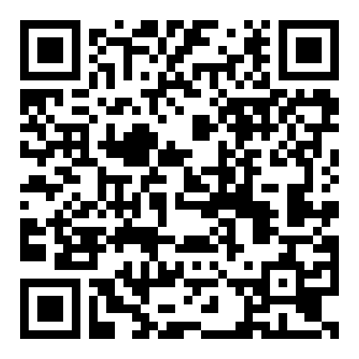
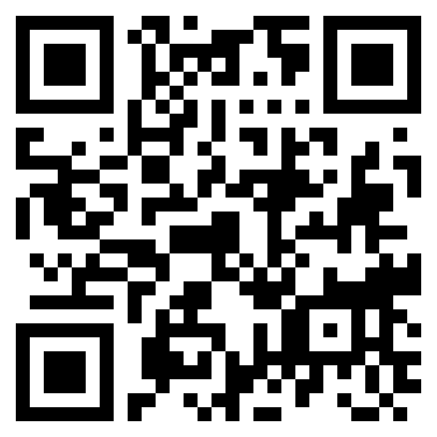
Thank You
Scan for my publications and LinkedIn
Scan for full paper ☺
e.s.durrant@newcastle.ac.uk

Slide 15
Introduction
Background
1
2
3
Up to 40% of global land area is estimated to be degraded
Ambitious restoration targets necessitating trade-offs in costs, resources and preferences.
Probability for positive outcomes increases with the extent to which stakeholders can shape decisions.
We need a holistic and equitable approach to strategic restoration planning.
2021-2030 is the UN Decade on Ecosystem Restoration with ~1 billion hectares committed to restoration of degraded lands globally.
Tool:
Participatory scenarios
Notes:
brief here since everyone knows.

Slide 16
Research Objectives
Research objectives
Why conduct this review?
There is no systematic understanding of the restoration contexts, involved stakeholder groups, methods that are used for developing participatory scenarios and application of participatory scenarios in exploring diverse sets of objectives, outcomes, and trade-offs.
We inform how scenarios can be better used as a decision-making tool within ecological restoration planning that can enable stakeholder participation and account for trade-offs in restoration outcomes across different dimensions.
Our Aim
To systematically map and present the evidence that exists on the use of participatory scenarios in restoration planning.

Slide 17
Outcomes and trade-offs
Introduction
Restoration planning
Restoration objectives are often posited to achieve social, economic and ecological success but win-wins aren’t always possible.
Ecological
Scenarios a tool to analyse outcomes and trade-offs
Diverse methods of data collection and analysis
Integration of social, ecological and economic dimensions
Offer the ability to evaluate inherent trade-offs
Social
Economic

Slide 18
Eligibility criteria
Methods
Question component | Criteria
Participants | Inclusion: The research has some form of participation: “A process where individuals, groups and organisations choose to take an active role in making decisions that affect them” (12). Participation can be at any stage in the scenario construction process.
Ecological restoration | Inclusion: The publication must address any form of ecological restoration: “Ecological restoration is the process of assisting the recovery of a degraded, damaged, or destroyed ecosystem to reflect values regarded as inherent in the ecosystem and to provide goods and services that people value”.
Future Scenarios | Inclusion: Publication must build or evaluate as least one ‘scenario’ per the definition “Plausible representations of possible futures for one or more components of a system, or as alternative policy or management options intended to alter the future state of these components” .
Outcomes | Inclusion: The systematic map will be displaying what and how outcomes are explored within eligible study types.
Additional criteria | Inclusion: Methods used may be qualitative, quantitative or a mixed methods approach. Inclusion: Book chapters, reports, grey literature publications, scientific publications, student theses (BSc, MSc, PhD)

Slide 19
Methods
Search terms and strings
Scenario: Scenario* OR forecast* OR backcast* OR futur* OR trajector*
AND
Participatory: participat* OR collabor* OR co-product* OR collectiv* OR stakehold* OR engag*
AND
Ecological: ecolog* OR environment* OR ecosystem*
AND
Restoration: restor* OR reveg* OR regener* OR reforest* OR afforest* OR remediat* OR rehabilitat* OR rewild* OR re-wild* OR "conservation translocat*"
The * character is a wild card and will include words containing any characters on the end of the word, so long as the beginning of the word returns a match. For example, participat* may include participation, participatory, participative.
Search terms developed using Web of Science to test combinations of search terms against benchmark articles - final string chosen to have a high sensitivity but a low specificity.

Slide 20
Methods
Databases searched
Bibliographic databases | Web of Science SCOPUS CAB Abstracts ProQuest Natural and Social Science Collection Lens.org | All databases and maximum date ranges Search String from previous slide All results
Web based search | Google Scholar | Modified search string due to limited capabilites
Specialist search for grey literature | 17 organisational websites eg. IUCN, FAO | All ‘Scenario’ only, except FAO website ‘scenario participatory restoration’
Targeted searching | Bibliographies and included articles relevant evidence syntheses or publications. Social media calls for submissions

Slide 21
Methods
Screening and data extraction
Stage 01
Stage 02
Stage 03
Title & Abstract
Primary reviewer all articles
3 other reviewers - 30%
Unsure --> put through
Agreement = fair (kappa >0.21)
Full text
Primary reviewer all articles
3 other reviewers - 30%
Unsure --> discussion
Agreement = substantial (kappa >0.61))
Data coding
Coded using a pre-defined codebook
Primary reviewer all articles
1 other reviewer - 20%

Slide 22
Methods
Data mapping method
01
02
03
Map database
Find studies
Readily updatable
Narrative synthesis and visualisations
Map data according to the research questions
Results outreach
1 -page lay summary
Biosphere Futures online database

Slide 23
Limitations
Limitations
Limitation | Implication | Mitigation
Searches were conducted in English and only translated bibliographic information would appear in results. | This may have biased article distribution towards English speaking countries, or organisations that publish in English. | We chose the search strings or terms with high sensitivity but low specificity.
Deviation from protocol | Some modifications to the coding sheet to include further details or categorisations. | Adding further categorisations allowed consistency between open answers for grouping and comparisons of studies.
Categorisation of outcomes and indicators into social, ecological, and environmental indicators was sometimes difficult due to the simplicity of the categorisation | For example, the indicator ‘tuna occurrence’ was categorised as an economic indicator because it was under the outcome ‘Satisfactory harvest of mahinga kai’ (Māori, resources that are customarily used/harvested). Also linked to environmental and social categories. | The reviewers discussed and decided best fit. We strived to have a balance between categorising variables to identify trends and knowledge gaps while maintaining the integrity of the data.

