Slide 1

Open-Source Software Tools for Research
Ben Wooding

Slide 2


About Me
Ben Wooding
School of Computing
EPSRC Doctoral Prize Fellow 2023
Fellowship Topic: Reliable AI-enabled Design of Cyber-Physical Systems
Designed 3 open-source software tools as part of my fellowship with one more in the works!

Slide 3

Picture the story: a brilliant researcher, called Researcher A, has a brilliant idea!

Slide 4

Parts of Researcher A’s idea could leverage techniques and methods from the literature in new ways!

Slide 5

However, these techniques were either time consuming to do from scratch or complicated enough that it was non-trivial implementing them afresh…

Slide 6

There was a famous tool developed by SuperCorp that implemented the techniques the researcher needed, but the license cost too much money!

Slide 7

Is this how the story ends for Researcher A?

Slide 8

Open-source software tools can come to the rescue of Researcher A!
No need to compute implementations from scratch
No need to pay for expensive tool licenses

Slide 9

Designing a tool? Sounds like a massive job?

Slide 10
Open-source tools can be lucrative!

Slide 11
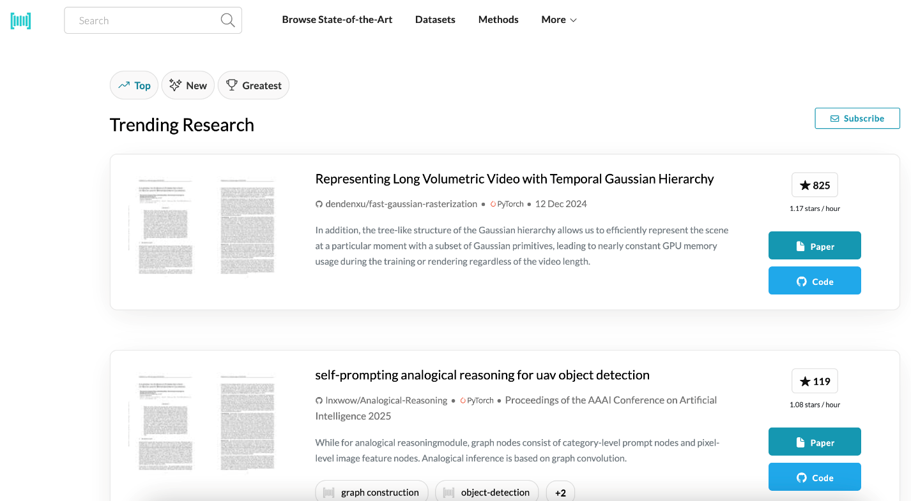
An aside – open-source paper results
Papers that provide their code/data tend to get cited more!

Slide 12
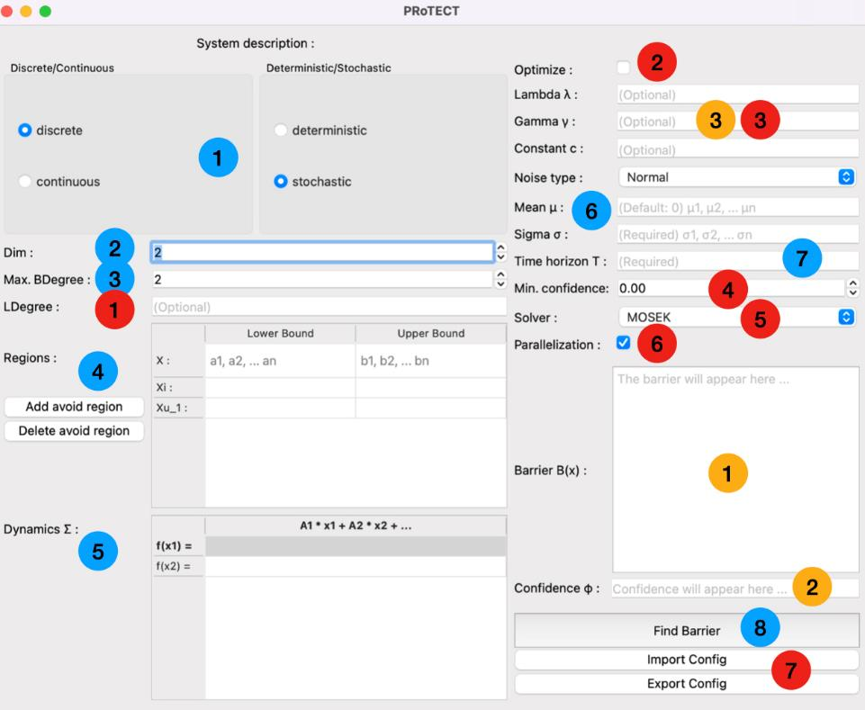
Designing your open-source tool
User-friendliness: GPU? API? Hosted on the web?
Can people leverage your tool or is it only usable in isolation?
Where will you host your tool? GitHub? GitLab?
Which license do you choose? MIT license? CC-BY-4.0? (Might be determined by your funding!)

Slide 13
Designing your open-source tool
If optimal solver requires license, can you also provide an open-source alternative? (at cost of performance)
Will the tool come with a manual? Youtube tutorial videos?
Is it easy to install? Docker?
How will you maintain the tool? Update tool as research grows?

Slide 14
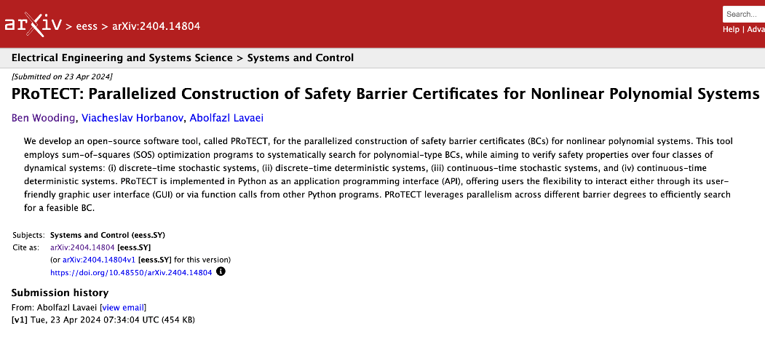
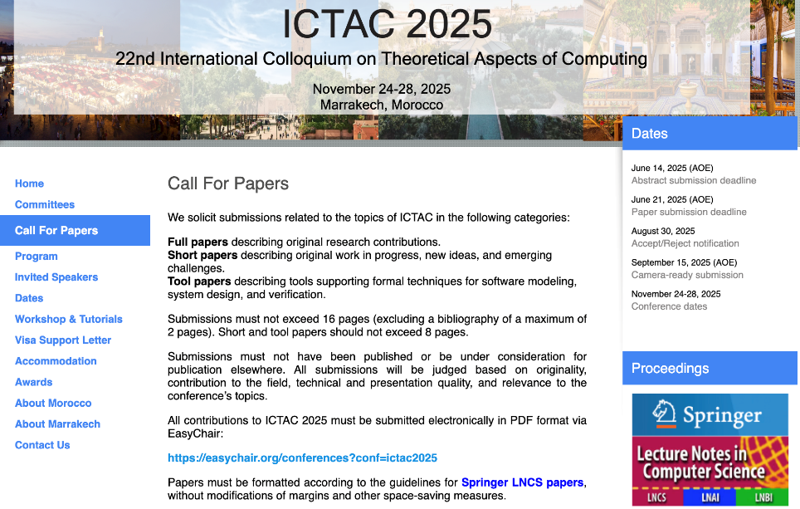
The Review Process
Upload your tool paper onto a preprint website like ArXiv
Some conferences have a ‘tool paper’ category, reducing expectation of novel theory in the work
Repeatability Evaluation: some conferences test if the results of your paper are repeatable and provide a badge to add to your paper
Linking GitHub to a Zenodo DOI creates permanent record

Slide 15

Inconsistent Reviewers/Expectations of Tools
I have received scores of +2 (Accept) and -2 (Reject) at the same venue for the same tool!

Slide 16
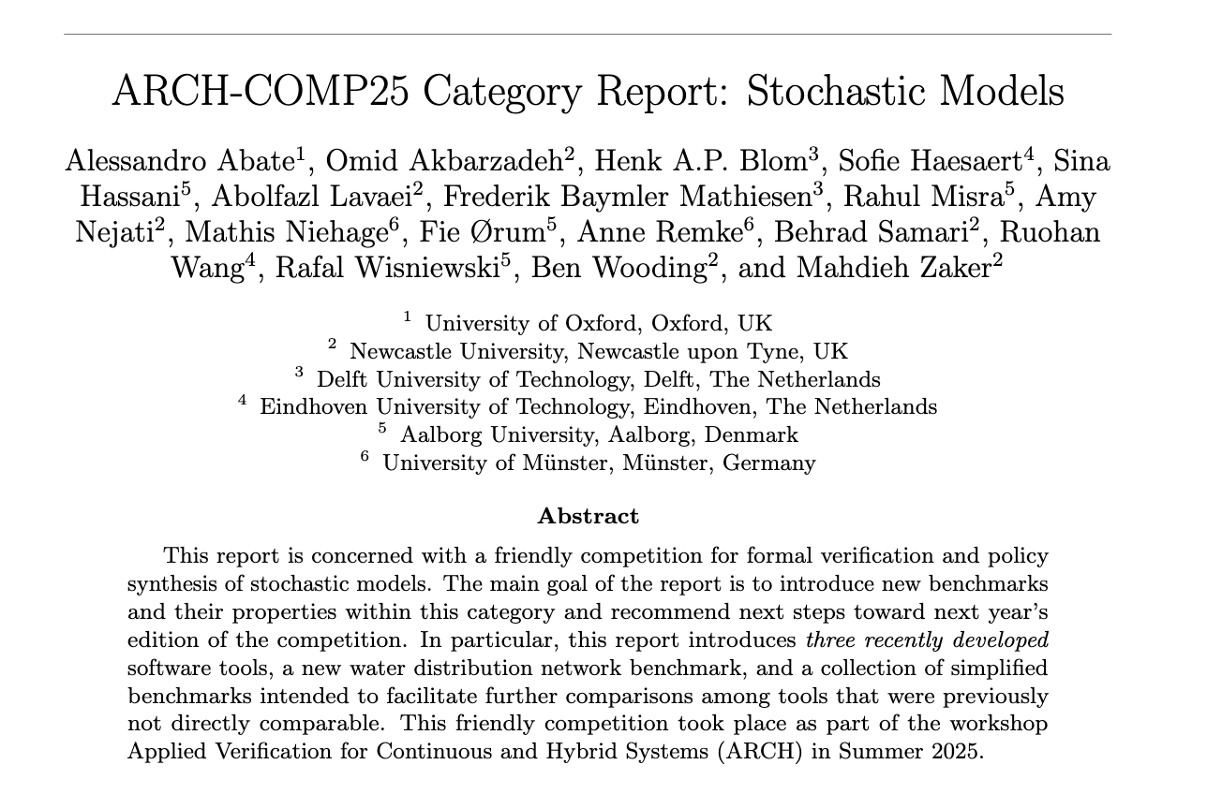
Competitions Encourage More Development
Applied Verification for Continuous and Hybrid Systems (ARCH) Workshop
running since 2014
8 different categories tools fall under
Stochastic Models has 17 tools
Ever expanding set of benchmarks to trial upon

Slide 17

Future Usability: What not to do!
Many tools are not updated, meaning they become useless in a few years (unable to even install)
Tool where authors tried to commercialise part of their implementation, tool is unusable and authors made no profit
Some unfortunate politics around stating that a tool can no longer be installed

Slide 18

Summary
Open-source tools benefit both the research community and the creator of the tool
Consider how you can make your tool as easy to use and to access as possible, e.g. Docker or Web app
Friendly competitions encourage open-source tool development
Keep up updating your tool for long-term wins for all!

