Slide 1



Open Access DNA-Encoded Library Screening:
Accelerating Therapeutic Discovery Through Collaboration
Project Goals
DEL Synthesis
DEL Screening
What are DELs?
We have established a DEL screening resource that provides cost-free and commitment-free access to high-throughput compound screening for academic research groups

Slide 2
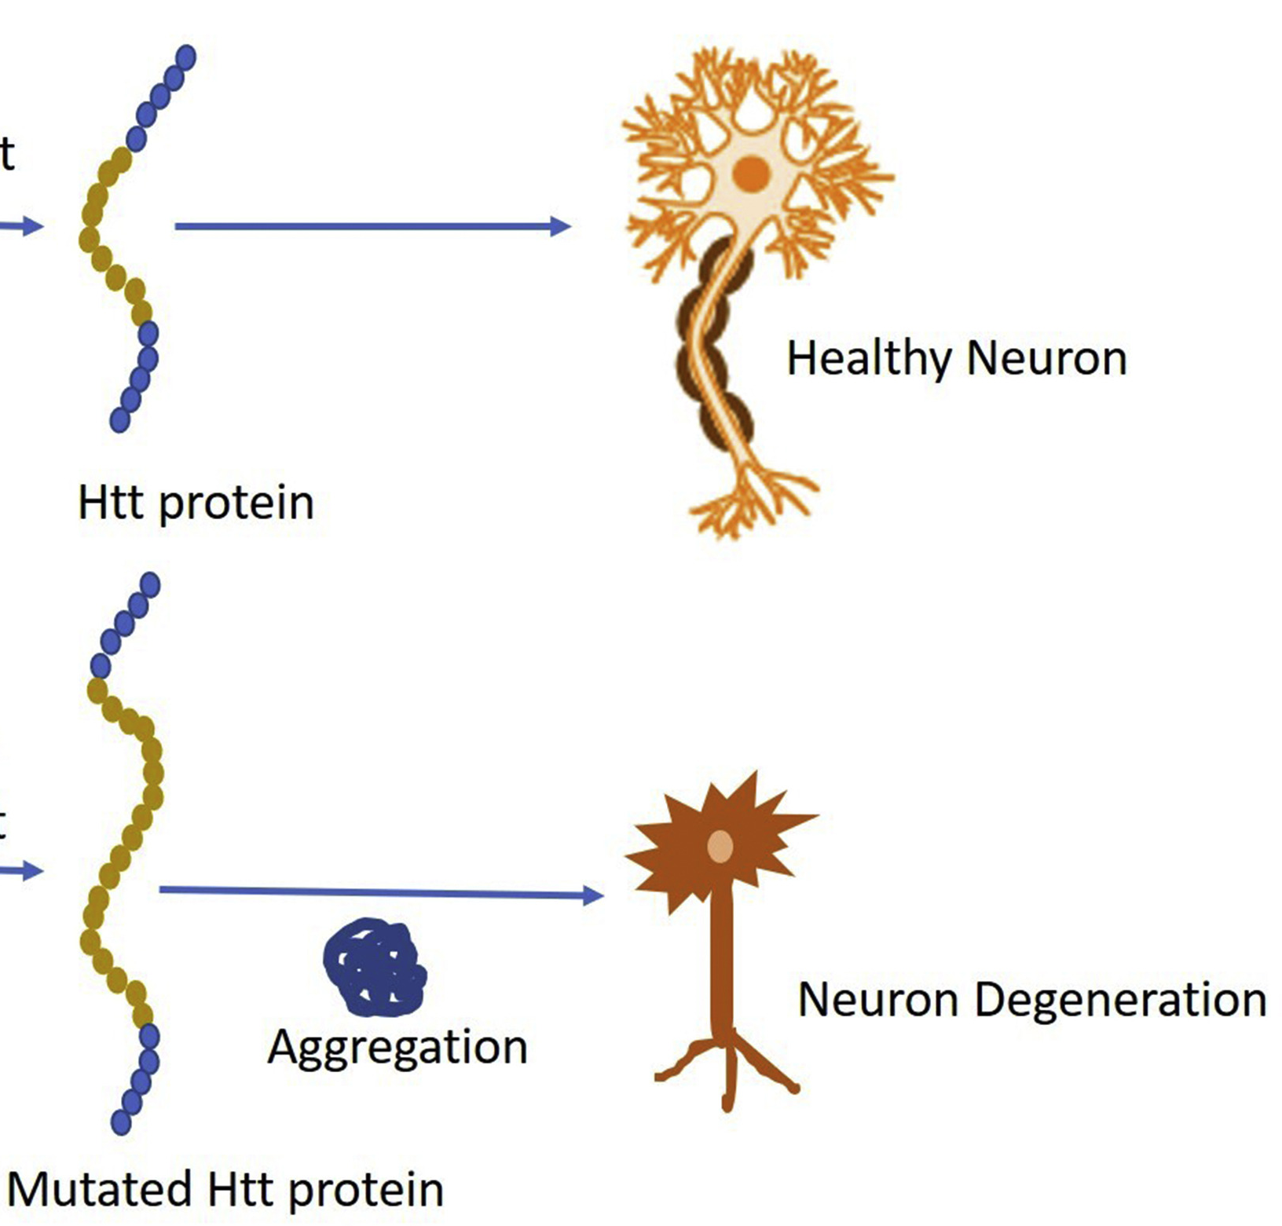
What Causes Disease in the Body?
Proteins carry out essential functions in our cells.
Sometimes, these proteins malfunction — they may be overactive, inactive, or misfolded.
These protein faults can cause diseases
Heliyon 2021, 7, e06088

Slide 3
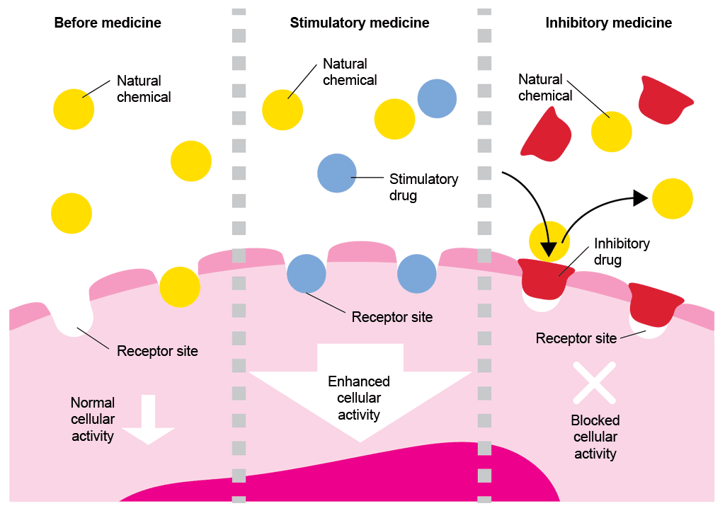
Proteins as Drug Targets
If a specific protein is causing disease, we can try to block or modify it.
This makes the protein a target for new medicines.
A small molecule binder is a chemical compound that fits onto a protein.
It can block the protein's activity, change its shape, or even help remove it.

Slide 4
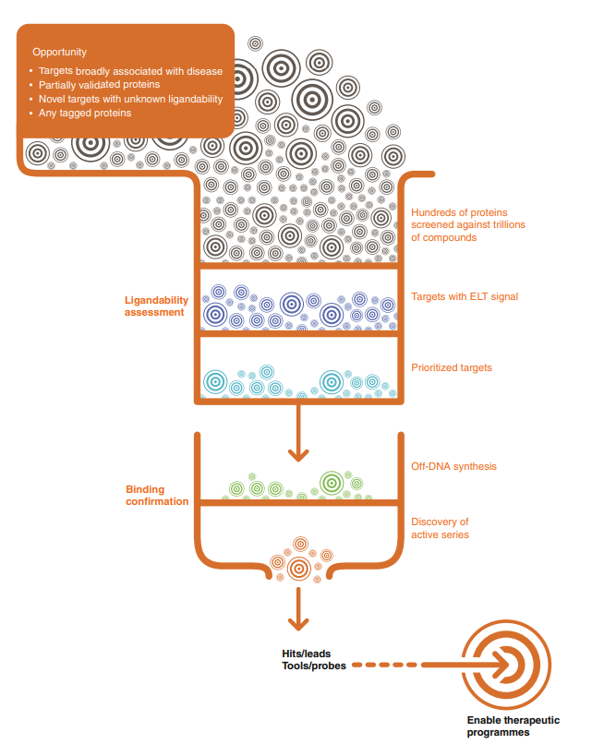
Nat. Commun. 2017, 8, 16081

Slide 5
What are DNA-Encoded Libraries?
DNA Barcode
Small Molecule
Sequence of the DNA encodes for the small molecule
DNA “barcode” results in aqueous solubility
DNA is extremely stable
3 chemical building blocks are typical

Slide 6
What are DNA-Encoded Libraries?
DNA Barcode
Small Molecule
Sequence of the DNA encodes for the small molecule
DNA “barcode” results in aqueous solubility
DNA is extremely stable
3 chemical building blocks are typical

Slide 7
DNA-Encoded Libraries for hit Discovery
DNA Barcode
Small Molecule
Majority of big pharma have either in-house DEL or collaborations with DEL providers
Library sizes range from 10⁶-10⁹ small molecules
NGS sequencing used to identify the chemical building blocks
Seminal published library from GSK (Nat Chem Bio, 2009, 5, 647)
Nat. Commun. 2017, 8, 16081

Slide 8
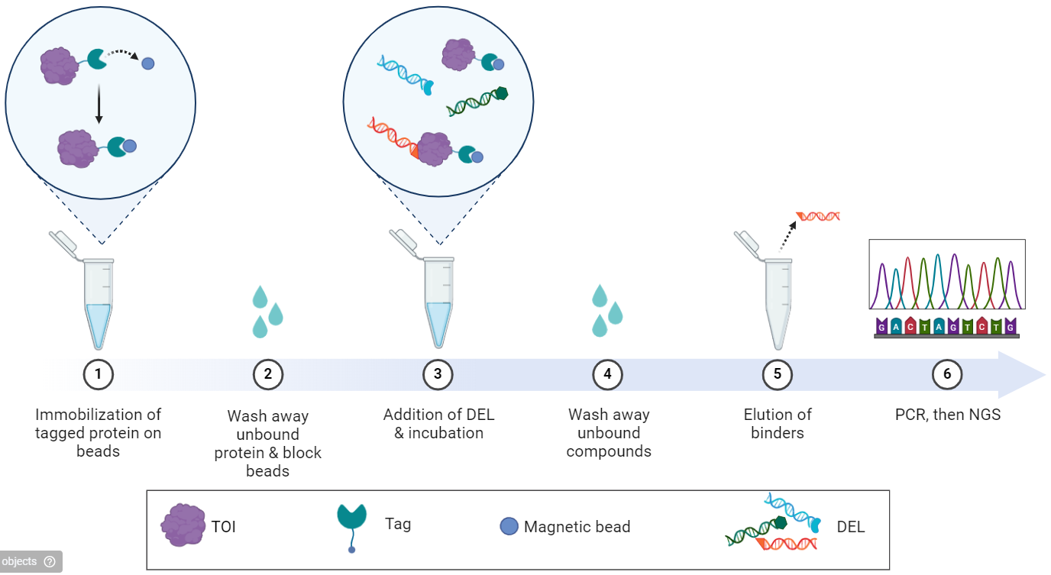
DEL Screening Process
Low protein requirement (5 µg)
Simple experimental procedure
Easy to run different conditions
Generates lots of information
NGS data is the output
Created with BioRender.com

Slide 9


Project Goal
UK biomedical research leads to the identification of many novel targets in areas of unmet need
However, projects often cannot progress due to poor academic access to screening
We have established a DEL screening resource that will provide cost-free and commitment-free access to high-throughput compound screening for academic research groups by;
Synthesis of DELs containing 5-10 million diverse and drug-like structures
Utilising these libraries to undertake target selections against novel protein targets
Cause of disease identified
Molecules that interact with that target
Drug generation
Disease with unmet clinical need

Slide 10
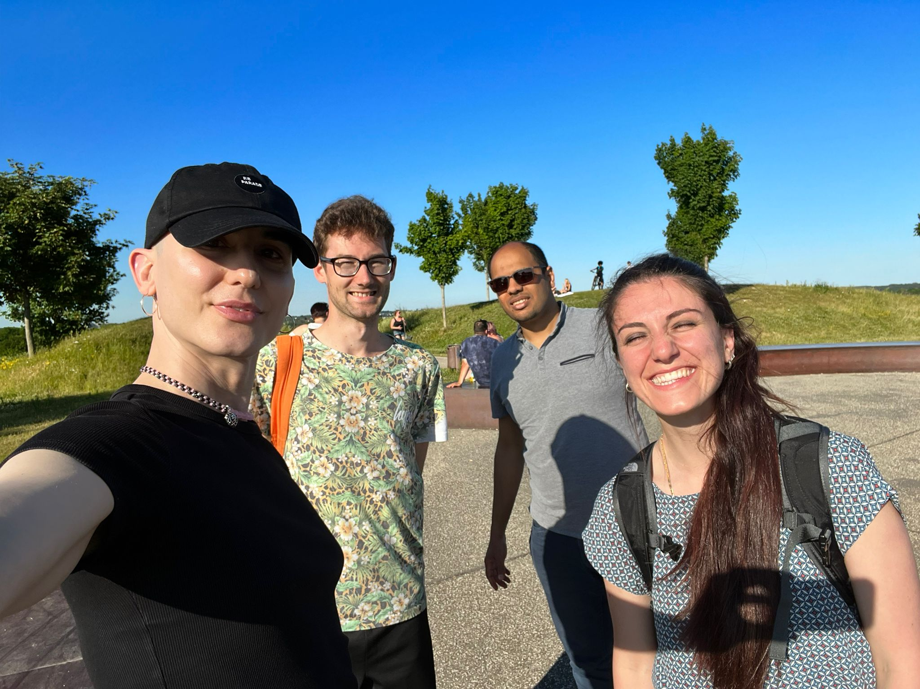
Project Start (June 2021)
6 lab members across 3 sites:
Newcastle
Manchester
Wurzburg
To start we all spent a few weeks at each institute to share expertise and also standardise workflows/methods
Continue tight sharing by visiting one institute per year to continue alignment

Slide 11
Library Synthesis
Newcastle
Wurzburg
Manchester
<100 µg chemical building block used (10⁶ less than literature)
Library diversity is driven by the diversity of building blocks
Companies provided large number of building blocks as part of open research
1 library synthesis yields approximately enough for 1000 uses
Manchester/Würzburg/Newcastle using complementary synthetic routes to create a pooled library
Pooled Library
DNA Barcode
Small Molecule

Slide 12
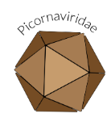




ASAP project
AI-driven Structure-enabled Antiviral Platform
Aim to find novel antivirals for: coronaviruses (covid-19/SARS/MERS), flaviviruses (dengue/Zika viruses), picornaviruses (polio)
Open science, global collaboration
Oral drugs
Affordable prices
3 protein targets sent to us for DEL screening
Found novel protein binders
Binding confirmed by collaborators
https://asapdiscovery.org/

Slide 13


Chicago Project
Collaborators have a complicated protein screening experiment
We post library to Chicago
They run experiments, then send the data back for analysis
We co-analyse results
Following up on hits to find novel molecular glues

Slide 14
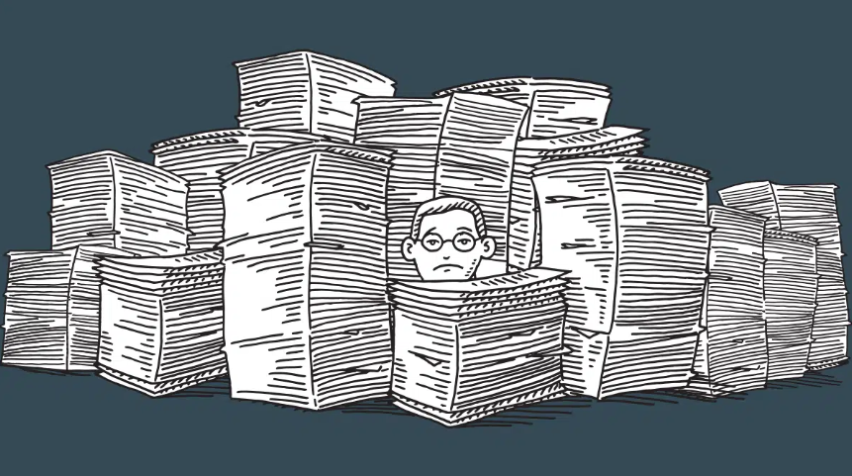
Data Sharing
Currently share all data with collaborators (or any interested parties)
Data is planned to be shared on a website…
Currently complicated by:
Data size
Data processing
Which institution will host
Who will pay for upkeep after the project has finished
Open research is a good way to share negative results, which is very valuable

Slide 15

Acknowledgements
Newcastle DEL team
Mike Waring
Haitham Hassan
Grace Roper
Nour Kourbeh
Dan Gugan
Newcastle Collaborators
NCL Med Chem
Newcastle DDU
John Lunec
Rhianna Baldwin
Universität Würzburg
Andreas Brunschweiger
Elena Detta
Katharina Götte
Lisa Liang
The University of Manchester
Sam Butterworth
Sergi Celis
Andrew Leach
University of Oxford
Michael Fairhead
University of Chicago
Bryan Dickinson
Rachel Chan

