Slide 1
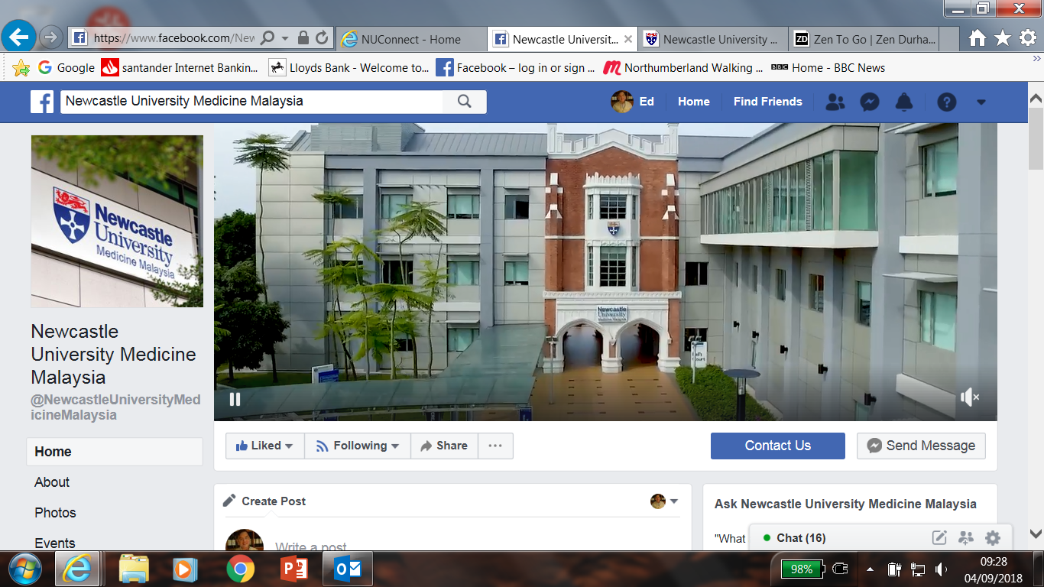
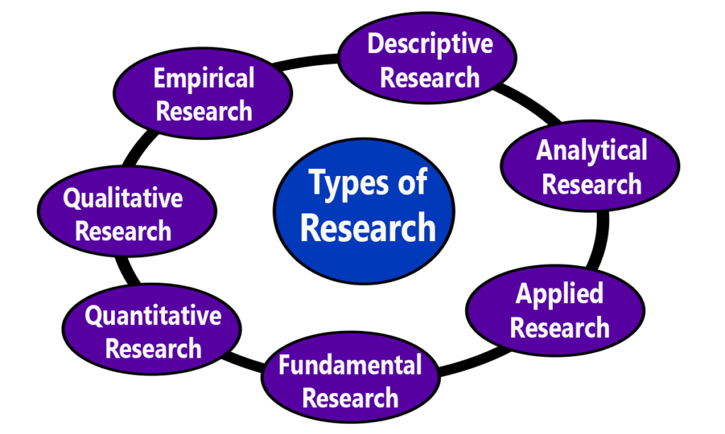



Demystifying Clinical Research vs Audit
Dr ELC Ong MBBS MSC FRCP FRCPI DTMH
Hon Prof and Consultant Physician
Newcastle University Medicine Malaysia

Slide 2
What’s Clinical Audit?
"Clinical audit is a quality improvement process that seeks to improve patient care and outcomes through systematic review of care against explicit criteria and the implementation of change. Aspects of the structure, processes, and outcomes of care are selected and systematically evaluated against explicit criteria. Where indicated, changes are implemented at an individual, team, or service level and further monitoring is used to conﬁrm improvement in healthcare delivery."
National Institute for Health and Clinical Excellence

Slide 3
Clinical Audit
Designed and conducted to provide new knowledge to provide best care
Designed to answer the question “Does this service reach a predetermined standard?”
Measures against a standard
Doesn’t involve a new treatment
Involves no more than administration of questionnaire or record analysis

Slide 7

Clinical Research
Designed and conducted to generate new knowledge
Quantitative research – hypothesis based
Qualitative research – explores themes following established methodology
May involve a new treatment
May involve additional therapies, samples or investigations
May involve allocation to treatment groups NOT chosen by HCP or patient
May involve randomisation
Requires REC review and approval

Slide 8
What’s the difference between clinical audit and research?
Research seeks to derive generalisable new knowledge
Audit and related activities assess how existing knowledge is applied in specific settings

Slide 9
RESEARCH vs AUDIT
RESEARCH | AUDIT
Generate new knowledge | Monitor and / or improve services
Defines best practice / standards | Benchmark against best practice / standards
Involves new treatment | Never involves new treatment
Well-defined selection criteria for participants | Recruitment representative of patient target group
Potentially generalisable to other institution | Pertaining to local services
Ethics always required | Dependent on local governance

Slide 10
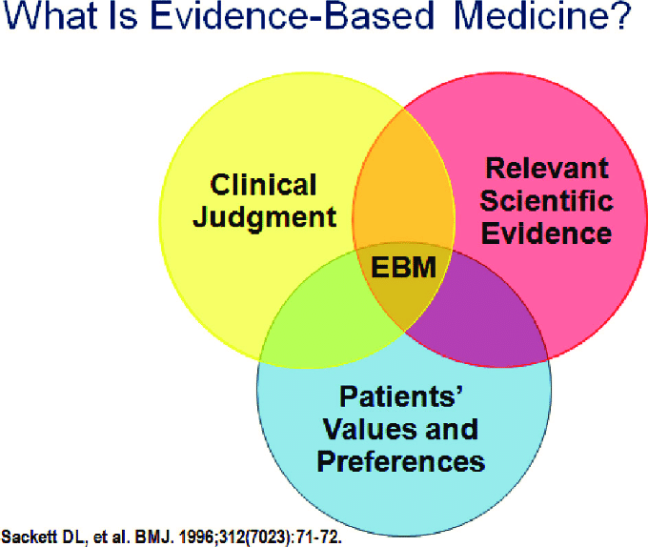

Slide 11
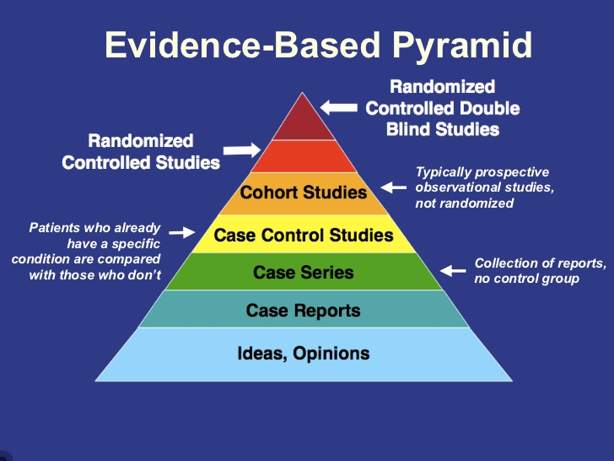

Slide 12
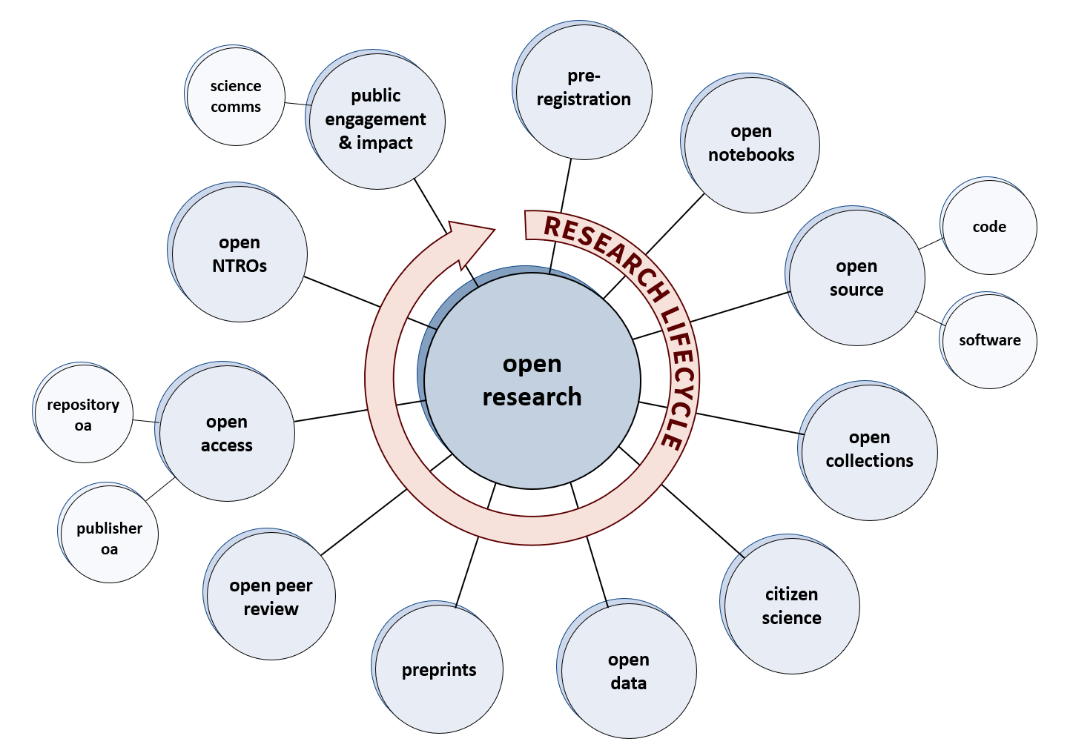

Slide 14
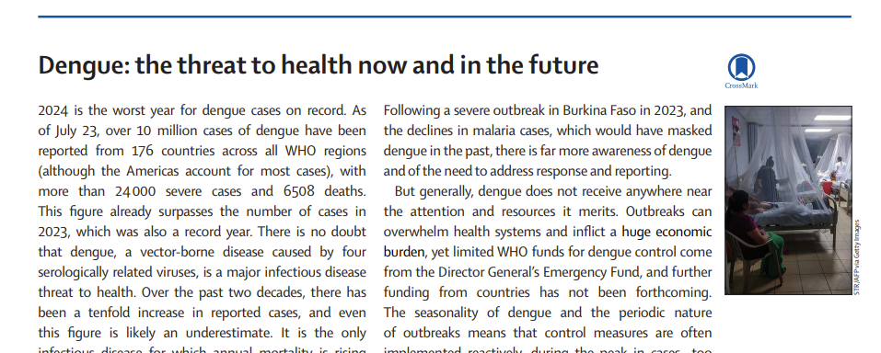

Slide 15
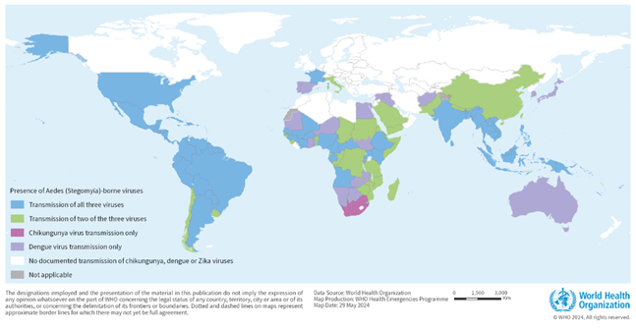
July 2023; 10 million reported (50% lab confirmed) 6500 deaths (estimated) - WHO

Slide 16


Slide 17
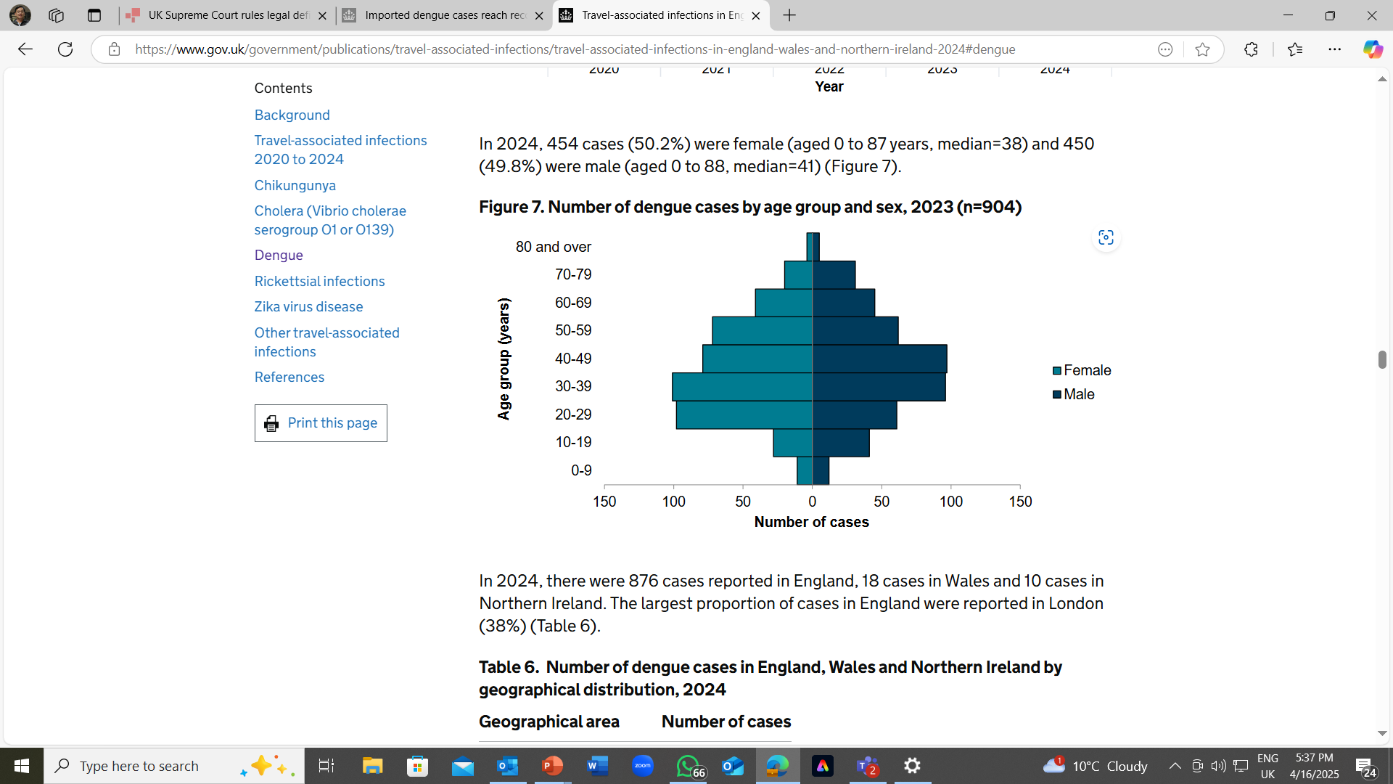
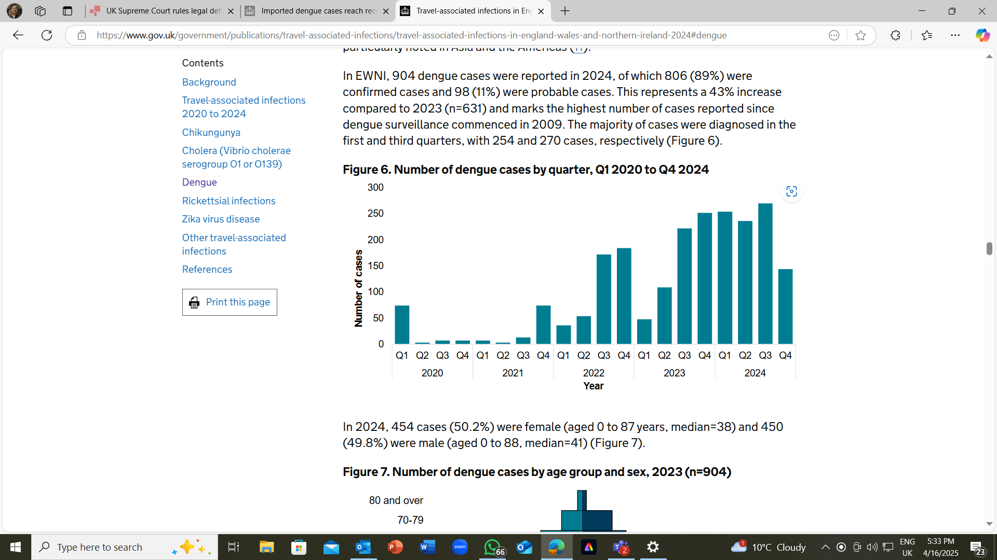

Slide 18
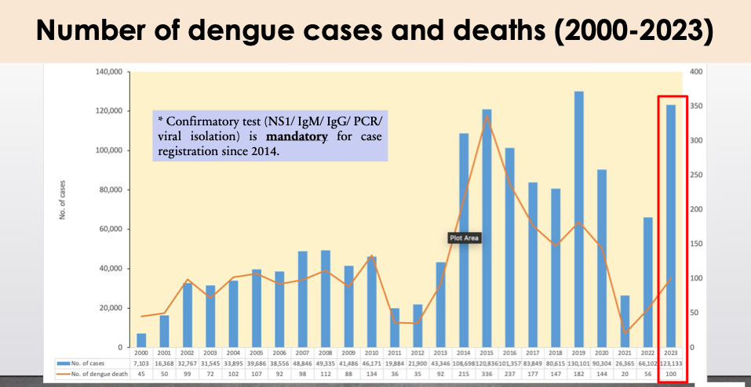
Dengue - Malaysia

Slide 19
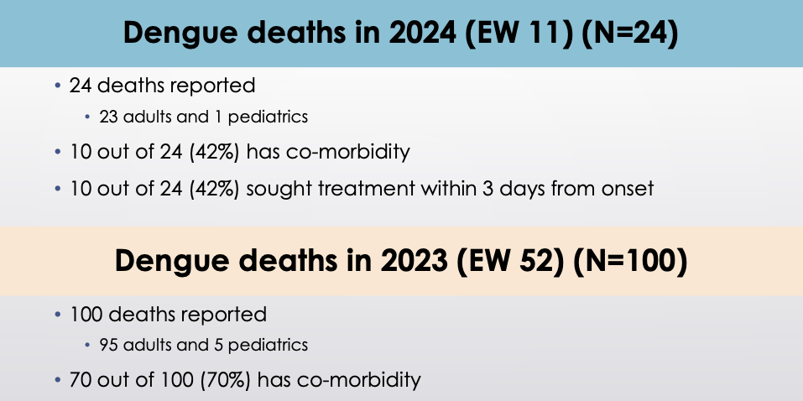
Delay in diagnosis , underestimate severity

Slide 20
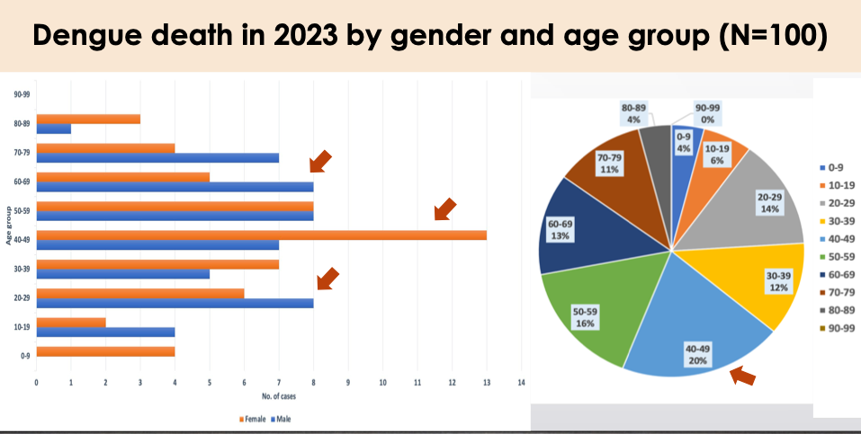
50% age 40-69

Slide 21
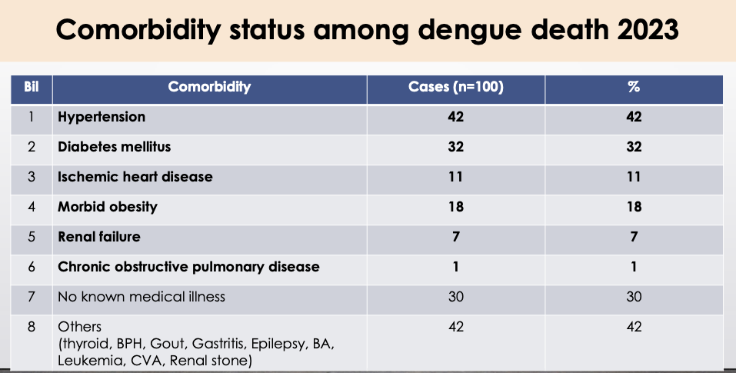

Slide 22
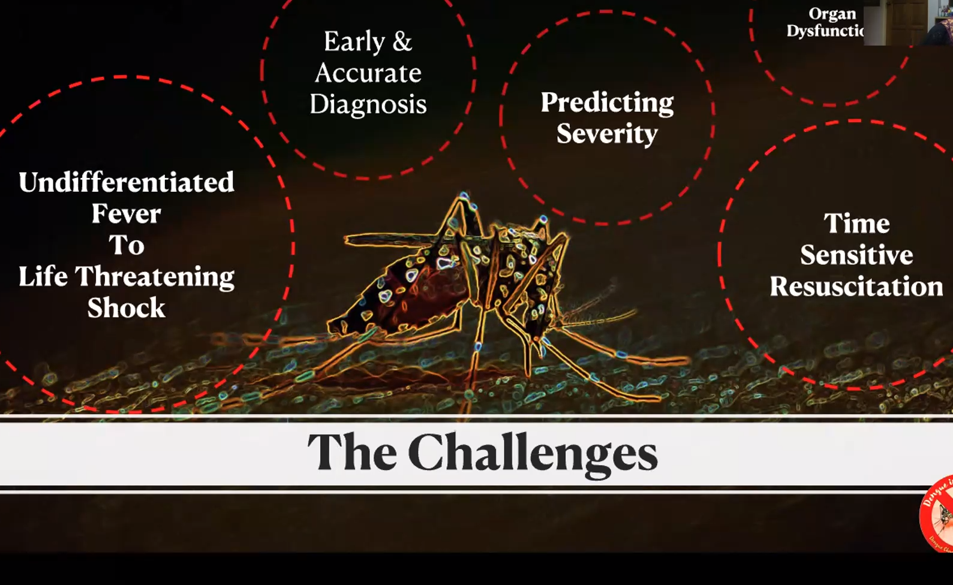

Slide 23
Dengue – wide spectrum of clinical presentations with unpredictable clinical evolution and outcome
CLINICAL PHASES OF DENGUE INFECTION
Dengue infection
Asymptomatic
75%
Symptomatic
25%
DF
95-99%
SEVERE
DENGUE
1-5%
Survive
95-99.5%
RIP
0.2-5%

Slide 24
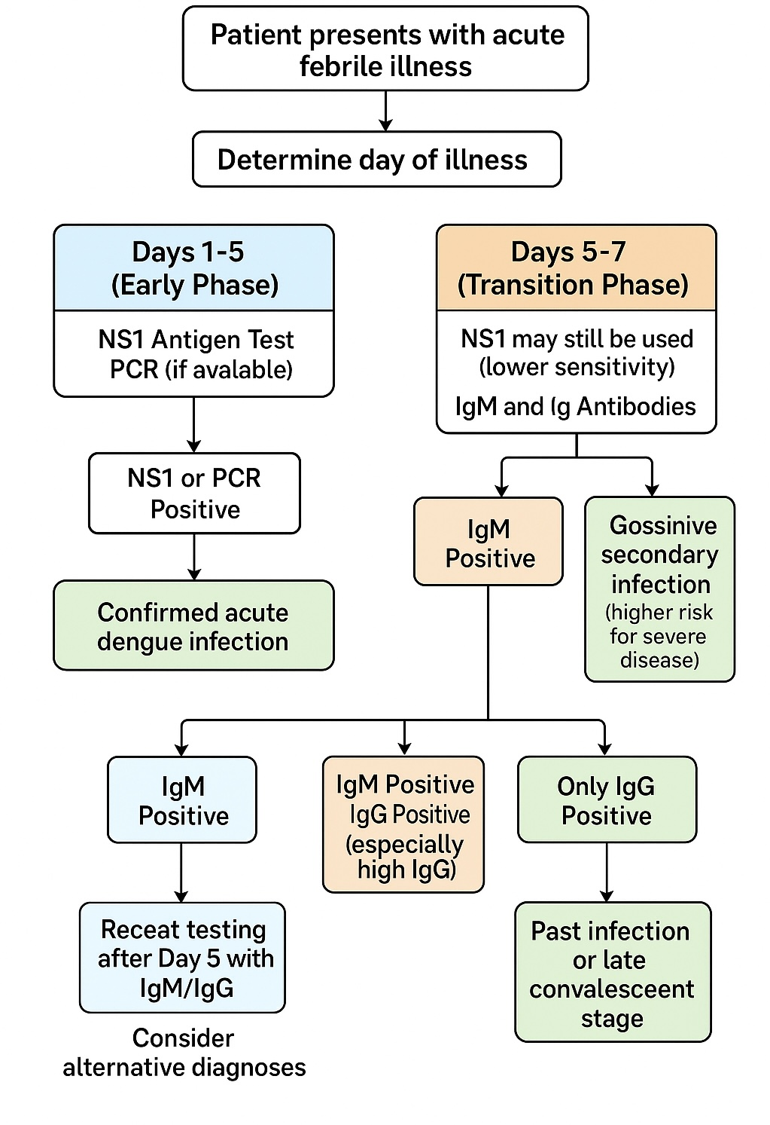

Slide 25
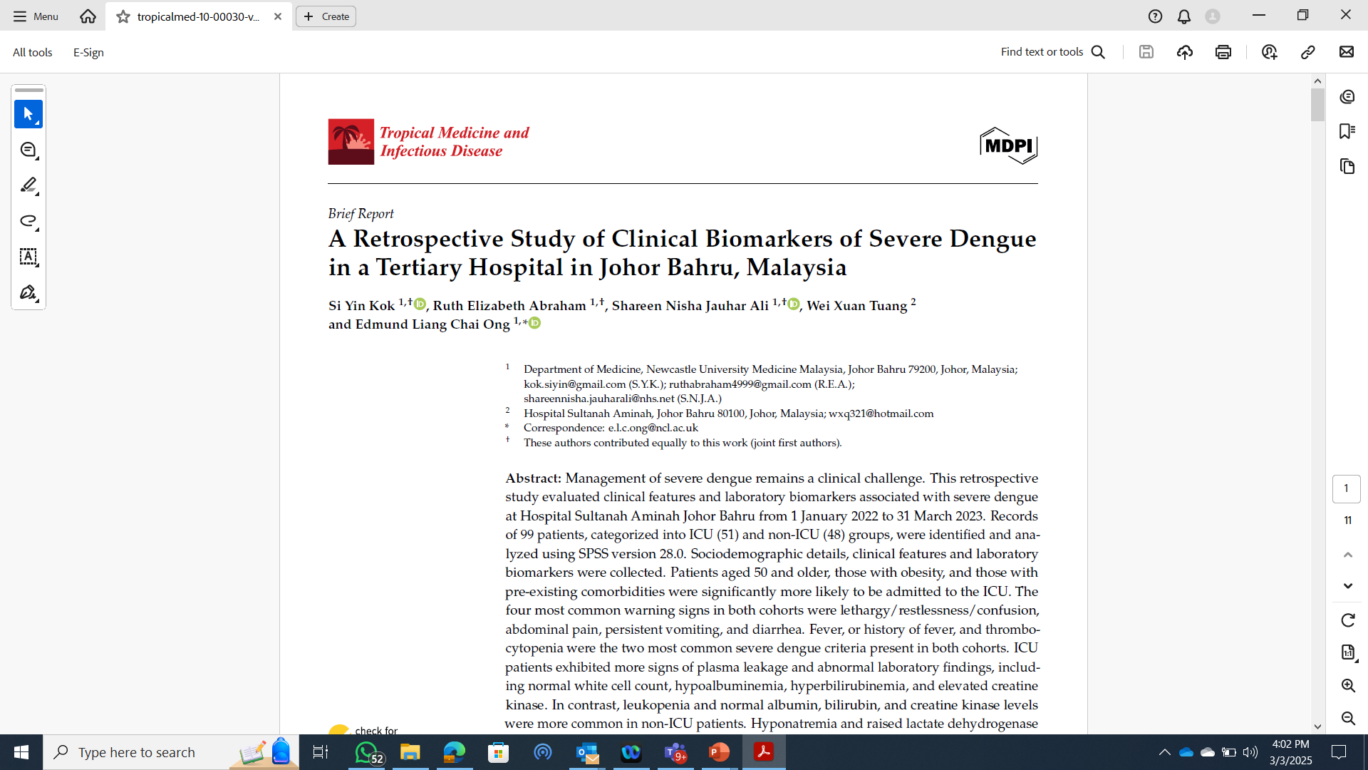
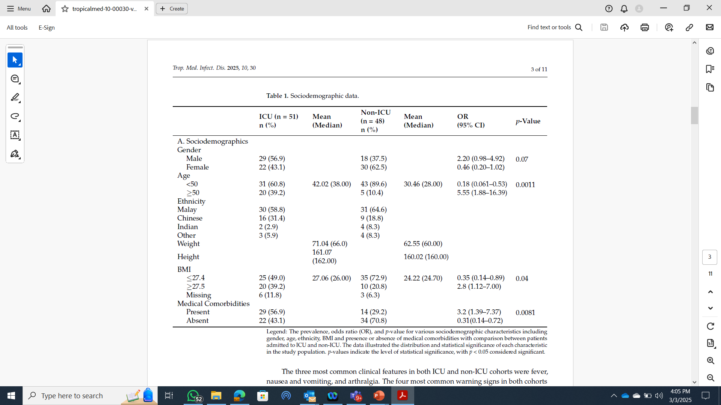
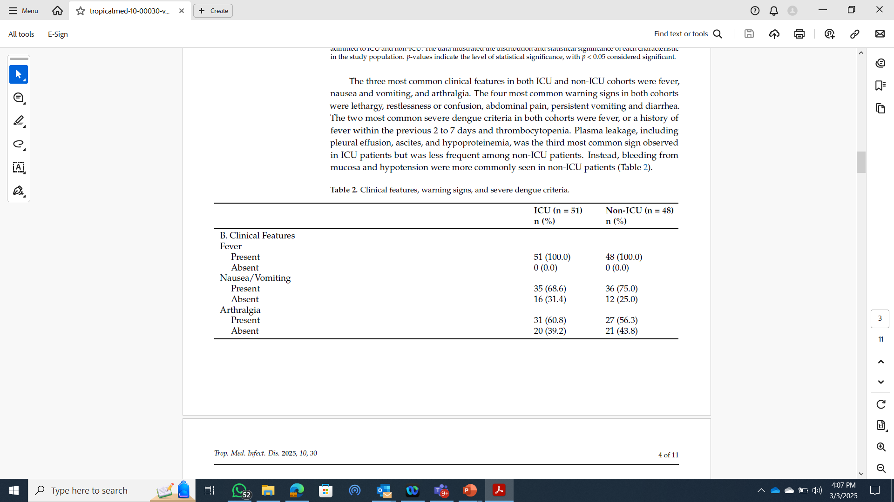
Trop. Med. Infect. Dis. 2025,
10, 30. https://doi.org/10.3390/
tropicalmed10020030

Slide 26
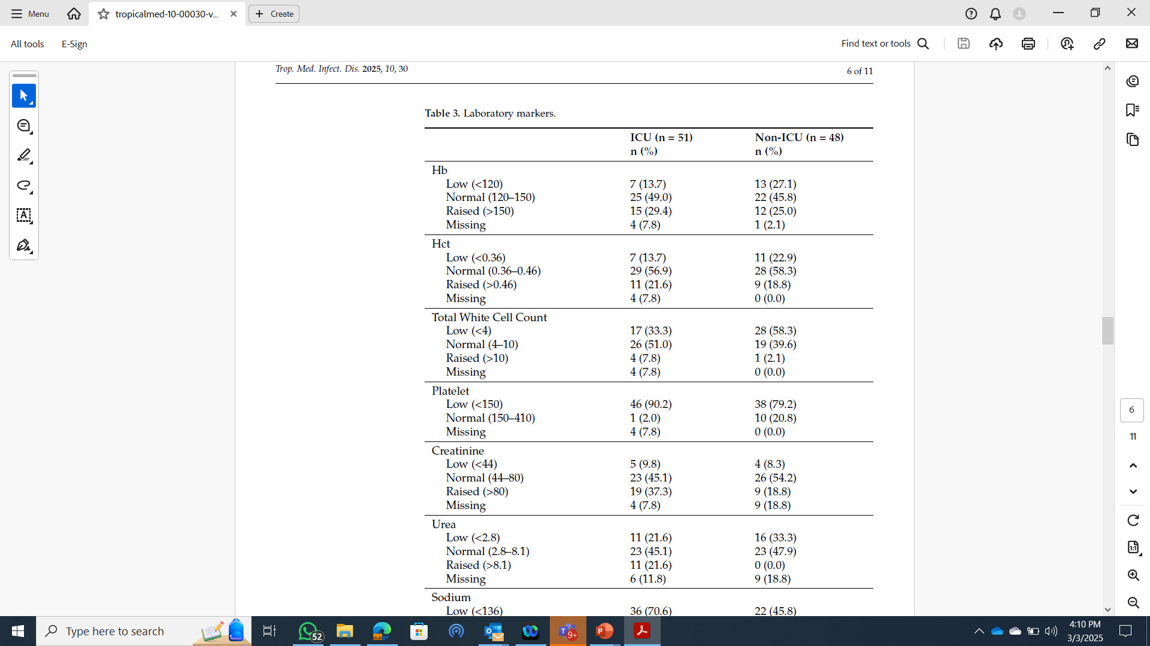

Slide 27


Slide 28


Slide 29


Slide 30
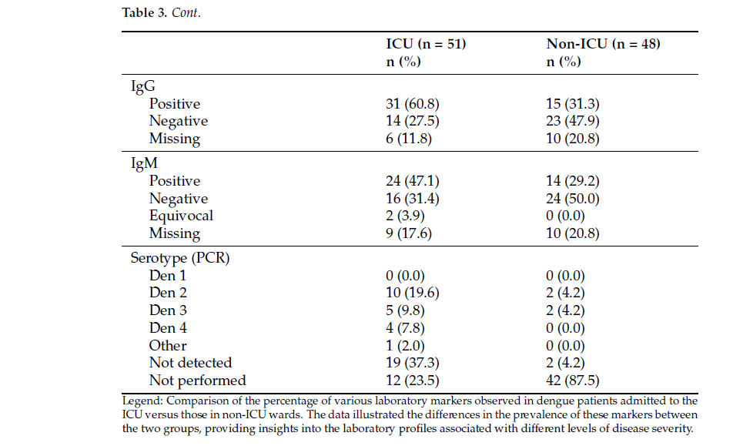

Slide 31
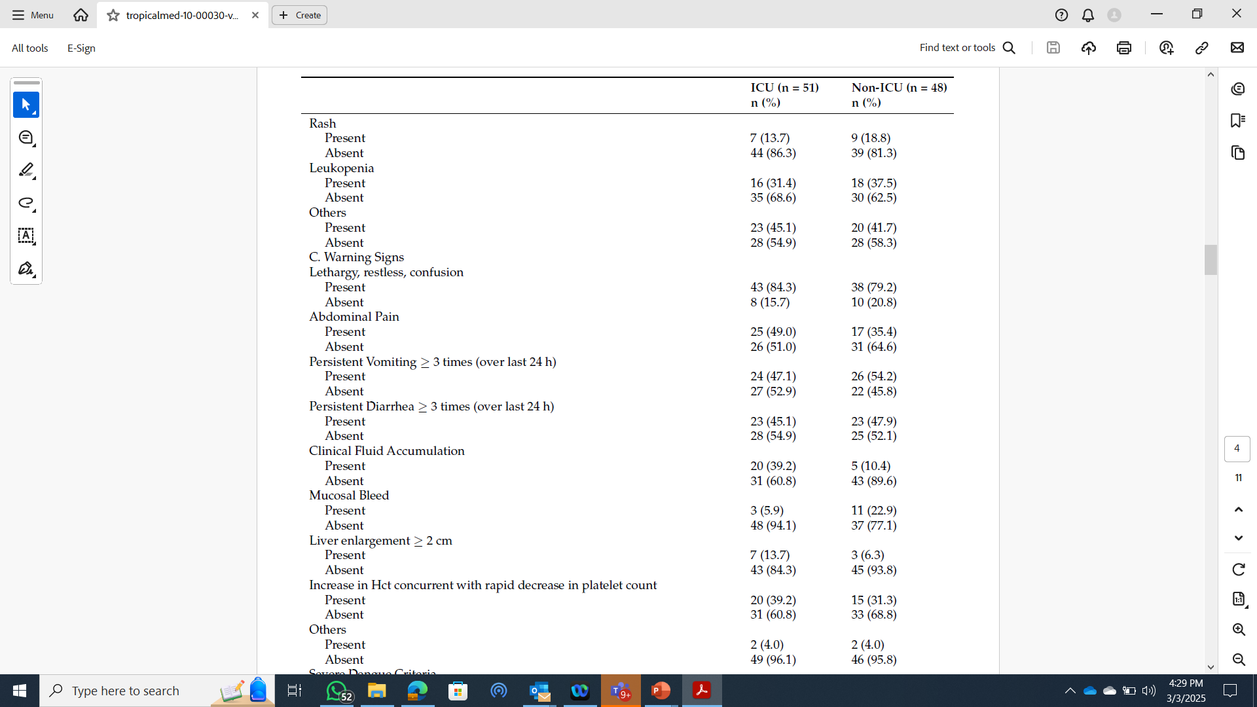

Slide 32

Key findings
Age > 50 ; 5x more likely to be in ICU
Obesity (BMI >27.6)
Thrombocytopenia
Plasma leakage
Mucosal Bleeding
Hypotension

Slide 33
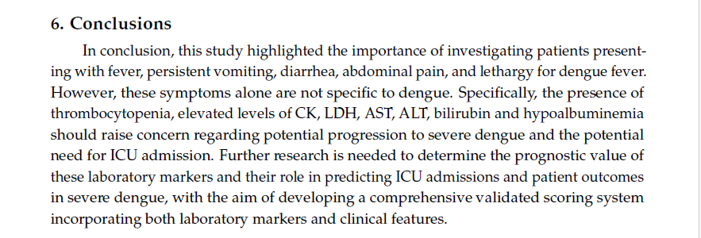

Slide 34

National AUDIT Project
Dengue and severe dengue April 2024 WHO Dengue and Severe Dengue
Chang CY, Mahaletchumi R, Zaid M, Ong ELC. Dengue fever complicated by haemophagocytic lymphohistocytosis Clinical Case Reports 2020 (http://dx.doi.org/10.1002/ccr3.3422 Early online publication October 2020)
Kok, S.Y.; Abraham, R.E.; Jauhar Ali, S.N.; Tuang,W.X.; Ong,E.L.C. A Retrospective Study of Clinical Biomarkers of Severe Denguein a Tertiary Hospital in Johor Bahru,Malaysia. Trop. Med. Infect. Dis. 2025,10, 30. https://doi.org/10.3390/tropicalmed10020030

Slide 35
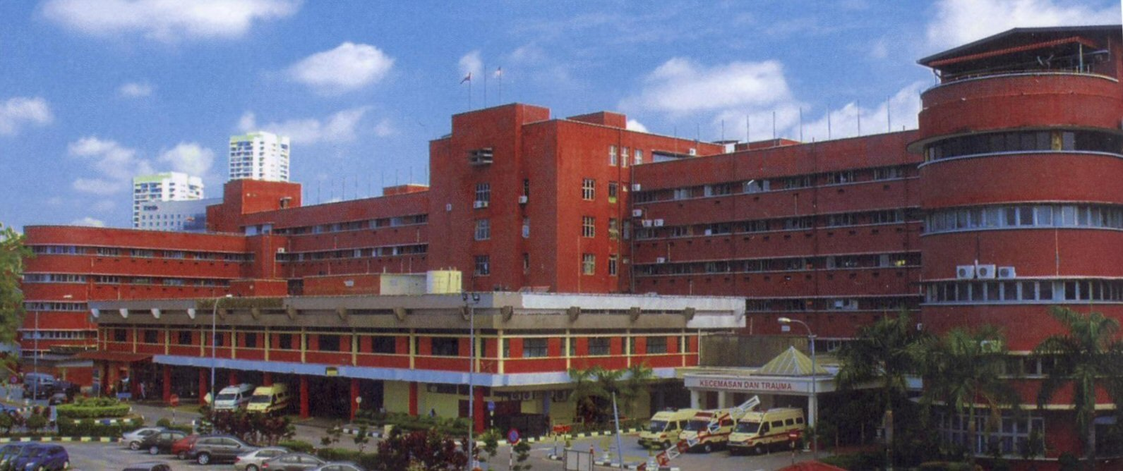
Acknowledgements:
Global Office, Royal College of Physicians, London, UK
British HIV Association (BHIVA)
Department for Foreign and International Development (DFID), UK
The Three Millenium Development Goal Fund (3MDG)
Commonwealth Scholarship Commission (UK)
UNOPS (United Nations Office for Programmed Services) Access for Health
HPA/UKHSA
Health and Hope, UK
THANK YOU

