Slide 1
Applying FAIR principles to Research Software
Frances Turner and Carol Booth
Newcastle University RSE Team

Slide 2
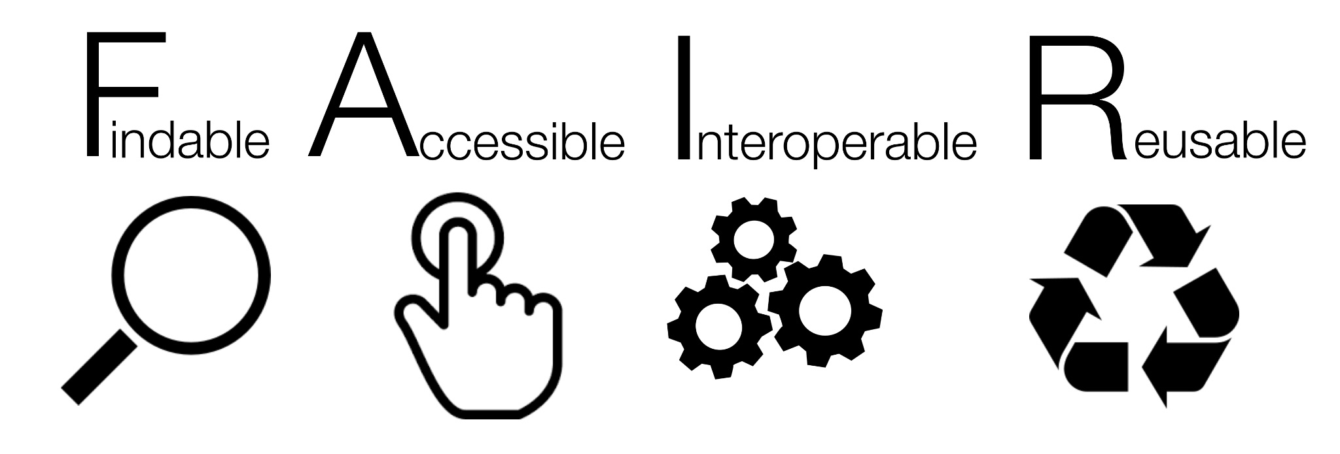
What is FAIR
Software and its associated metadata must be easy to discover by humans and machines.
The software and its metadata must be retrievable by standard protocols, free and legally usable.
Can interact with other software by exchanging data and/or metadata through standardised protocols and application programming interfaces (APIs).
Software should be usable and reusable (can be understood, modified, built upon, or incorporated into other software)
Image By SangyaPundir - Own work, CC BY-SA 4.0, https://commons.wikimedia.org/w/index.php?curid=53414062
Notes:
It’s not an exact science but any of the practices you employ in your research software workflow will bring you closer to the ideal of fully reproducible research
It’s not for criticising or discrediting work
It’s a set of values and principles to help researchers on a journey to better (FAIRer) software
Beware of using automated tools, the things which are easiest to measure automatically are not always the most valuable
Findable: Use standards for code metadata, public repository, register in an appropriate registry, use a unique and persistent identifier (DOI) - GitHub is not enough
Accessible: Can people obtain a copy using standard communication protocols (e.g. https, ftps), code and metadata available even when software no longer actively developed
Interoperable: use community-agreed standard formats for inputs, outputs and metadata, communicate with other software via standard protocols and APIs
Usable: Can be executed
Re-usable: Document - functionality and install so that it can be executed, can be understood, modified, built upon, incorporated into other software and License - how it can be re-used
Metadata: embedded information about the software within the code as metadata file, extrinsic metadata about the code in publicly available infrastructure (publish), version control, community standards - language specific best practices

Slide 3
Why be FAIR?
Good general principles for research
Reproducible code and models -> reproducible research
Sustainable Software Development
Reduce barriers to discovery
Increase the impact of your research output
So how do we apply these practically?
Notes:
Reproducibility - the ability to be reproduced or copied; the extent to which consistent results are obtained when an experiment is repeated
Computational Reproducibility means getting consistent results using the same input data, method (code) and conditions of analysis; work that can be independently re-created from the same data and the same code
The data and software is available to re-create the analysis
Sustainable Software Development - takes into account longevity and maintainability of code (beyond the lifetime of the project), environmental impact of re-doing work unnecessarily AI/HPC work
Impact: your work lives on, people build on it, it’s published in respected journals because it’s seen to be reliable, more people benefit from it because they can find and use it
Avoid the problem of the one person leaving the lab and nobody knows how to use their code
1 deep
Under a bus

Slide 4
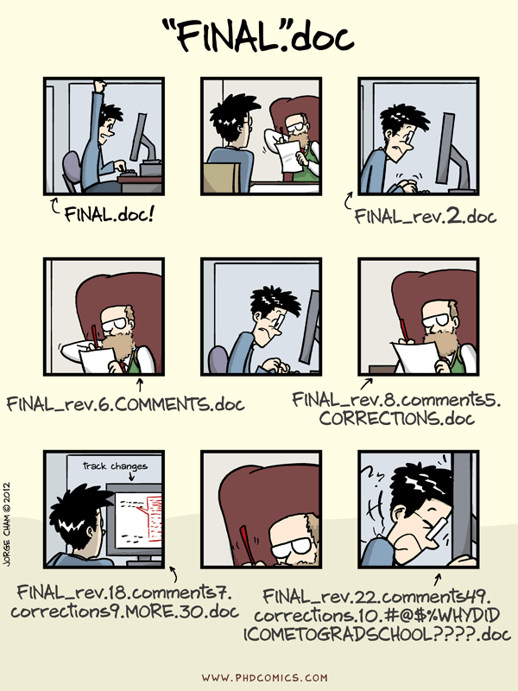
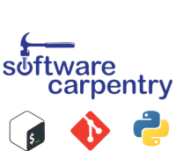
Version Control
Track changes for code and more
Many tools, Git, mercurial, subversion etc.
Collaborative tools to prevent overwriting/ duplicating work
Ncl University organisation on Github, where you can store code in the cloud
Notes:
https://github.com/newcastleuniversity

Slide 5
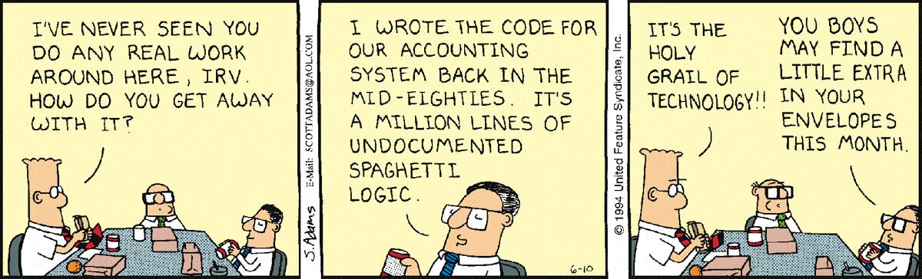
Readable Code
Know the code conventions for your language
Clear comments so you and others can understand what you’ve done
Linting tools can keep your code clean with minimal effort
Notes:
“If I re-read this piece of code in fifteen days or one year, will I be able to understand what I have done and why?” Or even better: “If a new person who just joined the project reads my software, will they be able to understand what I have written here?”
Linters check when you’ve deviated from coding standards - Consistency e.g.
Python: Pylint, Flake8
Java: Checkstyle
R: lintr
Languages differ but all have some things you should include at the top e.g. import dependencies/libraries, declaring variables, all allow comments
Sensible variable names

Slide 6
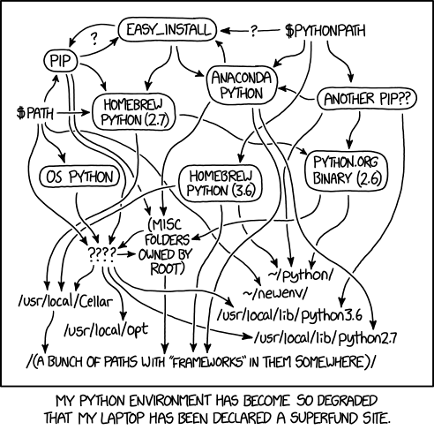
Reproducible Code
Avoid inaccessible/ unnecessary dependencies
Virtual environments
  Set dependencies project by project
  Easily share them with other users
  Streamline set up for new contributors
Containerisation
  Machine agnostic
  All the dependencies included
  E.g. Docker, Singularity
Notes:
“It works on my Computer”
Where possible, use well known and well maintained packages
Use standard protocols and file formats
Cartoon: what happens if you just start developing in Python for all projects, you add a little bit here and there each time something new comes along, you can’t remember what’s needed and what you only needed for that toy project 2 years ago
Superfund, USA program to identify, clean up, and return contaminated sites to productive use.
Check before using non-core functions/libraries in your language
Separate environment for each project means you know you’re not including ‘magic’
Virtual Environments
Python: venv, conda
R: renv
Java does this by default
Containerisation

Slide 7

Testing
Ensure and demonstrate that your code works
Informal testing - from the terminal, run one function at a time and check it behaves as expected
Formal testing - write dedicated test functions
Testing frameworks - find all the tests in the code base, run them and provide a summary
  E.g. pytest
Notes:
Particularly for cutting edge, fast changing software

Slide 8
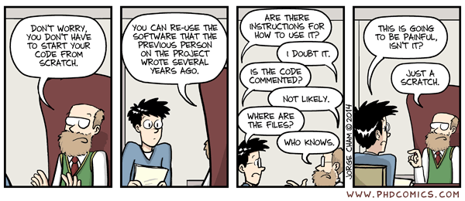
Documentation
Have a README, including:
  What it does
  How to install
  How to use
  Dependencies
Documentation Frameworks help with quality
Auto documentation can save a lot of time!
Add a citation file and license
Notes:
README file is best known form of metadata, discoverable, plain text requires no special software to access
Installation instructions are often missing. Many will fall at this hurdle. Documenting encourages you to consider future you as well as others installing on different platforms. Did you capture all dependencies? Will it work on another Operating System. It’s okay to set limits and say ‘this is only designed to work on linux / MacOS / Windows version X’ - you’ll allow people to make informed decisions about whether to commit time to it.
Python docstrings > Read The Docs
How to use? It makes perfect sense to you, you designed it bit by bit. A new user is faced with an entire system that may not align with their expectations. Risk you get blamed for wrong results.
:License, Citation

Slide 9
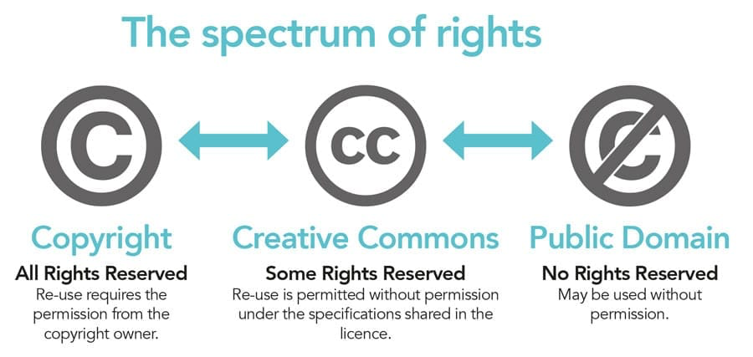
Citations and Licensing
Tell people how to cite your code for journal articles with a citation file.
By default, code isn’t open source, you need a licence!
Add a licence file to your code to make it clear what your re-use policy is.
Notes:
Licenses: money or not , restrictive or not
Spectrum of rights refers to all created work, not just software. Software has specific qualities that need specific types of licensing
License - publishing software doesn’t make it free to use. Let people know your intent, institutions will refuse to install unlicensed software - legal and reputational risk. Lack of / bad license will hamper commercialisation OR free re-use
Citation - courtesy, trustworthiness
License chooser tool
DOI is a unique and persistent identifier for your code - specific version or repository
ORCID is a free, unique, persistent identifier (PID) for individuals to use as they engage in research, scholarship, and innovation activities

Slide 10


DOI - Digital Object Identifier
Unique persistent identifier for your work
Published results using your code should come with a public release of that code for reproducibility
Archive that code in a repository with a DOI to keep it findable and available, e.g.
Figshare (free and paid tiers)
Zenodo
Data.ncl.ac.uk is an Institutional instance of Figshare
Notes:
Papers have a DOI, but so can code
Use a unique and persistent identifier (DOI) for your software (e.g. by depositing your code on Zenodo), which is also useful for citations - note that depositing your data/code on GitHub and similar software repositories may not be enough as they may change their open access model or disappear completely in the future, so archiving your code means it stands a better chance at being preserved
A DOI may refer to a specific release or to ‘latest version’
Release associated with particular results is really important for reproducibility
Some Repositories are curated and reviewed - higher trustworthiness, like publishing in a more respected journal
Review - a last line of defence against accidentally publishing sensitive (private), commercially valuable data - avoid getting sued! And ensures complete metadata (findable, accessible)

Slide 11
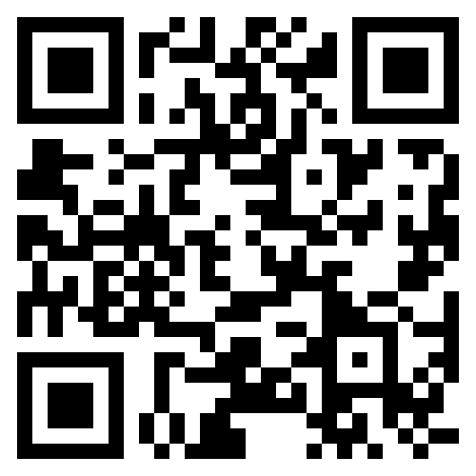
COME TO OUR WORKSHOPS FOR MORE!
Introduction to Unix Shell - 1 day
Introduction to Version Control with Git - 1 day
Introduction to Programming with Python - 1 day
Building Better Research Software - 2 days
  FAIR Research Software
  Version Control
  Reproducible Software Environments
  Code Readability, Structure, Testing
  Software Documentation
For more about our workshops, see The Newcastle University RSE Team Website or contact Jannetta Steyn in the RSE Team.
Notes:
The RSE team provides training

