Slide 1




Generating Trustworthy Evidence
A Painful Story
Gavin Stewart
Gavin.stewart@Newcastle.ac.uk

Slide 2
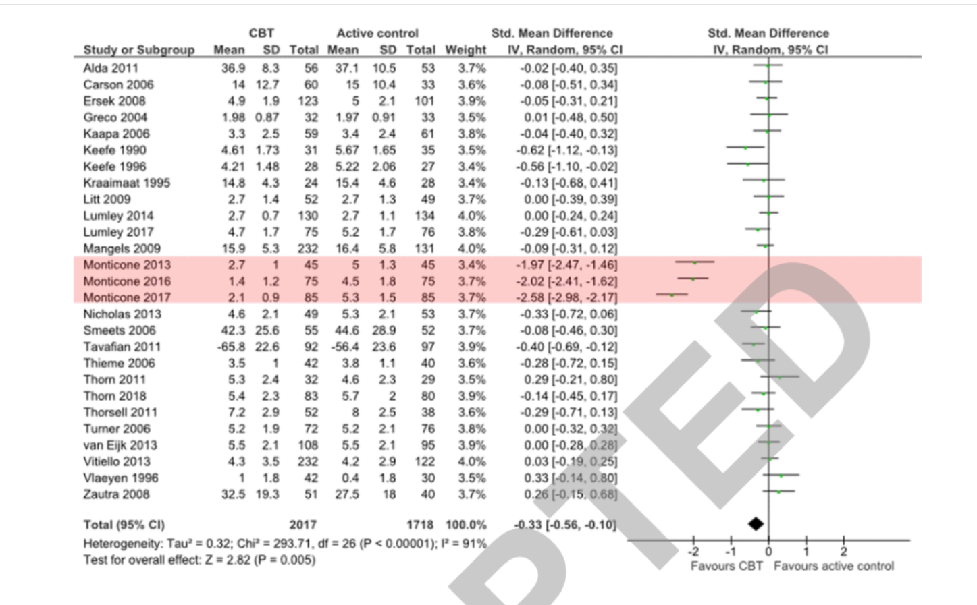
First look at the evidence…
Implausible effect sizes in a systematic review
Three studies from a group with the same lead author reported far greater effect sizes than all the others
Risk of bias assessment and exploration of heterogeneity did not explain inconsistency
Correspondence with the authors did not explain why their outcomes were so much better
For this reason Williams et al. excluded them from their analysis
Williams AC de C, Fisher E, Hearn L, Eccleston C. Psychological therapies for the management of chronic pain (excluding headache) in adults. Cochrane Database of Systematic Reviews 2020, Issue 8. Art. No.: CD007407. DOI: 10.1002/14651858.CD007407.pub4. Accessed 17 April 2025.
J Gurevitch, J Koricheva, S Nakagawa, G Stewart. Meta-analysis and the science of research synthesis. Nature 555 (7695), 175-182

Slide 3
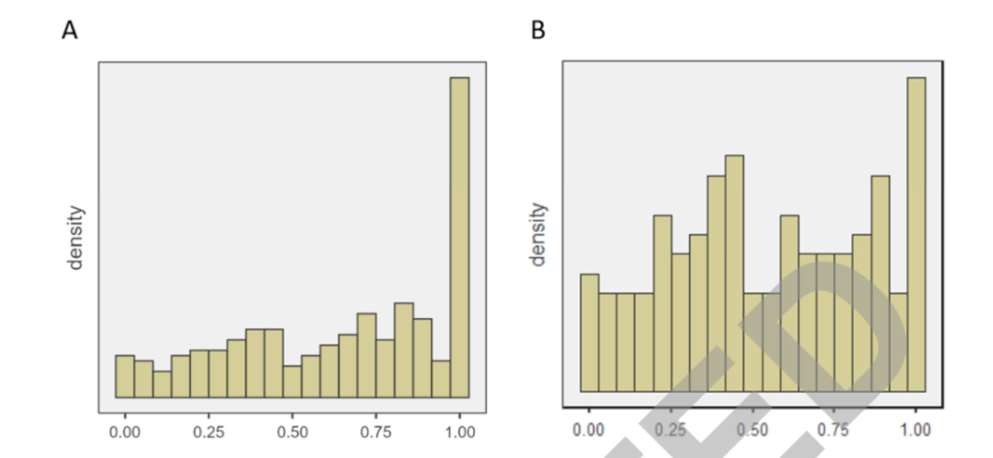
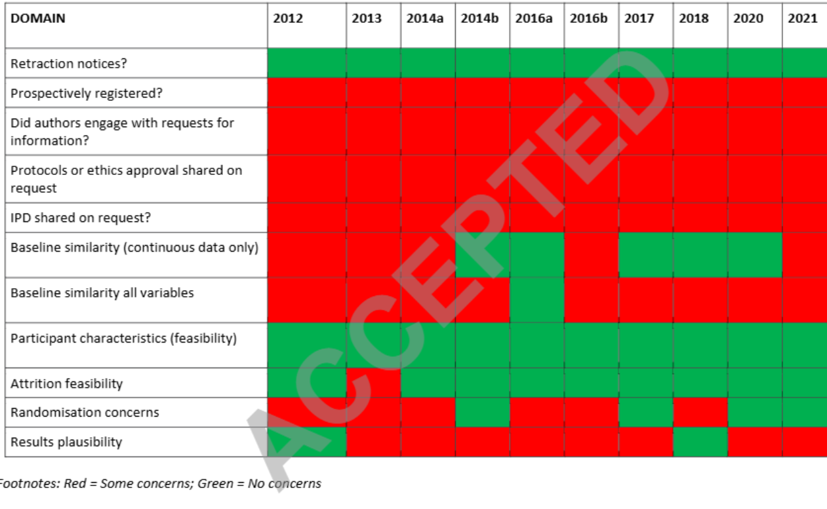
Investigating the veracity of a sample of divergent published trial data in spinal pain
Write a protocol
Retrieve all the backpain studies by the group
Eight trials reported results divergent from the evidence base
Assessment of risk of bias and participant characteristics identified no substantial concerns
Responses from the lead author did not satisfactorily explain this divergence
Trustworthiness screening identified concerns about:
Research governance
Data plausibility at baseline
Apparent data duplication
O'Connell, Neil,*; Moore, Andrew; Stewart, Gavin; Fisher, Emma; Hearn, Leslie; Eccleston, Christopher; Williams, Amanda. Investigating the veracity of a sample of divergent published trial data in spinal pain. PAIN 164(1):p 72-83, January 2023. | DOI: 10.1097/j.pain.0000000000002659

Slide 4

Untrustworthy trials should be challenged if no satisfactory response is forthcoming: a response to Monticone
“We acknowledge Dr Monticone’s letter in response to our paper which investigated the trustworthiness of a group of studies published by his group. Contrary to Dr Monticone’s suggestion, we made no accusation of data fabrication or misconduct. Rather, we raise valid concerns regarding the trustworthiness of this group of trials that we judge to be important, in particular because their inclusion in reviews and clinical guidance risks over-confidence and error. What caused these trial reports to be submitted and accepted for publication is beyond the scope of our investigation”
Reply to MonticoneNE O'Connell, RA Moore, G Stewart, E Fisher, L Hearn, C Eccleston, ...
Pain 164 (4), e239-e241

Slide 5
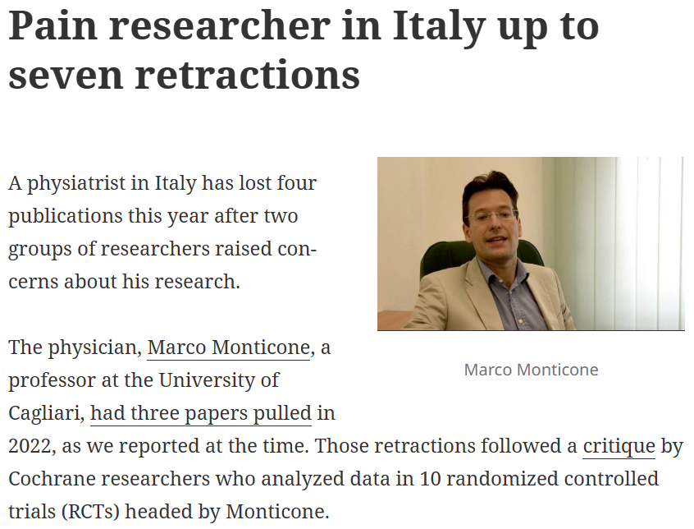
What did editors do?
Three editors acted consistently with COPE guidelines. Two immediately initiated investigations, informed us of progress, and ultimately retracted the trials (one each). The third journal editor, with two published trials (one of major concern), also investigated, resulting in retraction by the authors of the problematic trial for errors in data collection; this journal added a link to our trustworthiness paper to the trial of less concern and published an editorial on ways to improve research integrity.
The other three editors seemed reluctant to act.
The editor of the journal with four trials contacted the first author, receiving notice of his long-term sickness. Since this author had subsequently responded to other editors, we recommended further approaches, but heard nothing more.
Another editor advised us to address our concerns to the first author and his employer. Having previously been unsuccessful in this, we reminded him of the duties of editors outlined by COPE, and updated him on other editors’ initiatives. Following this, he wrote to the first author, receiving some data from the trial concerned, with complaints about our “unjustifiable attack”. These data, forwarded to us, confirmed our concerns of implausibility.
The sixth editor was reassured by his journal’s “fair review process by three experts”, so that “the results are likely to be useful to other researchers in the field”, and professed to being ”against academic intimidation”. We responded that unreliable results, which we already knew were included in multiple systematic reviews and clinical guidelines, were misleading rather than useful, while peer review of single papers would not identify duplicated data across trials
Effective quality control in the medical literature: investigation and retraction vs inaction ACC Williams, L Hearn, RA Moore, G Stewart, E Fisher.
Journal of Clinical Epidemiology, 2023

Slide 6
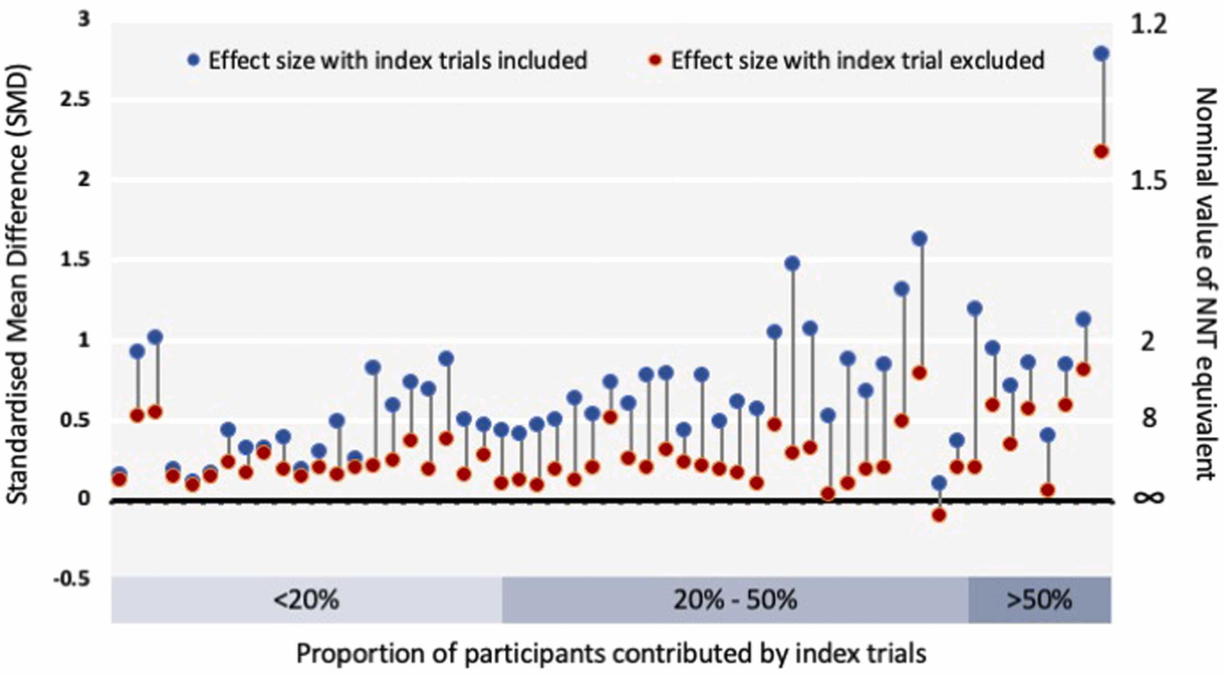
Just a few questionable studies….
Across meta-analyses (55 comparisons), the removal of index trials reduced effect sizes by a median of 58% (Inter Quartlie Range (IQR) 40–74).
85% of comparisons were classified as highly, 3% as moderately, and 11% as minimally impacted.
Nine out of 10 reviews conducting narrative synthesis drew positive conclusions regarding the intervention tested.
Nine out of 10 CPGs made positive recommendations for the intervention(s) evaluated. This cohort of trials, with concerns regarding trustworthiness, has substantially impacted the results of systematic reviews and guideline recommendations.
Trials we cannot trust: investigating their impact on systematic reviews and clinical guidelines in Spinal PainN O’Connell, RA Moore, G Stewart, E Fisher, L Hearn, C Eccleston, ...
The journal of pain 24 (12), 2103-2130

Slide 7
Retraction watch….
Retraction is a mechanism for correcting the scientific record and alerts readers when a study contains unreliable or flawed data.
We included 389 pain articles retracted between 1996 and 2022.
There was a significant upward trend in the number of retracted pain articles over time.
Sixty-six percent of articles were retracted for reasons relating to misconduct.
The median (interquartile range) time from article publication to retraction was 2 (0.7 to 4.3) years.
Data problems, comprising data falsification, duplication, and plagiarism, resulting in the longest interval (3 (1.2 to 5.2) years).
We found that retracted pain articles were most commonly published in Q1 impact factor journals, however this may have been affected by the addition of early access citations into 2021 impact factor calculations.
Retractions occur most frequently in high impact journals, especially when misconduct is involved. This may be a result of the reward for publishing in such journals, or simply because of the resources and expertise they dedicate to ensuring integrity of published data.
While journal editors and publishers are encouraged to follow COPE and ICMJE guidelines for retractions, there is currently no legal obligation for them to ensure the veracity or reliability of the data they publish.
The magnitude of this task may be too great for editors or peer reviewers to address alone.
Characteristics of retracted publications related to pain research: a systematic review. MC Ferraro, RA Moore, AC de C Williams, E Fisher, G Stewart, ...
Pain 164 (11), 2397-2404

Slide 8
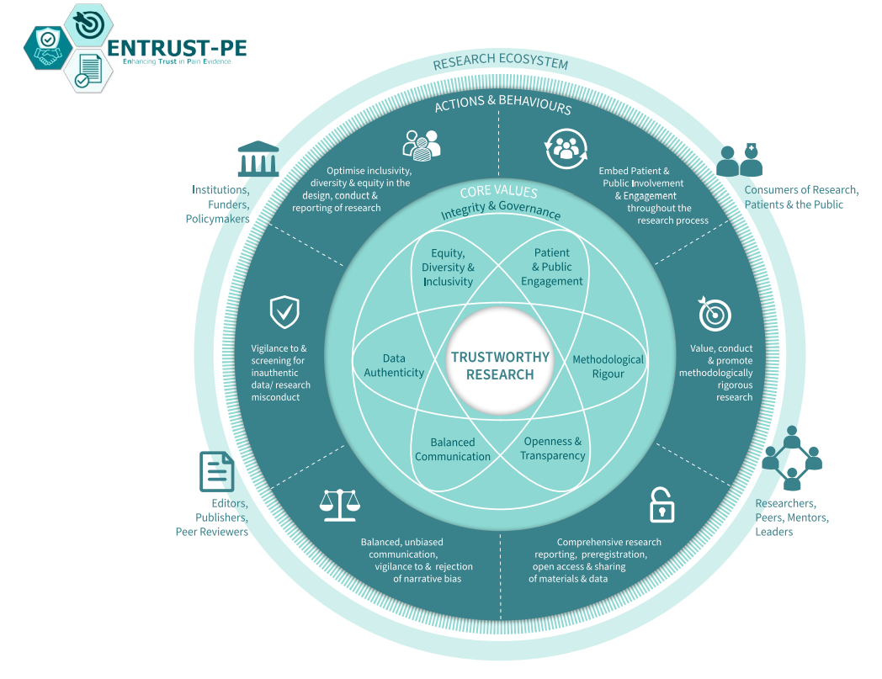
ENTRUST-PE.ORG
Enhancing the trustworthiness of pain research: A call to action.TEPE Network, NE O’Connell, J Belton, G Crombez, C Eccleston, E Fisher, Michael C Ferraro, Anna Hood, Francis Keefe, Roger Knaggs, Emma Norris, Tonya M Palermo, Gisèle Pickering, Esther Pogatzki-Zahn, Andrew SC Rice, Georgia Richards, Daniel Segelcke, Keith M Smart, Nadia Soliman, Gavin Stewart, Thomas Tölle, Dennis Turk, Jan Vollert, Elaine Wainwright, Jack Wilkinson, Amanda C de C Williams
The Journal of Pain 28, 104736

Slide 9
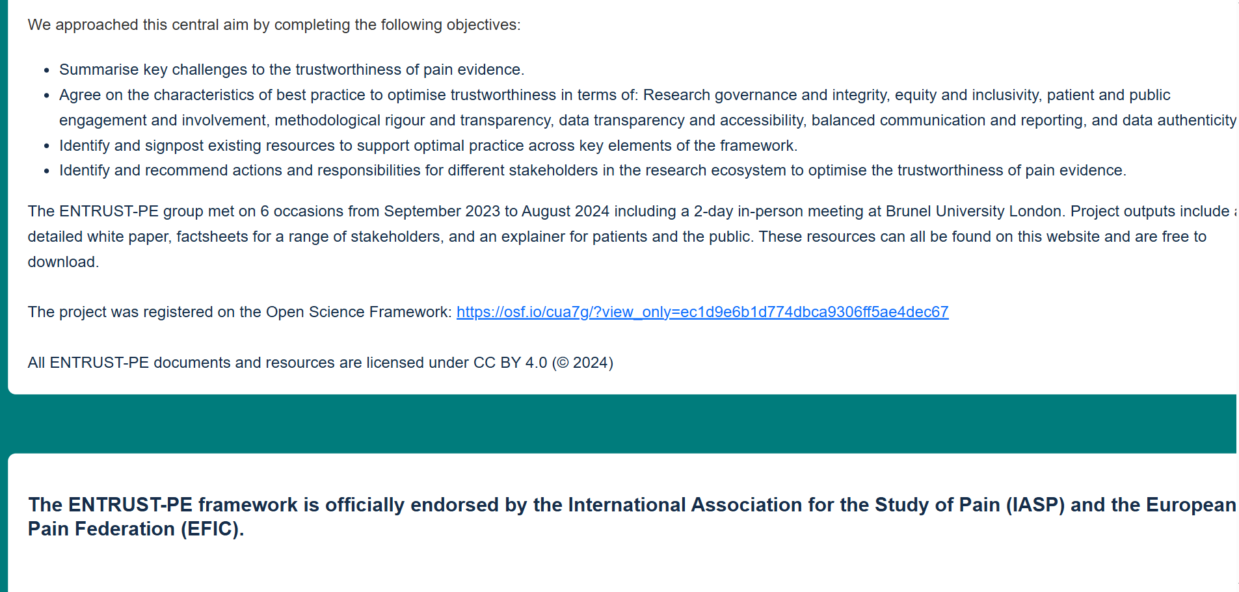

Slide 10
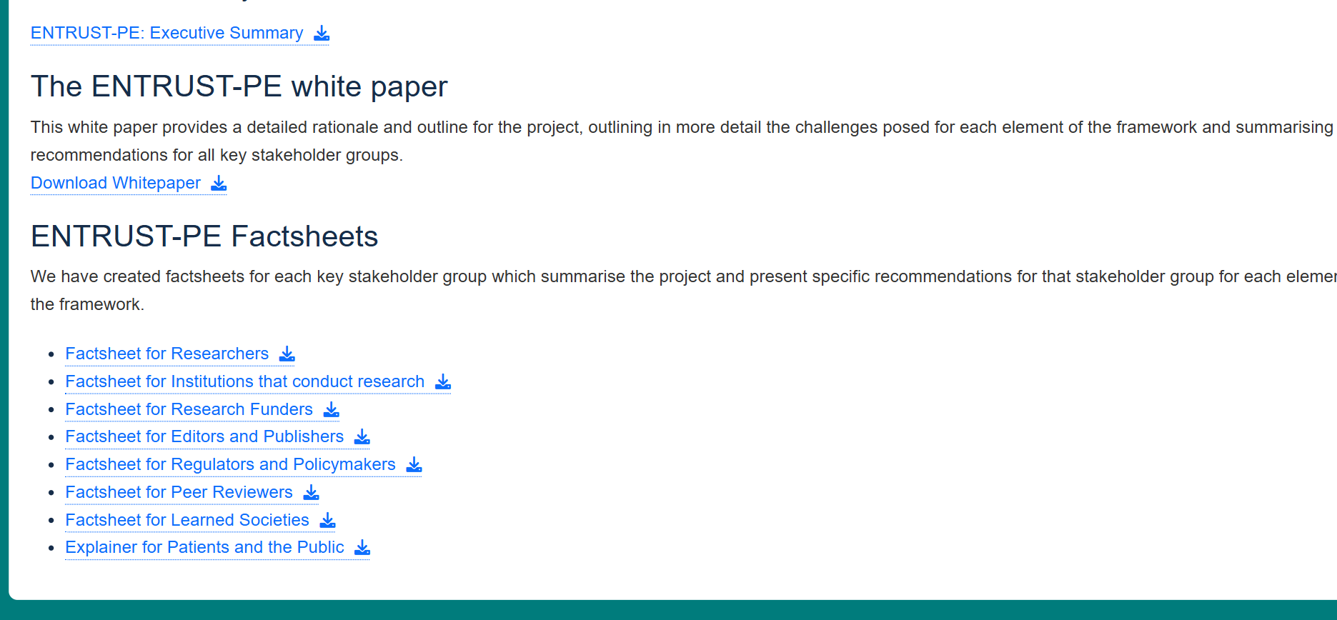

Slide 11
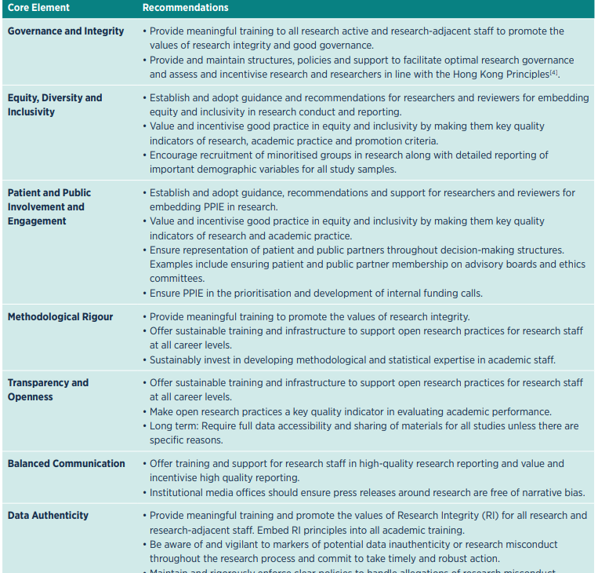
For institutions

Slide 12
Conclusions
“What have we learned? That open science practices, including publishing data, cannot come too soon; that we need better tools to detect problematic data within and across studies; that while error and fraud are acknowledged as widespread, some editors appear disinclined to believe that their journals are affected; that whistleblowers may still need to pursue concerns that are editors’ responsibilities. We know data can be flawed, futile, or fabricated, with documented examples in pain research. Left unaddressed by those tasked with tackling them, such data go on to influence evidence reviews and guidelines, and increase the risk of harm to patients.
We no longer worry about being too sceptical – we worry that we are not sceptical enough.”
Effective quality control in the medical literature: investigation and retraction vs inaction ACC Williams, L Hearn, RA Moore, G Stewart, E Fisher.
Journal of Clinical Epidemiology, 2023

