Slide 1

Multi100: Estimating the Analytical Robustness of the Social and Behavioural Sciences
Harry Clelland, Eotvos Lorand University (ELTE)

Slide 2

Analytical Variability: Defining the problem…
In the last decade we (social scientists) have been trying to make our findings more robust and replicable
Recommended practices to achieve this include pre-registration, registered reports, reproducibility checks etc
One critical aspect of robustness is the extent to which results depend on the analytical choices of researchers
In a typical research pipeline, conclusions are drawn based on a single analytical path, often conducted by a single analyst
The peer review process is designed to ensure that a given analysis meets the statistical (field-specific) standards, however…
The peer review process does not look at alternative (equally justifiable) analytical pipelines

Slide 3
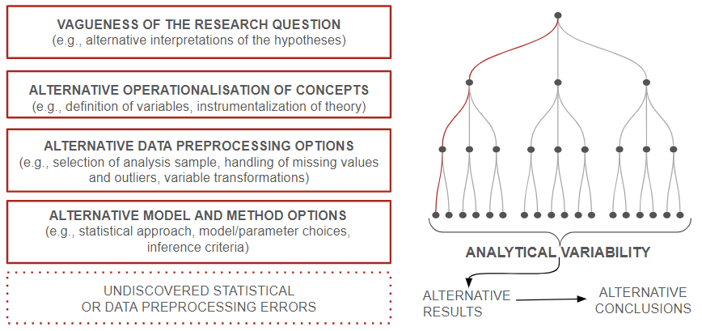
There are many ‘researcher degrees of freedom’ due to the abundance of options a researcher has when deciding how to operationalise their variables, process their data, select the test(s), choose frequentist or bayesian inference etc. This is analytical variability which can lead to qualitatively differing conclusions…

Slide 4

Do we know how robust published findings are in the social and behavioural sciences?
Multi-analyst projects (where different researchers independently analyse the same dataset) have already pointed to a variability in effect sizes caused by analytical variability which is greater than variability in effect sizes caused by sampling error…
These existing studies could be biased towards the ‘worst case scenario’ (i.e., areas with little consensus), which would be great news
However, if the issue persists across the disciplines, adjustments need to be made to how we do science to accommodate the additional uncertainty
Either way, we need to know the extent of the problem (if any)!

Slide 5
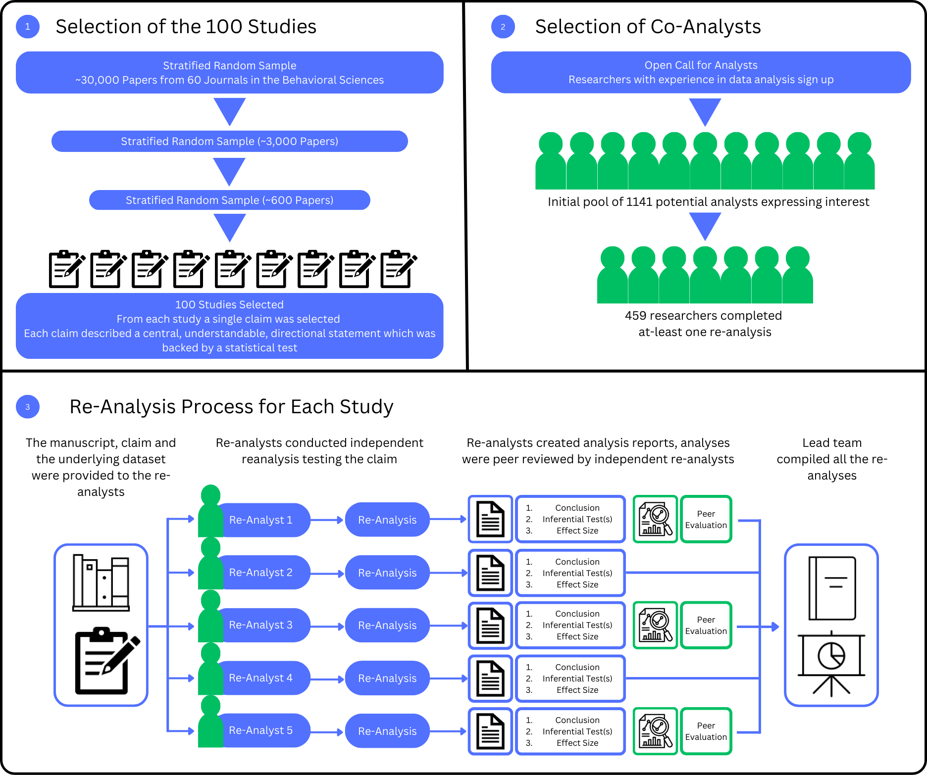


Slide 8

Two questions we asked…
Do different analysts…
Arrive at the same result (effect size) as the original study?
Arrive at the same conclusion as the original study?
Primary Aim: Estimate the analytical robustness of the social and behavioural sciences
Robust research should be minimally sensitive to analytical decisions of researchers

Slide 9
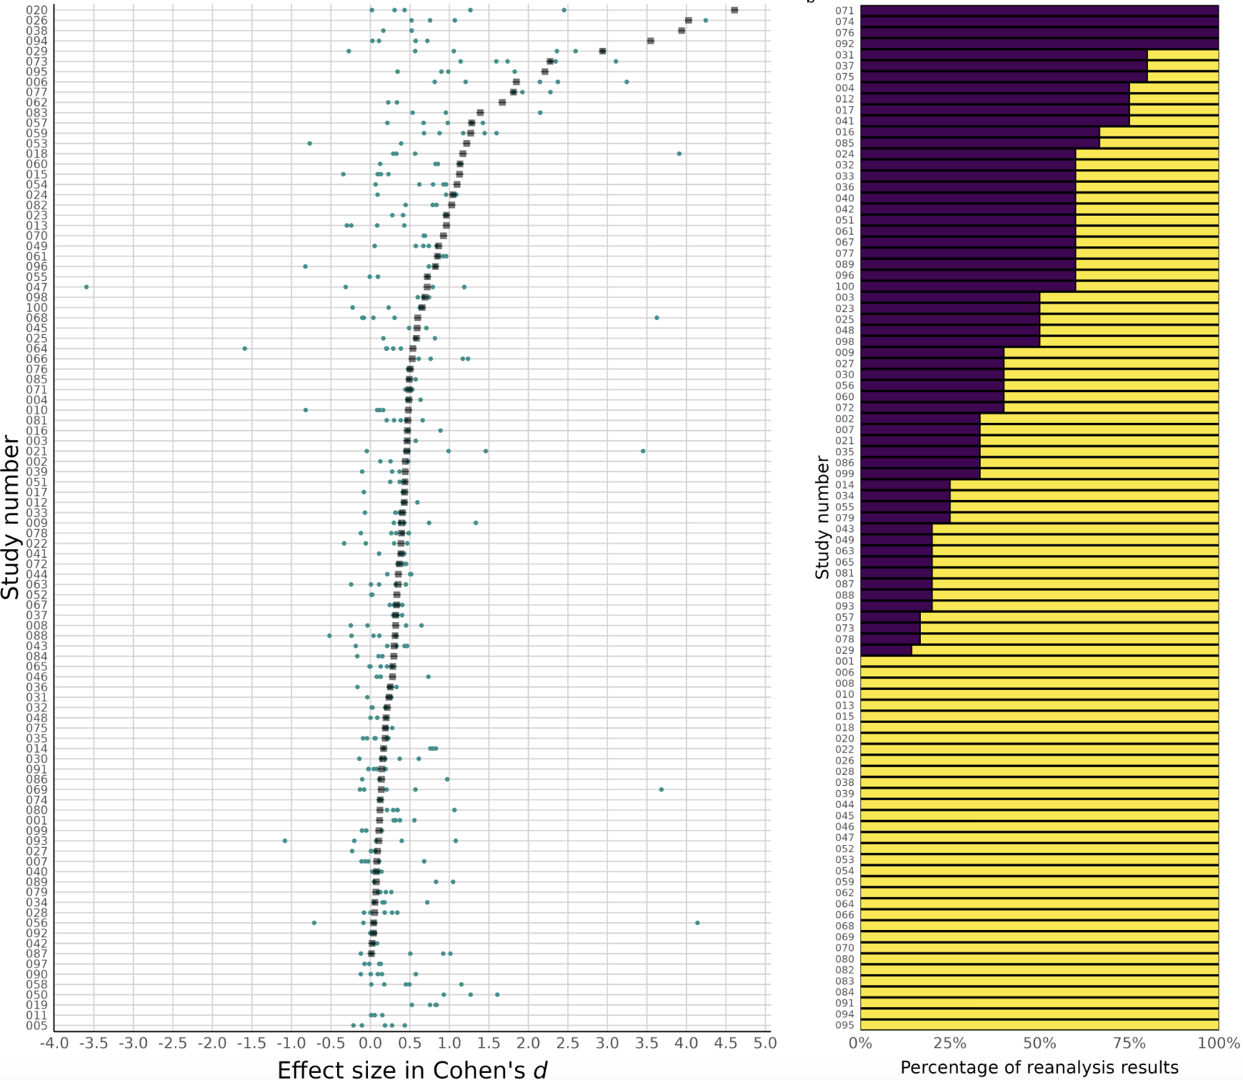
Result/Effect Size
Out of the 93 studies that we could calculate an effect size for…
All re-analyses had the same effect size (+/- 0.05) in only 4 cases (4.3%)
Out of 417 re-analyses, 31.4% found the same effect size as the original
With a 4x wider tolerance region (+/- 0.20), the number increases only to 55.6% (232 out of 417)

Slide 10
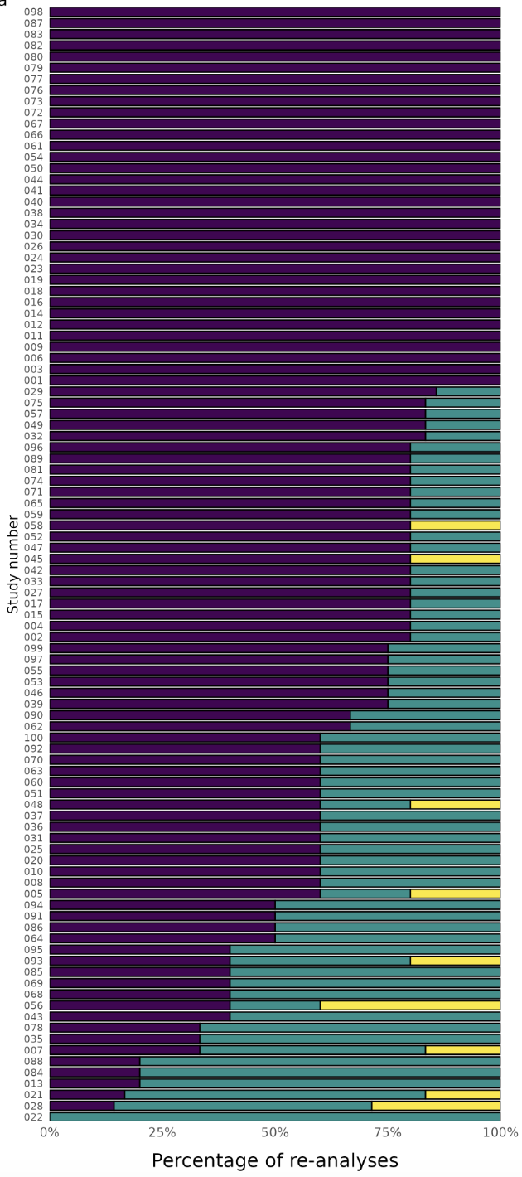
2. Conclusions
Out of 100 re-analysed papers, 34% were robust to independent re-analysis
That is, in 34 out of 100 papers all re-analysts arrived at the same conclusion as the original study
Across all re-analyses (504), 73.6% arrived at the same conclusion as the original study
Interestingly, 82% of re-analyses for experimental data reached the same conclusion, whereas 69% for observational data reached the same conclusion

Slide 11
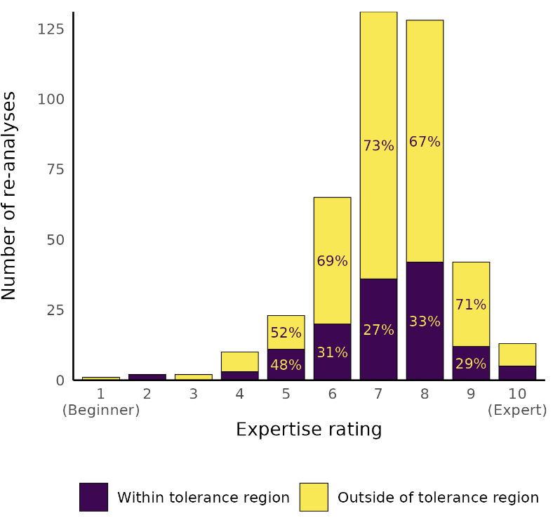
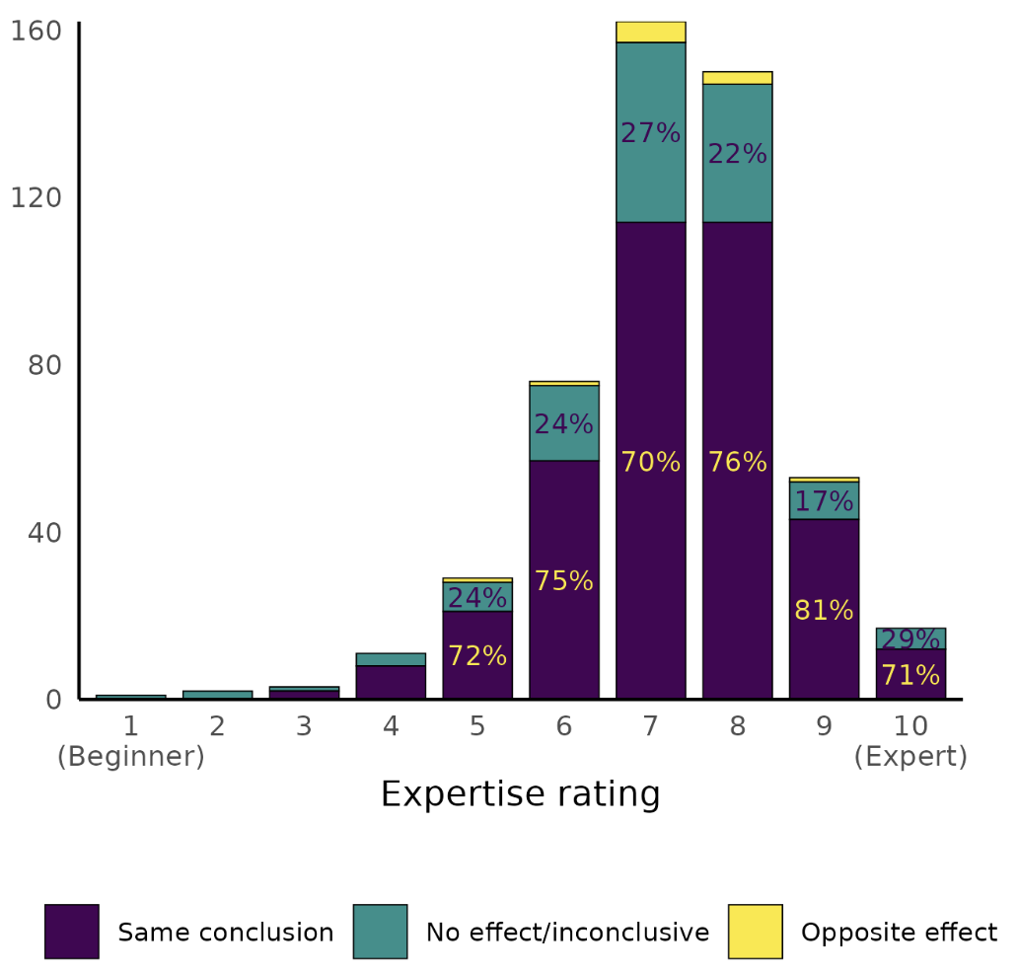
Can it be explained by expertise?
Effect Size
Conclusion

Slide 12
Limitations to Consider
100 papers is a small sample of the published empirical work in the social and behavioural sciences
  We could only select those where data was available and the finding was reproducible - sampling bias
Does 5 re-analyses per study capture the full variability of analyses?
Some of the discrepancies between original and re-analysis could be explained by weaknesses in the approach of the re-analysts
  Our peer review process can only partially protect us against this criticism

Slide 13
Lessons About Analytical Variability
The manuscript is under ”Revise and Resubmit” at Nature - 490 co-authors from 62 countries
Our results support the view that the results published in the social and behavioural sciences are contingent on the analytical decisions of researchers
If an analyst reports a single result from a single analytical path, they have not exhausted all of the possible answers that the dataset can provide
The limitations of "single-shot" analyses are probably a science-wide issue

Slide 14

How do we address the uncertainty created by analytical variability?
Two solutions: (1) multi-analyst approach, (2) multiverse approach
Multi-analyst
Strength: Multiple different (independent) analysts, variability captured in the diversity of analysts
Limitation: Resource intensive, does not exhaust all plausible analytical pathways
(2) Multiverse
Limitation: Fewer independent analysts, lots of analytical information to handle
Strength: Efficient and exhaustive - 1000’s of analytic combinations vs. a handful of single analyses
Strength: Allows you to plot the multiverse of effect sizes (i.e., visualise the flexibility)

Slide 15
What I’ve Learned About Open Research (recently…)
Big Team Science projects are an exercise in conscientiousness, but they’re worth it!
The conversation is shifting from encouraging engagement to recognising non-engagement
As of 2025, you will still get credit for things that you likely consider to be ‘the standard’

Slide 16

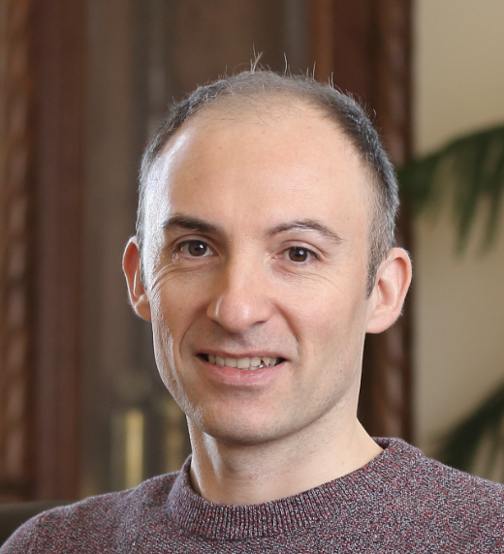


Thanks!
The Real Masterminds
Reach out to me: harry.clelland@ppk.elte.hu
Balazs Aczel
Barnabas Szaszi
Marton Kovacs

