Slide 1

Introduction to Open Hardware Principles
James Grimshaw

Slide 2



UKRN Train the trainers: Open Hardware Makers
https://openhardware.space/
Notes:
I’m James Grimshaw, I work in the BioImaging unit working primarily with Image analysis but this role also involves maintenance of microscopes.
Working in academic setting you learn pretty quickly to bodge things together, particularly when many spares and repairs for scientific instruments can cost far more than they are worth.
This got me interested in 3D printing replacement and spare parts to keep my microscopes running, along with figuring out how to share them so other people can use them as well.
I was then given the opportunity to do the Open Hardware Makers course funded by the UKRN train the trainers scheme, and I will be passing on the information that I learned from that course

Slide 3
What is Open Hardware?
“Open source hardware is hardware whose design is made publicly available so that anyone can study, modify, distribute, make, and sell the design or hardware based on that design.”
Open Source Hardware Association (OSHWA)
Notes:
The open source hardware association came up with this definition based upon open source software principles, however there are additional components to consider with open hardware.

Slide 4
Working Open: What it can do…
More minds on a single task
Gets you closer to your users and their needs
Give your project maximum impact
Notes:
More minds on a single task:
benefit from different approaches and ways of thinking
Diverse perspectives produce a better, richer product.
Contributors may also catch errors that you’ve missed.
Gets you closer to your users and their needs:
Integrate your target audience into the development process
Future users can be involved in decision-making about project design, direction, and features, as well as contributing project work.
Give your project maximum impact:
your final product will launch to a built-in audience which are often passionate about the results
others can build on your work, adapt your process or a part of your project for a novel use

Slide 5
Working smart: create, contribute or fork?
Don’t reinvent the wheel!
May make more sense to contribute to an existing project rather than start up your own
If your project is quite similar to another open hardware project, it may make more sense to fork and adapt that project rather than starting from scratch
Notes:
However, if you are forking a project it is important to understand what licences it is covered under, what use cases you creating derivative works based off it are allowed and what proper attribution is required

Slide 6
Elements of licences
Attribution: Should/must original authors be attributed or not
Use areas: Is the project allowed to be used in any/all areas (e.g. is there text in the license that prohibits use in potentially harmful areas?)
Commercialisation: can the project be used for commercial purposes
Derivatives: Are derivatives of the project allowed? and if so, how should/must they be shared?

Slide 7
Copyleft and non-copyleft licenses
Many licences provide specific requirements on how derivative work must be shared
Copyleft licences are an example of this. They require that any derivative works also be covered under the same licence.
This creates a “viral effect” where more and more projects become open
There are also Permissive or non-copyleft licences which place no such requirements.
These give more freedom to those adapting the projects but don’t have the benefits of making more projects open

Slide 8
Some example licences
 | Copyleft | Fully Permissive
Software | GNU General Public License v3.0 | MIT License
Hardware | CERN Open Hardware Licence Version 2 - Strongly Reciprocal | CERN Open Hardware Licence Version 2 - Permissive
Documentation | Creative Commons Attribution-ShareAlike 4.0 International | Creative Commons Attribution 4.0 International
Notes:
More examples can be found on choosealicense.com and creativecommons.org

Slide 9

Version Control Systems
Always work on the latest version of a file
Can roll back changes or work on earlier releases
All collaborators can work on the project at the same time and merge changes later
There is also a conflict resolution system if changes overlap
Depending on your settings, contributors from outside your organisation can also make edits and submit a “pull request” which can be approved or rejected by moderators
Notes:
To work on a project with many contributor’s, version control systems are a necessity
I am sure many of you attended the workshop for git earlier so I will be brief here
Very important if you want to manage a community of contributors

Slide 10



Git vs GitHub et al
Git is the software that handles the version control
Allows you to make and track local file changes and then sync them with a remote repository
GitHub and similar platforms such as GitLab and Bitbucket are based upon Git which allow you to host your repositories remotely
They also have other features such as issue tracking, hosting of web pages for documentation and community management features
Notes:
Git is just the software you have locally, github and other platforms are where you host them remotely
They have different benefits and features, although github is the most commonly used
It is also possible to host your own repositories remotely. This gives more control over your data but the responsibility is fully on you to maintain it

Slide 11
Documentation
Good, clear documentation is crucial for any open hardware project
There needs to be sufficient information for both external contributors to help to develop the project and for users to quickly and simply use it
It is often beneficial to separate these out, having separate documentation for developers and for users

Slide 12
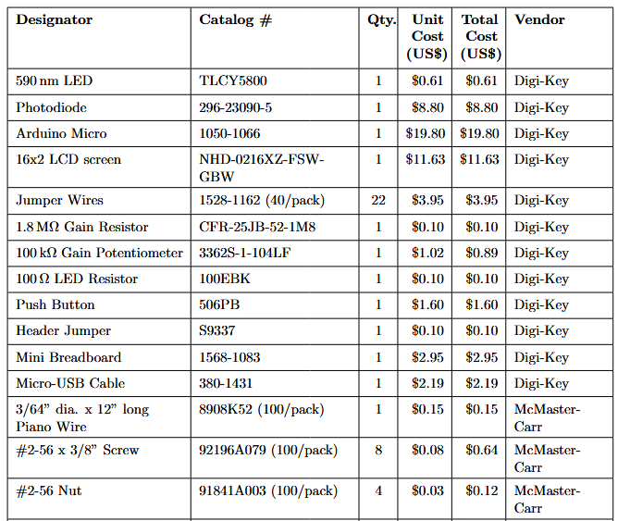
Documentation - Bill of Materials
Bill of materials
Often list part numbers and suppliers
Try to use common and easily available parts
Important to remember that the same suppliers may not be available in all regions
This can also be a benefit of working open. You can put out a call for users to provide a list of local suppliers for many regions

Slide 13
Documentation - Bill of Materials
Bill of materials
Tools needed
3D printer, laser cutter, soldering equipment etc
Try to consider what equipment is truly accessible. Not everyone may have access to high end large printers
Skills needed
Often forgotten about. People need to know what skills they may need before they embark on building your device

Slide 14
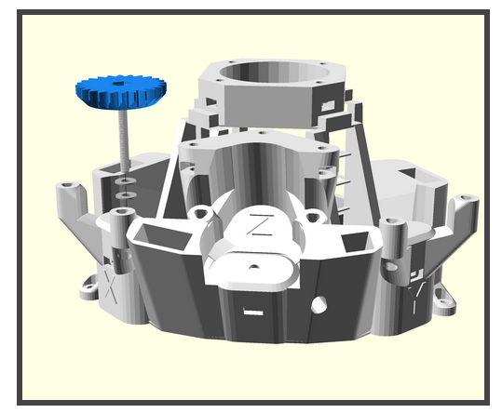
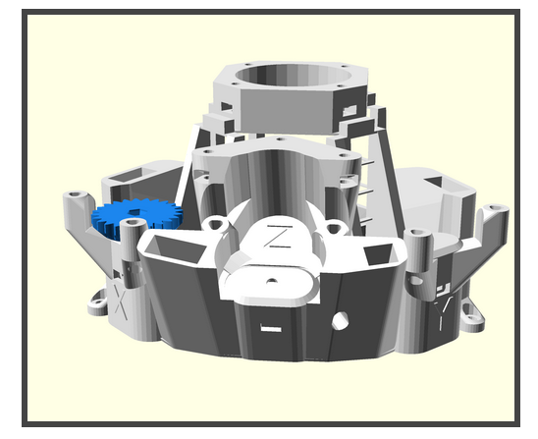
Documentation - User Guides
Bill of materials
Building instructions/Assembly guide
How to use your product
Common problems and troubleshooting
Visuals are key!
Videos, particularly for operation can be invaluable
OpenFlexure.org

Slide 15
Documentation - Developer Guides
Typically more in depth and technical
May want to have:
A detailed description of how your project was/is developed e.g. CAD software you are using
Current state of development
Open tasks
Tasks currently being worked on
API for any software libraries that may be involved
Contributor guidelines
Often helpful to have templates for things like pull-requests and issues

Slide 16

Standards
The distributed nature of Open projects means that they normally do not follow one specific standard. However, certain standards are beginning to be accepted by some in the community
One such set is developed by the Open Source Hardware Association (OSHWA).
They proscribe certain documentation practices that must be used along with which licences are acceptable
They also provide Certification, which allows projects to display that their project conforms with OSHWA’s definition
Specifically for documentation the DIN standard DIN SPEC 3105 was created by many from the Open Hardware community in collaboration with the German Institute for Standardisation.

Slide 17
Building a Community
In order to build a community, you need both ways for people to find your project and make it easy for them to engage with it when they do
It’s worth thinking about:
Discovery - How someone may hear about the project
First Contact - How they will first engage with it
Participation - How they can participate in the group if they choose to
Sustained Participation – How their contribution or involvement can be continued/maintained
Networked Participation – How they may network within the community
Leadership – How they may take on some additional responsibility on the project or begin to lead
Open Hardware projects naturally lean towards distributed leadership. This allows for both continued engagement with the project from committed individuals and allow the work done on the project to expand

Slide 18
Building a Community - Participation Guidelines
With an open community it is important to have structures in place which protect all members in the community, and allow for everyone to see how it is structured
Codes of Conduct serve as a guide for participation in the community. They serve two main purposes:
To establish the sorts of behaviours encouraged by the community, and to make clear which behaviours are unacceptable and discouraged
To establish the processes by which any problems or violations of the guidelines will be handled by the project lead or leads.
Governance models serve to provide transparency about the leadership of the project. This allows potential contributors to understand how they can contribute and be involved in the leadership of the organisation
The website communityrule.info has templates of governance models you can learn about and tailor to your community needs.
Notes:
Often don’t need a governance model right away but can be important as the project begins to grow

Slide 19
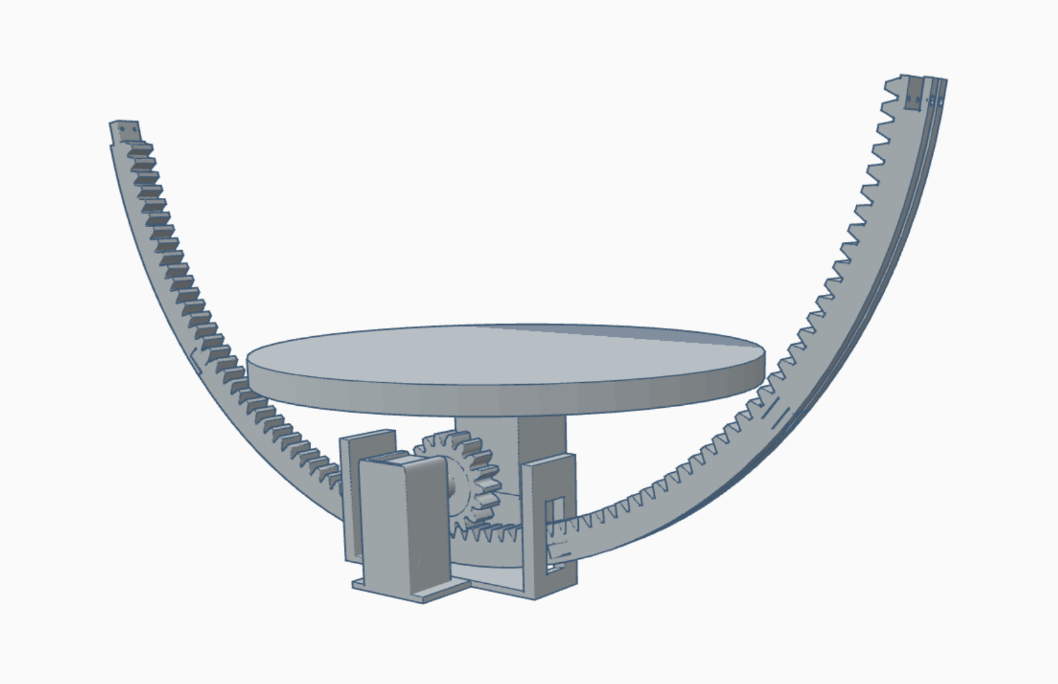
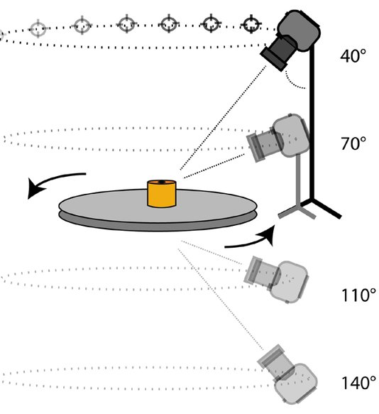
Example Project: Photogrammetry Rig
Poigt. 2018
Notes:
As an example, I’m going to be talking about a project I have been working on. This is a photogrammetry rig that we have been designing in collaboration with the Hancock museum.
It is used to take a number of pictures of an object placed upon the spinning table from a number of different angles.
These images are then used to reconstruct a 3D model of the object
The camera will go on the end of the arm to allow imaging of the top and sides of the object, and then the turntable can rotate to get all the different angles.
We have designed it so that it can be printed on a relatively small 3D printer, with the long arm being able to be printed as smaller pieces that are slotted together.
This can be used by the Hancock and hopefully other museums and researchers, in order to make 3D models of artefacts in their collection for both display virtually, and allowing them to be 3D printed to allow for the public to have a more interactive understanding of the objects in question.

Slide 20
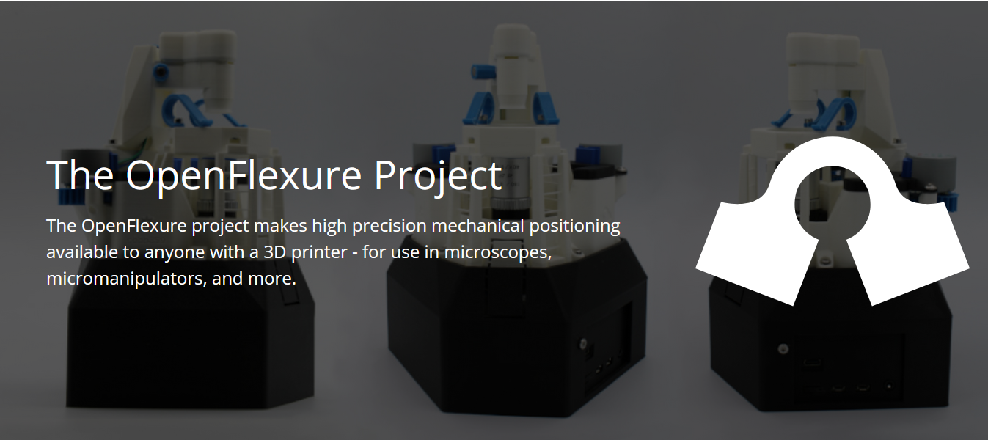
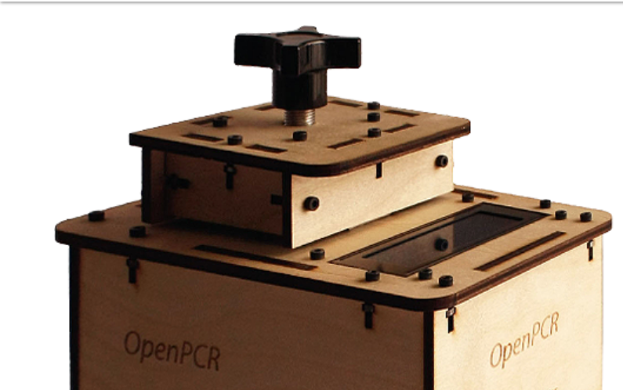
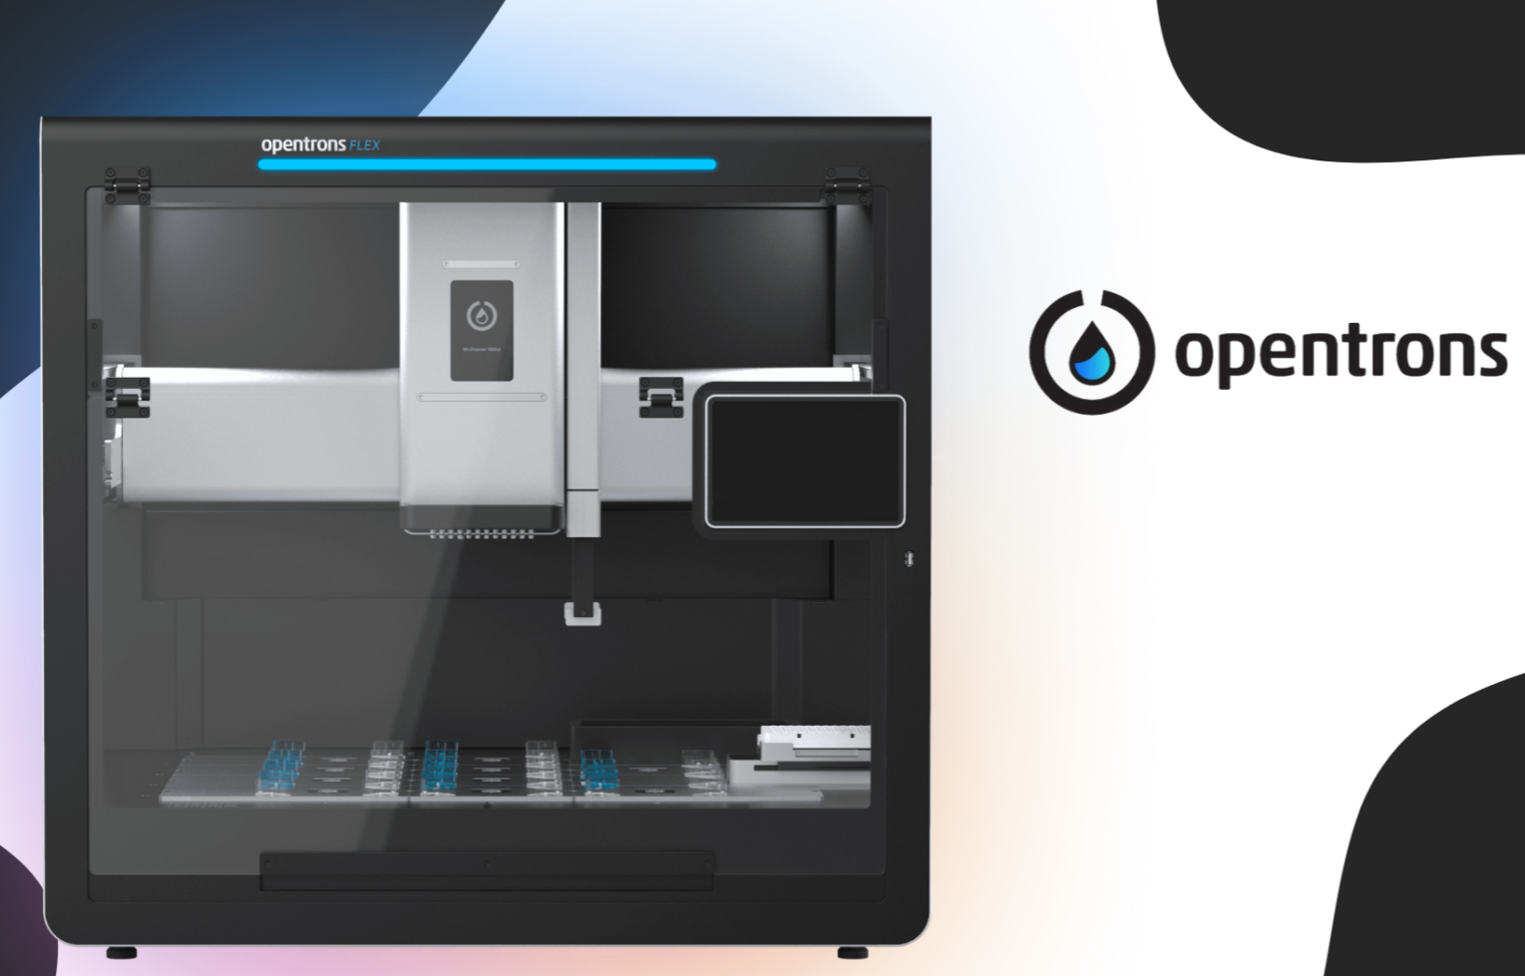
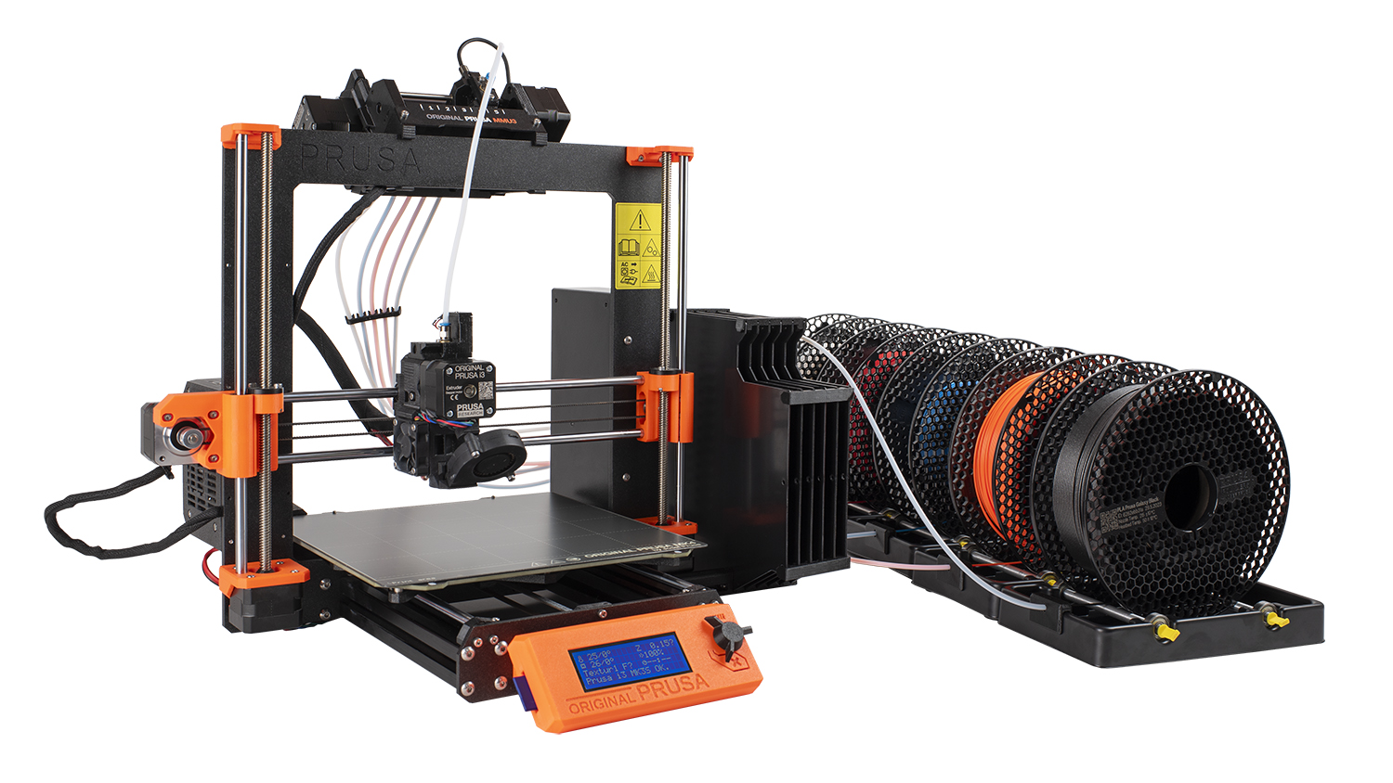
Example Projects

Slide 21

Acknowledgements
https://openhardware.space/
Open Hardware Makers: https://curriculum.openhardware.space/

