Slide 1

Smart and Inclusive Urban Planning with Sensitive User Data in Mind
Shouai Wang, PhD Student,
Department of Electrical and Electronic Engineering
13-Jun-2025

Slide 2
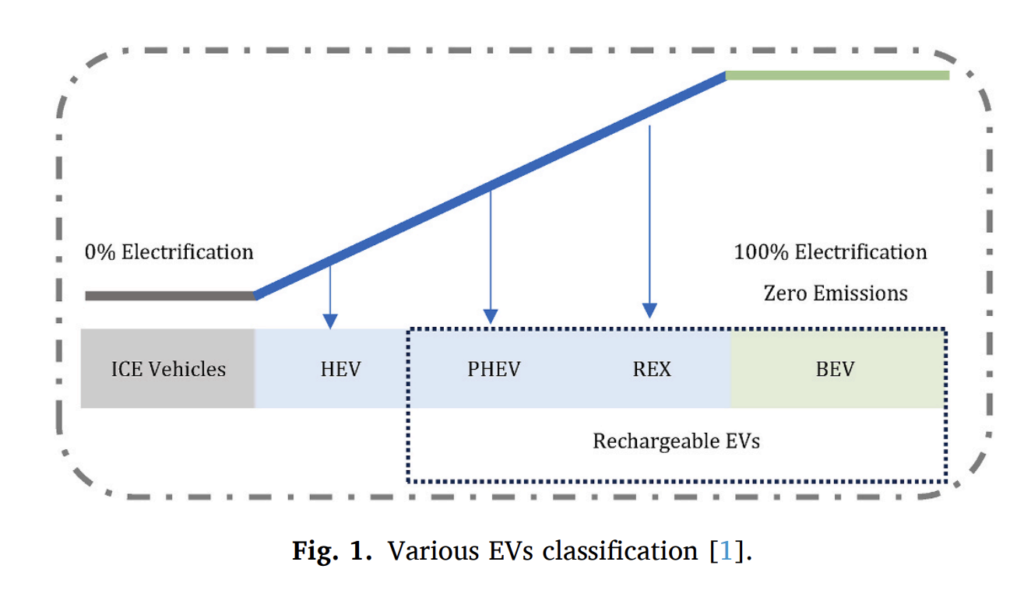
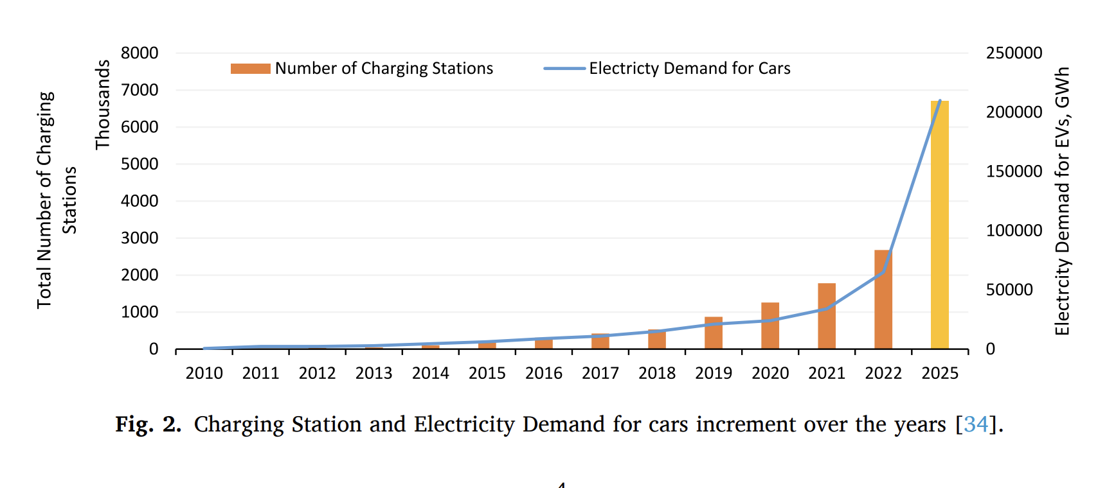
Introduction
A well-structured policies and regulations play a pivotal role in the successful adoption and proliferation of EVs.
It provides the necessary framework to encourage both consumers and manufacturers to embrace EV technology.
Charging infrastructure development are crucial for ensuring convenient and accessible charging options, further bolstering the appeal of EVs.
As nations strive to mitigate the effects of climate change and reduce greenhouse gas emissions, the transportation sector represents a significant contributor to the problem.
What are the main challenges?
Several challenges have been identified in the literature regarding EVs, encompassing a detailed examination of issues ranging from charging infrastructure and limited range to high initial costs and lack of properly designed incentives.
Qadir, S.A., Ahmad, F., Al-Wahedi, A.M.A., Iqbal, A. and Ali, A., 2024. Navigating the complex realities of electric vehicle adoption: A comprehensive study of government strategies, policies, and incentives. Energy Strategy Reviews, 53, p.101379.

Slide 3
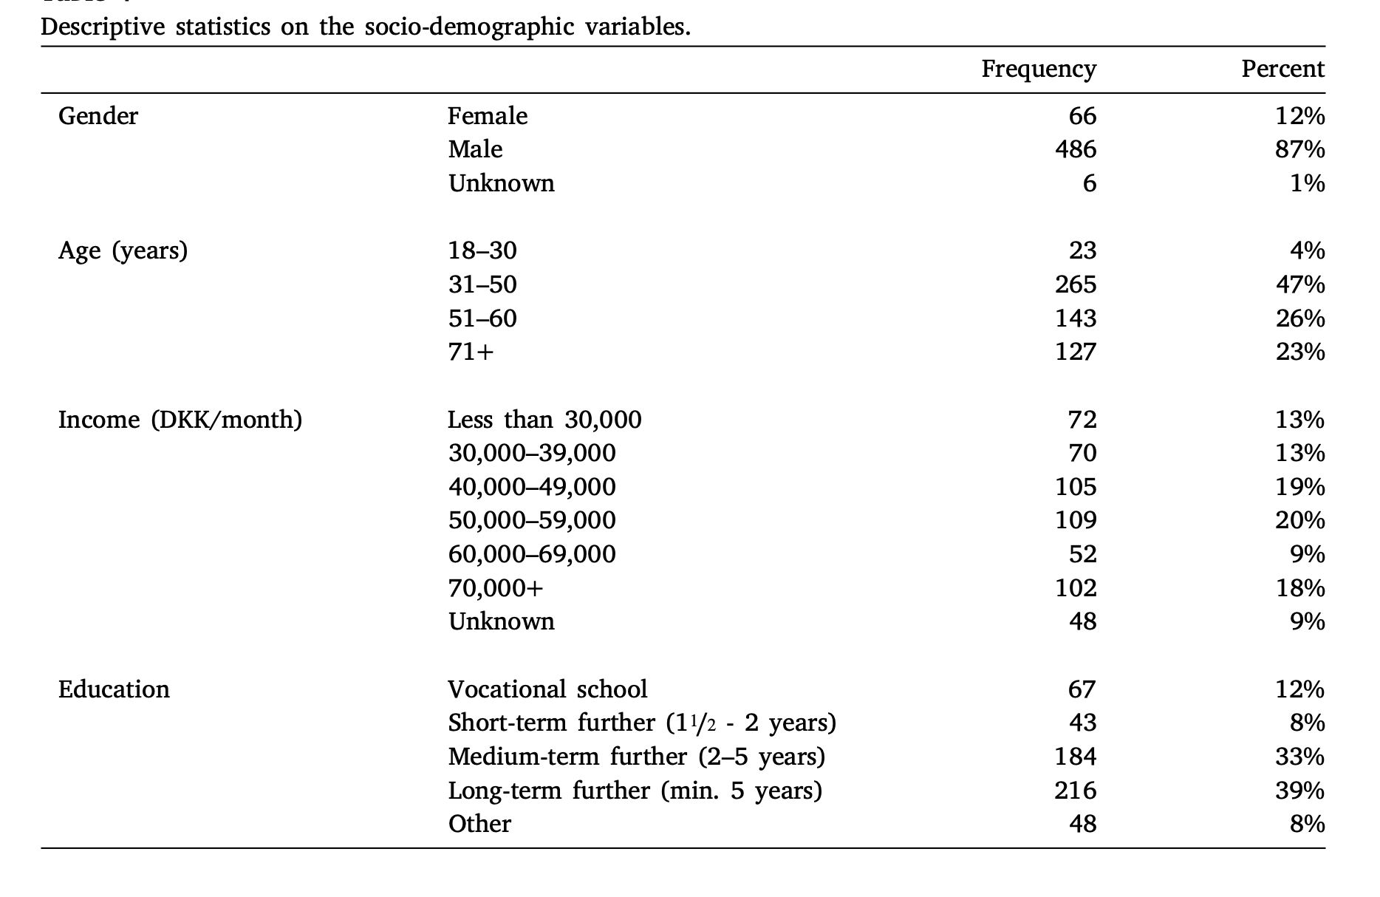
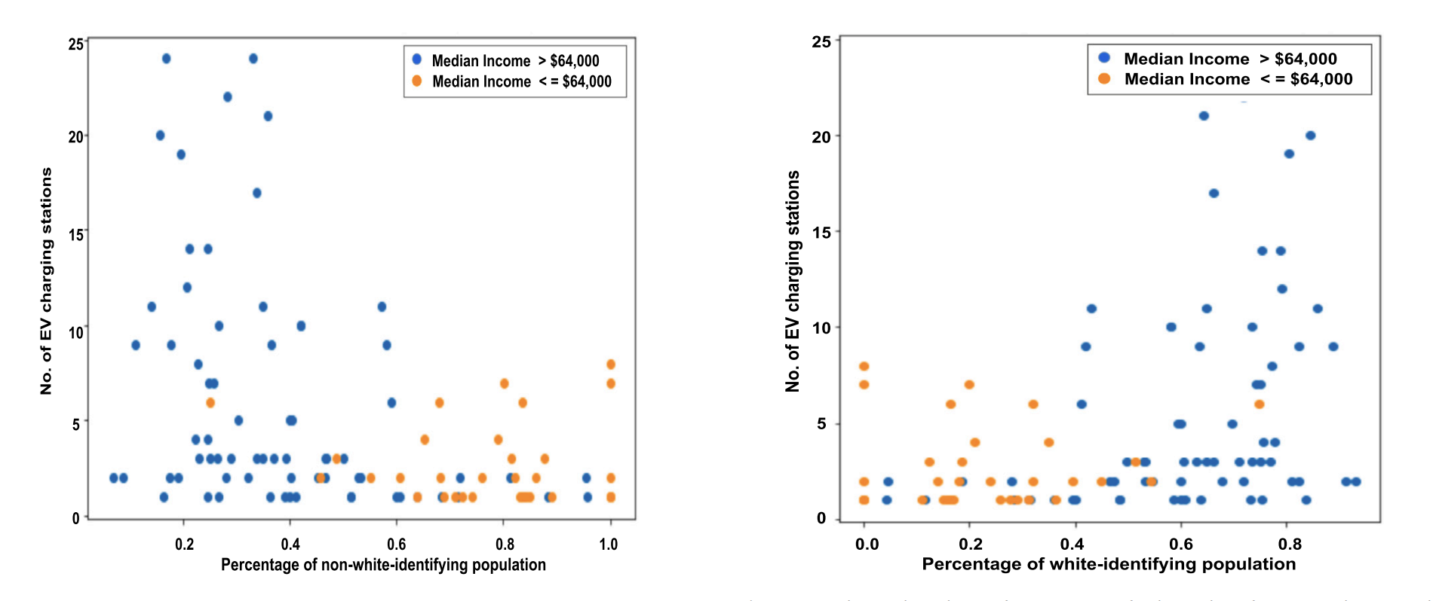
Background
Charging infrastructure availability, especially fast charging, significantly influences EV adoption, though its impact varies by context and market maturity.
Home charging dominates user behaviour, but timing and location of charging are becoming more critical due to grid concerns.
Cost, access, and network interoperability shape charging decisions, while free charging may lead to congestion.
Public charging etiquette issues (like space misuse and charger sharing) underscore the need for clear norms and real-time support tools (A.A. Visaria et al., 2022).
Khan, H.A.U., Price, S., Avraam, C. and Dvorkin, Y., 2022. Inequitable access to EV charging infrastructure. The Electricity Journal, 35(3), p.107096.
Visaria, A.A., Jensen, A.F., Thorhauge, M. and Mabit, S.E., 2022. User preferences for EV charging, pricing schemes, and charging infrastructure. Transportation Research Part A: Policy and Practice, 165, pp.120-143.

Slide 4
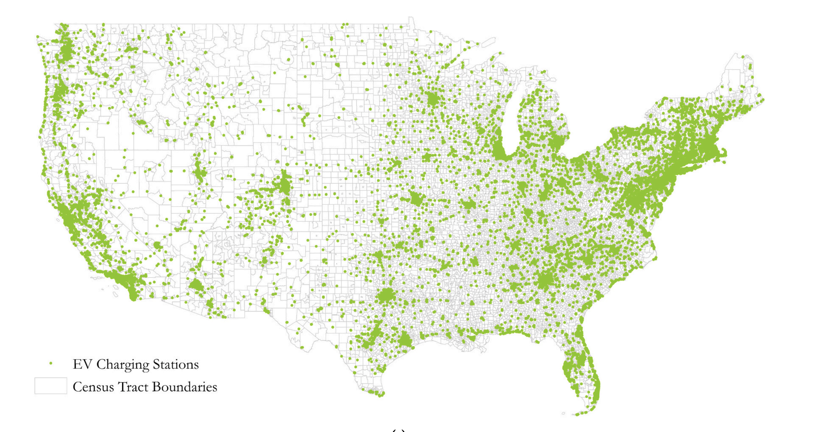
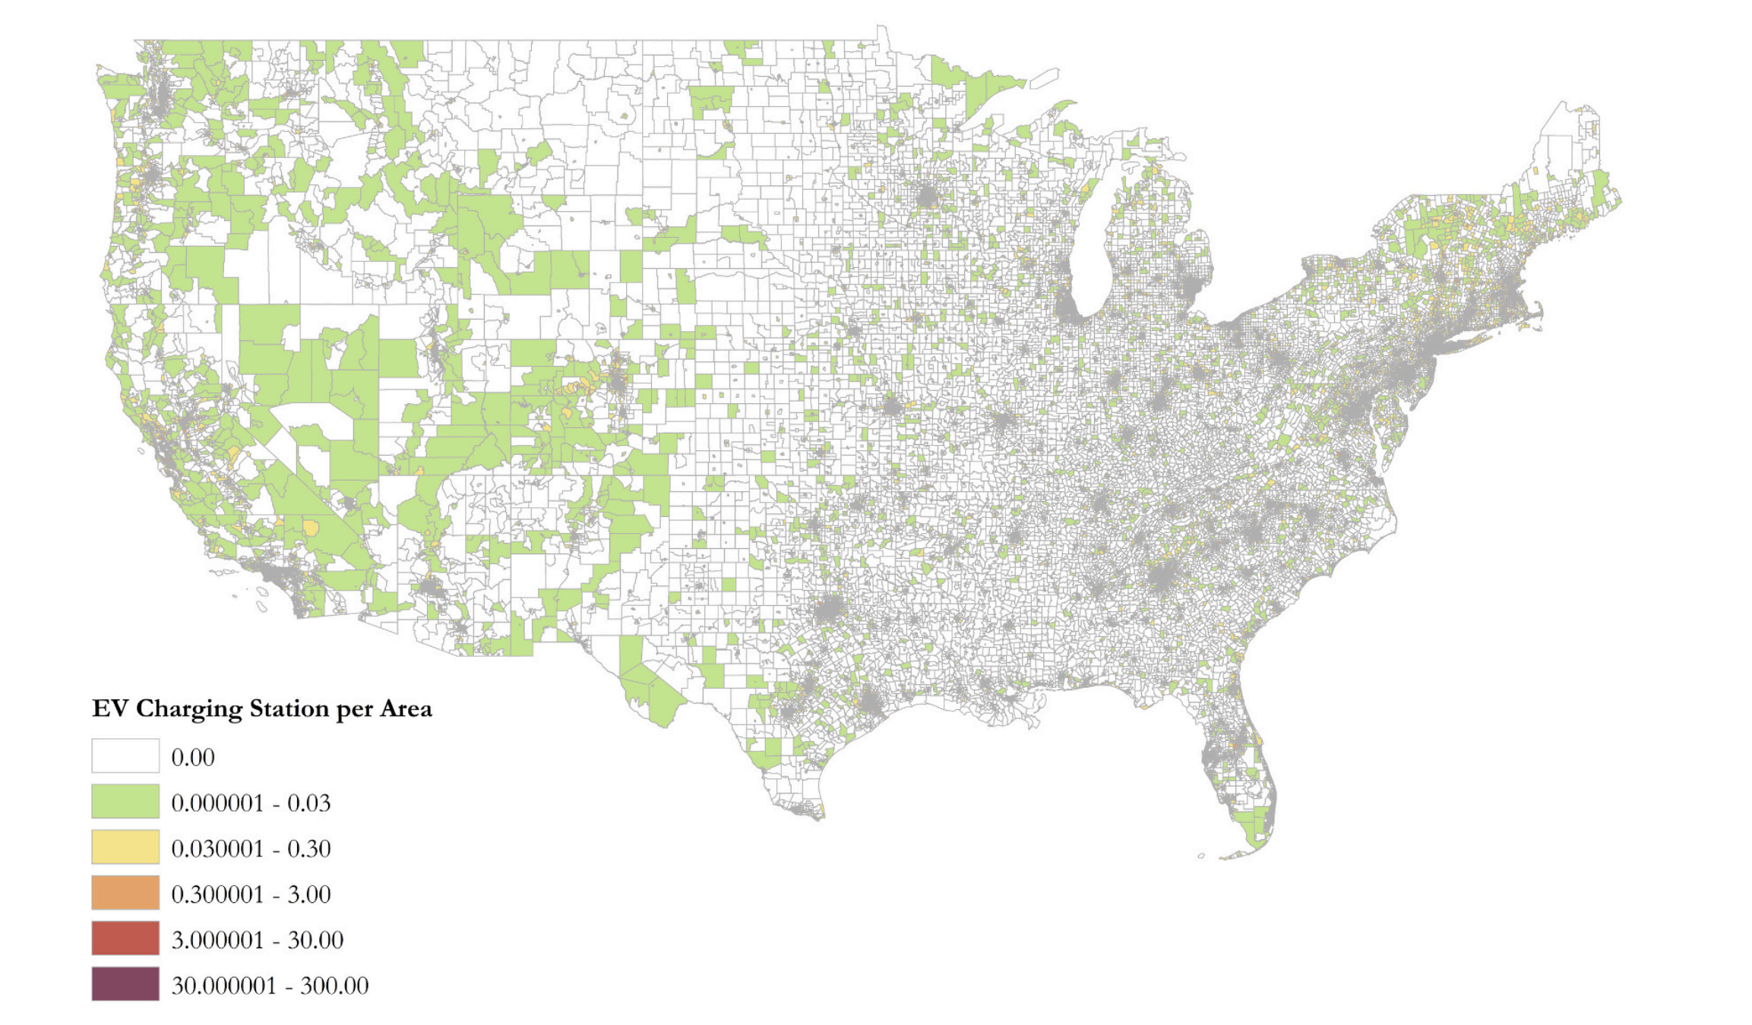
Literature Review (Socio-demographics)
In the US, research on charging infrastructure equity has expanded following federal investment, focusing on demographic, socioeconomic, and built environment factors that affect access (especially in marginalised and underserved communities).
Quantitative studies at various geographic levels (city, state, national) reveal disparities in charger availability, density, and type, with methods like Poisson and regression models commonly used to analyse spatial distribution.
Key findings show unequal access to EV chargers – minority and low-income communities face limited access, while higher-income, better-educated, and predominantly white areas have greater infrastructure, reinforcing social and spatial inequalities (A. Ermagun and J. Tian et al., 2024).
Ermagun, A. and Tian, J., 2024. Charging into inequality: A national study of social, economic, and environment correlates of electric vehicle charging stations. Energy Research & Social Science, 115, p.103622.

Slide 5


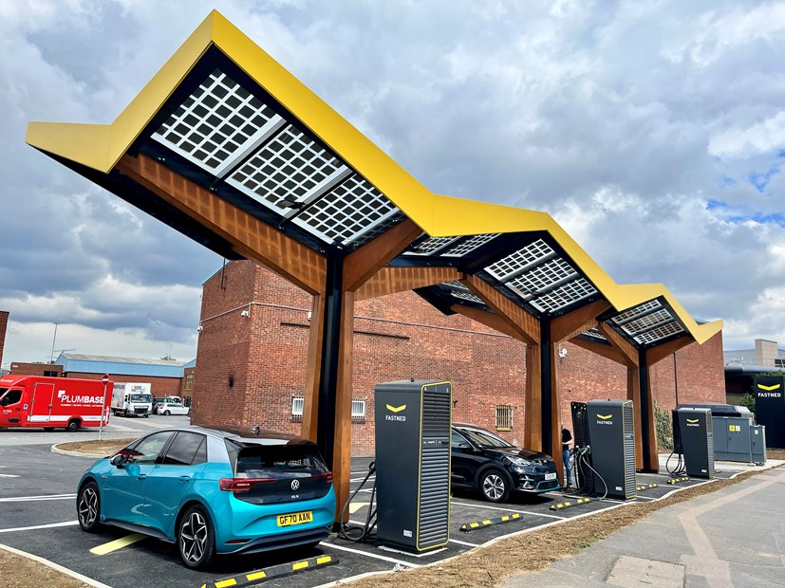
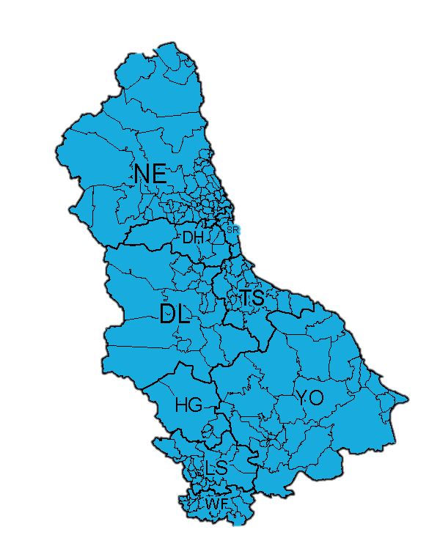

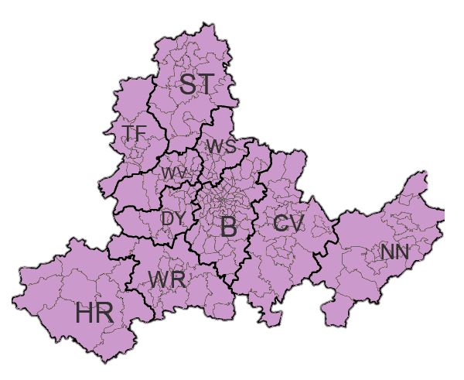
Our Approach
The study applies the ISE-CAP framework with machine learning to analyse EV user behaviours and charging preferences in the North East and West Midlands.
It incorporates detailed demographic comparisons to capture regional social and economic differences.
Behavioural and demographic data are combined to support targeted, data-driven EV infrastructure planning in these UK regions.
North East
West Midlands

Slide 6




Our Data
OPEN Data - ChargePlace Scotland
An open dataset with 3,538 charge points across 400+ hosts, including real-time usage data. Around 2.75 million charging sessions were recorded between Oct 2022 and May 2024.
FAIR Data – Urban Science Building
Obtained from Newcastle University, featuring six charge points operated by Fastned.
SENSITIVE Data: Survey
Distributed through the Prolific web platform includes demographic, personality, EV ownership and usage, charging patterns​, experience with charging infrastructure​, users preferences​, route planning​ and traffic and parking​ in total 8 sections.

Slide 7
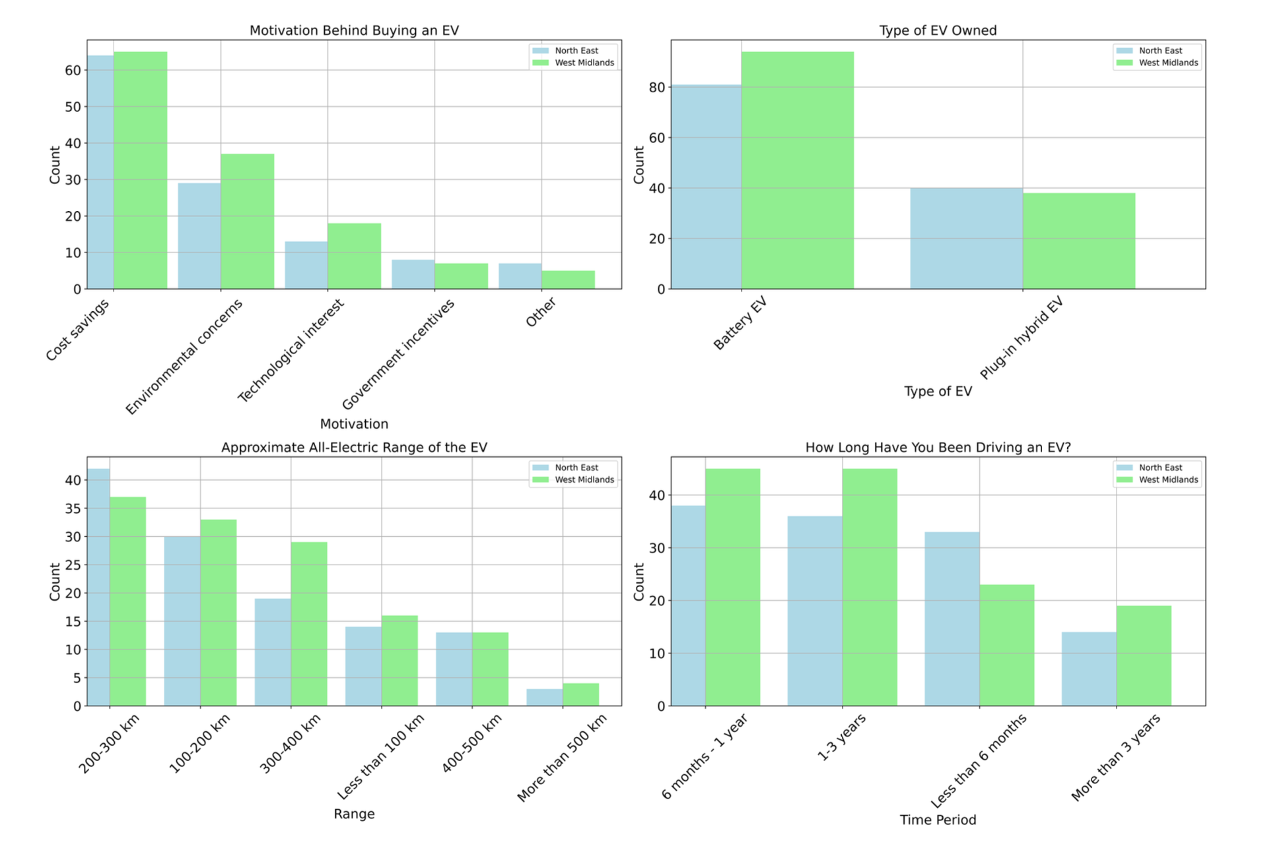
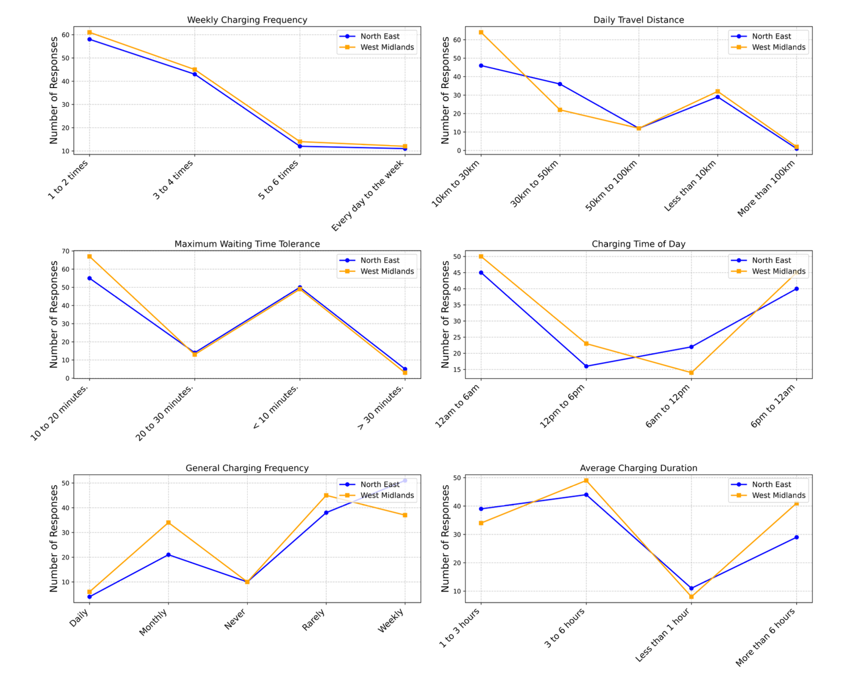
Some of Recent Results
Education levels are similar across regions, but income differs, with more high earners in the West Midlands and more lower-income households in the North East.
EV adoption is driven by cost savings in the North East and environmental concerns in the West Midlands; most own battery electric vehicles with typical ranges of 200–300 km and under three years of ownership.
Charging behaviour shows 1–2 times weekly charging, daily travel mostly 10–30 km, 10–20 minute wait tolerance, preferred charging times in evening (North East) or early morning (West Midlands), and typical sessions lasting 3–6 hours.
(In collaboration with Northumbria University, Iskenderun Technical University, and the University of Birmingham)

Slide 8
Next Steps and Conclusion
Design predictive models using machine learning to forecast EV charging behaviour based on socio-demographic, personality, and regional data.
1
Train, validate, and optimise algorithms (e.g., Random Forest, XGBoost, Neural Networks) to ensure accuracy and generalisability across diverse populations.
2
Analyse model data to identify key behavioural drivers and support data-driven decisions for equitable and efficient EV infrastructure planning.
3

