Slide 1

Removing TEL Barriers
Supporting adoption of technology-enabled learning for institutions and individuals
Ann Thanaraj - University of Cumbria
Steve Williams - Newcastle University
BETT – London – 22 January 2014

Slide 2
Guiding thought
I acknowledge and understand the issues in using technology to facilitate learning.
I have some ideas about how to address these issues.
I am inspired to do something about it!

Slide 3
Context
“Every one of our students does e-Learning”

Slide 4
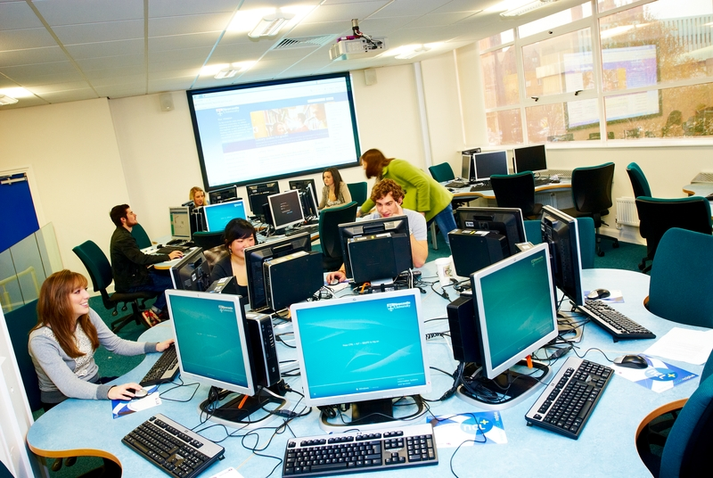
Our project - aims
Our work aims to:
  Break down barriers between academics and Technology-Enhanced Learning (TEL) – it’s not a bolt-on!
  Enhance institutional policies on using TEL
Focus on institutional as well as individual barriers
  Today is more about individuals
Notes:
Under review existing, say that there is a lot of material but not much on both institutional and individual.

Slide 5
Our project - method
Consult academic leaders, academics, students, service providers
Review existing literature
Blog
Focus Groups
Present Conclusions in Summer 2014
Your role in enriching this work
Notes:
Under review existing, say that there is a lot of material but not much on both institutional and individual.

Slide 6

Barriers
Cost
At an institutional level
Time
I haven’t got time
I don’t know who is doing what
Technology
The software tools I can access aren’t good enough to develop quality content
I’ve just got used to the old version of the software, and now you’ve damn well changed it all!
I want to use product X but the IT department say to use product Y

Slide 7
Barriers
Attitude
There’s no way that (my subject) can be taught online
Online assessment won’t work – we need discussion each time
I need to see it in their faces
I need to know my students
Students may SAY they want blended learning, but the benefits are not clear to me
I am a research professor. I’m not interested in online learning
I am interested, but my tech skills are low

Slide 8

Enablers
Having a personal interest
Supportive and embedded institutional drive and culture
Properly resourced development programme
Trusted, reliable underpinning IT
Knowing whom to go to, to resolve problems
Openness to learn from peers
Student voice, including
personalisation, backed up by…
… convincing data
Enhance reputation

Slide 9
The underpinning pedagogy
Is there a risk of assuming that technology enhances learning, without really knowing whether it does or understanding how and why?
It’s not about the technology, but about using it to facilitate high-quality learning and excellent student experience.
Effective use of TEL will differ between disciplines.
Purposes of TEL in HE.
Rationale of TEL.
  Collaborative learning
  Personalised learning
  Active/experiential learning
Notes:
Personalised learning includes WP, different learning styles, non-native speakers.

Slide 10
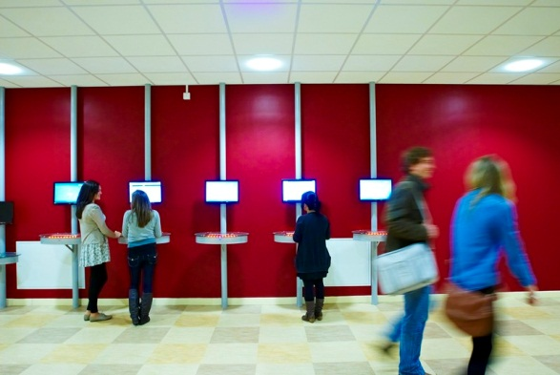
Next steps
Participate in the workshop!
Reflect on your practice
  Can I do more, for my students’ benefit?
  Can I influence others?
Share this material with your colleagues
Contribute to our blog – share your thinking!
blogs.ncl.ac.uk/removingtelbarriers

